Slide 1
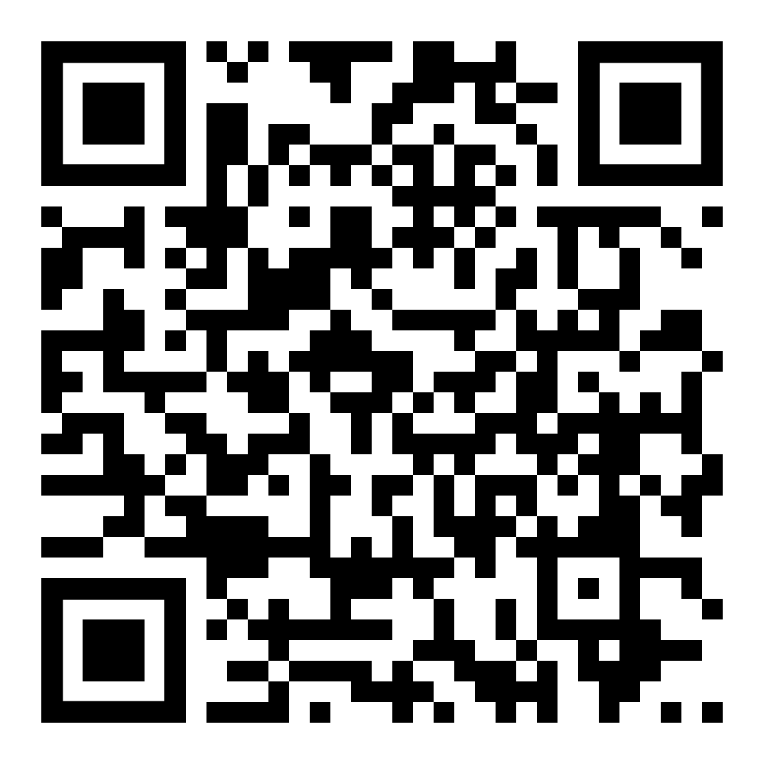
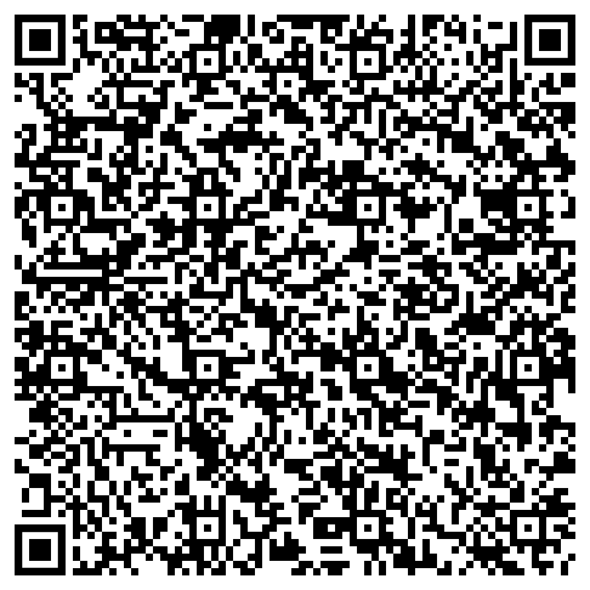
Adopting Updated NPO Standards for Adult Inpatients Receiving Electroconvulsive Therapy
Standardizing clear liquid cut off times is key to changing practice in this population
AUTHOR
Janet Elrod MSN, RN-BC
BACKGROUND:
NPO after midnight is no longer a best practice for general anesthesia
VPH inpatients scheduled for ECT generally had NPO after midnight orders
METHODS
IRB approval obtained
Staff surveyed re: current NPO practices and perceived impact of proposed changes
Education re: updated guidelines after staff buy-in obtained
Adopted strict interpretation of guidelines to standardize patient care assuming 8 AM treatment time
A new order set was developed to ensure consistency across providers
The majority of RN and Behavioral Health Specialist staff surveyed reported NPO patients experienced thirst and hunger.
A large majority reported allowing clear liquids until 6 AM would NOT make their job more difficult .
In practice, standardizing NPO times worked best
While NPO do your ECT patients complain of:
Hunger: 70% Yes 30% No
Thirst: 77% Yes 23% No
CLINICAL IMPLICATIONS
Goal: increase in patient comfort leading to a reduction in anxiety and refused appointments
Goal: decrease in missed medication doses due to cessation of blanket NPO orders
Would it make your job more difficult if you could allow ECT patients to consume:
Light meal until 2 AM
21% Yes 79% No
Clear Liquids until 6 AM
5% Yes 95% No
NPO impact on medications:
Timing issues
65% Yes 25% No
Missed doses
79% Yes 21% No
CONTACT ME FOR A JOB AID
SCAN FOR REFERENCES

