Slide 1
Radiology Resource Nurses
Sheryl Redlin-Frazier, RN, MSN
Jennifer Glenn, RN, MSN, CPN
Rachel Hale, RN, DNP
Brittany Justice, RN, MSN
Ashley Vosilla, RN, MSN - Infographics

Slide 2
Objectives:
Understand the history of the Radiology Resource Nurse (RRN) role
Discuss current state of the RRN role
Identify future goals of the RRN role

Slide 3
November
2018
December
2018
March
2019
May
2019
Fall
2019
FUTURE
Need for Radiology Resource Nurse (RRN) identified
Initial RRN Job Description created
Brittany Justice hired as Radiology Nursing Educator (August)
HCAHPS/iRounding
Ticket-to-Ride
Inpatient and Radiology Nursing & Technologist (IRNT) Taskforce created
Barcode Medication Administration (BCMA) implemented
Radiology Resource Nurse Role created
CURRENT
Revision of RRN Job Description
Visual Notification System Trial
Radiology Department specific education and SOP development
Collaboration with VUH Float Pool
Rachel Hale and Schuyler Jung-Figura hired as Clinical Staff Leaders of Radiology Nursing

Slide 4
November 2018
Need for Nursing Coverage in Radiology Department identified by the State in response to a Sentinel Event

Slide 5
December 2018
The Radiology Resource Nurse (RRN) is a Registered Nurse that is critical care trained who acts as a clinical liaison between VUH patient care areas and the Department of Radiology. The RRN applies the nursing process to provide continuity of care while a patient is in the Department of Radiology for an imaging encounter. The RRN is responsible for collaborating with the Health Care Team through assessment and observation of/for:
Potential instability or a change in condition;
Maintain infection control measures;
Contrast allergy response management per protocol;
Assessment of intravenous access and complications such as infiltrations;
Facilitate communication between Radiology staff, Radiologists, and Inpatient care teams;
Assist with patient throughput;
Intervenes in High Risk Events

Slide 6
The Radiology Resource Nurse does not:
Take a patient assignment;
Assume care of a patient while in the Radiology Department. Per the “Transport of Patients Receiving Medications That May Cause Impaired Consciousness or Undesired Changes in Vital Sign” Standard Operating Procedure, the RN/paramedic accompanies the patient when:
IV medication has been administered within the past 30 minutes for minimal sedation/anxiolysis in preparation for a procedure/test. Patient is monitored utilizing pulse oximeter during transport and until patient returns to baseline neurocognitive status, maintaining consistent level of care for patients while off the unit.
New IV analgesic or sedative medication (e.g., benzodiazepine, opioid) has been administered within the past 30 minutes.
Patient is on PCA/epidural/continuous controlled substance infusion with a change in medication, dose, concentration, or rate of administration within the last hour, maintaining consistency with a. MM SOP - Patient-Controlled Analgesia (PCA) and Continuous Controlled Substance Infusion: Administration and Management; and b. MM SOP - Epidural Analgesia Administration and Management.
Patient is receiving cardiac/telemetry monitoring. A RN/paramedic trained in basic arrhythmia accompanies the patient during transport and throughout the procedure/test unless it is confirmed that monitoring can be maintained by a qualified telemetry technician.
Patient needs observation based on the criteria above or RN/Paramedic judgement and there is not a RN/Paramedic to receive and observe the patient during testing or procedure. RN/Paramedic will document their assessment supporting their decision.

Slide 8
March 2019
24/7/365 coverage
7.2 FTEs
4 Day Shift RNs: 0645-1915
2 RNs Monday –Friday
1 RN Saturday-Sunday
4 Night Shift RNs: 1845-0715
2 RNs Monday –Friday
1 RN Saturday-Sunday
Holidays = 1 Day Shift RN + 1 Night Shift RN

Slide 9
May 2019
The Inpatient and Radiology Nursing & Technologist (IRNT) Taskforce, comprised of nurses, techs, pharmacists, and respiratory therapists from Radiology, ICUs, and Acute Care areas, was created to:
Focus on the provision of safe patient care and transition of care between inpatient units and the Department of Radiology;
Understand, assess, and monitor data regarding patient safety and outcomes related to transition of care between inpatient units and the Department of Radiology
Objective data from Veritas reviews
Observational data from purposeful rounding
Nurse-patient experience
Rapid response data
Literature review
Foster the development of a sustainable collaboration and culture of safety between inpatient care units and the Department of Radiology.

Slide 10
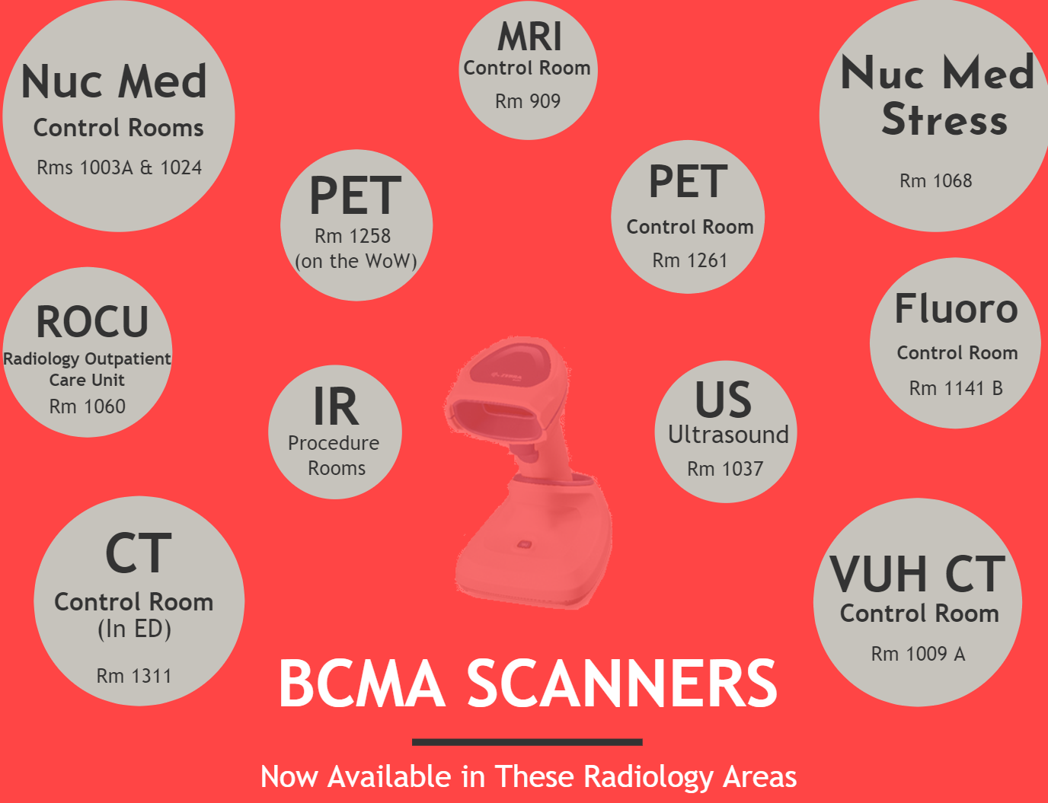
IRNT Taskforce outcomes:
BCMA scanners in all control rooms for medication administration
BCMA MRI conditional scanners for each MRI
Creation of an MRI pump drug library
MHB phones for RRNs
Roadshow to all inpatient units
Updated Omnicell medication list to ensure availability of needed medications
Improved Interface and communication between areas
Notes:
Roadshows: Primary MRI pump, but also RRN role. Educated roughly 250 staff across ICUs and Acute Care areas
Omnicell medication list: Valium, Ativan
Prior: MRI tech changed fluids to MRI pump. Was supposed to be nurse role, but many nurses did not know how. New pump and drug library

Slide 11
Fall 2019
Brittany Justice, RN, MSN is hired as the Nursing Education Specialist for Radiology, Noninvasive Cardiac Diagnostics, and Clinical Research Center.
Rachel Hale, RN, DNP and Schuyler Jung-Figura, RN, BSN are hired as the first ever Clinical Staff Leaders in Radiology Nursing

Slide 12
CURRENT
The RRN Job Description has been revised to include the following RRN interventions:
Pacemaker monitoring: RRN will monitor patients with pacemaker/ICD during MRI scan, as outlined in the “Radiology SOP-Cardiac Implantable Electronic (CIED) in MRI” SOP;
MRE: RRN will verify order and administer IM Glucagon as prescribed;
Urogram: RRN will verify order and administer Lasix and Fluid Bolus as prescribed;
Cystogram: RRN will assist with Foley Catheter insertion and management;
COVID screening: RRN will assist with rapid pre-procedure COVID screening as outlined on the VUMC COVID website
COVID notification: RRN will assist with clearing Radiology Halls prior to transport of COVID suspected/confirmed patient
Nursing Skills:
PIV placement, management, and assessment
PICC/Central Line management and assessment, including accessing and de-accessing patient ports
Foley catheter insertion and management
Medication administration per order
Venipuncture

Slide 14
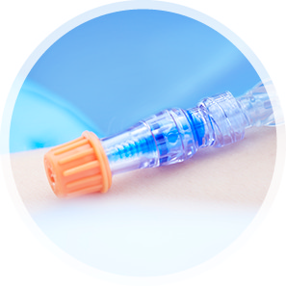
Cap the Line, Every Time
Target Audience: CT and MRI technologists
Instructor: Sonia Duffey, RN
How do lines become infected?
Importance of using a swab cap
Prevention of CLABSI.
Swab Cap use demonstration.
Visual Notification System Trial:
2-week trial
Pre-survey: 55 responses
Post-survey: 12 responses
Patient waiting for imaging and has been assessed by RRN.
Patient imaging complete. Waiting for return to inpatient unit.
Nuc Med patient: RN component complete, Patient waiting for additional imaging.

Slide 15
Visual Notification System Trial:

Slide 16
Visual Notification System Trial:

Slide 17
Visual Notification System Trial:

Slide 18
What suggestions do you have for improving the care of inpatients waiting in the Radiology Hallway?
Pre-Survey:
A system in place to identify if the patient is coming or going from the department & it would be helpful to know where they are supposed to be going (CT/Ultrasound/Nuc Med/MRI) and coming from (which unit are they from) Round trip for patient transport needs to come back! It increases the risk for harm tremendously and I have personally seen it happen multiple times since they were told to not do a roundtrip.
Modalities should label the patient as incoming or outgoing [stickers, hallway signs that can be flipped (one side incoming and one side outgoing) prior to placing the patient in the hallway. Or if a patient is waiting for a scan that will occur in an extended amount of time that patient should be labeled that way.
It is my opinion that inpatients that are waiting in the hallways should be continuously monitored and not left alone
SBAR handover document
Round trip transport... we need more transporters, then patients wouldn't be waiting for long periods of time unattended.
Easier access to a computer for the RRN to look up patients when they need care in the hallways
Looking in to RRN phone lines that do not have "dead zones."
Post-Survey:
I work night shift where there is a pretty consistent system to identify our inpatient travels (coming or going). Our night RRN's are awesome at monitoring the flow of patients before this new visual system was instituted.
During my night shift, the nurses are always available if we need them

Slide 19
What did we learn?
There is a need for improved communication of inpatients in the Radiology department;
There are concerns about patient safety in the Radiology Hallway; however, there are minimal safety events reported.
Day shift and Night shift RRNs may have different visibility due to varying workload and demands.
Limitations:
Response rate: pre-survey: 55 vs post-survey: 12
Potential lack of awareness of study by various Radiology staff
Inability to see post-it notes on stretchers: too small, didn’t stick to beds
Competing priorities of RRNs: May not have been able to place a post-it on every stretcher
Next Steps:
Ticket-to-ride, SBAR Handover
Evaluate Transport Staff Resources

Slide 20
FUTURE
HCAHPS scores/iRounding: Rounding/Service Recovery on floors if a patient expresses a concern regarding their care/experience in the Radiology Department
Ticket-to-Ride: SBAR handover to improve awareness and care of patients in Radiology Department
Collaboration with the VUH Float Pool to help fill staffing vacancies
USGPIV training for RRN staff
How can we improve the care of your patients in the Radiology Department?
What can we do better for you?

Slide 21
References:
Standard Operating Procedure: Transport of Patients Receiving Medications That May Cause Impaired Consciousness or Undesired Changes in Vital Signs https://vanderbilt.policytech.com/dotNet/documents/?docid=16006

