Slide 1
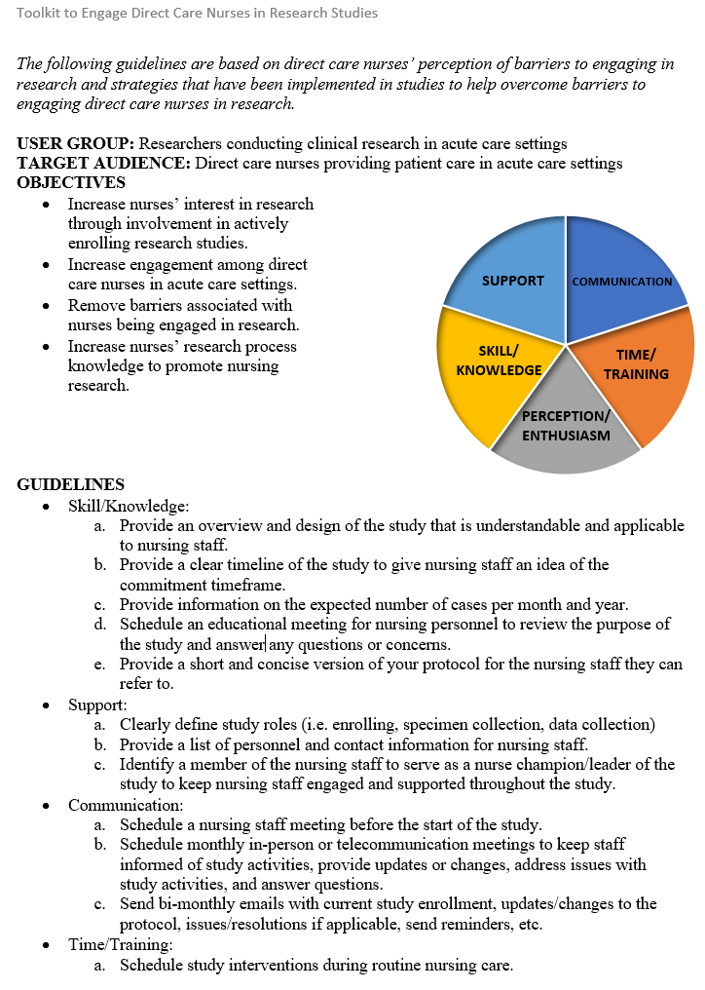
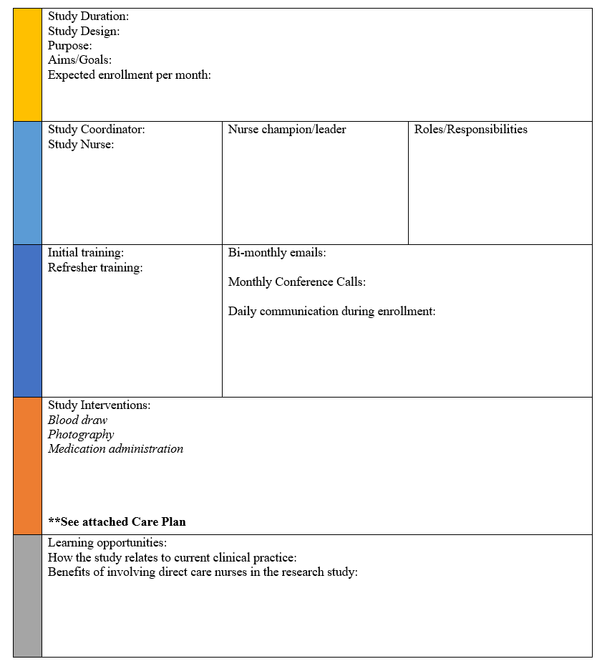
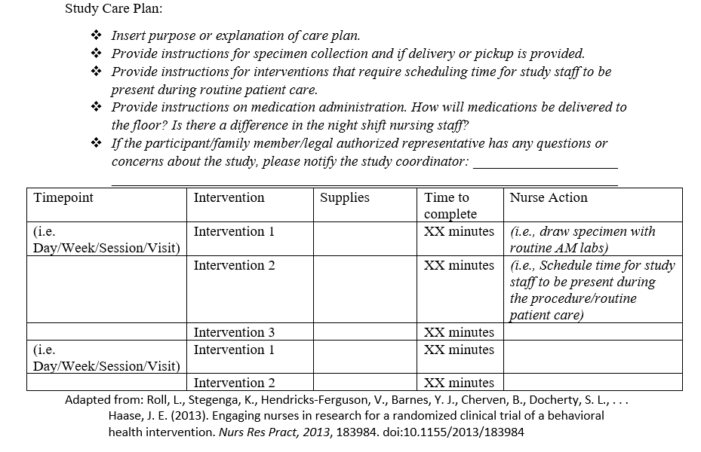
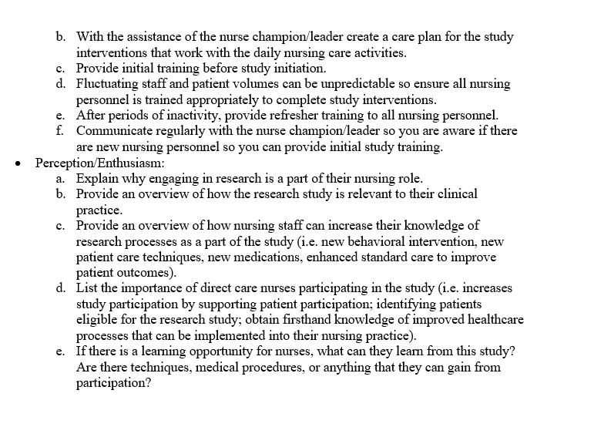
Engaging Direct Care Nurses in Clinical Research: An Evidence-Based Framework and Toolkit
Kristina Williams, RN, MSN, CCRP
Abstract Literature Review Implementation of Framework and Toolkit
Barriers exist that decrease nurse’ ability to engage in research.
PICO Question: “For researchers conducting studies in the acute care setting, will implementing an evidence-based framework and toolkit decrease barriers and increase engagement among direct care nurses?
An evidence-based framework and toolkit were designed to decrease barriers for nursing participation and increase engagement of direct caring nurses in research.
Evaluated for effectiveness and usability by two separate groups, the Research Staff Council and Nursing Research and Evidence-Based Practice Committee at Vanderbilt University Medical Center.
Comprehensive search through the Annette and Irwin Eskind Family Biomedical Library and Learning Center, using PubMed, CINAHL, and Google Scholar.
Keywords: nursing engagement, evidence-based practice, toolkit, barriers, research, nursing.
Characteristics of research active nurses included feeling empowered to make a difference, opportunity to advance professionally, and ability to see the change in the research process
Barriers and perceptions were lack of time, low perception, lack of resources, lack of cooperation and support.
Low satisfaction with research opportunities among nurses due to low perception and lack of time.
Implementing strategies to reduce barriers increase nurses’ participation. These include training, consistent communication, integrating research activities into daily nursing care, and generating enthusiasm.
Barriers identified across literature were categorized into five themes: 1) skill and knowledge, 2. support, 3) communication, 4) time and training, and 5) perception and enthusiasm.
The framework is a list of suggested guidelines and the toolkit is a template for research staff to individually populate information about a specific study. A corresponding study care plan complements the toolkit.
Evaluation and Results
The framework and toolkit were presented to the Research Staff Council and the Nursing Research and Evidence-Based Practice Committee.
Presentations consisted of an overview of the literature review, a corresponding outline of the project design with framework and toolkit and concluded with a guided discussion tailored with questions specific to each group.
The Research Staff Council mutually agreed they would utilize this framework and toolkit within their current practice. Some members of the council have noticed research staff have encountered issues with engaging direct care nurses. The framework and toolkit would help facilitate discussion among research staff and nursing staff.
The Nursing Research and Evidence-Based Practice Committee agreed this framework and toolkit would increase research interest and participation. They recommended engaging the clinical staff leader as they work with both management and nursing staff directly. They agreed the study care plan would help work study interventions into daily nursing care and overcome lack of time.
Summary
Feedback from both groups was positive and encouraging for success of this framework and toolkit.
Mutual agreeance among both groups on the importance of engaging nursing professionals in research by providing opportunities to participate in studies.
Both groups recommended an electronic platform to house both the framework and toolkit for all participating staff to quickly and easily access.
Initial and consistent communication were key items noted by both groups to ensure buy-in from nursing personnel, especially prior to study startup.
Direct care nurses completing protocol activities would need to complete human subject training and be added as key study personnel on IRB studies. Ensuring nursing staff would be amenable to completing this training during non-working hours is essential to determine for their participation.
Further testing and evaluation are required in a real-time setting to decide best the effectiveness and usability of the framework and toolkit. Implementation is planned in a randomized phase III clinical trial conducted in a Burn Intensive Care Unit at Vanderbilt University Medical Center.
References
American Nurses Association. (2015). Code of Ethics for Nurses with Interpretive Statements. Silver Spring, Maryland: American Nurses Association.
Berthelsen, C. B., & Holge-Hazelton, B. (2015). Orthopaedic nurses' attitudes towards clinical nursing research - A cross-sectional survey. International Journal of Orthopaedic and Trauma Nursing, 19(2), 74-84. doi:10.1016/j.ijotn.2014.10.004
Hagan, J. (2018). Nurse Satisfaction With Opportunities to Engage in Research. West J Nurs Res, 40(2), 209-221. doi:10.1177/0193945916682472
Hagan, J., & Walden, M. (2017). Development and Evaluation of the Barriers to Nurses' Participation in Research Questionnaire at a Large Academic Pediatric Hospital. Clinical Nursing Research, 26(2), 157-175. doi:10.1177/1054773815609889
Landon, L., Crane, S., Nance, S., Stegenga, K., Cherven, B., Perez Prado, L. N., . . . Haase, J. (2019). Engaging Clinical Nurses in Research: Nurses' Experiences Delivering a Communication Intervention in a Behavioral Oncology Clinical Trial. Nursing Administration Quarterly, 43(2), 175-185. doi:10.1097/NAQ.0000000000000341
Leach, M. J., & Tucker, B. (2017). Current Understandings of the Research-Practice Gap From the Viewpoint of Complementary Medicine Academics: A Mixed-Method Investigation. Explore (NY), 13(1), 53-61. doi:10.1016/j.explore.2016.10.005
Nkrumah, I., Atuhaire, C., Priebe, G., & Cumber, S. N. (2018). Barriers for nurses' participation in and utilisation of clinical research in three hospitals within the Kumasi Metropolis, Ghana. PanAfrican Medical Journal, 30, 24. doi:10.11604/pamj.2018.30.24.15230
Roll, L., Stegenga, K., Hendricks-Ferguson, V., Barnes, Y. J., Cherven, B., Docherty, S. L., . . . Haase, J. E. (2013). Engaging nurses in research for a randomized clinical trial of a behavioral health intervention. Nursing Research and Practice, 2013, 183984. doi:10.1155/2013/183984
Scala, E., Patterson, B. J., Stavarski, D. H., & Mackay, P. (2019). Engagement in Research: A Clinical Nurse Profile and Motivating Factors. Journal for Nurses in Professional Development, 35(3), 137-143. doi:10.1097/NND.0000000000000538
Siedlecki, S. L., & Albert, N. M. (2017). Research-active clinical nurses: against all odds. J Clin Nurs, 26(5-6), 766-773. doi:10.1111/jocn.13523
Notes:
Single sided poster!

