Slide 1
The OR Clock Natalie Mast, BSN, RN, CNOR
This Photo by Unknown Author is licensed under CC BY-SA
Notes:
I am here to talk to all of you today about an education tool I developed for my unit in 2016 called the OR CLOCK. The OR clock is a 12 step, didactic learning tool that our staff use to safely, and effective turn a room over.

Slide 2
Natalie Mast, BSN, RN, CNOR
Clinical Staffing leader
Team Lead for Pediatric Plastic Surgery, Pediatric OMFS, and Burn Surgery
Certified Nurse in the Operating Room
Member of Association of Operating Room Nurses, Middle TN chapter
Notes:
My name is Natalie Mast, and I am a Clinical Staff Leader- CSL - in the pediatric operating room, where I manage our plastic, burn and OMFS service lines. I have been at Vanderbilt for 5 years, and have been utilizing and revising the OR clock for 4 years. I am a Nashville native, with a passion for working in the pediatric operating room along side the most amazing individuals this city has to offer.

Slide 3
First case on time start Refers to the scheduled start time for the first case set in each operating room
Notes:
Before we get too bogged down with the details of what the clock comprises of , I wanted to go over what an OR nurse does, and what I mean by room turnovers and first cast starts. for those of you who have not had the opportunity to work in the operating room before.
OR nurses have different responsibilities before, during, and after procedures to ensure safe and effective patient care. As the patient advocate, we ensure every team member provides high quality, safe care for the surgical patient. We are also monitors for surgical conscience, which is the concept of human conscience as it applies to the performance of all of the activities that occur in the operating room.
While maintaining a culture of safety, circulators work in tandem with anesthesia staff and scrub techs to set up first case starts and turnover rooms for multiple procedures a day
First case starts refer to the scheduled time that our first procedure of the day is set to begin in all of our operating rooms. This is a quality indicator for our unit. Typically, our nurses have 30 minutes to set up our surgical suits in order to hit those appropriate times. These are crucial to attain in order to have a positive impact on the rest of the day.

Slide 4
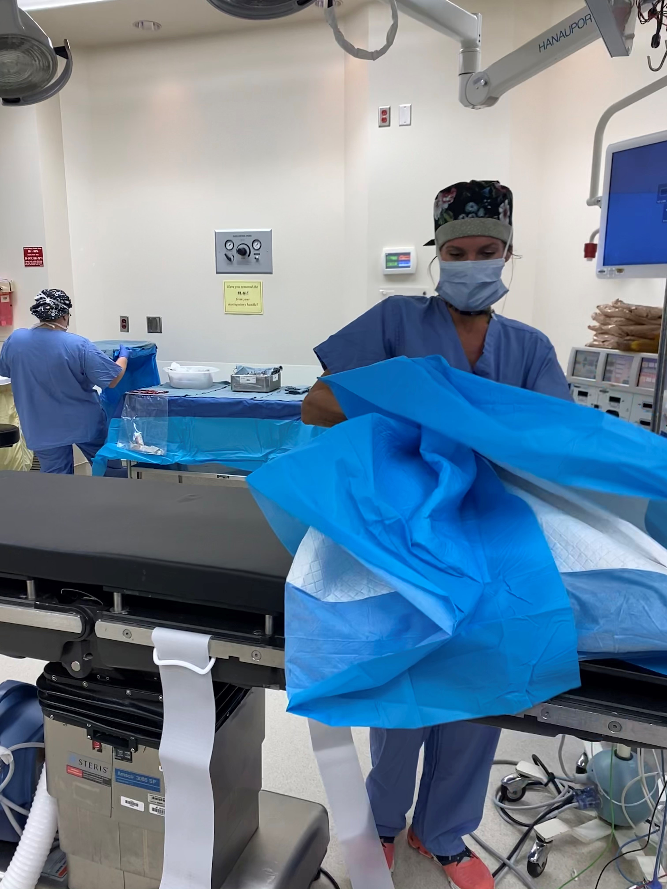
Turnover Refers to the amount of time it takes for a patient to leave the OR, until the next patient rolls into the OR
Notes:
Turnovers refer to the amount of time it takes for a patient to leave the or, until the next patient rolls back. While maintaining a culture of safety, circulators work in tandem with anesthesia staff and scrub techs to set up first case starts and turnover rooms for multiple procedures a day.
We are also involved with the cleaning of the OR suit after each patients leaves. . Every or is cleaned in between patients. This involves wiping down all surfaces, cleaning the floors, beds, and positional aids, taking out the trash and bio waste from the previous patients, returning all unused surgical instrument and supply, and taking dirty instruments and case carts downstairs for our sterile processing teams.
First case starts and turnovers are crucial to a healthy and successful OR environment. Not only are they important for fiscal responsibility, it is also a driving factor for patient and staff satisfaction.
Typically, patients and families arrive 2 hours before their expected procedure start time. Turnover delays as little as 15 minutes twice a day can translate to extensive wait times for our patients and families, especially for those with late case starts.
Staff satisfaction can also be directly related to elongated turnover times. We may be scheduled for 10 or 12 hour shifts, but teams can not clock out until their surgeries are complete or relief staff can come in and take over. This can lead to staff being held longer at work, fatigue, and burnout.

Slide 5
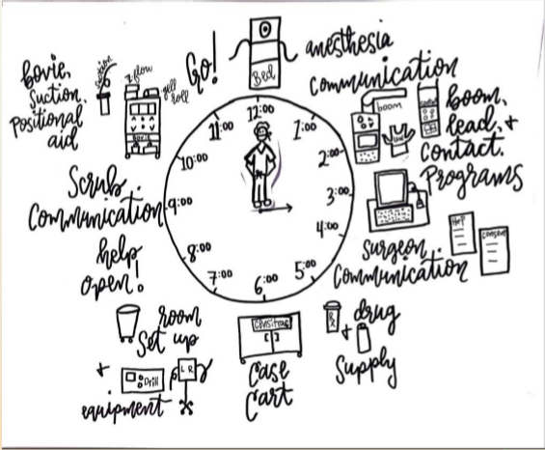
Notes:
I am a visual person and when explaining the set up to my newest co workers and orientees, it helped me to visualize the Operating Room and its set up as a clock. This is the visual of the OR Clock.
So, what takes place in the time an RN clocks in, until his or her patient is on the OR table, ready for incision?
After a damp dusting of all of the surfaces in the OR, setup for surgery begins. This setup includes having the right equipment for surgery, as well as instrumentation, drugs, instructions, and surgical supply. We also review our procedures and fill any knowledge gaps we may have with our service line leadership team. Once the physical setup is underway, circulators will review pertinent lab work like a type and screen, pregnancy screening, and now, our covid +/- documentation . Every patient now has a covid test resulted before we can bring them into the OR. We also check legal documents for consent and history & physical, communicate with all interpersonal team members, and finally, last but certainly not least, we have our patient interview. Circulators have an extremely small window to make a positive impression on our surgical patients. We have to complete all of these tasks, and establish rapport with our patients and families all within the turnover window.
Knowing all of this, RN’s can improve their practice by utilizing tools to help them work within turnover windows.

Slide 6
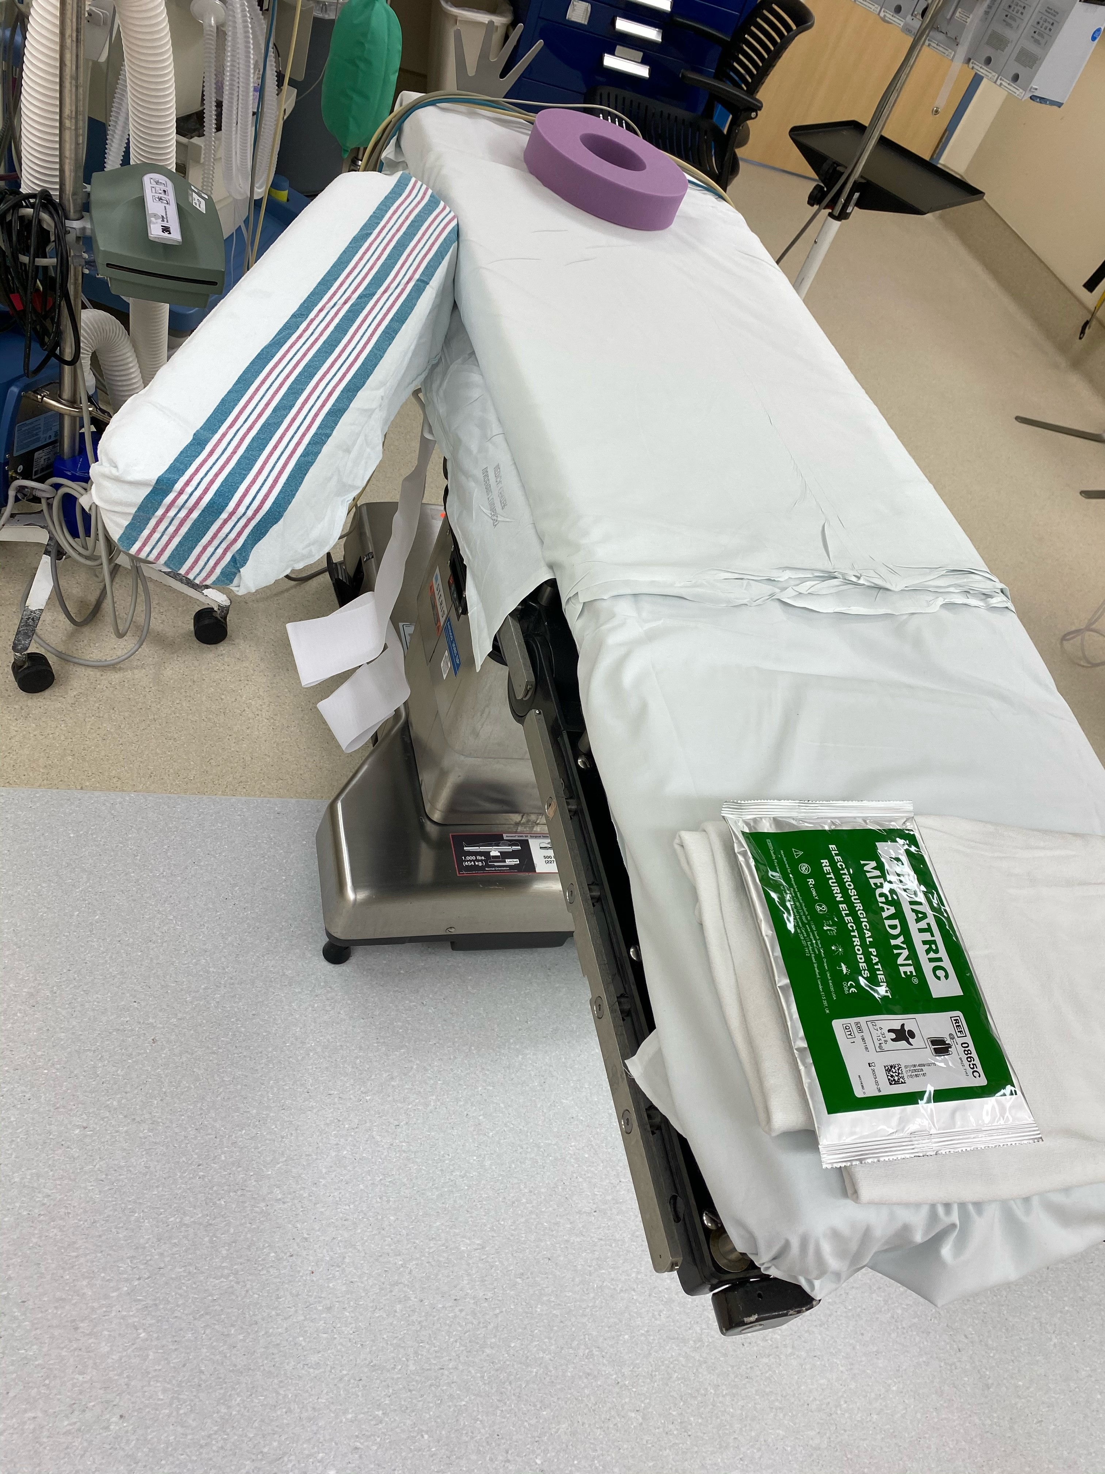
12:00 -Is the bed ready? - Draw sheet, Bovie pad, Bair hugger, pillow, Donut. - Is it the correct orientation, is it locked, and is it the correct bed? 1:00 -Have you spoken with Anesthesia? Introductions, discussion of special precautions or considerations for the case
Notes:
When I was precepting new staff I was trying to think of a way to explain to them a process for setting up the OR, that would include everything they need to do or check on before going to get the patient. As I put an arm board on the OR table I realized that the OR bed looks like a clock and that is where my inspiration came from.
The 12 o’clock position represents the OR table or “do I have the correct OR table”
There are several different beds that could be used for many different surgical procedures. We have spine beds, eye peds, OR tables, stretchers, and many more. It is the circulators responsibility to know what needs to be used for their procedures. Not only do they need to know what type of bed, but they need to establish if it is in the correct orientation, and if all safety equipment like bed straps are available.
The 1:00 represents communication with our anesthesia colleagues. We work with them to establish a plan for proceeding to the or, and assisting them with the specific intubation plan for each patient. We also preform a two way handoff at the patient’s bedside with our anesthesia team, so knowing each others availability and plan is crucial to successful first case starts and proper turnover times.

Slide 7
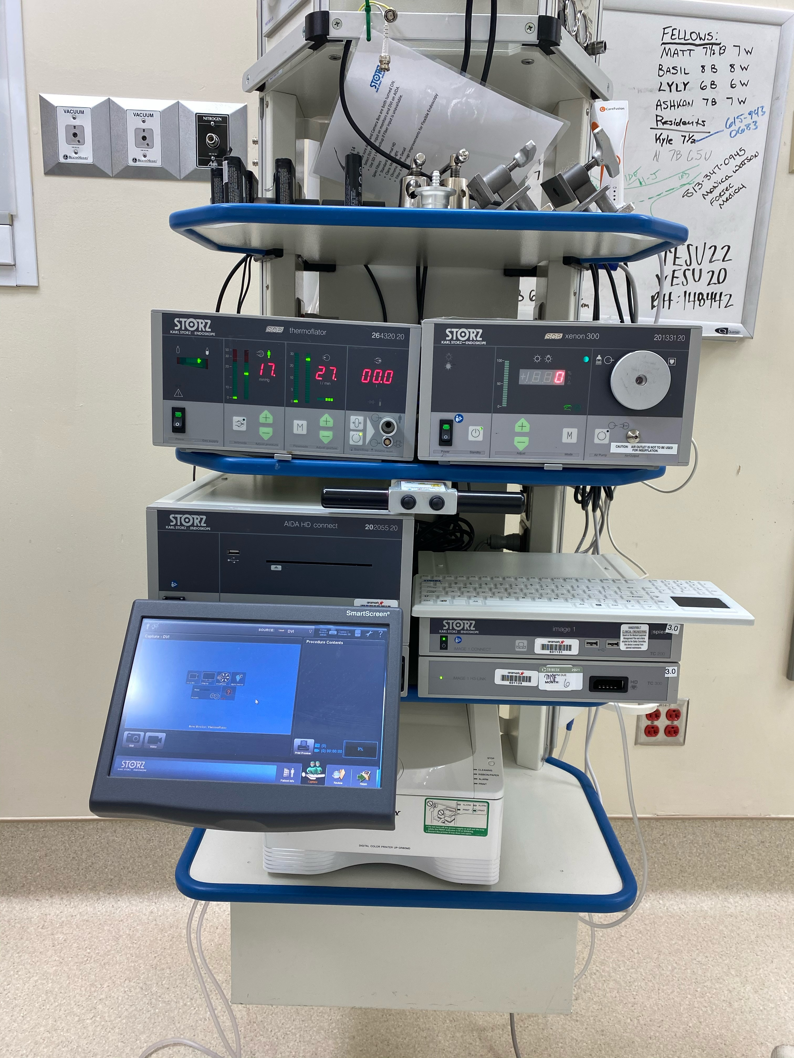
2:00 - BOOM Set-up. Patient information entered, insufflation needed, smoke evacuation needed. -is lead available if needed? 3:00 -Do you have an updated H&P, have you reviewed your consent -have you reviewed the patient chart, and noted any necessary Labs and your COVID status? -Have you opened POU and scanned to censitrac?
Notes:
Moving on the 2:00, you can see this is a picture of a BOOM. We use Booms in many different procedures. It is utilized for Laparoscopic cases for lighting, camera, and insufflation. It is also used in many ENT procedures with airways and cases that involve cameras like urological cystoscopy. The nurse must enter the patients information into the computer so that the information will be available if pictures are taken and need to be uploaded into a patients EMR. The nurse also checks to make sure all the equipment is functioning properly on the boom.
3:00 is our patient chart. In the patient chart, we look for legal documents such as the H&P and Consent for surgery. Many times we review the surgeons last clinic note so that we are confident that we have all the necessary implants and othe patient specific items needed for the case. We also review any necessary Lab work like the type and screen and the patients current covid status. We will open up our POU, which is short for POINT OF USE. In the OR we also utilize a system called CENCITRAC, which is a means to track instrumentation use in ORS and link them to specific patients.

Slide 8
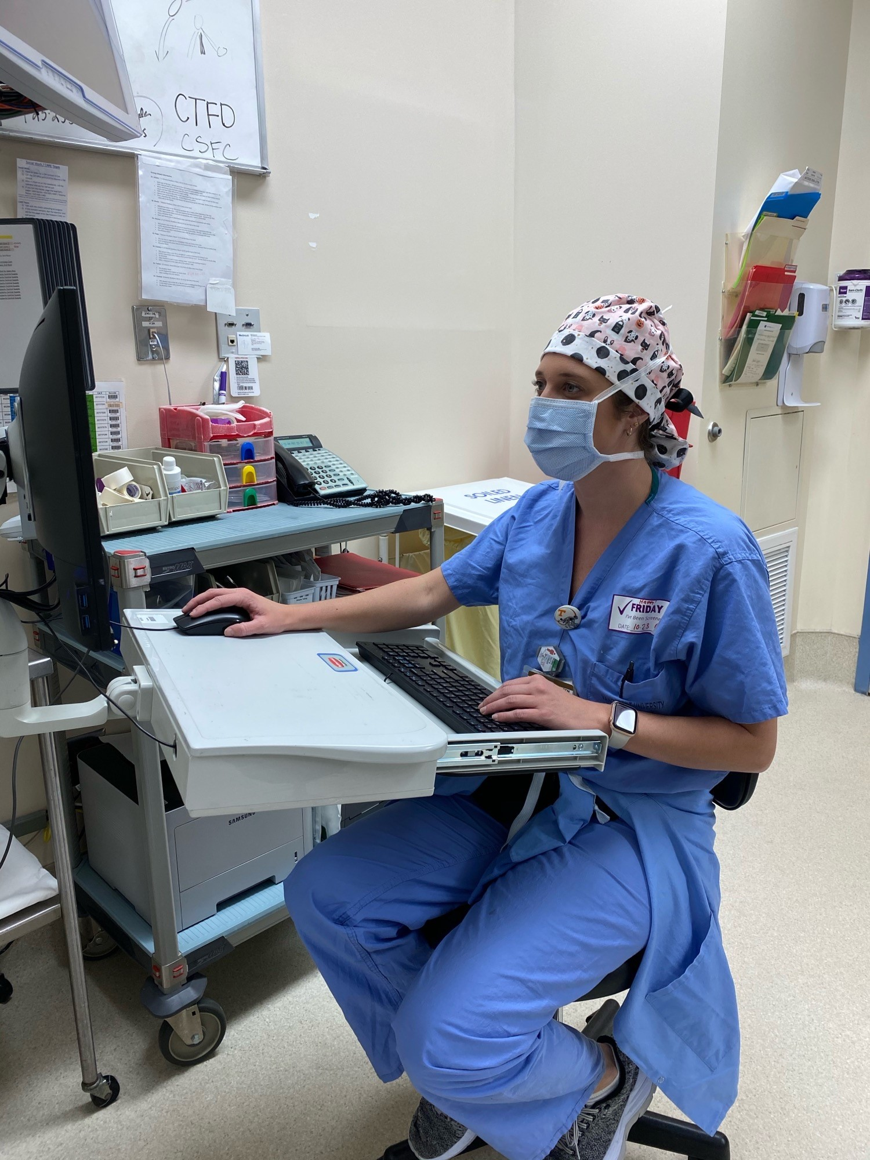
4:00 -Have you communicated with your surgeon? -Do you feel confident you understand the procedure? 5:00 -Have you pulled your necessary drugs for this case? -DO you need any surgical supply from the core?
Notes:
4:00 is communicating with our surgeon. We page, text, or call our surgeons before every first case start. We open this line of communication early on to establish their availability, and to confirm the surgical plan. We never roll back into the operating room without hearing from and seeing our surgeons. It is also an opportune time to ask them any procedure specific questions, and to ensure we have not missed any special requests.
Now, its 5:00
This step involves pulling our necessary drugs from our core or from pharmacy. It also involves pulling any surgical supply that may not have come up on our case cart. We have two sterile cores that stock thousands of surgical items. The circulators must know what is needed, and how to find it quickly and efficiently in order to stay within turnover and first case start times. It is a skill that is developed over time and experience.

Slide 9
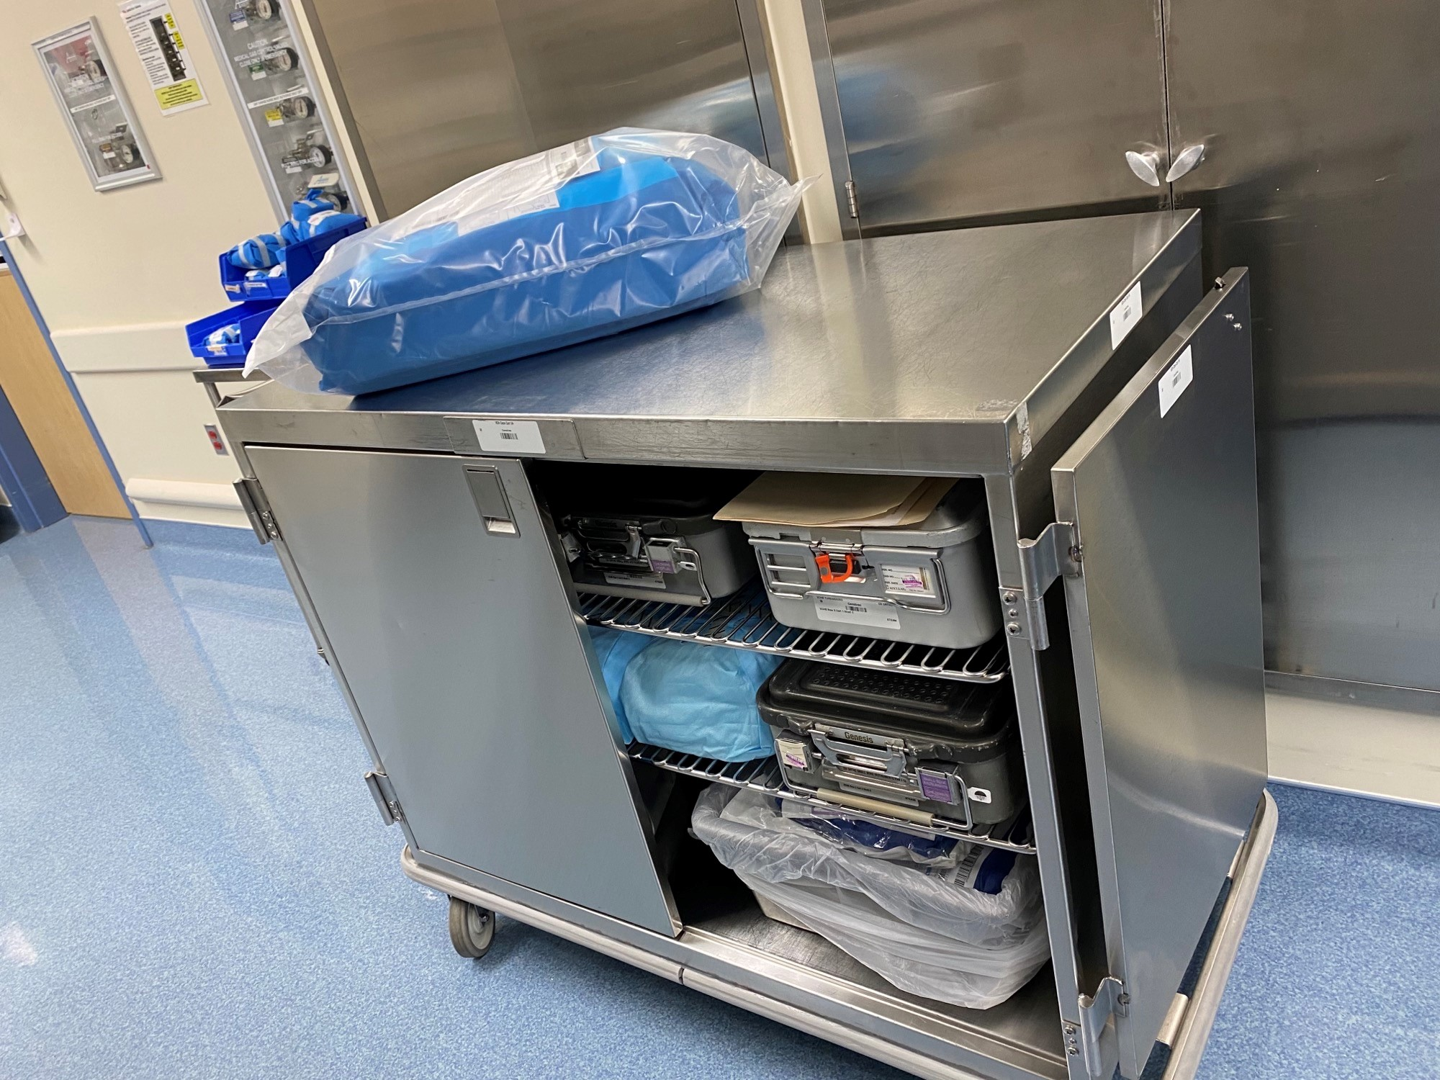
6:00 -Is your case cart in the room? Did all necessary instruments come up? 7:00 -Do you have all necessary equipment in the room? -Bovie, Drills, microscope, x-ray, etc… -Is your room in the proper orientation for your procedure? Is any rearranging necessary?
Notes:
6:00 – this step involves case carts. Here at VCH, we house our instrumentation in the basement of the hospital, and have our surgical supply picked at Briley Parkway. Every morning, our sterile processing team brings these carts into our sterile core, and delivers them to the operating room. RN’s need to assess the available instruments and supplies, and be able to adapt to changes in order to have the necessary supply available. If things were missed, we need to act quickly to identify a solution so that surgery can begin on time.
7:00
-This step involves equipment. Between all of the available equipment at VCH, VOR, MCE, and FEL, this can be one of the most overwhelming steps for new RN’s to learn. There are hundreds of options that could be needed for procedures. Circulators need to know what is needed, where it is located, and how to get it.

Slide 10
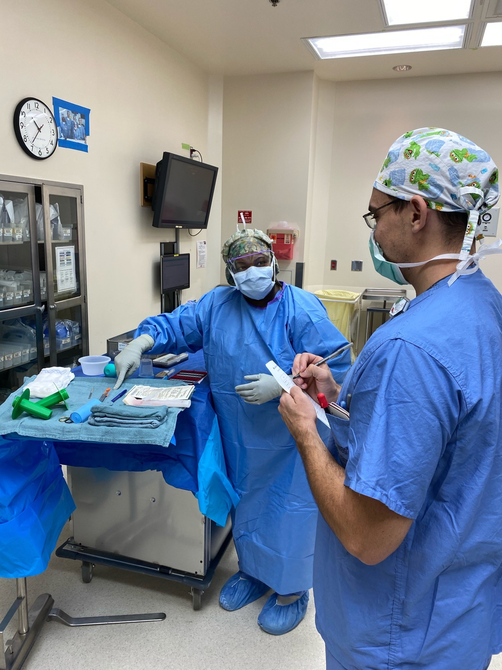
8:00 -Have you communicated all necessary information to your scrub? Have you helped them open? 9:00 -Have you counted with your scrub and passed necessary drugs? Do they feel comfortable with you getting the patient?
This Photo by Unknown Author is licensed under CC BY-SA
Notes:
8:00
For every nurse in the OR, there is a surgical technologist. The OR”s could not run without them. As a crucial member to the surgical team, we must open the line of communication early in the day with them to ensure the OR runs on time. We help them set up for procedures, and assist in the opening of all necessary surgical supply. The surgical technologist has special training in sterile technique, instruments and surgical procedures, they remain sterile throughout the surgery and pass surgical instruments to the doctor as we all as assisting with surgical procedures in hospitals that do not have residents.
9:00 – this step is all about counting and passing of drugs. One of the BIGGEST jobs RN’s have in the OR is to establish counts with their CST. We also must pass off drugs to our surg tech, and ensure that the correct label, dose, and indication is communicated to them. We never leave to obtain our patient if our surgical tech feels they are not safely prepared.

Slide 11
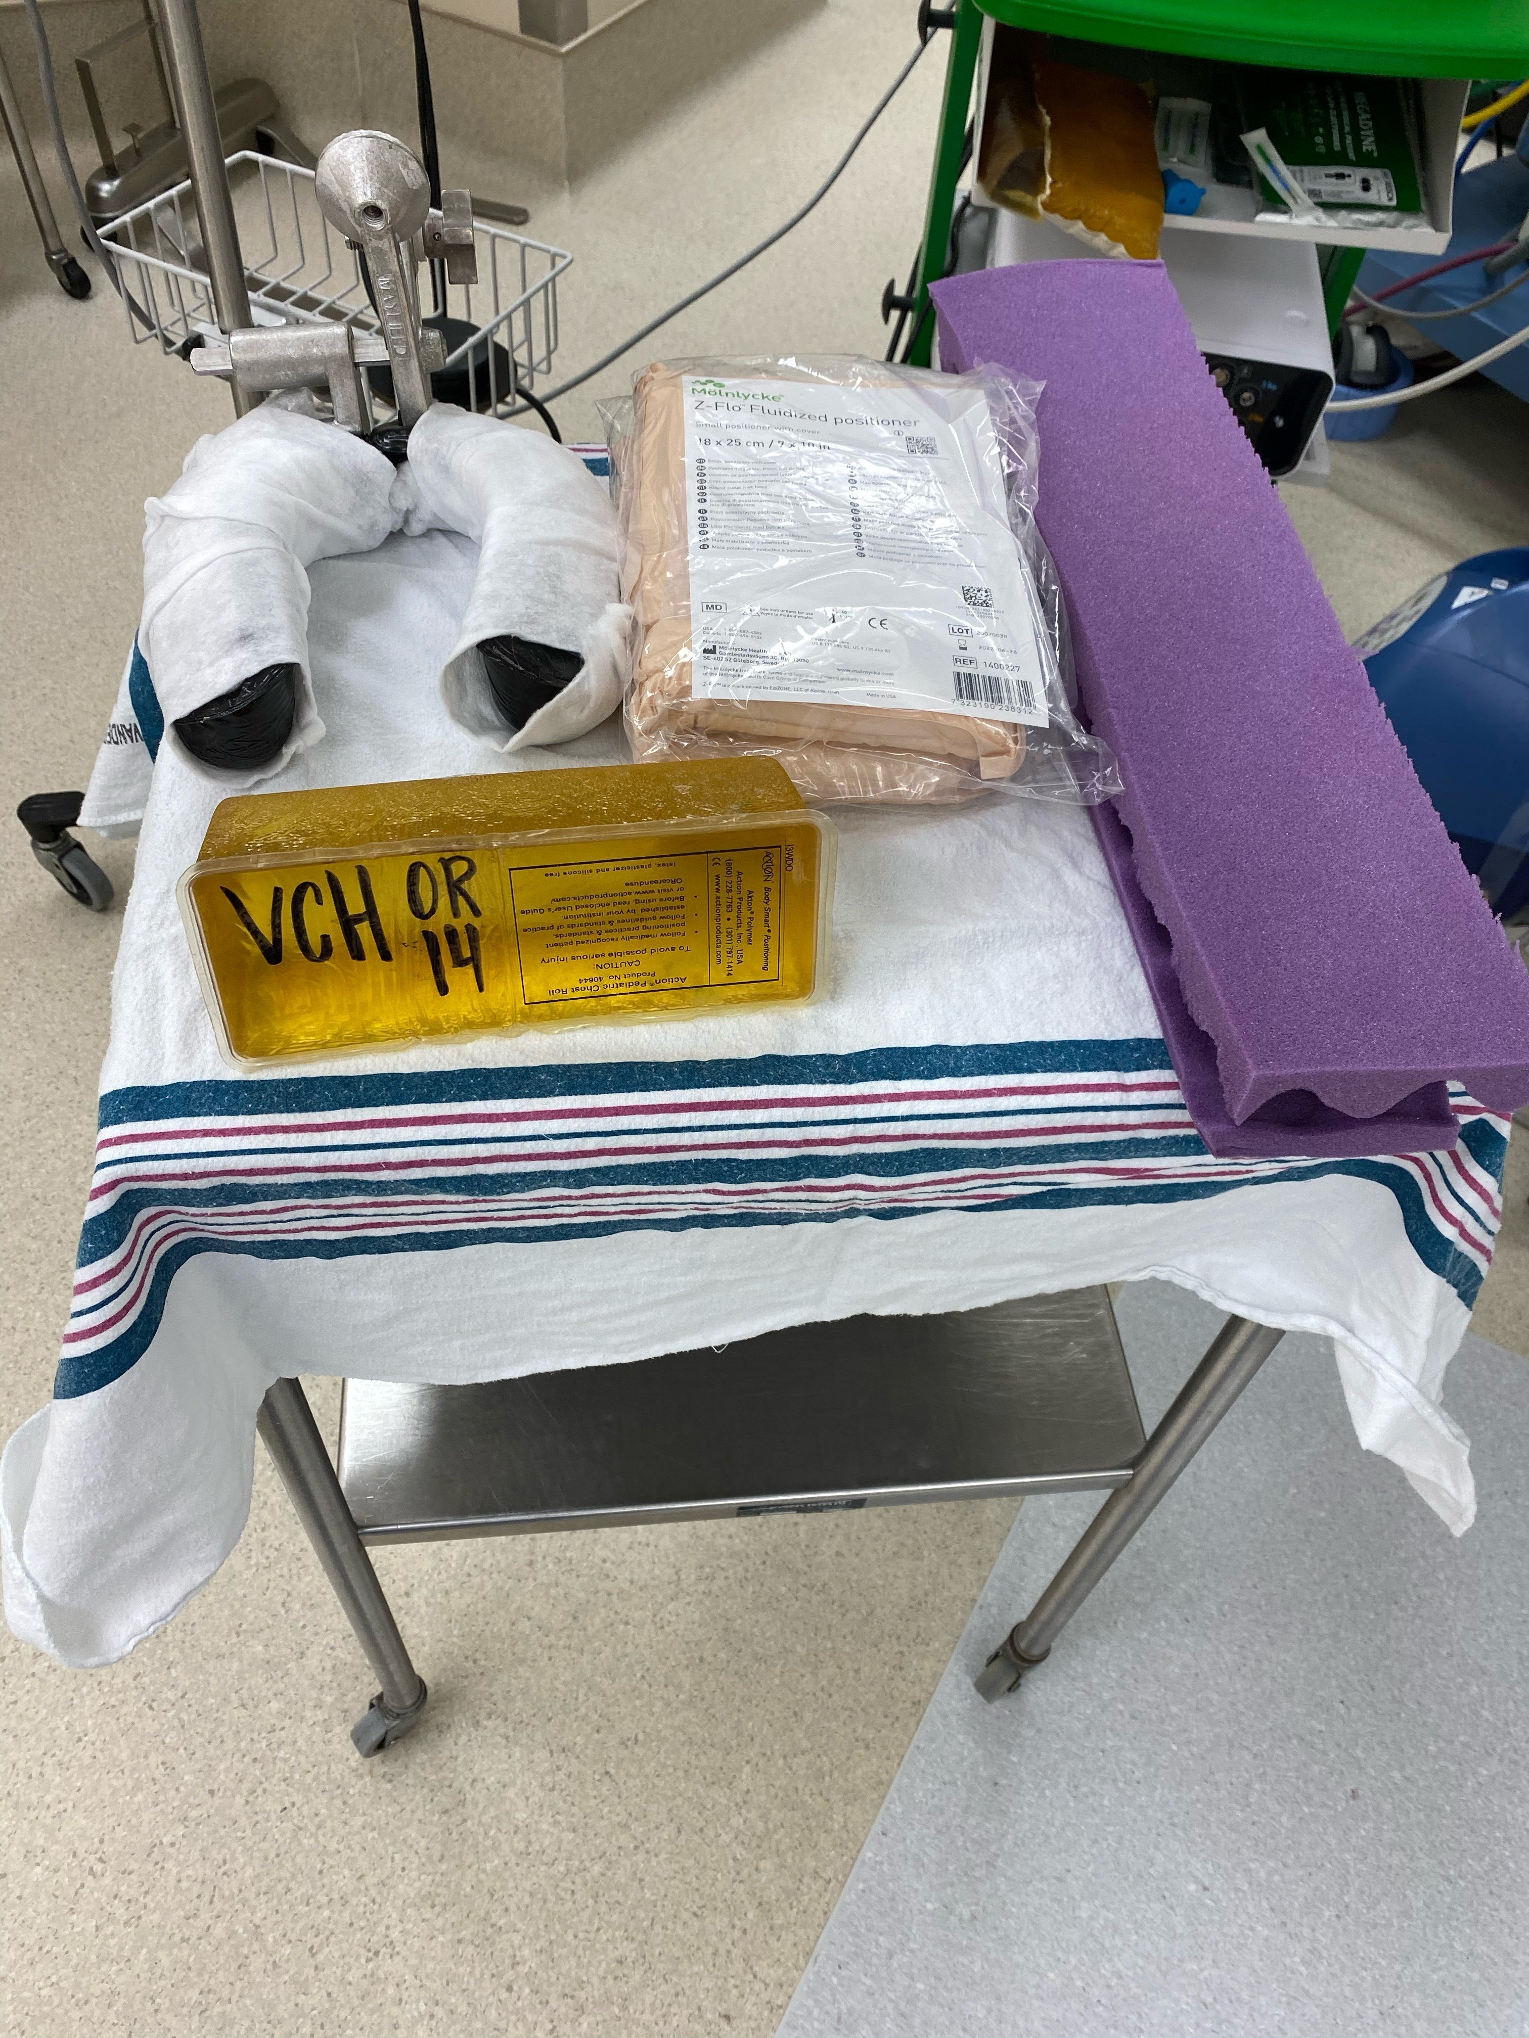
10:00 -Are all your positional aids available for your case, and withing easy reach when it is time to position? 11:00 -Have you completed all necessary steps? Then you are ready! Go get your patient.
Notes:
10:00 – This step is to ensure we know the correct patient position, and have the positional aids necessary to safely position our patients once their airway is established and secure. This is another very difficult task for new nurses to learn. There are many different surgical positions, each more complex than the last. There are dozens, if not hundreads or ways to position a patient safely. Having all the positioning aids readily available and close at hand when it comes to positioning is a crucial component to safe practice in the OR.
11:00 – the final step – completion of the clock. If you have run through every step, and feel confident you are ready, then you can proceed to getting your patient!

Slide 12
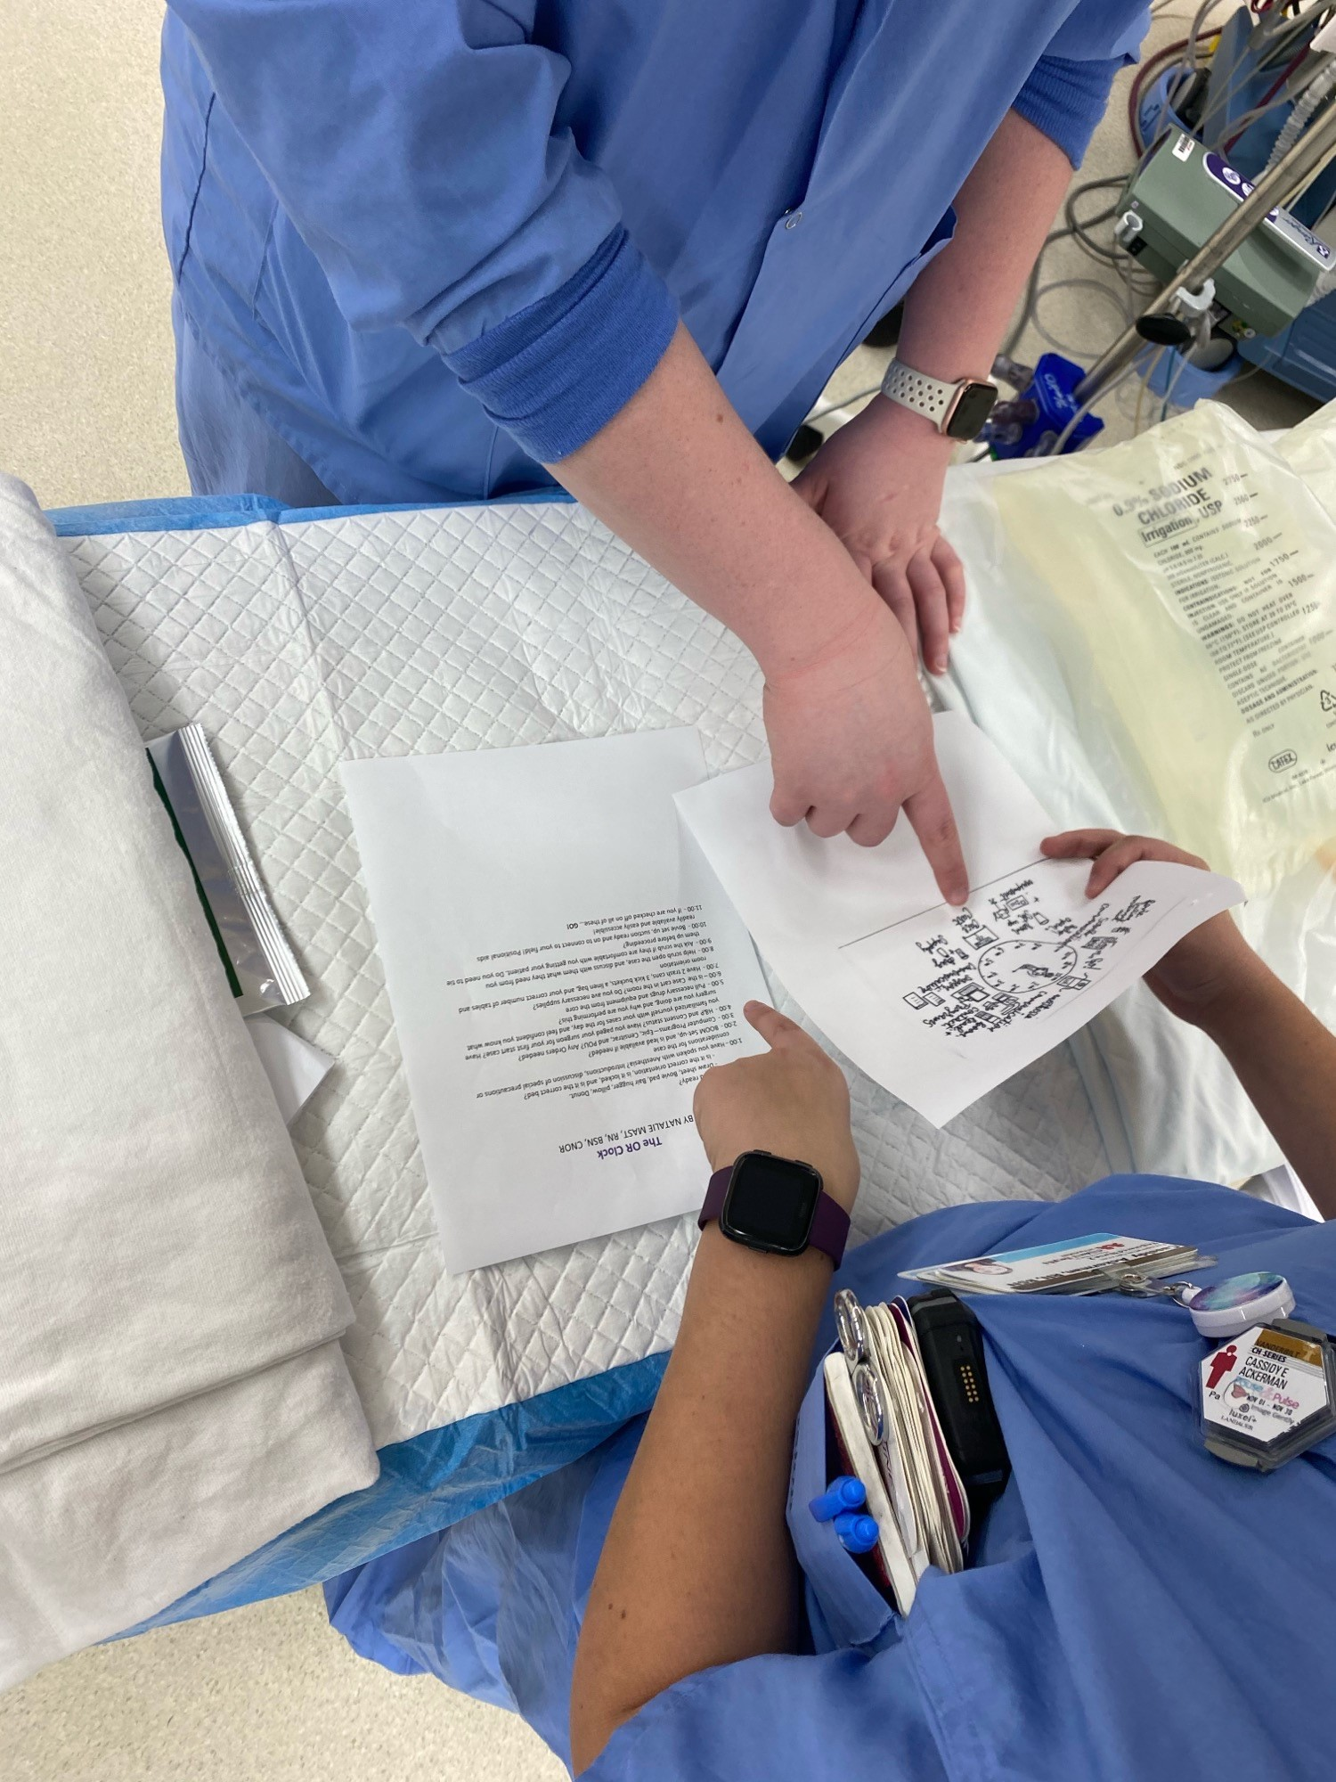
Countdown to success
Notes:
I began teaching this model to staff in 2016. I developed it for myself after coming off of the night shift. I had to adjust to the pressure of completing my tasks within the very small window we have to hit our start times. I found myself literally turning in circles, trying to fit everything I needed to do within my allotted time. I noticed that, if I wrote down my tasks as I was preforming them, there was a natural circulate progression. If I started with the OR bed, which coincidentally looked like an hour hand, I could move on to speaking with my anesthesia colleague, then checking the boom, and the rest is history. I revised, edited, and revised again until I had a process that I could succeed in utilizing and teaching. To this day, I have taught the clock to every PNR that has oriented through the VCH OR.

Slide 13
Staff feedback – 2016 to present
“The OR clock is very helpful, and a great reminder tool. Mentally, I use it every day, especially with my first case starts to ensure the room is set up how I need it, and I have everything I need to start my day”
Rachel Engelhart, BSN, RN
“I have used the OR clock working with orientees and will genuinely use it for myself when I think to myself "I'm missing something." I found it to be a good introduction about how ready you are before going to get the patient. The basics of looking around the room from one area 360 degrees will get you set up for the case. Setting yourself up for success as much as possible before involving a patient will allow for the unknowns that may come up to be less stressful.”
Jason Linsley, BSN, RN, CNOR
“It was definitely helpful when I was on orientation and needed the best way to figure out the flow of what was important for getting a room started. I was able to modify it into my own mental check list once I got on my own”
Alyssa LaRocca, BSN, RN
Notes:
This is staff feedback from those I have taught the clock to. This information, presented early in their orientation, allows a healthy framework for new nurses to build on. It helps them establish strong and ethical practice to ensure rooms are set up effectively while never compromising on patient safety.

Slide 14
Notes:
I used the OR clock as my VPNPP nursing advancement in, where it was noticed my our then educator, Maria Sullivan. She championed me to submit it to AORN for a poster presentation. I presented it at the AORN conference in early 2019.

Slide 15
Notes:
After my presentation at AORN, I was contacted for an interview with Outpatient Surgery Magazine. They published my OR clock for their Ideas that Work column where they highlighted my coundowm to room set up process.
It was also featured in our own Eskin Biomedical Library virtual Graphic Medicine Exhibit in April 2020.

Slide 16
Notes:
Since my publication in outpatient surgery magazine, I have been contacted by educators at both Barstow Community Hospital and IU health blackford hospital for use in training their OR staff. I am always thrilled when another hospital can utilize the tools I developed to help their staff succeed.

Slide 17
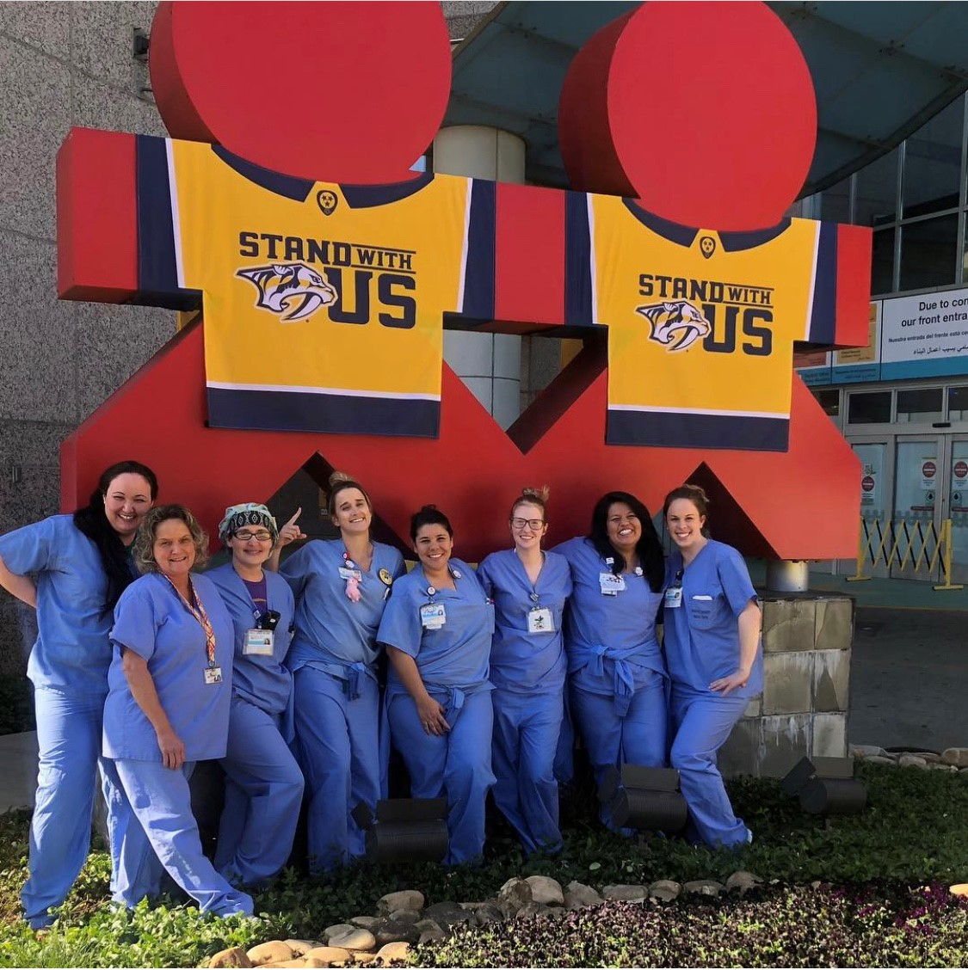
Questions?
Notes:
That is the OR clock, I wanted to take a few minutes to open the floor for any questions you may have.

