Slide 1
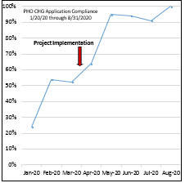
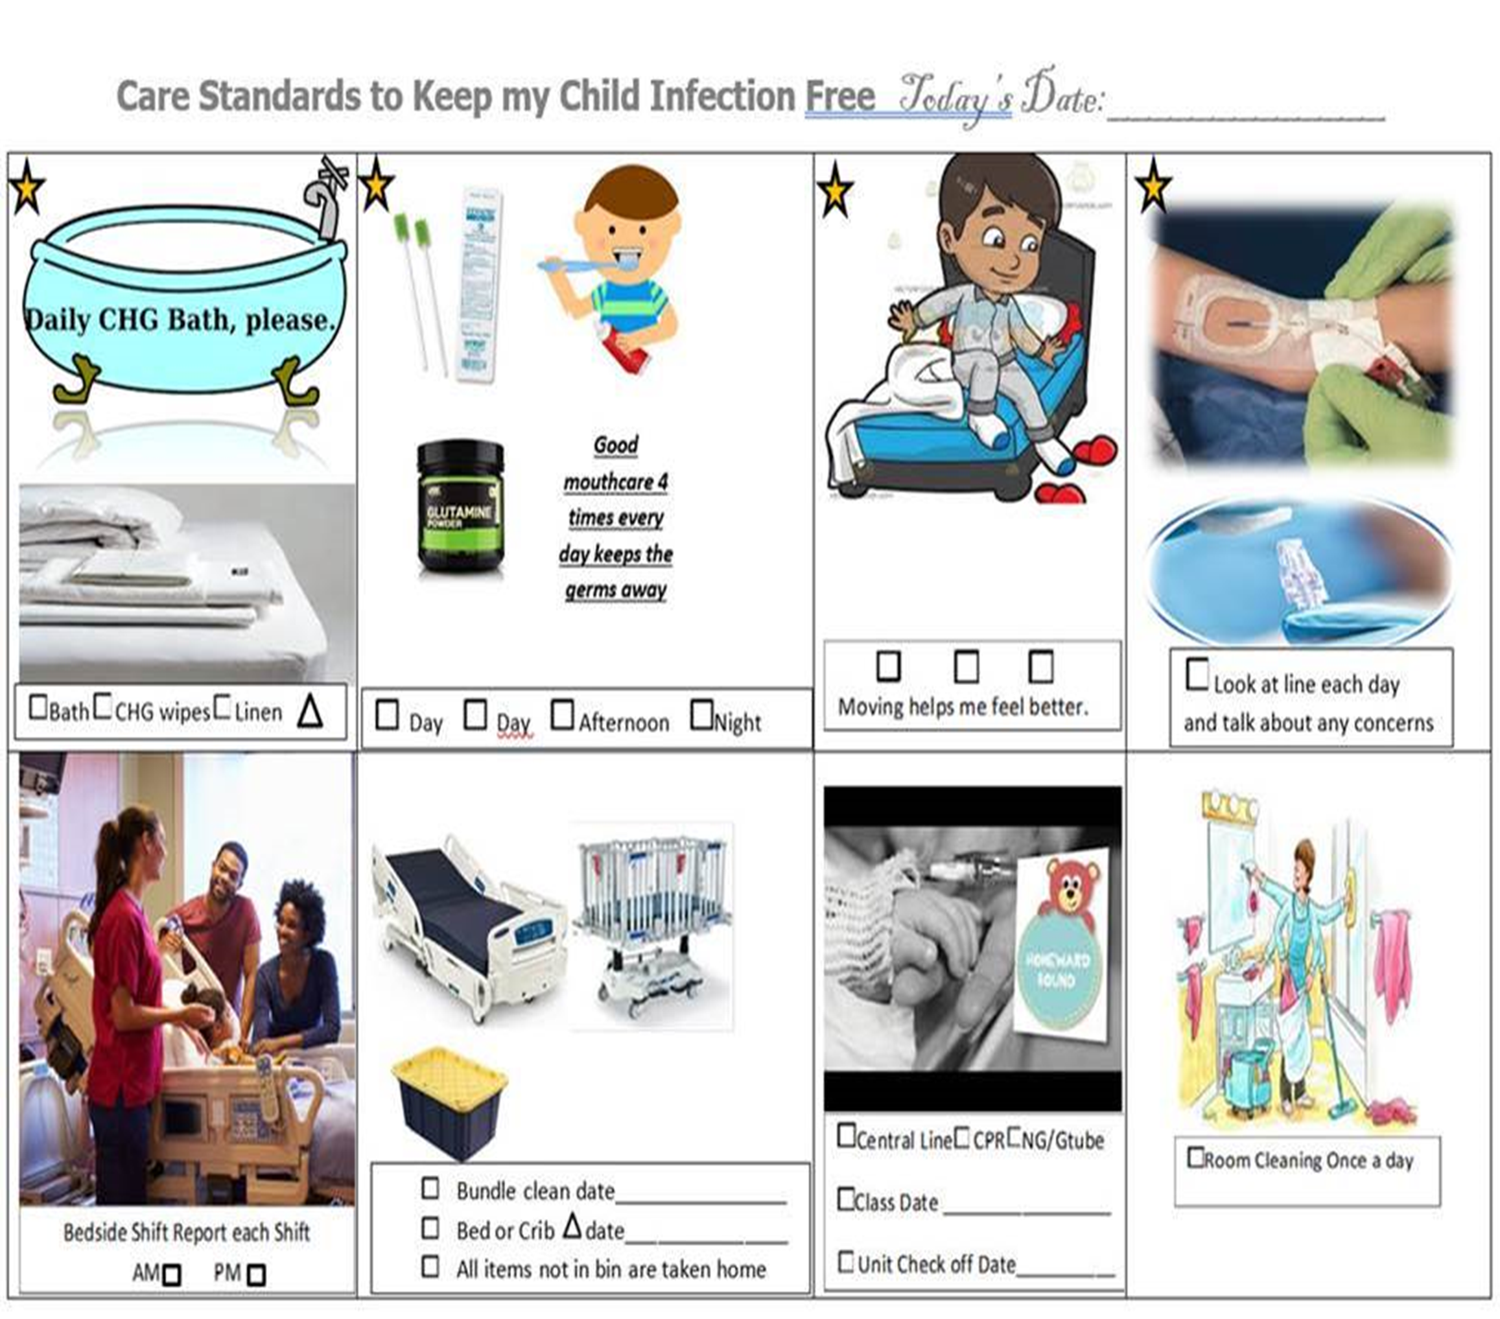
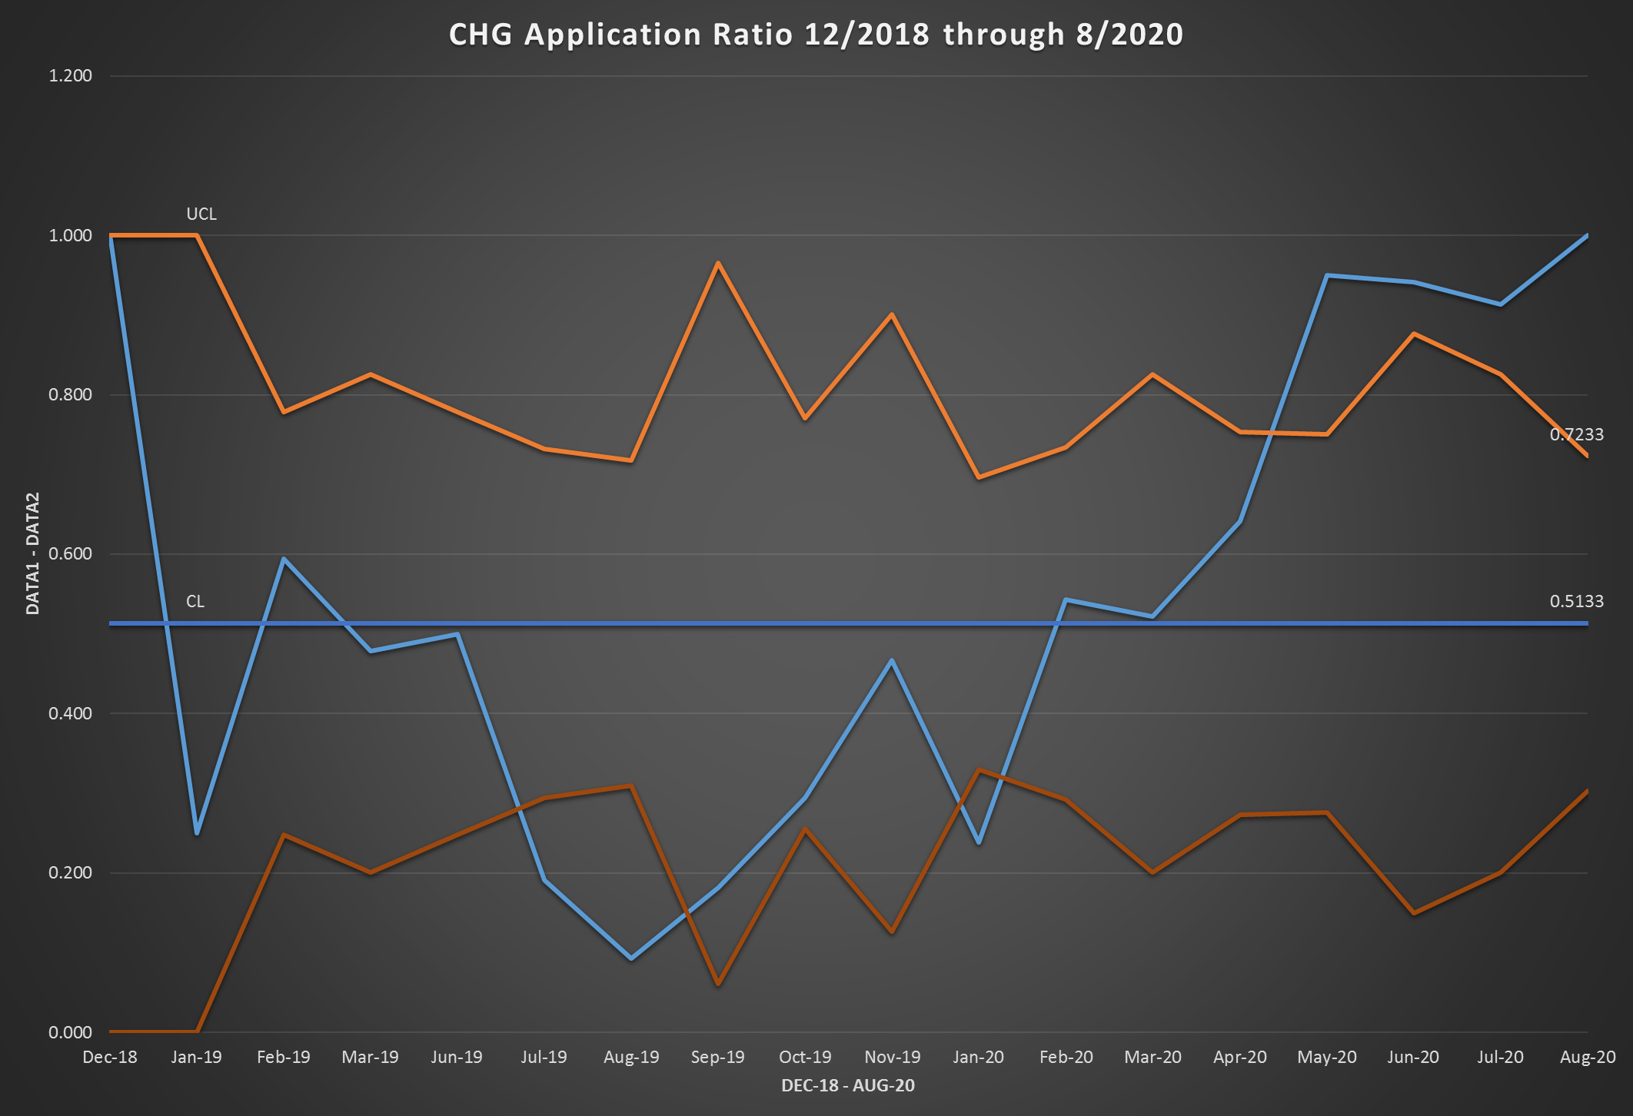
Process Improvement to Increase CHG wipe application
Roderic Armstrong, MSN, MMHC, RN, CPN, Amanda Smith, BSN, RN, CPHON, Valerie Herndon, BSN, RN, Deanna Norman-Bryant, BSN, RN, CPHON,
Laura Parks, BSN, RN, Patricia Throop, RN, BSN, CPHQ, Vicki Jones, MSN, RN, NE-BC
PURPOSE
METHODS
MATERIALS/TOOLS
RESULTS
To increase CHG wipe application and documentation compliance to >90%.
The following interventions were identified at a unit board meeting and implemented in the Pediatric Hematology Oncology and Stem Cell Transplant Unit:
Delineation of responsible role to complete CHG wipe application and escalation strategies in the event of delay or refusal.
Development of Quality Calendar to provide a visual display of daily patient care needs to increase compliance
Selection of reward from treasure chest for non-compliant patients
Re-education initiative aligning CHG wipe application rationale with desired quality outcomes and patient safety
Documentation focus
Product availability
Steps to document CHG wipe contraindication
Daily audits reviewing compliance for 3-month period:
Staff touch points in event of non-compliant documentation to assess challenges
Creation of standardized documentation space in e-Star
CHG application gel transitioned to CHG impregnated wipes
BACKGROUND
31 bed Hematology Oncology & Stem Cell Transplant unit with Central Line Associated Blood Steam Infection (CLABSI) SIR centerline of 1.717 compared to comparison group benchmark of 2.325.
Chemotherapeutic drugs, radiation therapy, and stem cell transplants predispose patients to acquiring CLABSIs due in part to immune system suppression, which increases healthcare cost, length of stay and morbidity.
Chlorohexidine (CHG) bathing is among national recommendations to decrease CLABSI rates.
There are inconsistent practices regarding the application and documentation of CHG wipes.
ambiguity regarding application process and steps to navigate non-compliance
CONCLUSIONS
Staff and leadership's interventions and educational materials serve as a model to increase CHG wipe application compliance among pediatric oncology and stem cell transplant patients at other institutions.
Consistent communication of outcomes and discussion of barriers is imperative to the success of any process change
Family engagement is a hallmark to the success of CHG wipe compliance and mitigation of CLABSIs.

