Slide 1
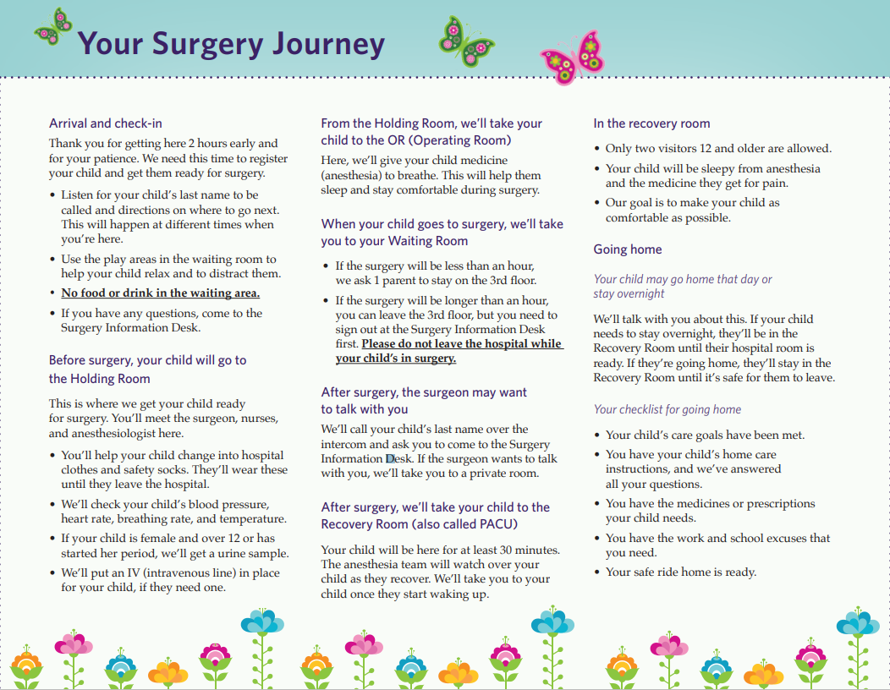
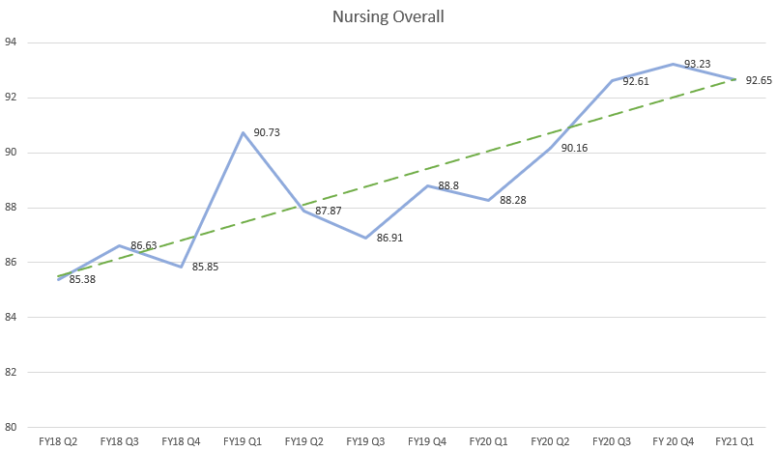
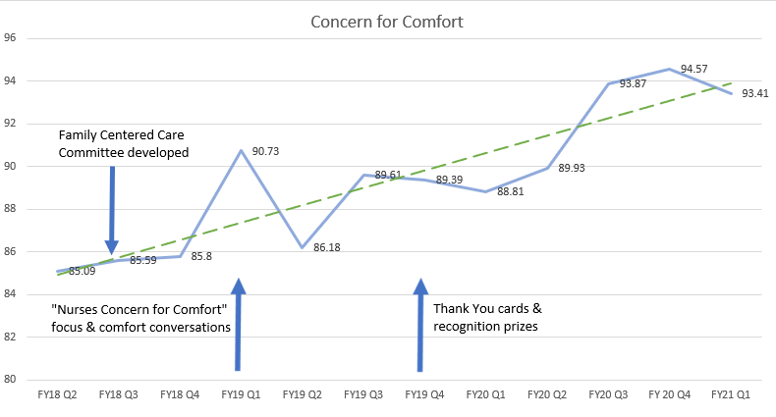
Improving Patient and Family Centered Care with Transparency Kayln Wolfe, MSN, CPNP-PC, CCRN, LeighAnn Chadwell MSN, RN, NE-BC
BACKGROUND
FIGURES
OUTCOMES
The partnership between the healthcare team, patients and families is vital to safe, positive outcomes for pediatric patients.
MCJCHV includes Family Centered care in our Focus values and places it at the core of our professional practice model.
To enhance this culture on a unit level, a core group of staff champions and members of the HR/PACU leadership team created a Family Centered Care Committee (FCC).
The goal of this committee was to bring awareness to the aspects of family centered care and progressed to include improving the overall Press Ganey Top Box score for “Nurses Concern for Comfort” and increase interdisciplinary staff recognition.
Since implementation of the HR/APCU Family Centered Care Committee there has been a steady increase in Press Ganey “Overall Nursing” scores.
Within 6 months of implementation Press Ganey “Overall Nursing” increased from 86.63 to 90.73.
Targeted staff education related to comfort resulted in 5% increase in Press Ganey “ Nurses Concern for Comfort”.
Staff recognition helped increase Press Ganey Scores for “ Overall Nursing” and “Nursing Concern for Comfort”.
CONCLUSIONS
METHODS
The FCC committee has instilled MCJCHV’s patient and family centered approach on a unit level, improved staff engagement and the patient-families perioperative experience.
Press Ganey comments provide valuable insight into patient-family experiences and perceptions.
Sharing positive comments has created an effective tool for motivation and recognition of HR/PACU staff and other members of our perioperative healthcare team.
We would like to thank the members of the HR/PACU team for your commitment to providing high quality patient centered care. Additionally, we would like to thank the FCC committee members Jill McCann-Van Dokkum, Makala Gordon and Pia Panozzo for your dedication to the success of this committee.
The FCC committee provides monthly education sessions which included:
Reviewing Press Ganey comments
Identifying themes for improvement which included:
Educating day of surgery expectations
Updating Perioperative Journey Map
Communicating delays to OR in a timely manner
Setting realistic expectations for post operative pain management
Maintaining professional conversations and PACU staff noise level
HR/PACU staff identified in positive comments are celebrated and awarded prizes.
Interdisciplinary staff identified in positive comments receive personalized Thank You card from PACU staff with comment included.
Focused education to address “ Nurses Concern for Comfort”. Initiated Comfort Conversations which include:
Addressing comfort throughout the plan of care
Ensuring nursing and parent perceptions of pain align
Assessing parent’s comfortable level before discharge
ACKNOWLEDGEMENTS
REFERENCES
Bruckenthal, Patricia, PhD, APRN-BC, ANP, FAAN, SIMPSON, MELANIE, PhD, RN-BC & OCN, CHPN. (2016). The Role of the Perioperative Nurse in Improving Surgical Patients' Clinical Outcomes and Satisfaction: Beyond Medication. AORN Journal, 104, S17-S22. https://doi.org/10.1016/j.aorn.2016.10.013
O'Leary KJ & Cyrus RM. (2015). Improving patient satisfaction: Timely feedback to specific physicians is essential for success. Journal of Hospital Medicine (Online), 10, 555-6. https://doi.org/10.1002/jhm.2403, 10.1002/jhm.2403

