Slide 1
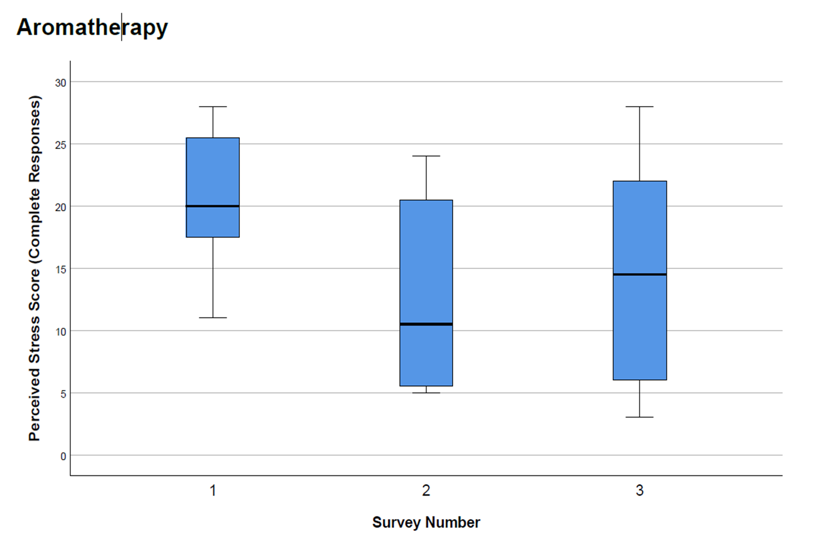
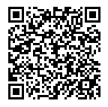
In demanding care environments,
aromatherapy supports employee
wellbeing by reducing stress perception.
Effect of Essential Oils on Perceived Stress Among Walk-in Clinic Staff
,
Janet Myers, DNP, APRN, FNP-BC,
GNP-BC, BC-ADM, CDCES, NE-BC DNP, APRN, FNP/GNP-BC,
Stress is common in healthcare settings
Employee wellness is crucial to:
Satisfaction
Productivity
Positive patient experiences
Aromatherapy may support wellness
12-week IRB approved study
Purpose
evaluate impact of citrus oil diffusion on perceived stress
Author
Methodology
Data Analysis
Outcomes
Pre/Post design quantitative
Convenient sample of walk-in clinic staff
Three essential oils
Blood orange
Lemon
Grapefruit
Perceived Stress Scale (PSS)
Before diffusion
During diffusion
After diffusion
Perceived stress reduced by 45%
Findings are statistically significant (p=0.015)
Perceived stress increased 21% when diffusion ceased
Background
Take-Aways
Aromatherapy may support employee wellbeing by reducing stress perception
Replicable wellness innovation intervention:
Rendered no adverse effects,
Cost effective
Sustainable
PSS scores ranged from 0-40
Scores > 14 = moderate - high perceived stress
Participants’ median stress levels:
Before diffusion - 20
During diffusion - 11
Post effusion - 14.5
Framework
SCAN FOR
CONTACT INFO
SCAN FOR REFERENCES
Methodology

