Slide 1
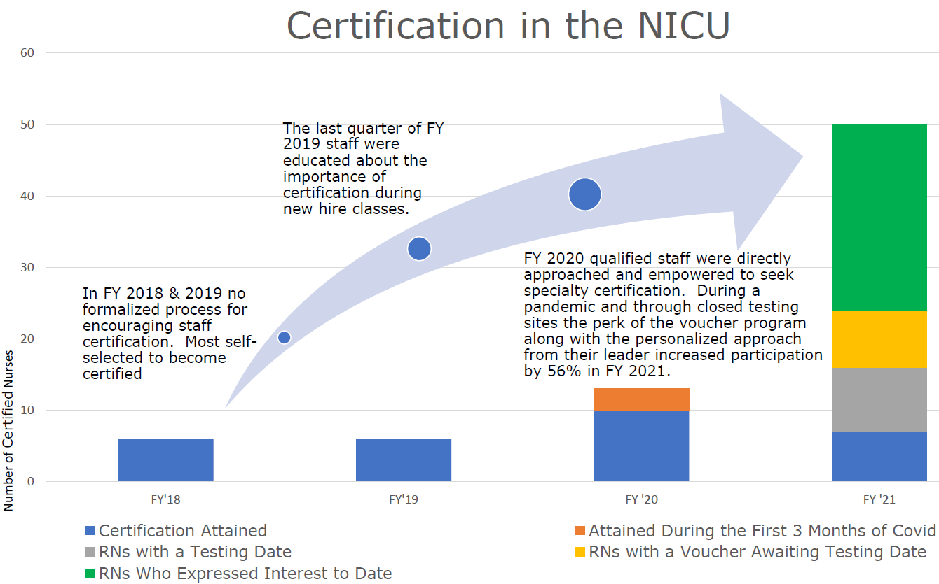
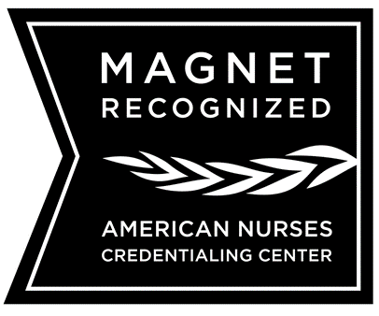
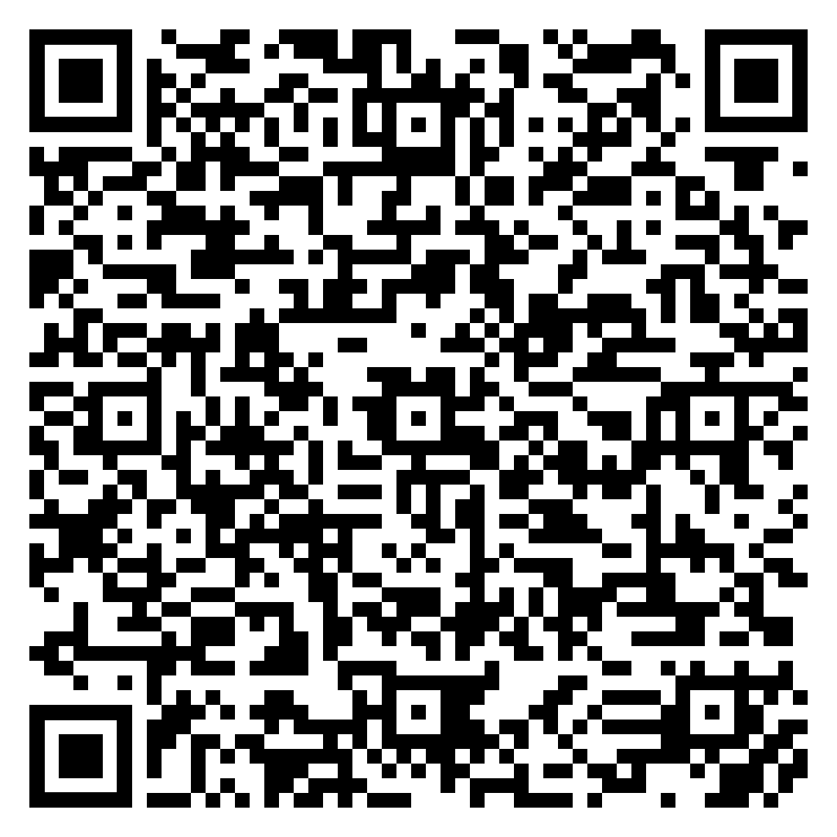
Specialty Certifications in Your Unit: Increasing Staff Participation During a Pandemic
Erin Havrilla, MSN, RN, NE-BC
Leader Driven Support and Engagement Increases Staff Participation in Specialty Certifications
BACKGROUND:
Specialty certification shows a commitment to superior healthcare delivery
Magnet designated hospitals support the distinction of excellence in nursing
METHOD
Quantitative data collected pre/post implementation via an orientation dashboard overlaid with a position management spreadsheet.
Captured level of experience, seniority date, days off orientation and certification readiness
SETTING - Neonatal Intensive Care Unit (NICU)
106 bed Level IV NICU
ADC 97
Level II Special Care Nursery
ADC 7
Staff Structure
1 Administrative Director
4 Clinical Managers
12 Clinical Staff Leaders
350 staff RNs
23 Certified RN’s prior to beginning of study
37 RN3
7 RN4
Encouragement from senior leaders fosters trust
Creates a platform for career development
An orientation dashboard/tracking system allows for a seamless process
RESULTS
SCAN FOR CONTACT INFORMATION

