Slide 1
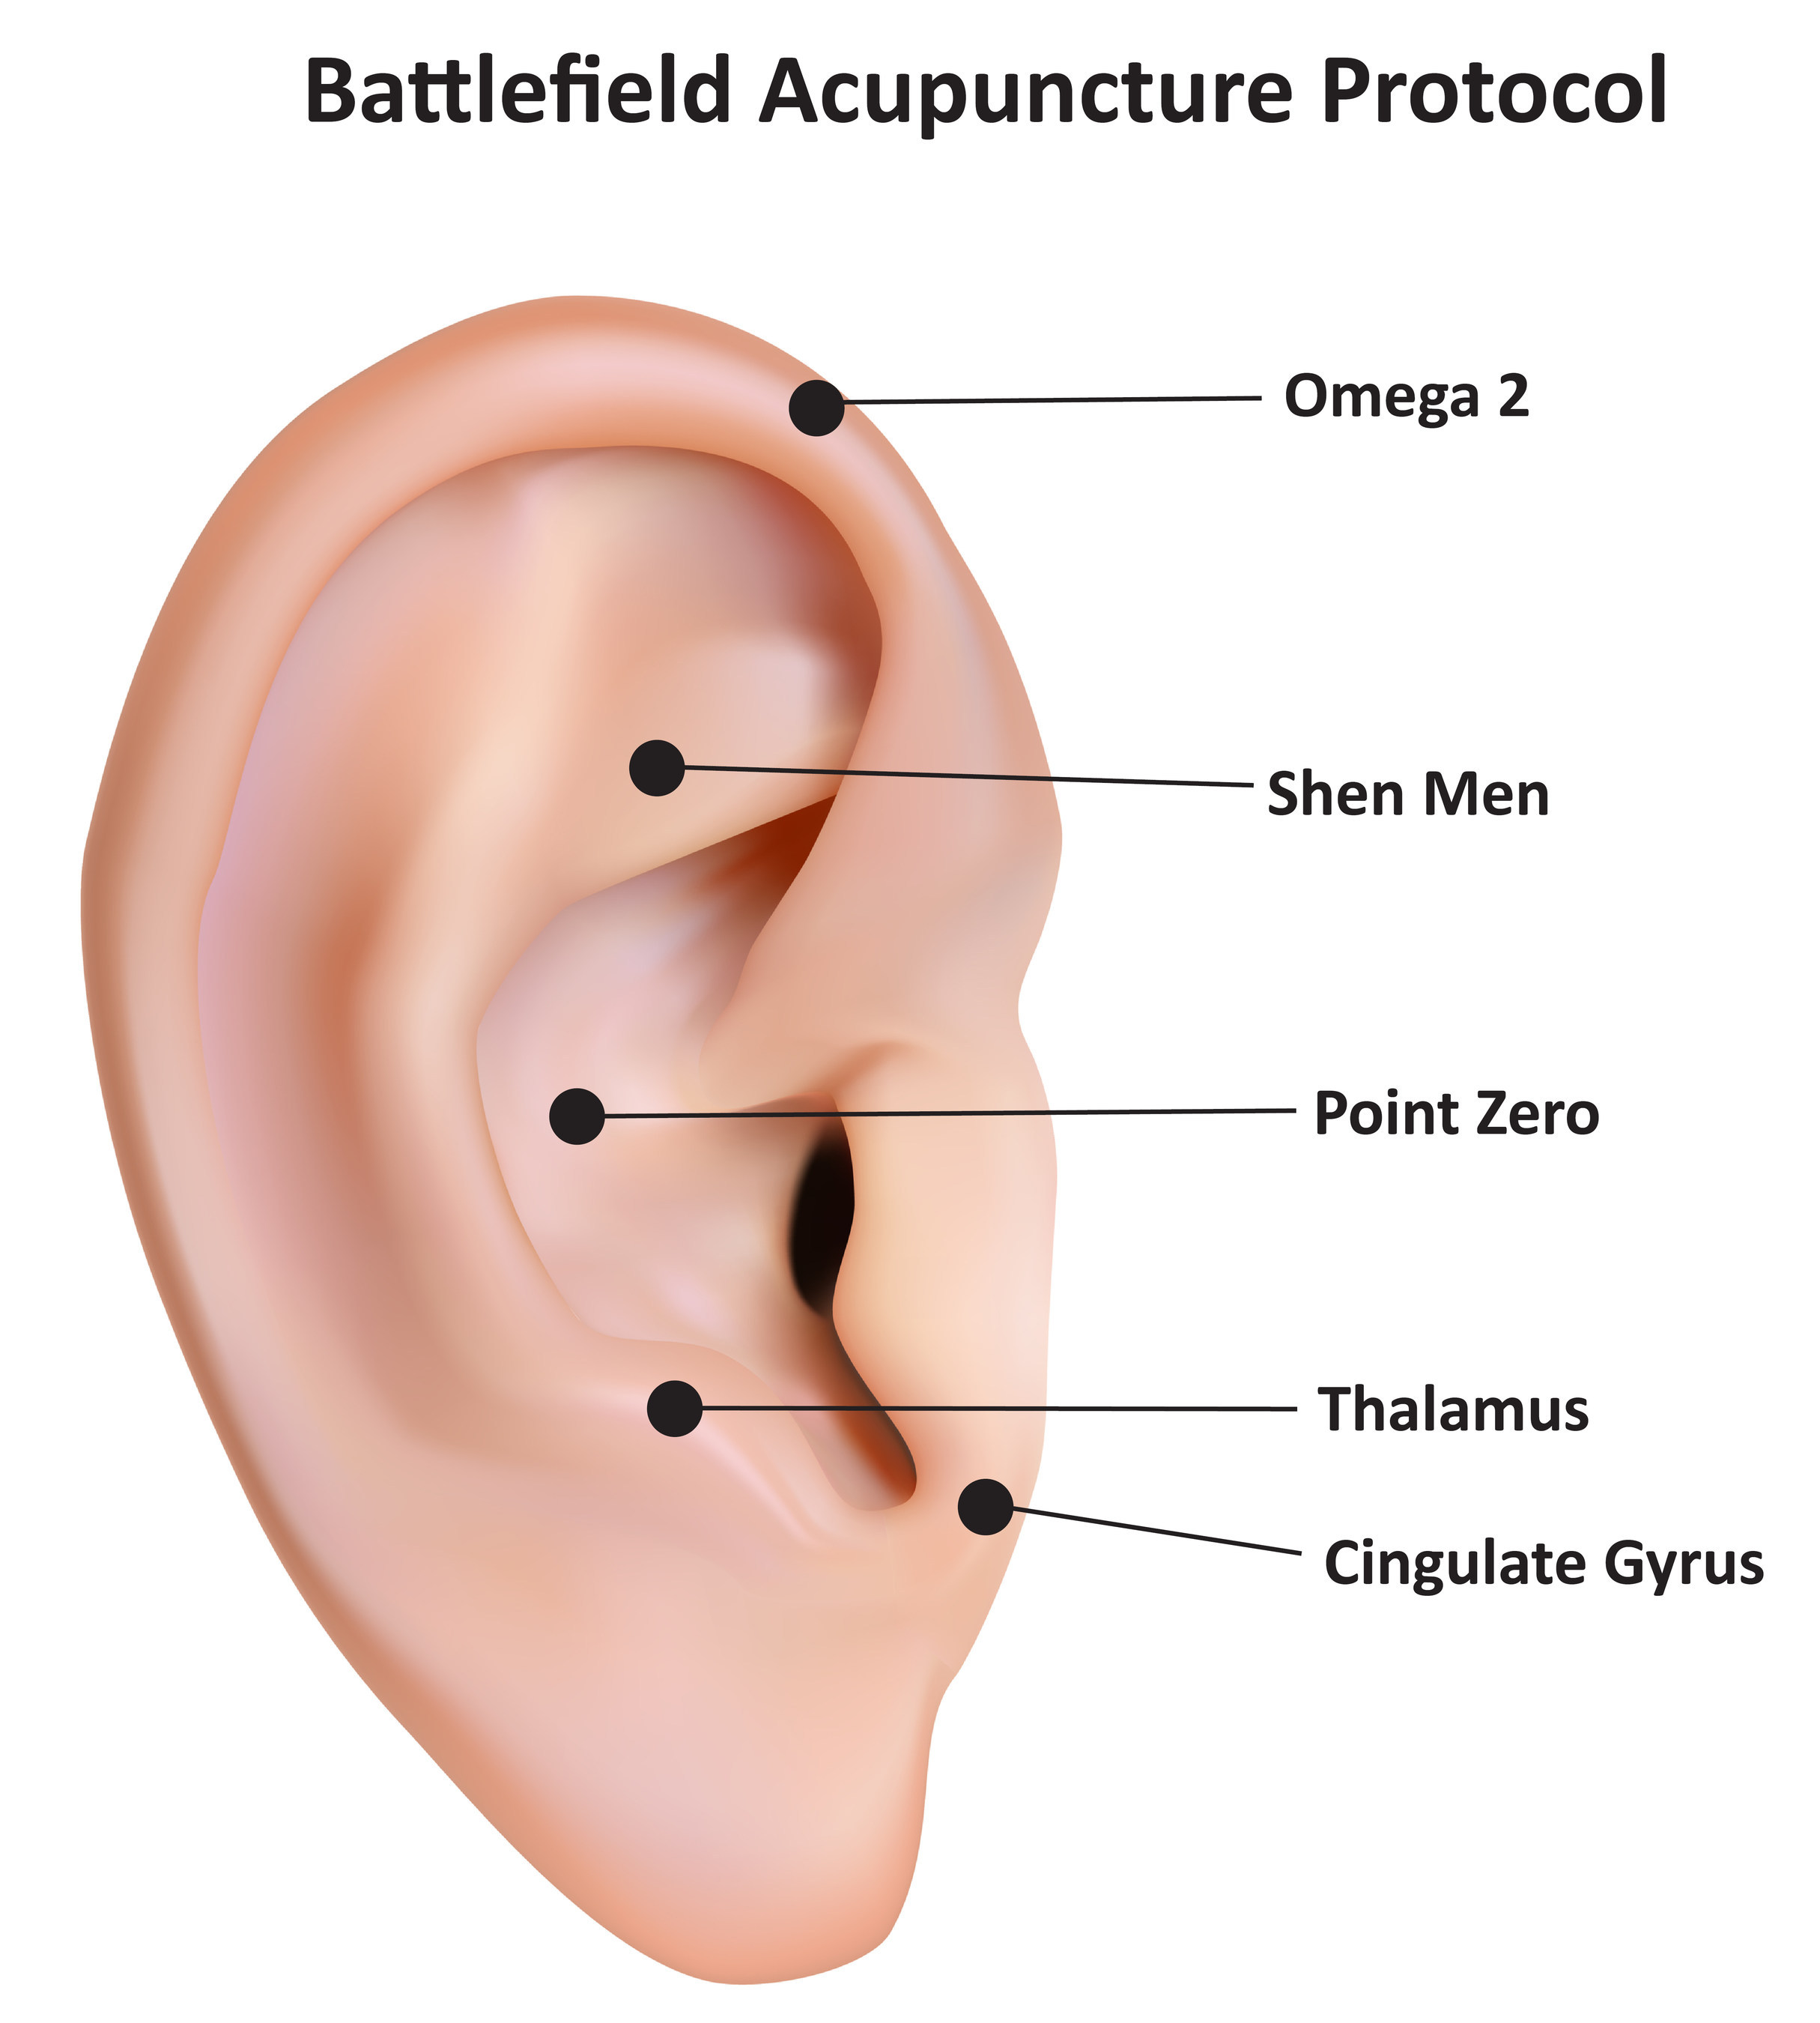
z
THE ROLE OF BATTLEFIELD ACUPUNCTURE IN REDUCING PAIN AND OPIOID USE IN METASTATIC PAPILLARY THYROID CANCER-ASSOCIATED TRIGEMINAL NEURALGIA
BRIDGET FITZGERALD, MSN, RN, AGPCNP-BC; KAREN HANDE, DNP, ANP-BC, CNE, FAANP, HEATHER JACKSON, PHD, APRN, FNP-BC;
Vanderbilt Ingram Cancer Center, Vanderbilt University Medical Center
BACKGROUND
RESULTS
Overall 50% pain reduction on left side- improved from 8/10 to 4/10
Reported improvement in ability to eat
Reduced oxycodone MED from 30mg/day to 15mg/day
Patient plans to continue to wean from opioids
Battlefield acupuncture (BFA) is a technique involving placement of five needles in designated areas (see left). It is suggested that the auricular placement of these needles trigger release of anti-inflammatory cytokines and β-endorphins leading to pain relief (Levy, Casier & Fitzgerald, 2018).
METHODS
50 year-old male with trigeminal neuralgia related to metastatic papillary thyroid cancer
Following his resection and treatment with radioactive iodine, patient experienced pain in the left cheek from top of ear to the bottom of the jaw and temporomandibular joint
Underwent acupuncture treatments using the battlefield method on 12/16/2020 and 1/6/2021
CONCLUSIONS
This case provides promising results for the efficacy of battlefield acupuncture at relieving pain associated with trigeminal neuralgia
There is a gap in the literature regarding the use of this procedure and this evidence supports the need for further study.
PURPOSE
To assess the impact of battlefield acupuncture on trigeminal neuralgia related to metastatiac papillary thyroid cancer
REFERENCES
Center for Pain & Stress Research. (2018, June 26). A new pain management process for the Military: MPS applied to Battlefield Acupuncture (BFA). Retrieved April 26, 2021, from https://www.prnewswire.com/news-releases/a-new-pain-management-process-for-the-military-mps-applied-to-battlefield-acupuncture-bfa-300507953.html
Levy, Charles E. MD; Casler, Nicholas BS; FitzGerald,David B. MD Battlefield Acupuncture: An Emerging Method for Easing Pain, American Journal of Physical Medicine & Rehabilitation: March 2018 - Volume 97 - Issue 3 - p e18-e19 doi: 10.1097/PHM.0000000000000766
Patient Visits *Post-Procedure

