Slide 1
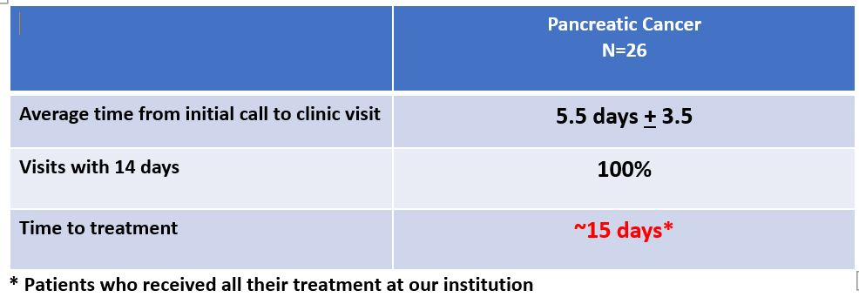
Care Coordination In Newly Diagnosed Pancreatic Cancer
Improves Time to Treatment
Amy Hayes, BSN, RN, OCN; Kamran Idrees, MD, MSCI, MMHC, FACS
VanderbiltNursing.com
BACKGROUND
TABLES/FIGURES
EVALUATION
Patients facing a new diagnosis of pancreatic cancer often feel overwhelmed and helpless. Diagnostic workup and staging of pancreatic cancer frequently involve a variety of tests with a multi-disciplinary team of specialists which can take a considerable amount of time to complete before initiation of the cancer treatment. Newly diagnosed pancreatic cancer patients can have a significant reduction in time to initial treatment under the guidance of a nurse navigator facilitating complex care in this commonly vulnerable patient population.
A pilot project at The Vanderbilt-Ingram Cancer Center demonstrated a significant reduction from time of diagnosis to initiation of therapy with the assistance of a nurse navigator coordinating care for patients with newly diagnosed pancreatic cancer.
Pancreatic cancer is a complex illness requiring care from multiple specialists such as gastroenterology, endocrinology, medical oncology, surgical oncology, and nutrition counseling. A nurse navigator can serve as the primary point of contact among multiple teams and can help patients feel less overwhelmed by the multitude of appointments through coordinated and timely visits.
Under the guidance of a dedicated nurse navigator, patient satisfaction is increased which can improve overall quality of life during a significant illness.
PURPOSE
Develop a systematic approach for completing staging of newly diagnosed pancreatic cancer patients with the assistance of a nurse navigator facilitating multi-disciplinary visits by improving access to care thus reducing time to initial therapy, and by providing psycho-social support to patients during this time.
INTERVENTIONS
At the time of referral to the cancer center, introduce the nurse navigator to the patient for coordination of care and counsel.
Create a systematic workflow for facilitating diagnostic testing and multi-disciplinary visits to reduce unnecessary delays in care.
Form partnerships with referring physicians and key members of multi-disciplinary team utilizing the nurse navigator as the central point of contact.
REFERENCES
Horner, K., Ludman, E.J., McCorkle, R., Canfield, E., Flaherty, L., Min, J., . . . Wagner, E.H. (2013). An oncology nurse navigator program designed to eliminate gaps in early cancer care. Clinical Journal of Oncology Nursing, 17, 43–48. https://doi.org/10.1188/13.CJON.43-48
Lee, T., Ko, I., Lee, I., Kim, E., Shin, M., Roh, S., . . . Chang, H. (2011). Effects of nurse navigators on health outcomes of cancer patients. Cancer Nursing, 34, 376–384. https://doi.org/10.1097/NCC.0b013e3182025007
Pancreatica.org. (n.d.). Genetic Testing for Pancreatic Cancer. Retrieved September 15, 2020, from https://pancreatica.org/genetic-testing-for-pancreatic-cancer/#:~:text=PROPOSED%3A%20Every%20newly%20diagnosed%20person,BRCA2%2C%20PALB2%2C%20and%20others.
INNOVATION
As clinicians continue to expand on the role of genetics in pancreatic cancer, the nurse navigator can educate patients on the importance of integrating genetic testing with a new diagnosis of pancreatic cancer.

