Slide 1
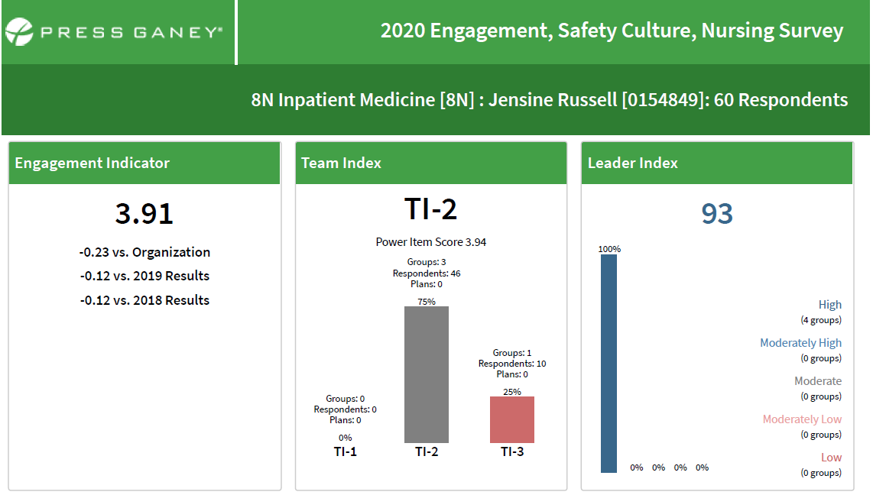
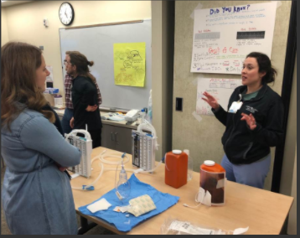
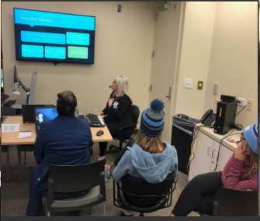
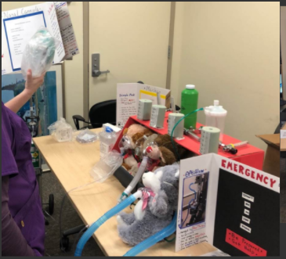
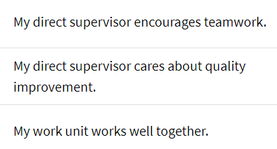
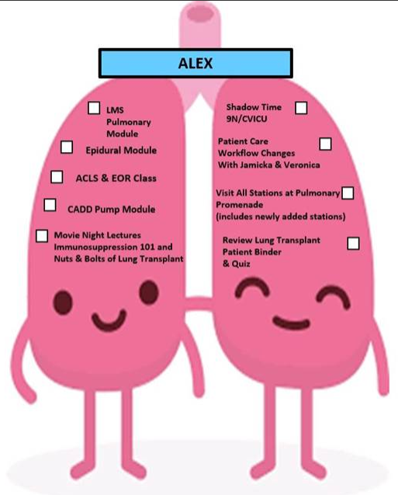
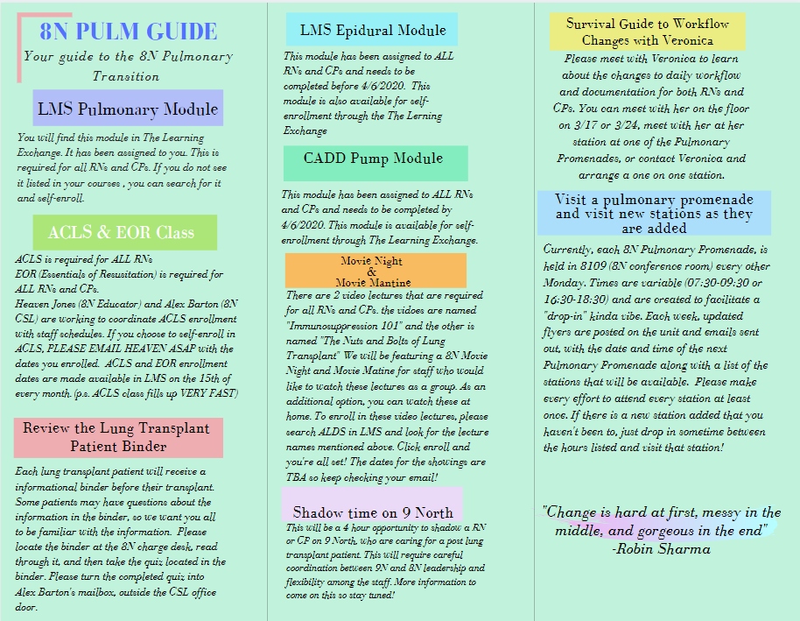
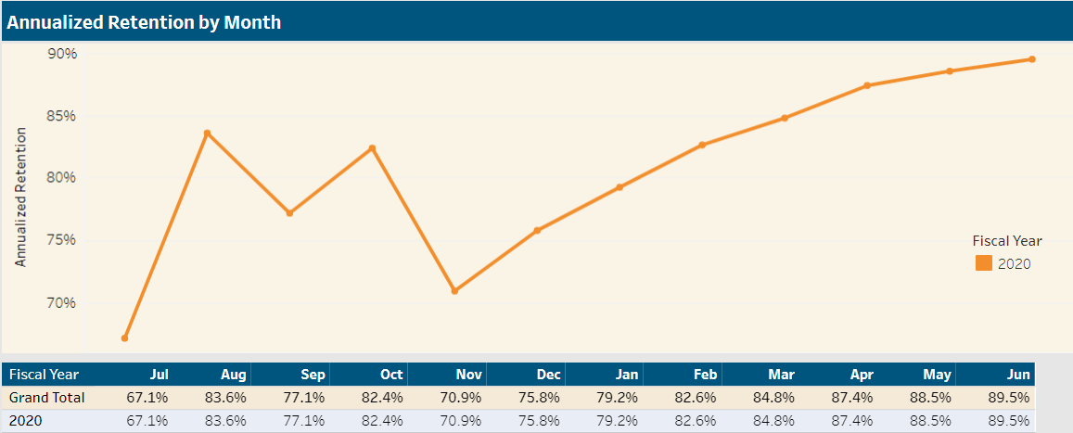
Utilization of Transformational Leadership to Transition from Acute to Stepdown Nursing Practice
Nursing staff who actively participate in nursing practice change are empowered to successfully implement organizational goals.
AUTHORS
Jensine A. Russell, DNP, RN, NE-BC
Alexandria B. Barton, BSN, RN
BACKGROUND:
Vanderbilt Lung Institute (VLI) created to provide specialized care to patients with complicated pulmonary disease
VLI established an NP led Advanced Lung Disease Service (ALDS) to manage new patient population
8 North chosen as primary inpatient unit for all ALDS patients
Transformational leadership concepts guided staff in their transition in from acute medicine to pulmonary stepdown nursing care practice
Active participation in the transition in planning empowered staff to participate in creative problem solving and fostered a unit culture of teamwork
METHODS
Onsite visit to University of Alabama Birmingham Medical Center’s Pulmonary Intermediate Care Unit
Brainstorming sessions with staff
Interdisciplinary collaboration with providers, pharmacy, respiratory therapy, and acute rehab services
Nursing support from stepdown units
Hands-on skills sessions
ACLS certification for RNs
Weekly project status updates
Reduced patient ratios
Increased nurse pay rate
CLINICAL IMPLICATIONS
As VUMC transitions to providing quaternary level of nursing care, more inpatient units will require higher acuity nursing training
Strategies used could guide nursing leaders who are implementing organizational change
Staff empowerment is an effective retention tactic

