Slide 1
Change Network Department Presentation: July
Please review slides and talking points found within the Notes with you teams and leadership as needed.
July 27, 2022

Slide 2
MyWorkday Quick Reference
Watch This Video | Link to What’s Happening? What's happening with time off?
Visit the MyWorkday Website | vumc.org/myworkday | What’s Changing Systems Impacted Project Timeline Training Hub
Questions? | Email myworkday@vumc.org with questions
Notes:
Here is a summary of resources to keep you informed regarding the MyWorkday project.
What’s Happening with Time Off– This is a 2-minute overview of time off
MyWorkday Website – Visit the MyWorkday website to view updates, project timeline, and access to the Training Hub
Questions? – Email any MyWorkday questions to the myworkday@vumc.org.

Slide 3
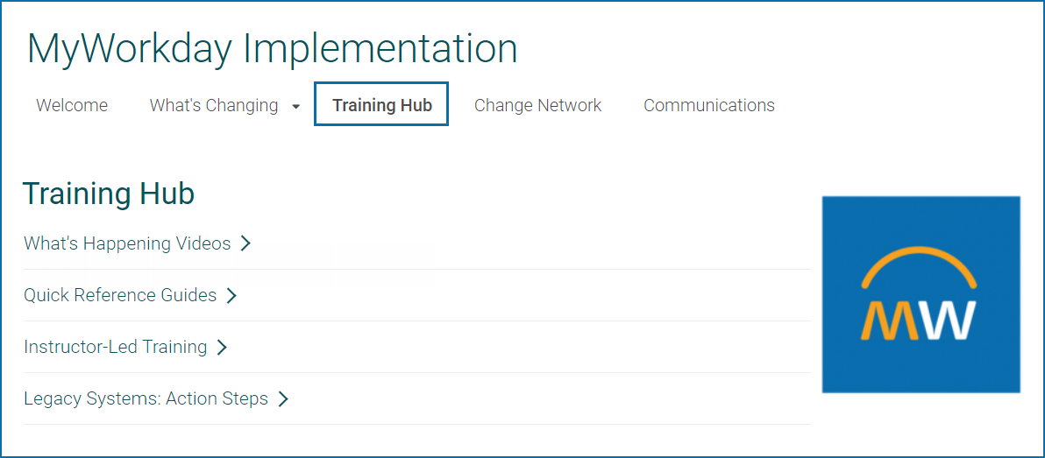
Training: What’s happening? Videos
Location www.vumc.org/myworkday/training-hub
What’s Happening? What's happening with time off?
Notes:
Visit the Training Hub for more information and/or click on the ‘What’s happening with time off?’ link to view the latest MW video.

Slide 4
Research & Grants Change Network Meeting
August 17th (10am) off-cycle meeting to cover Workday Research & Grants
Invitations are being sent to those in the Academic Enterprise
Please forward to grant managers or others on your team as needed
Email MyWorkday@vumc.org if you did not receive this invite and are interested
Notes:
Here are details related to the upcoming Research & Grants off-cycle Change Network meeting. If you received the meeting invitation, please forward it to grant managers or others on your team. Email MyWorkday@vumc.org if you did not receive this invite and are interested.

Slide 5
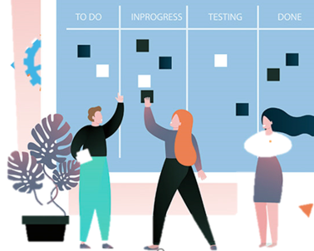
MyWorkday Project Update
Overall project status
New project team resources
Tracking to original cutover schedule
Notes:
Now, we want to give you all an update on the overall status of the project. We have heard that there are some rumors out there that we are delaying cutover until after the winter holidays – and we are here to tell you that this is not true! Though the testing phase of the project uncovered some issues that originally put the overall project status off-track, VUMC is committed to a November cutover. We have lined up and assigned lots of new resources to alleviate these issues and hope to get the timeline back on schedule. Since bringing in those resources, we’ve made great progress and feel confident we’re tracking to our original cutover schedule. We fully anticipate beginning the active part of the cutover in early November as scheduled.
If you hear your colleagues bring this topic up, we hope you feel empowered to address these rumors and let them know we will begin using Workday as scheduled in November.

Slide 6
What is cutover?
Goal - Plan to minimize disruption to patient care and normal operations
Process - Move from old systems to a new system
Timing – Time period is longer than past go-lives (2-month period)
Cutover Planning - Cutover plan includes a strategy to manage activities, roles and responsibilities
Notes:
Goal: Plan to minimize disruption to patient care and normal operations
Process: Move from old system to a new system
Timing: Period of time longer than other go-lives (2-month period)
Cutover Planning: Cutover plan includes a strategy to manage activities, roles and responsibilities

Slide 7
High Level Timeline
Plan
Confirm Cutover Leads
Finalize all components of Cutover Plan
Cutover Education
Draft Cutover Checklist
Cutover
Tenant Build
Catchup Transactions
Freeze/Blackout period execution
Communications & Prep for Go-Live
August ‘22
November ‘22 – February ‘23
July – August ‘22
September – October ‘22
Pre-Cutover
Continue Cutover Checklist updates & coordination
Establish Daily Calls
Communicate to Impacted Stakeholders
Post-Cutover
Post-production support
Post Go-Live Catch up
Legacy System Sunset
Support model execution
Transition to Business as Usual
Notes:
Here is a high-level timeline of our cutover plan. There will be much more detail provided on the Cutover phase in the weeks to come.

Slide 8
Soft Freeze & Hard Freeze
32°
-32°
Soft Freeze
Hard Freeze
Notes:
A ‘soft freeze’ is a time where transactions are limited in the old systems. Whereas no transactions are allowed during a ‘hard freeze.’ More information will be released closer to cutover about which systems will undergo which types of freezes, and when and the steps you will need to take to ensure critical transactions are not impacted.

Slide 9
Absence Management Module
Consists of Time Off and Leaves of Absence
Manage leave requests; collect information & track balances
Enables workers to view their time off balances & leave request, including an absence calendar view
Managers can:
View balances for team and see a team absence calendar view
Approve time off requests
Adjust worker's time off or leave
Return a worker from leave
Notes:
The absence management module within Workday consists of both Time Off and Leaves of Absence
Manage leave requests within the module, allowing the collection of information and tracking of leave balances.
Enables workers to view their time off balances and leave requests in a single absence calendars & managers can see a team absence calendar

Slide 10
Absence Management – Time Off
Primary way to adjust PTO balances
Work with VandyWorks and Kronos
Employees using VandyWorks for PTO requests will continue to do so
Exempt staff:
Will no longer use Kronos to report PTO taken
Will enter requests within Workday
Notes:
Workday Absence will be the primary way an individual's PTO balance is adjusted.
Important for the system to work hand and hand with Kronos and VandyWorks for requesting and reporting time off.
Staff currently using VandyWorks to request PTO will still utilize that system. We are working on an interface to move the requested information from VandyWorks into Workday once approved, with the intent to eliminate duplicate entry.
Other non-exempt staff will enter their PTO requests in Workday for approval.
Assuming the leave information is in an approved status within Workday (from either WD or VandyWorks), that information will be fed to Kronos and will pre-populate the leave hours.
The hours pre-populated in Kronos can be edited if changes are made. Edits will then be sent back to Workday at the end of the pay period to adjust balances.
Exempt staff will no longer use Kronos to report PTO taken, but will put the request within Workday.

Slide 11
Absence Management – Time Off Requests
Workday Absence Management
Workday
Leave Approvals
Workday Payroll
VandyWorks Leave Approvals
End of pay period
Non-exempt only
Kronos
Leave Hours
Edits within Kronos will be sent to Workday at the end of pay period to adjust leave balances
Notes:
Visual depiction to help explain the time off request process just outlined with movement between Workday, VandyWorks and Kronos

Slide 12
Talent Management
Workday allows us to capture employee information:
Education
Certifications
Licensures
Professional affiliations
Job history
Notes:
Workday allows us to capture information on employees, such as:
Skills, Education, Certifications, Licensures, professional affiliations and job history
By having this information within an employees HR record, we are looking to retire the CATS systems and utilize Workday functionality.
Workday allows the employee to enter information in the system, and for approval/review by the manager.

Slide 13
Performance Management
Performance Management includes:
Annual Performance Reviews
Disciplinary & performance improvement plans
Performance evaluation process for 2023 will be within Workday
Notes:
The Talent Management module also includes performance management, including annual performance reviews, disciplinary and performance improvement plans.
The annual performance evaluation process for 2023 will be completed within Workday.

Slide 14
Workday Help
Case Management Tool
Workflow Tracking
Case Escalation
Service Level Agreements (SLAs)
Resources
Notes:
HR Employee Service Center and the FMLA team are thrilled to have a case management tool for assistance in tracking the various requests receive.
ESC currently has approximately 70,000 interactions annually with customers through phone calls and email with no easy way to track those interactions.
Workday Help is a relatively new module for Workday.
The ability to escalate cases when needed.
Ability to track who is responded, and the ability for the employee/requestor to also be able to see responses and information within the system.
Service level agreements setup within the system will allow for monitoring of response time and adjust accordingly.
Knowledge articles will be available to help answer questions, along with the ability to open a case for further support.

Slide 15
Supervisory Organizations
Each worker is a Member of a Supervisory Organization
A Manager (role) is assigned to a Supervisory Organization
A Manager is not a member of the organization(s) they manage
Executive Management
Executive Management
Max Schneider
Member - Executive Mgmt
Manager - Operations
Manager - Operations
Operations
Operations
Susan Steinberg
Open Position
Member - Operations
Manager - Global Support
James Brooks
Manager – R&D
Member - Operations
Manager - Global Support
Kelly Brown
Member - Operations
Global Support Center
Member - Operations
Global Support Center
Manny Soto
Member – Global Support
Maya Scott [C]
Member – Global Support
Katarina Lindgren
Member – Global Support
Open Position
Member – Global Support
Notes:
<<CLICK>>
Supervisory organizations report to one another to form the Supervisory organization hierarchy. We only have one manager
<<CLICK>>
Workers are MEMBERS of a supervisory organization.
<<CLICK>>
A manager is ASSIGNED to a Supervisory Organization - <<<<CLICK>> <<CLICK>>
(shows 2 levels of management building) (In this picture, we see 3 orgs, Global Support-North America , Global Support EMEA and Global Support Center. The bottom 2 orgs have people in them (Dylan, Laurie and Dalji) and they have managers assigned to them (Scott and Katarina and Susan)
<<CLICK>> (this click adds the boxes for Katarina and Scott IN the org above where they are tied as manager)
A manager is NOT a member of the organization to which they are assigned <<pause for a moment to let this sink in! This is a key point. >>
In this example, Katarina and Scott are not assigned to (or “in”) the orgs Global Support North America and Global Support – EMEA, they are assigned to (or “in”) the org above, Global Support Center
<<CLICK>>
If the manager is not ASSIGNED to a supervisory organization, it will be inherited from the organization above.
What this means to you is that if a manager leaves the organization, things like business processes don’t “break” because the system looks up to the level above for the person serving that same manager role.

Slide 16
Automated, consistent processes & workflows
Data in single system is more readily visible & accessible
Role-based security access
More controls around access to sensitive or confidential data
Restrictions on delegation & task sharing (security reasons)
What will be new in Workday?
Notes:
Here’s what’s new in Workday. Position driven, role-based security will replace system access that we are currently accustomed to seeing in Privilege Management.

Slide 17
Manager Security Role in Workday
What’s changing?
Managers will initiate, own & complete administrative supervisory tasks within Workday
Limited/temporary delegation to others
Workday Manager Role Scope (not all-inclusive list):
Viewing position information of direct reports
Reviewing and approving time off requests*
Initiating job requisitions
Assessing candidates
* Those currently approving time off requests in VandyWorks
will continue the current process.
Initiating job changes
Expense report approval
Performance management

Slide 18
Manager Security Role in Workday
How will we prepare managers?
All managers receive user training
Why is this role beneficial?
Managers have better control of the tasks & data that they “own”
Provides greater visibility into process & data
Can better help their team members
Better management of work & tasks in their areas
Notes:
Additional training and communication will be forthcoming.

Slide 19
How may some individual contributor roles change?
What’s changing?
Some support roles & responsibilities may evolve
Fewer administrative tasks with Workday (e.g., less paper for routing, fewer transcriptions of data between systems, etc.)
Why is this beneficial?
Opportunity to tap into these individuals’ professional potential (e.g., grow skills, engage them in new ways, align them to VUMC’s growth)
How will we support affected employees & their managers?
Post-cutover, consult with HR Business Partners as needed (e.g., ensure job titles/descriptions align with the work, determine professional development)

Slide 20
Super Users

Slide 21
The Role of Workday Super Users
Activities | Attributes
Attend Super User Change Network meetings Complete training (early access to training and UAT) Gain technical expertise to provide real-time support during and after cutover Communicate future system changes to others | Willingness to learn and provide support to their team(s) Strong communication and technology skills Approachable and accessible to colleagues
Executive
Leadership
Committee
Executive
Steering Committee
Change Network
Department
Readiness Leads
Change Agents
Super Users
Leaders and Managers
All End Users
Notes:
We are now ready to begin identifying Super Users. Just as a quick point of reference.
The SUs we're talking about now are for Workday. Those of you involved with Tecsys will hear about “At Elbow Support” next and how to identify those individuals.
Super Users have an important role in our CN. SU will be invited to attend our CN meetings, they will have early access to training and to a practice environment. The intent is to gain technical expertise to help others during and after cutover so you want strong communicators and those that are approachable and accessible.
Workday Super Users are not testers – they may notify others of a major defect or share desired enhancements

Slide 22
Overview of Workday Functionality
Managers:
Initiate personnel transactions,
Review/approve transactions below
Individual Contributors:
Edit personal info, benefits enrollment
Submit expense reports, PTO*
Initiate purchase requisitions
Notes:
In our current state, access to functionality was driven by privilege management, with Workday, it will now be driven by the security role assigned to your position.
Everyone in the organization, at minimum will be and Individual contributor will ability to edit personal information, submit expense reports, initiate purchase requisitions.
Managers, will have this functionality in addition to the ability to initiate personnel actions and review and approved many of the actions of an Individual contributor.
If you assign someone as a SU that will be an individual contributor, that will be the training and access to practice environment they will receive. Same for managers/people leaders – they will receive training and access approved for that role.

Slide 23
Workday Super User Training
Early access to training (Role-based at go-live)
Available in September
Online training modules + downloadable guides
Access to practice environment
Available functionality dependent on role
Notes:
SUs will have early access to training. Remember, it will role based.
The training will be available in September. It will be online with access to download user guides.
Not all supervisors, managers need to be SUs – remember ALL will receive training. Selecting a SU is not required.

Slide 24
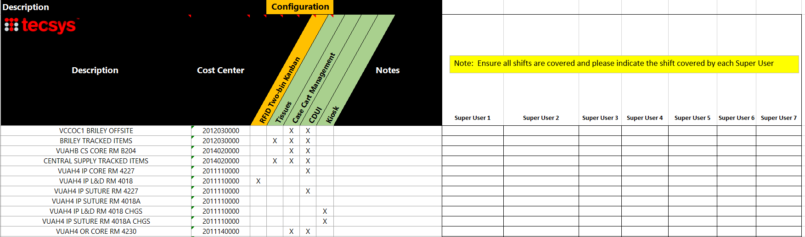
Tecsys At-The-Elbow Support (www.vumc.org/pou/training-hub)
Notes:
If you have not already filled this out, and your area is affected by Tecsys, please populate it and cover all shifts.

Slide 25
Thank You

