Slide 1
Physical Activity Intervention to Improve
Surgical Spine Outcomes (PASS Trial)
Kristin R. Archer, PhD, DPT
Professor and Vice Chair, Orthopaedic Surgery
Director, Center for Musculoskeletal Research
Vanderbilt University Medical Center
ISSLS Annual Meeting, Atlanta, GA
May 13, 2025

Slide 2
Disclosures
Funding: Academy of Orthopaedic Physical Therapy, Vanderbilt Center for Musculoskeletal Research, and a CTSA award (UL1TR000445) from the National Center for Advancing Translational Sciences.

Slide 3
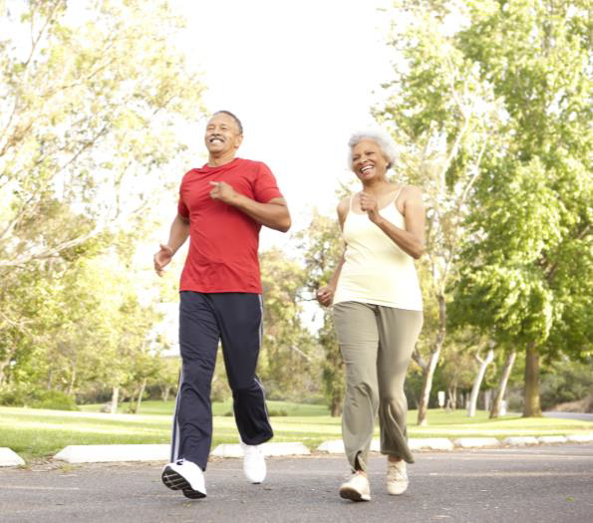
Lumbar Spine Surgery Outcomes
Wide variation in physical activity (PA) outcomes
  Up to 80% remain physically inactive after surgery
  Physical inactivity increases risk of persistent pain/disability
Patients report needing help with PA due to fear of reinjury and increasing pain
Wearable technology has improved PA in other orthopaedic populations

Slide 4
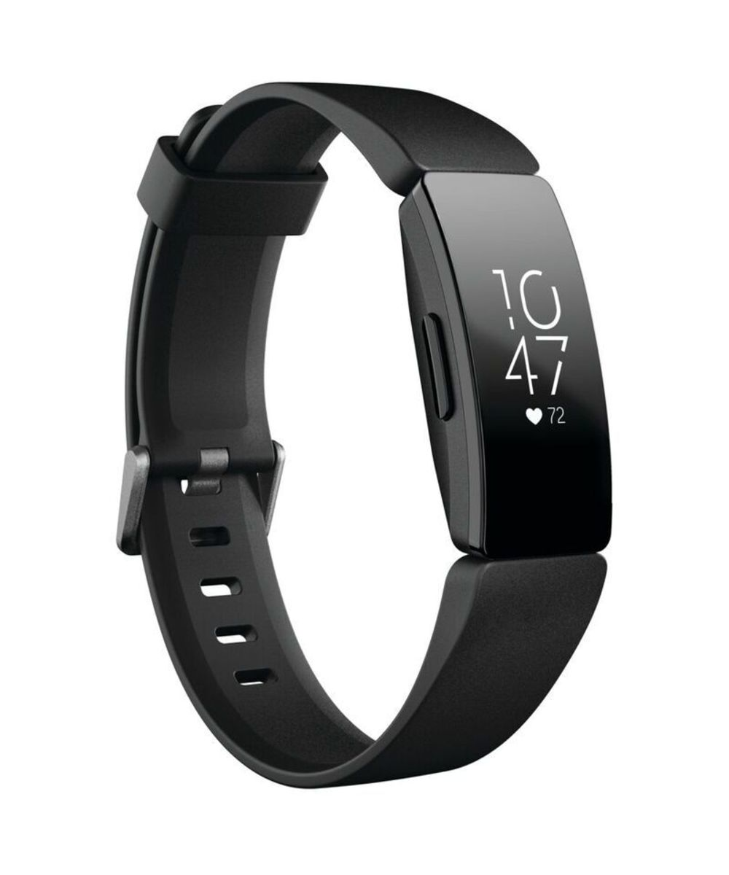
Objective
We aimed to determine the efficacy of a telehealth physical activity intervention in patients following lumbar spine surgery.
  Wearable technology (Fitbit Inspire HR)
  Remote physical therapist support
  Clinicaltrials.gov: NCT04968821

Slide 5
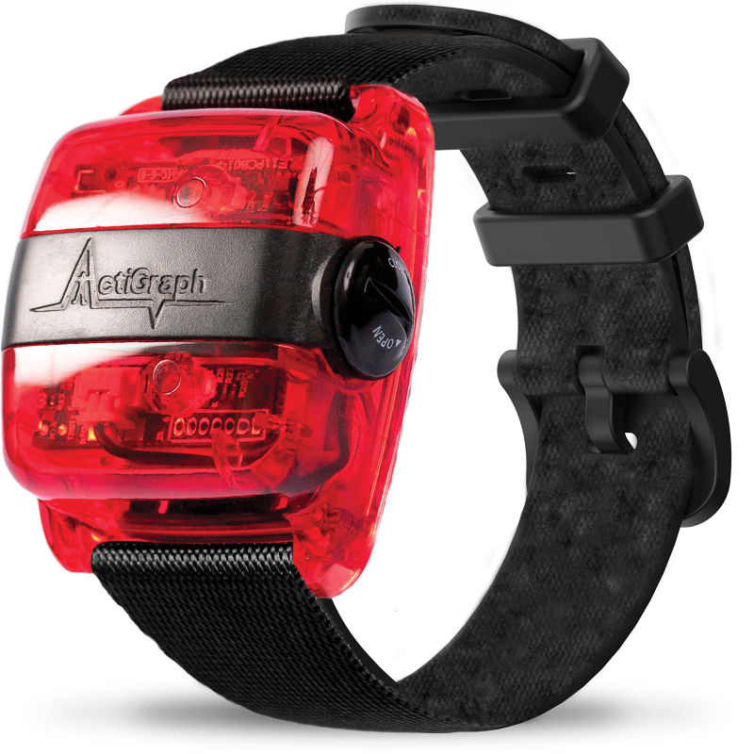
Outcomes at 6 and 12 Months
Primary Physical Activity Outcome (accelerometer):
  Activity counts per day
Secondary Physical Activity Outcome (accelerometer):
  Time spent in moderate-to-vigorous physical activity (MVPA)
  Time spent in sedentary physical activity
Secondary PROs
  Physical Function (PROMIS PF)
  Disability (ODI)
  Back Pain (NRS)
  Leg Pain (NRS)
Notes:
Accelerometer 4 days or more of 10 hours

Slide 6
Study Participants
Inclusion Criteria (adults)
  Lumbar degenerative condition
    spinal stenosis, spondylosis with or without myelopathy, degenerative spondylolisthesis
  Elective surgical treatment
    laminectomy with or without arthrodesis
  Exclusions: revision surgery, microsurgical techniques, spinal deformity, trauma, tumor, infection

Slide 7
Randomized Controlled Trial Design
Preoperative
2 weeks after surgery
Treatment
Follow-up
Physical Activity
8 sessions
Preop
Screen
Preoperative Assessment
Randomization
6 & 12 months
Usual Care

Slide 8
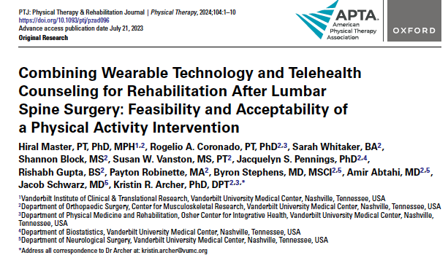
Physical Activity Treatment Protocol
Remotely delivered (ZOOM)
8 sessions weekly
Wearable device (Fitbit Inspire)
PT Counseling
  Motivational interviewing
  Goal Setting
    Fitabase review
    Weekly walking goals
    Goal tracking sheet

Slide 9
Assessed for eligibility preoperatively (n=733)
Enrollment
Excluded (n=540)
Not Approached (n=37)
Declined (n=63)
Enrollment and Consent (n=93)
Randomized (n=60)
Allocation
Allocated to PA Intervention (n=30)
Allocated to Usual Care (n=30)
Lost to follow-up PA (n=3)
Lost to follow-up PROs (n=2)
90%
93%
Lost to follow-up PA (n=3)
Lost to follow-up PROs (n=2)
Follow-up
Notes:
N=54 actigraph
N=56 PROs

Slide 10
Description of the Sample
Variable | PA Intervention (n=30) | Usual Care (n=30) | Total sample
Age (yrs) | 59.7 (13.2) | 62 (10.8) | 60.9 (12.0)
Education, (%) Greater than HS | 76.7 | 63.3 | 70
Male, (%) | 53.3 | 26.7 | 40
Married, (%) | 80 | 63.3 | 71.7
White, (%) | 83.3 | 90 | 86.7
Employed, (%) Retired Not Working Working | 33.3 13.4 53.3 | 40 3.3 56.7 | 36.7 8.3 55
Fusion, (%) | 63.3 | 63.3 | 63.3
Spinal Stenosis, (%) | 56.7 | 66.7 | 61.7

Slide 11
Proportional Odds Regression Results
6 Months
Odds ratio for Intervention
6 months
Physical Activity | Odds Ratio* | 95% CI | P-value | R²
Activity Counts per day | 2.9 | 1.02 to 8.0 | 0.04 | 0.58
MVPA per day | 4.2 | 1.4 to 11.8 | 0.007 | 0.41
Sedentary per day | 0.48 | 0.18 to 1.3 | 0.15 | 0.57
* Model controlled for outcome preoperatively and sex

Slide 12
Proportional Odds Regression Result
12 Months
Odds ratio for Intervention
12 months
Physical Activity | Odds Ratio* | 95% CI | P-value | R²
Activity Counts per day | 1.4 | 0.49 to 3.89 | 0.53 | 0.38
MVPA per day | 1.6 | 0.58 to 4.5 | 0.35 | 0.14
Sedentary per day | 0.24 | 0.09 to 0.69 | 0.008 | 0.58
* Model controlled for outcome preoperatively and sex

Slide 13
Linear Regression Results
6 Months
Beta coefficient for Intervention
Secondary Outcomes | β* | 95% CI | P-value | R²
PROMIS PF | 3.9 | 0.32 to 7.4 | .03 | 0.39
ODI | -4.6 | -10.9 to 2.6 | .17 | 0.45
Back Pain | -1.3 | -2.4 to -0.13 | .03 | 0.25
Leg Pain | -1.2 | -2.4 to 0.09 | .07 | 0.14
* Models controlled for outcome preoperatively and sex
Notes:
Finally, we compared clinically meaningful improvement from preoperative to 6 months following surgery in both groups using published values and found larger improvements in the CBPT group compared to education for all outcomes, except for leg pain.

Slide 14
Linear Regression Results
12 Months
Beta coefficient for Intervention
Secondary Outcomes | β* | 95% CI | P-value | R²
PROMIS PF | 3.3 | -0.77 to -7.4 | .11 | 0.22
ODI | -3.9 | -11.9 to 4.1 | .33 | 0.25
Back Pain | -1.5 | -2.6 to -0.43 | .007 | 0.18
Leg Pain | -1.5 | -2.8 to -0.21 | .02 | 0.13
* Models controlled for outcome preoperatively and sex
Notes:
Finally, we compared clinically meaningful improvement from preoperative to 6 months following surgery in both groups using published values and found larger improvements in the CBPT group compared to education for all outcomes, except for leg pain.

Slide 15
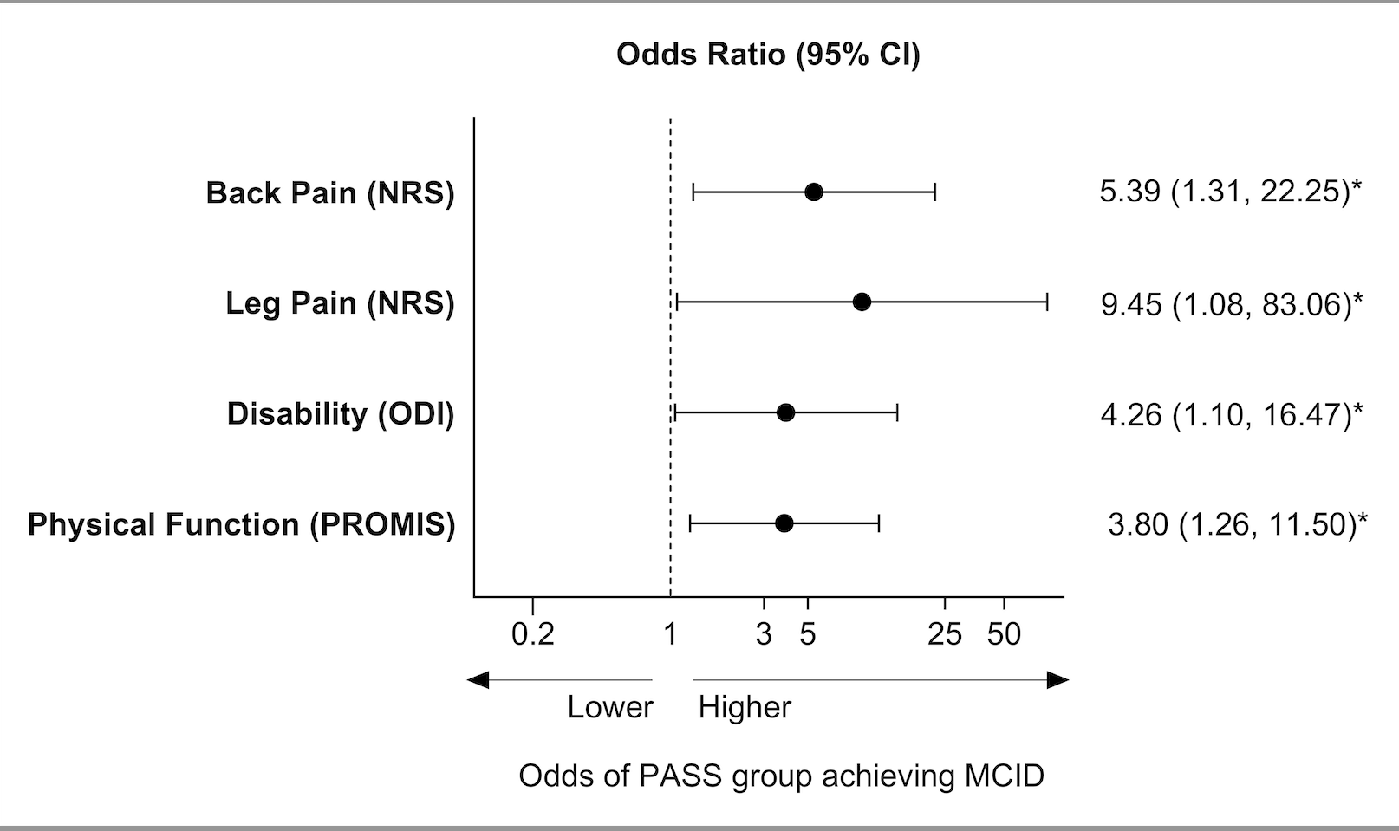
Proportional Odds Regression Models
MCID at 12 Months
Notes:
30% change pain and ODI
1 SD for PF – 10 points

Slide 16
Intervention Assessment (N=27)
 | Mean (SD) or N (%)
Helpful to recovery (0-10), mean (SD) | 9.0 (1.3)
Likely to recommend (0-10), mean (SD) | 9.3 (1.1)
Activity increased a meaningful amount, N (%) | 23 (85%)
Intervention more important than other services, N (%) | 19 (70%)
Benefits outweighed the effort, N (%) | 17 (63%)

Slide 17
Discussion
6 months
  Significant differences activity counts, MVPA, physical function, back pain
12 months
  Significant differences sedentary PA, back and leg pain
High adherence and satisfaction with intervention
  77% completed all 8 sessions
  85% extremely likely to recommend/meaningful increase in activity
  70% extremely helpful to recovery/more important than other services

Slide 18
Clinical Implications
Wearable technology and physical therapist counseling has potential to improve physical activity/exercise adherence
Physical activity screening may be beneficial for a targeted rehabilitation approach
  Walking programs alone or in combination with traditional rehabilitation may be an effective way to improve outcomes

Slide 19

Acknowledgments
Hiral Master, PT, PhD, MPH
Rogelio Coronado, PT, PhD
Jackie Pennings, PhD
Susan W. Vanston, MS, PT
Keith R. Cole, DPT, PhD
Alicia M. Hymel
Emily Oleisky
Jacob P. Schwarz, MD
Scott L. Zuckerman, MD, MPH
Amir M. Abtahi, MD
Byron F. Stephens, MD, MSCI
Amanda Priest
Aran Sullivan
Sarah Whitaker

Slide 20

Thank You
Vanderbilt Center for Musculoskeletal Research
https://www.vumc.org/musculoskeletal-research
Kristin.archer@vumc.org
@VUMC_MSK

