Slide 1
EdgeforScholars.org

Slide 2
Marketing Your Manuscript
Aimee Edgeworth
Program Manager
Office of Clinical and Translational Scientist Development
Vanderbilt University Medical Center
A guide to social media for scholars.
EdgeforScholars.org

Slide 3
EdgeforScholars.org

Slide 4
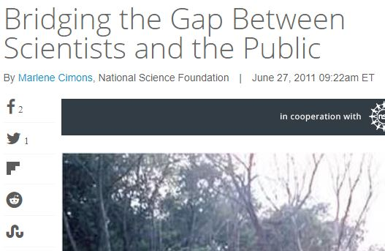
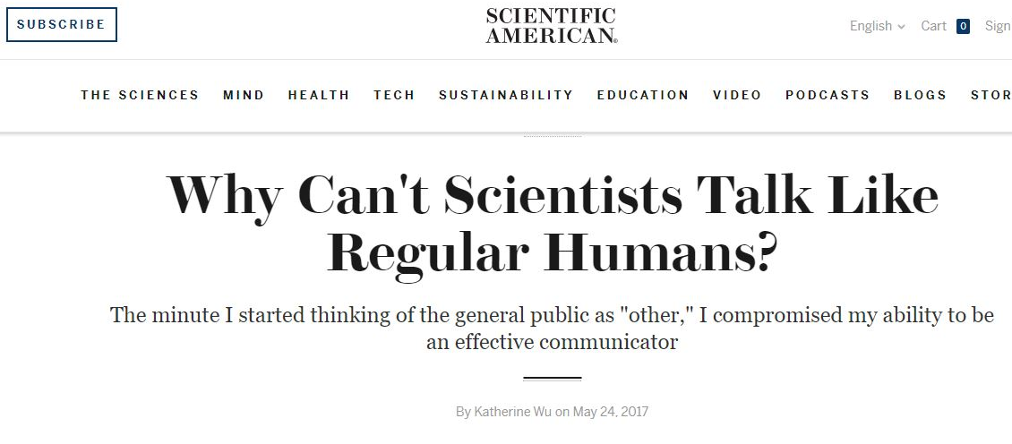
Why is it important to “market” research towards the general population?
EdgeforScholars.org

Slide 5
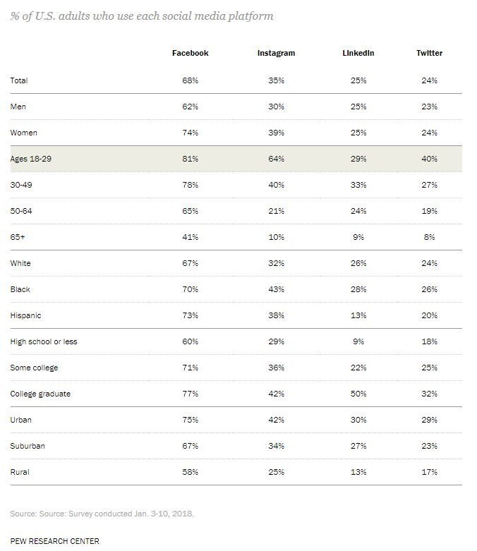
Source: http://www.pewinternet.org/2018/03/01/social-media-use-in-2018/
Source: http://www.pewinternet.org/fact-sheet/social-media/
EdgeforScholars.org

Slide 6
So, you published a paper… now what?
In this guide you will learn how to:
Create a snazzy infographic to display your data
Craft clever ways to craft messages about your research
Develop a social media plan and schedule
Track the results of your work
EdgeforScholars.org

Slide 7
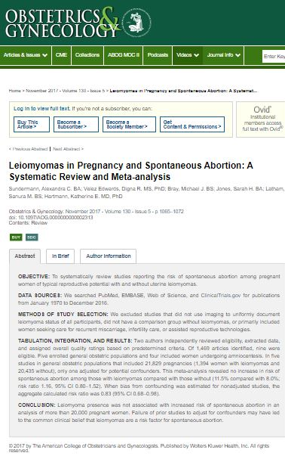
But first… A tale of two papers
Example
EdgeforScholars.org

Slide 8
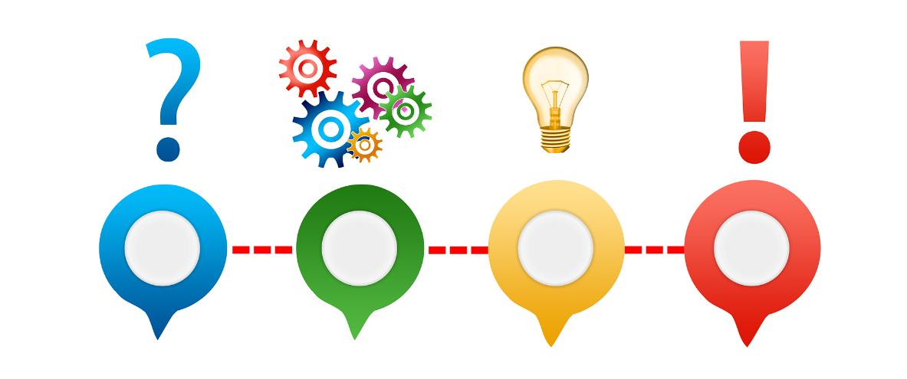
Women’s Reproductive Health Studies
Overview
Two papers set to be published November and December 2017 on related topics.
Animated video already done by professional.
Permission granted to use images and credit artist.
Use of free tools to create infographic in similar look as video.
Social media campaign leading up to journal publication and thereafter.
Example
EdgeforScholars.org

Slide 9
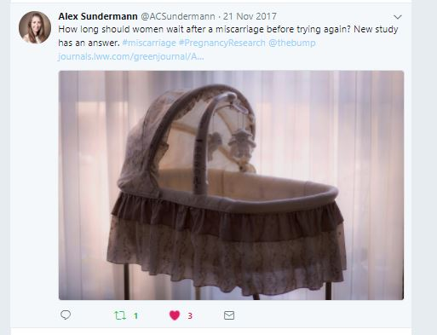
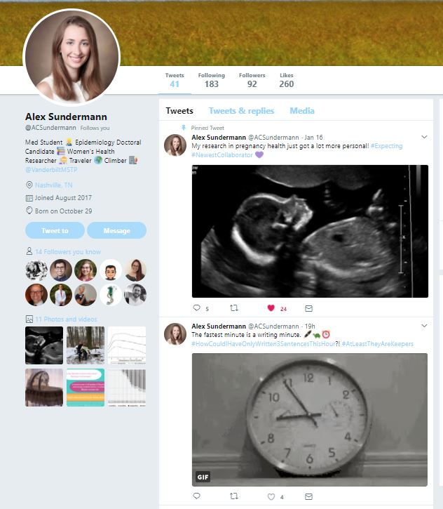
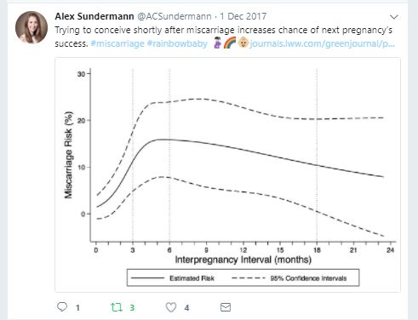
Twitter handle @ACSundermann
Example
EdgeforScholars.org

Slide 10
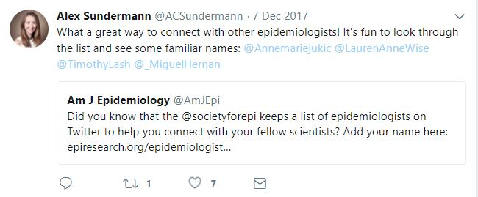
Example
EdgeforScholars.org

Slide 11
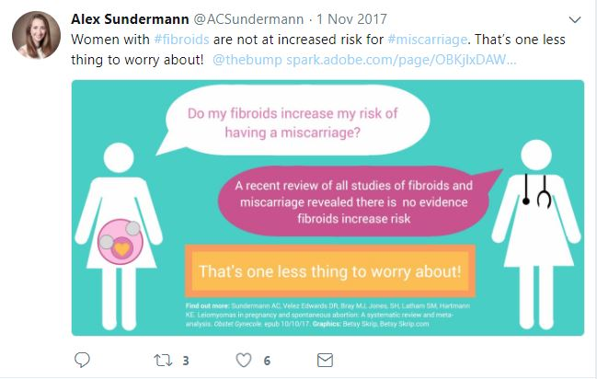
Example
EdgeforScholars.org

Slide 12
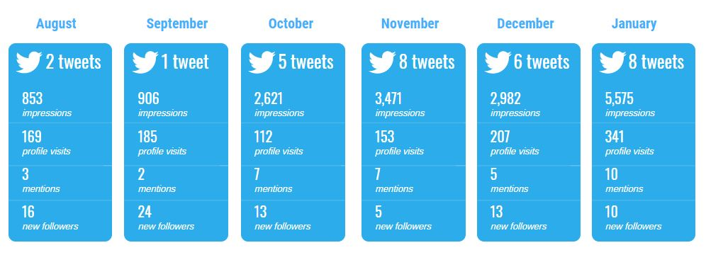
Sundermann Research Twitter Campaign
August 2017 – January 2018
Total Tweets: 30
Total Impressions: 16,408 Total Profile Visits: 1,167
Total Mentions: 34 Total New Followers: 81
Example
EdgeforScholars.org

Slide 13
5 Steps to Marketing Your Manuscript
Using Twitter to share your science.
EdgeforScholars.org

Slide 14
Step One: Analyze Data to Create an Infographic
What are the details that make your research exciting?
Step One: Analyze Data
EdgeforScholars.org

Slide 15
Tips:
“So what?” test/ Why do I care?
Consider why sharing this information should matter to others.
Who is likely to care most about this information?
What’s the point?/ What does it mean?
Which quantitative figures matter most to communicating your research findings?
How can you display that data?
Use infographics that clearly tell a story for inspiration.
Use free tools and resources:
Canva.com
Piktochart
Venngage
Freepik
PowerPoint
EdgeForScholars.org
Step One: Analyze Data
EdgeforScholars.org

Slide 16
WHO are you trying to reach?
Scientists vs General Population
Methodical
Process-driven
Chronological presentation
Who was involved?
Conclusion focused
Results-driven
Most relevant data first
How does this affect them?
Source: Forbes “9 Tips For Communicating Science To People Who Are Not Scientists” https://goo.gl/FJYFom
Step One: Analyze Data
EdgeforScholars.org

Slide 17
Step Two: Create visual representations of your data
Clear title
Eye-catching figures
Bright colors
Clear take-away
Source: https://www.easel.ly/
Don’t forget citations at the bottom of your infographic!
Step Two: Create Visual Representations
EdgeforScholars.org

Slide 18
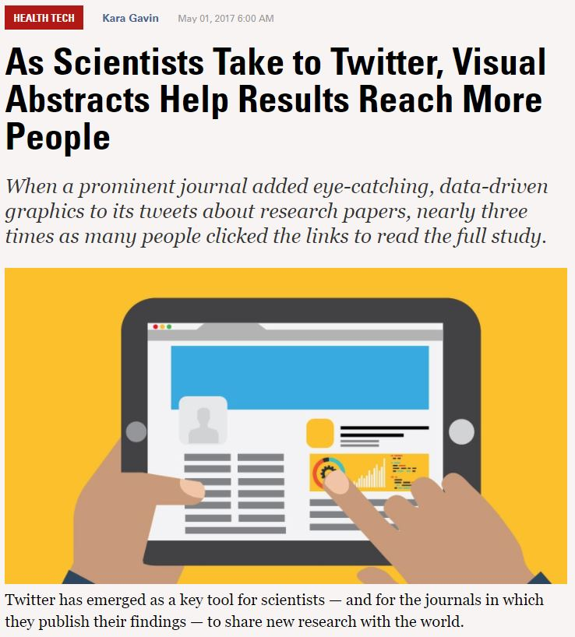
Source: https://blog.hubspot.com/marketing/visual-content-marketing-strategy
Source: https://labblog.uofmhealth.org/health-tech/as-scientists-take-to-twitter-visual-abstracts-help-results-reach-more-people
Step Two: Create Visual Representations
EdgeforScholars.org

Slide 19
YES!
Source: https://goo.gl/MkeVgr
Step Two: Create Visual Representations
EdgeforScholars.org

Slide 20
Visual Perception and Graphical Interpretation
When things go wrong…
June 4, 2014: The Times shared a graphical display of absolute number of US military personnel acting in Europe across the years, from 1945 to 2014 (graph A).
Corrected X-axis produced graph B, which conveys very clearly that the change in the correction of the axis makes a big difference in terms of visual perception and graphical interpretation.
The first point on the Y-axis (1945) was annotated in the original as having a value of 3 million, while all other points were below 450,000 (where the Y-axis ended).
Graph C, with scales adjusted for both axes – sharply contrasts with graph A.
Ensuring the
visual display
accurately reflects data findings.
Source: https://goo.gl/MkeVgr
Step Two: Create visual representations
EdgeforScholars.org

Slide 21
Data Visualization Tips:
Think outside the box
Icons and numbers can be more impactful than a complex and possibly confusing graph.
Don’t overdo it on the graphics
Limit to key stats and keep multiple graphs relative to one another.
Keep it clean
Minimal text, white space aplenty, and easy-to-read fonts.
Get feedback
Host mini-focus groups with peers in 5-minute hallway discussions.
Source: https://datasaurus-rex.com/training/data-viz/saying-no-to-busy-vizzies
Step Two: Create Visual Representations
EdgeforScholars.org

Slide 22
Convert manuscript diagrams and figures to vibrant graphic designs
What items attract your attention to this graphic?
What problems do you notice if this were to appear in your Twitter feed?
Source: http://www.jenniferrosedesign.co.uk/scientific-infographics/
Step Two: Create Visual Representations
EdgeforScholars.org

Slide 23
EdgeforScholars.org
Pro-tips for commonly used graphic design tools
Step Two: Create Visual Representations
EdgeforScholars.org

Slide 24
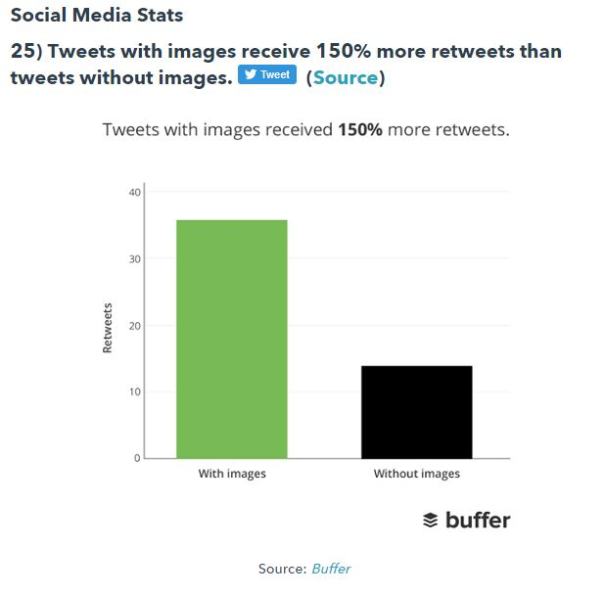
Posts with images get MORE traffic.
Use other images in addition to your infographic, like related stock photographs.
Pixabay
Unsplash
University Flickr
Check for creative commons licensing
Photo credit: Source
Source: https://blog.hubspot.com/marketing/visual-content-marketing-strategy
Step Two: Create Visual Representations
EdgeforScholars.org

Slide 25
Step Three: Cue the Clever Copy
Use basic language to share across social media
Don’t use alliteration.
Say what you want to say, then eliminate all unnecessary words.
Limit to 140 characters or less.
Find at least 10 different ways to say something important about your data.
Basic facts and stats relate better than writing “Check this out!”
Step Three: Clever Copy
EdgeforScholars.org

Slide 26
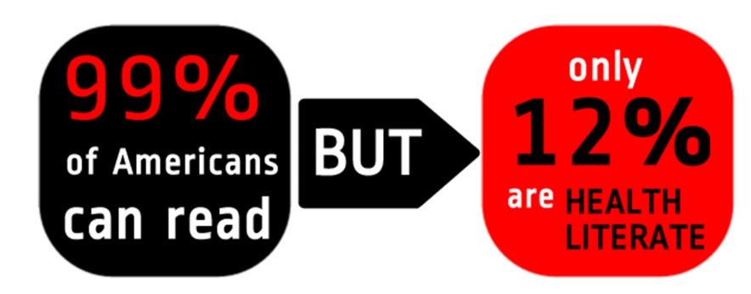
Challenges
A lay audience is a mixture of different ages, cultures, professions, and socio-economic backgrounds, each with its own ‘language’.
Source: http://journal.emwa.org/media/2188/2047480615z2e000000000320.pdf
Step Three: Clever Copy
EdgeforScholars.org

Slide 27
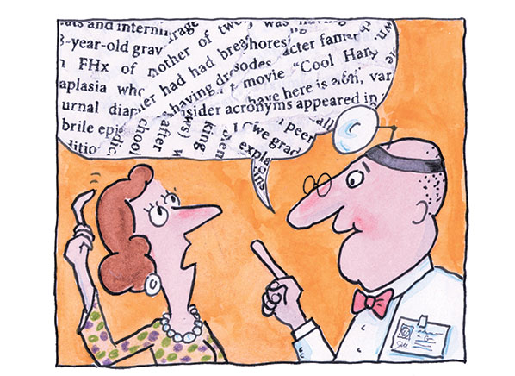
Health Literacy and Lay Language
TIPS:
Avoid jargon
Exclude details that may not be interesting for the readers
Use plain language
Use the active voice
Use visual aids
Source: https://newcomerhealthmatters.com/2016/12/05/health-literacy/
Step Three: Clever Copy
EdgeforScholars.org

Slide 28
Examples of converting scientific jargon into lay language facts
Scientific findings
Tweetable facts
Scientific jargon
Genetic abnormalities often result in sterility, such as in Turner syndrome.
The phospholipid bilayer allows for bidirectional transport of cellular metabolites via membrane pores and transmembrane proteins.
Tweet length phrase
Genetic abnormalities often result in sterility, such as in Turner syndrome, in which a female is missing an X chromosome.
The cell membrane allows for the entry of molecules needed by the cell as well as the exit of molecules produced by the cell.
Source: https://twp.duke.edu/sites/twp.duke.edu/files/file-attachments/scientific-jargon.original.pdf
Step Three: Clever Copy
EdgeforScholars.org

Slide 29
Sample lay language messages:
Later school start times may help teenagers improve sleep habits.
Schools might be motivated to provide instructional information about sleep and circadian rhythms to students.
School start times influence what time kids need to go to sleep in order to get adequate rest.
Sleep tip: Avoid light and stimulating activities in the evening and allow natural light exposure in the morning.
Empower adolescents to make informed choices about their sleep schedules by sharing the facts.
What is your pre-sleep ritual?
Example:
Sleep in Adolescents: The Perfect Storm
Mary A. Carskadon, PhD
Sources: https://www.ncbi.nlm.nih.gov/pmc/articles/PMC3130594/ https://www.sciencedirect.com/sdfe/pdf/download/eid/1-s2.0-S0031395511000198/first-page-pdf
Step Three: Clever Copy
EdgeforScholars.org

Slide 30
Step Four: Start Up Your Social Media Strategy
Do you already use social media?
Step Four: Social Media Strategy
EdgeforScholars.org

Slide 31
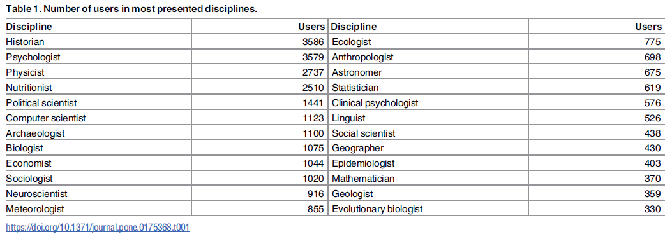
A Systematic Identification and Analysis of Scientists on Twitter
Source: http://journals.plos.org/plosone/article?id=10.1371/journal.pone.0175368
Step Four: Social Media Strategy
EdgeforScholars.org

Slide 32
Create one (or more) social media profiles
Use a professional photo or appropriate icon for your profile.
Follow others who share similar interests.
Tag organizations and individuals who might be interested in your data or who have been part of your work.
Share the related work of others in your field.
Engage in professional dialogue with others in your network.
Step Four: Social Media Strategy
EdgeforScholars.org

Slide 33
Questions to ask yourself when planning.
So. Many. Social. Platforms.
Where do I even start?
What is the most natural way for you to engage socially online?
What is the platform you are most likely to use?
What is the best platform to reach your intended audience?
What is the level of time commitment you are willing and able to commit to?
Step Four: Social Media Strategy
EdgeforScholars.org

Slide 34
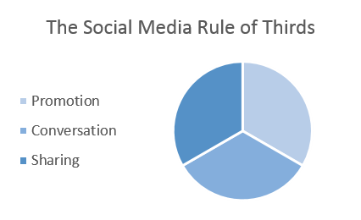
Step Five: Post but Don’t Pester. Developing a realistic social media schedule for a set period of time.
Follow the content sharing guidelines and only post about 1/3 content that is directly related to your paper.
Do share often, don’t be annoying. Find different features of the research to point out so that the posts don’t feel repetitive and retweet the work of others.
Step Five: Posting Schedule
EdgeforScholars.org

Slide 35
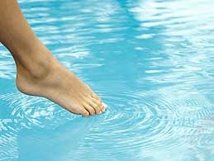
Sample Schedule
Getting your toes wet…
Post 1x week about your team’s research
Post 1x week about other people’s research or related content and tag them
Comment 1x week on other content
Share 1x week “fun” stuff
Share/repost 5x week
Diving in headfirst…
Post 3x week about your team’s research
Different times of day and different content each time
Post 5x week about other people’s research or related content
Tag relevant sources
Comment daily
Share daily “fun” stuff
Share/repost multiple times per day
Leading up to publication or upon publication of manuscript for 1-6 months
Step Five: Posting Schedule
EdgeforScholars.org

Slide 36
How to squeeze Twitter into your schedule
In line while waiting for coffee or food order
During break time
Waiting for meeting to begin
Walking across campus
Riding the shuttle
Commuting on public transportation

Slide 37
Tips for social media
Putting the plan into action.
Tips: Put the Plan into Action
EdgeforScholars.org

Slide 38
Recipe for Success
Have these items prepared before you begin your social media campaign:
Social media account
For professional use
Hashtag list
SCIHASHTAG: A collection of Twitter hashtags for academics
http://www.scihashtag.co.uk/
Search directly on Twitter for relevancy and current use
Pre-composed posts (min 10)
Check character length to meet posting limits
Assortment of images (min 10)
Sized according to social platform
List of partner organizations to feature/ disseminate
University press and health publications including newsletters
Ex: My Southern Health at Vanderbilt, Women’s Health Research page
Publish infographic as live pdf on web
Google docs link
Create your plan/ schedule
Post regularly, adjust frequency and content as needed
Tips: Put the Plan into Action
EdgeforScholars.org

Slide 39
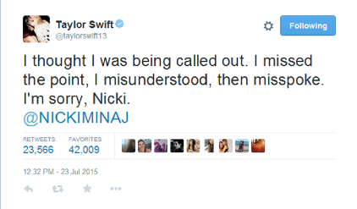
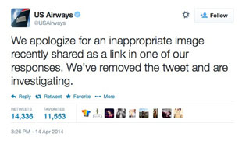
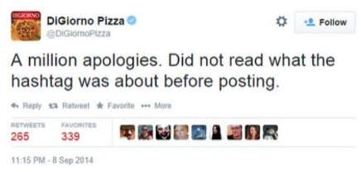
Use Caution
Don’t
Share photos/ info about patients, volunteers or staff
Proprietary lab stuff; confidential information
Offensive or inflammatory memes
TMI / oversharing
Negativity and bashing; libel and slander
Use others images without attribution; data and info that you are peer-reviewing
Do
Share photos of nature you observe when walking to meetings
Photos of work environment
Commemorate holidays
Personal and/or professional milestones and achievements
Be positive and encouraging
Commend others achievements and those who have inspired you
Take ownership of mistakes: acknowledge and apologize if necessary
Ask for support/help if questions arise
Tips: Put the Plan into Action
EdgeforScholars.org

Slide 40
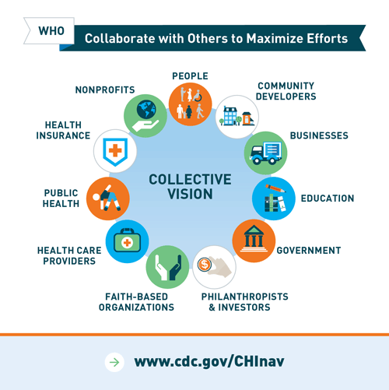
Networking
Where to start, who to connect with, and where to go from there.
Connect with people in your department or organization who you already know, then reach out to those who you would like to know.
Community health organizations you’ve worked with, are related to the work you do and/or the work you are interested in.
Reach out to local department social media networks to find out about press releases and other local press.
Prepare professional headshots for media releases accompanying your publication.
Plan how to direct people to Twitter (or platform of choice). Example: Prepare small cards w/social media handles at poster session, add social media handle to profiles and business cards.
Tips: Put the Plan into Action
EdgeforScholars.org

Slide 41
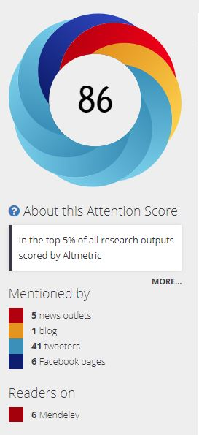
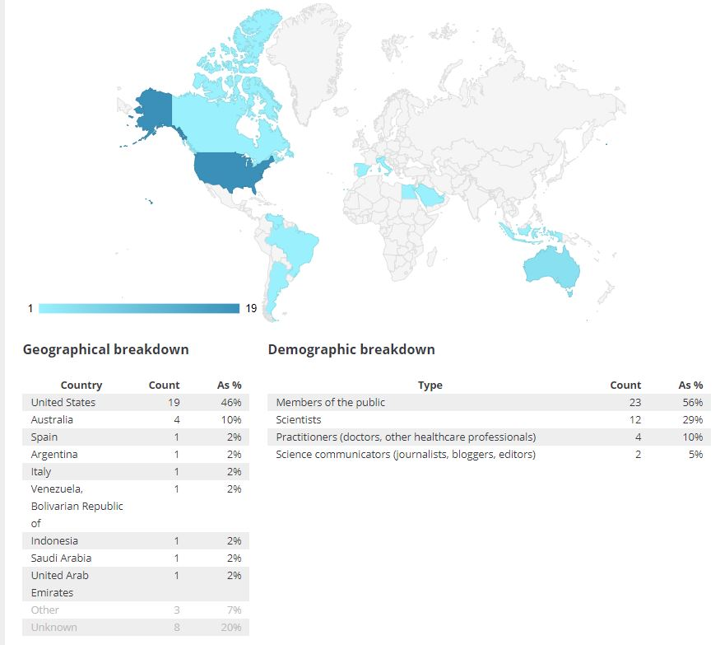
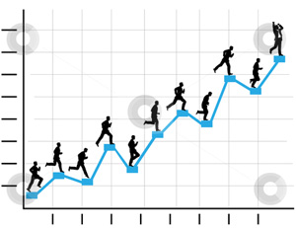
Track Progress: Paper #1
Source: https://wolterskluwer.altmetric.com/details/28667029
Tips: Put the Plan into Action
EdgeforScholars.org

Slide 42
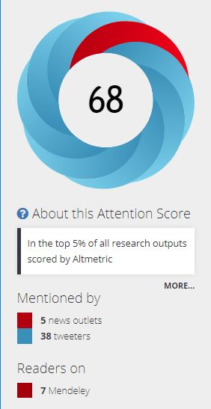
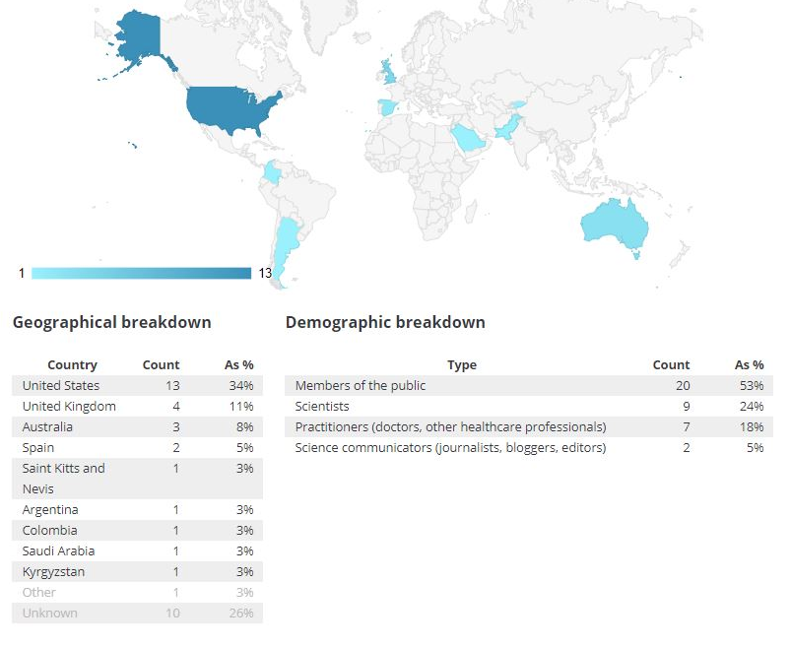
Track Progress: Paper #2
Track traffic of paper by viewing stats on sidebar of online publication (new feature specific to some online journals)
Other tracking tools:
Google analytics
Twitter analytics
Facebook analytics
Source: https://wolterskluwer.altmetric.com/details/27413909
Tips: Put the Plan into Action
EdgeforScholars.org

Slide 43
Acknowledgements
Thank you to Alex Sundermann for permission to use Twitter analytics and Tweets.
Thank you to Melissa Vaught, PhD for additional information on social media precautions as presented on January 19, 2018 in “The Long Game: Finding Meaning for Social Media in Scientists’ Lives”, sponsored by the BRET office.
Connect on Twitter: @ACSundermann and @Biochembelle
EdgeforScholars.org

Slide 44
EDGE for SCHOLARS
Our team is dedicated to helping you succeed.
From grant reviews and career awards, to our funded grants library and career development seminars, every program we offer focuses on developing and retaining talented scientists.
EdgeforScholars.org

Slide 45
MEET OUR TEAM
Dr. Katherine Hartmann
Associate Dean for Clinical & Translational Scientist Development | katherine.hartmann@vanderbilt.edu
>> Program development, mentor & expert matches, career consultation, VU navigation
Adrienne Babcock
Senior Administrative Assistant | adrienne.babcock@vumc.org
>> Dr. Hartman’s calendar, Grant Pacing Workshops
Helen Bird
Program Manager | helen.bird@vanderbilt.edu
>> Translational Bridge, Partners Program, Cutting Edge eNewsletter, Marketing & Outreach
Aimee Edgeworth
Program Manager | aimee.edgeworth@vumc.org
>> Academic Writing Program, Social Media
Rebecca Helton
Program Manager | rebecca.helton@vumc.org
>> Newman Society, VFRS, Edge Reviews, Funded Grants Library, Edge for Scholars Editor
EdgeforScholars.org

Slide 46
LinkedIn: Edge for Scholars
Twitter: @EdgeforScholars
Facebook: @EdgeForScholars
Blog: edgeforscholars.org
Email: Aimee.Edgeworth@vumc.org
EdgeforScholars.org

Slide 47
Additional References
Learn more about important topics from today’s presentation.
EdgeforScholars.org

Slide 48
Why is it important to “market” research towards the general population?
https://www.pbs.org/newshour/science/study-reveals-wide-opinion-differences-scientists-general-public
https://www.ncbi.nlm.nih.gov/pmc/articles/PMC3852879/
https://www.livescience.com/14779-bridging-gap-scientists-public.html
https://blogs.scientificamerican.com/observations/why-cant-scientists-talk-like-regular-humans/
https://theconversation.com/science-communication-training-should-be-about-more-than-just-how-to-transmit-knowledge-59643
https://www.forbes.com/sites/marshallshepherd/2016/11/22/9-tips-for-communicating-science-to-people-who-are-not-scientists/#5b5bae966aea
EdgeforScholars.org

Slide 49
Health Literacy and Lay Language
Quick Guide to Health Literacy, US Dept Health and Human Services Office of Disease Prevention and Health Promotion: https://health.gov/communication/literacy/quickguide/about.htm
America's Health Literacy: Why We Need Accessible Health Information, US Dept Health and Human Services Office of Disease Prevention and Health Promotion: https://health.gov/communication/literacy/issuebrief/
Lay Language, Stanford IRB: https://humansubjects.stanford.edu/new/docs/glossary_definitions/lay_language.pdf
Writing for lay audiences: A challenge for scientists, by Joselita T. Salita: http://journal.emwa.org/media/2188/2047480615z2e000000000320.pdf
EdgeforScholars.org

Slide 50
KISS your Data: Keep It Simple Smarty
Source: http://stephanieevergreen.com/dataviz-checklist/
EdgeforScholars.org

Slide 51
EdgeforScholars.org

