Slide 1
The Impact of the Social Determinants of Health on Laryngotracheal Stenosis Development and Treatment Outcome
Sabina Dang BA, Gaelyn Garrett MD, Christopher Wootten MD, Alexander Gelbard MD

Slide 2
Background
Laryngotracheal stenosis (LTS) = Fixed extra-thoracic airway narrowing
Most commonly iatrogenic secondary to prolonged intubation

Slide 3
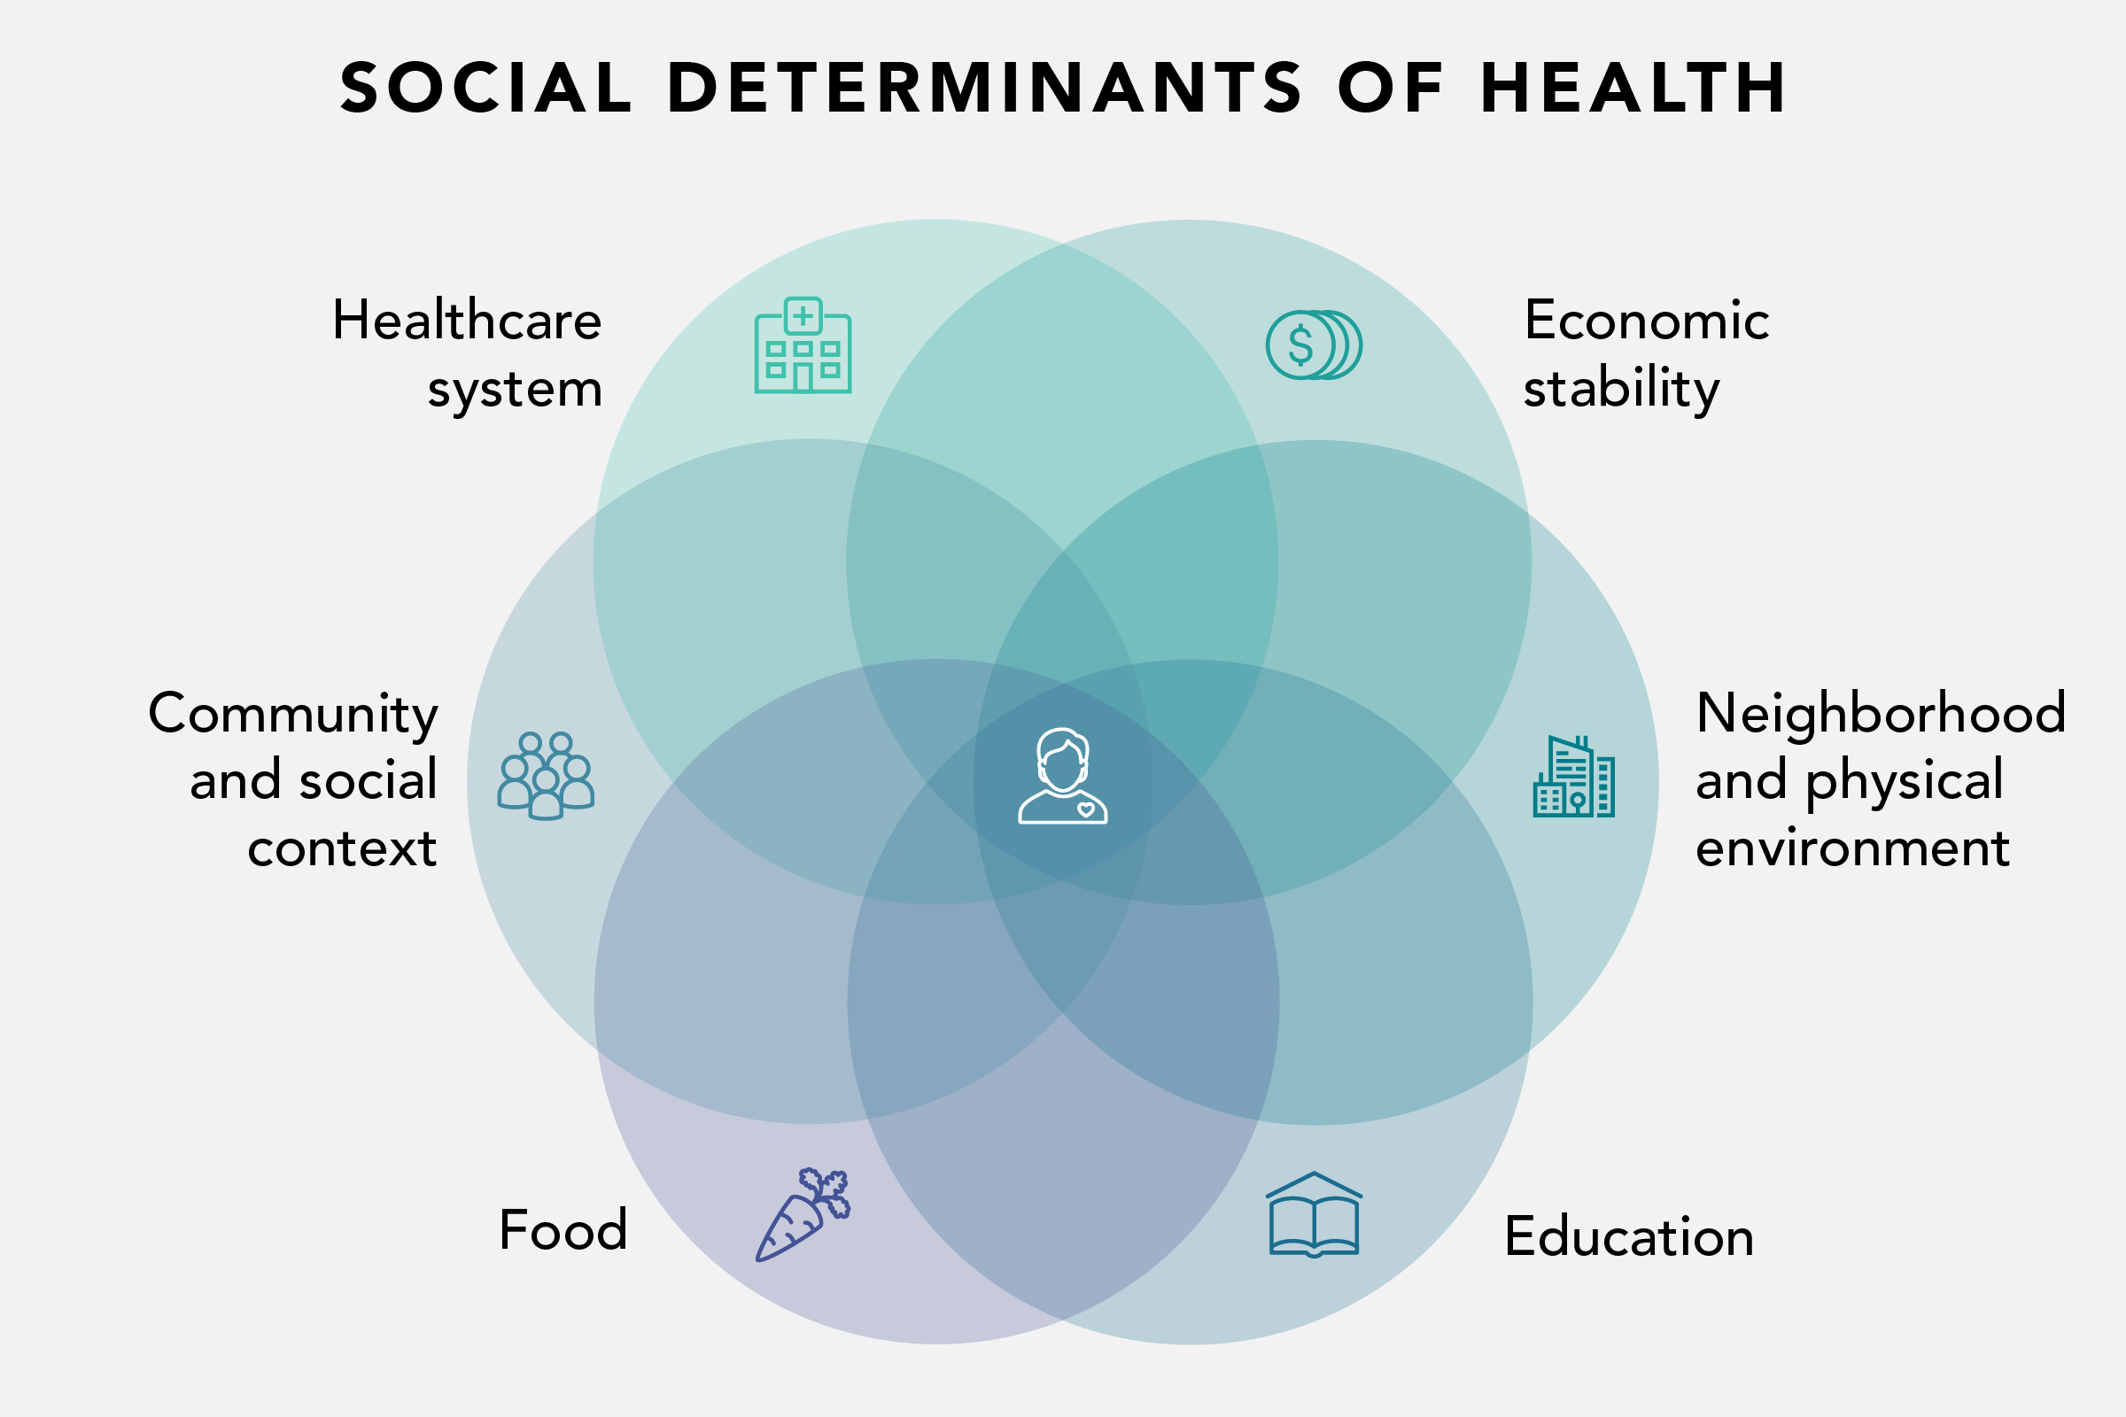
Uncovering social determinants of health in EHR data. Becker's Hospital Review. January 8th, 2019.

Slide 4
Objectives
  Characterize the social determinants of health of the post-intubation LTS population in comparison to age-matched intubated ICU controls.
  Evaluate the impact of the social determinants of health on LTS treatment outcome.

Slide 5
Methods
Case-control study performed at Vanderbilt University Medical Center (VUMC) between 2017 and 2018 (IRB 140429)
Notes:
American FactFinder -> from the US Census Bureau

Slide 6
SDH of Cases, Controls, and TN
*
*
* Cases significantly different from controls

Slide 7
The Impact of SDH on Treatment Outcome
*
*

Slide 8
Multivariate Analysis of Tracheostomy Dependence
 | Adjusted Odds Ratio | p-value
Insurance Status (public vs. private) | 1.18 | 0.026
Age (10y units) | 1.00 | 0.871
Median household Income (10k units) | 1.01 | 0.646
Open Surgical Intervention | 0.79 | 0.014
Diabetes Mellitus Type II | 1.18 | 0.092
Multilevel Disease | 1.30 | 0.005

Slide 9
Conclusions
The LTS population did not differ from intubated ICU controls with respect to income, education, or insurance status.
However, the social determinants of health appear to influence treatment outcome (tracheostomy dependence).

Slide 10
Implications
Identification of at-risk populations in ICUs may allow for disease prevention or improved outcomes through early intervention.
Understanding the mechanism by which the social determinants of health influence treatment outcomes may offer a new opportunity to improve care.

Slide 11
Limitations
  Limited sample size
  Utilization of zipcodes to evaluate social determinants
  Definition of controls
  Single-Center
  Retrospective

Slide 12
Future Directions
Prospective, multicenter study to increase sample size and generalizability
Focus on the role of insurance status in treatment outcome
Increase the capture of patient-level data for robust assessment of the social determinants of health

Slide 13
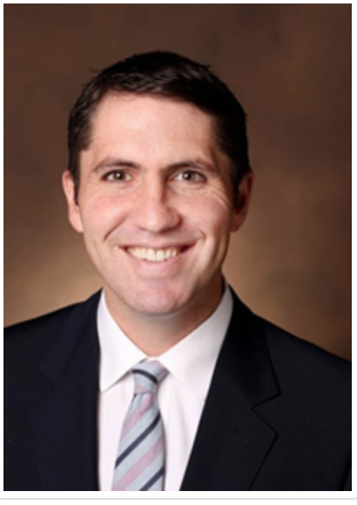
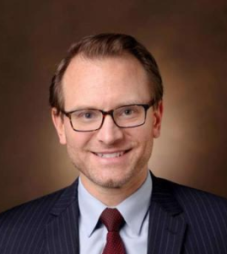

Acknowledgements
Dr. Alexander Gelbard
Dr. Christopher Wootten
Dr. Gaelyn Garrett

