Slide 1
Area deprivation index
An efficient tool for identifying social determinants of health?
Rohini Chakravarthy, MD/MBA Candidate

Slide 2
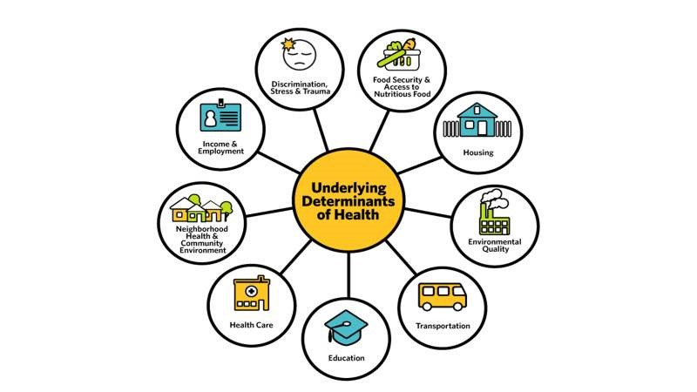
Robert Wood Johnson Foundation “A New Way to Talk about the Social Determinants of Health”
Notes:
Moreover, there are many domains of social determinants of health.

Slide 3
Existing Screening tools:
Notes:
. Collection can be time-consuming and few interventions are available if screening is positive. There are also a number of community health needs assessment tools

Slide 4
Race
Language at Home
Immigration
Food stamps
Household income
Employment status
Occupation type
Median rent
Owner-occupied
Family structure: marital status, caregiver status
Geographic mobility
Disability status
Insurance
Method of transportation to work
School enrollment
High school graduation
Notes:
This project utilizes publicly available information from the census to estimate the contribution of these domains to overall health outcomes. This diagram identifies surrogate markers found in census data to social determinants of health.

Slide 5
GEOCODING
https://www.neighborhoodatlas.medicine.wisc.edu/mapping
911 Buchanan St, Nashville, TN 37208

Slide 6
ADI and HPV-related Cancers

Slide 7
Area Deprivation Index
Developed by Cole Brokamp from 2015 5-year ACS data
Used by eMERGE network
Developed based on a principal component analysis
Includes the following census tract variables:
Fraction of households with income in past 12 months below poverty level
Median household income in past 12 months in 2015 inflation adjusted dollars
Fraction of population with no health insurance
Fraction of households receiving public assistance income or food stamps in the last 12 months
Fraction of houses that are vacant
Fraction of population 25 and older with educational attainment of at least high school graduation (includes GED equivalency)
Notes:
In addition, composite measures have been created which integrate a number of these census components into a single number. Developed by the Health Resources and Services Administration 20 years ago. We are using an adaptation of the one provided here. The components have differing weights, and the higher the score, the more disadvantaged the neighborhood.
More information about our ADI can be found here: https://github.com/cole-brokamp/dep_index

Slide 8
Research Derivative Cohort: HPV Related Cancers
Qualifying Diagnosis
Geocoded Address
Tumor Registry
3247
Oropharyngeal
Rectal
Anal
Vulvar
Vaginal
Cervical
Penile
(within 10 years)
Only one address associated with each record

Slide 9
Model Components
Stage at Presentation
Age at Presentation
Race
Area Deprivation Index
Notes:
The components of this very simplistic preliminary model are:
Age – from tumor registry
Ethnicity – as documented in electronic health record (self vs user-reported)
Area Deprivation Index – from census data
This Photo by Unknown Author is licensed under CC BY-SA

Slide 10
Model Components
Stage at Presentation
Age at Presentation
Race
Fraction with High School Education
Notes:
The components of this very simplistic preliminary model are:
Age – from tumor registry
Ethnicity – as documented in electronic health record (self vs user-reported)
Area Deprivation Index – from census data

Slide 11
Model Components
Stage at Presentation
Age at Presentation
Fraction of Census Tract Using a Car for Transportation to Work
Race
Notes:
The components of this very simplistic preliminary model are:
Age – from tumor registry
Ethnicity – as documented in electronic health record (self vs user-reported)
Area Deprivation Index – from census data

Slide 12
 |  | Total (%) | Stage 0 | Stage 1 | Stage 2 | Stage 3 | Stage 4 | Stage 5 | Stage 7
Total |  | 3247 (100%) | 370 (12%) | 923 (28%) | 293 (9%) | 602 (19%) | 388 (12%) | 89 (3%) | 582 (18%)
Age
 | Missing | 40 (1) | 2 | 8 | 3 | 9 | 4 | 1 | 13
 | <30 | 109 (3) | 23 | 31 | 4 | 11 | 7 | 1 | 32
 | 30-40 | 220 (7) | 45 | 74 | 18 | 27 | 15 | 3 | 38
 | 40-50 | 586 (18) | 81 | 151 | 50 | 105 | 78 | 20 | 101
 | 50-60 | 937 (29) | 108 | 232 | 86 | 216 | 130 | 19 | 146
 | 60-70 | 844 (26) | 81 | 241 | 72 | 164 | 110 | 27 | 149
 | 70-80 | 381 (12) | 22 | 137 | 43 | 62 | 36 | 11 | 70
 | >80 | 130 (4) | 8 | 49 | 17 | 8 | 8 | 7 | 33
Sex
 | Male | 1836 (57) | 160 | 487 | 150 | 431 | 246 | 50 | 312
 | Female | 1411 (43) | 210 | 436 | 143 | 171 | 142 | 39 | 270
Race
 | Asian | 33 (1) | 6 | 11 | 0 | 3 | 5 | 0 | 8
 | African American | 261 (8) | 40 | 67 | 30 | 34 | 28 | 8 | 54
 | Hispanic | 45 (1) | 5 | 18 | 2 | 6 | 6 | 2 | 6
 | Native American | 6 (0) |  | 3 | 0 | 0 | 0 | 1 | 2
 | Caucasian | 2822 (87) | 312 | 813 | 256 | 544 | 336 | 75 | 486
 | Other | 9 (0) | 3 | 2 | 0 | 2 | 1 | 0 | 1
 | Missing | 71 (2) | 4 | 9 | 5 | 13 | 12 | 3 | 25
Ethnicity
 | Hispanic | 45 (1) | 5 | 18 | 2 | 6 | 6 | 2 | 6
 | Not Hispanic | 3115 (96) | 361 | 890 | 284 | 583 | 372 | 84 | 541
 | Unknown | 87 (3) | 4 | 15 | 7 | 13 | 10 | 3 | 35
Table 1: Participant Demographics
Notes:
Normally distributed ages
Predominance of males
90% Caucasian
<1% not Hispanic

Slide 13
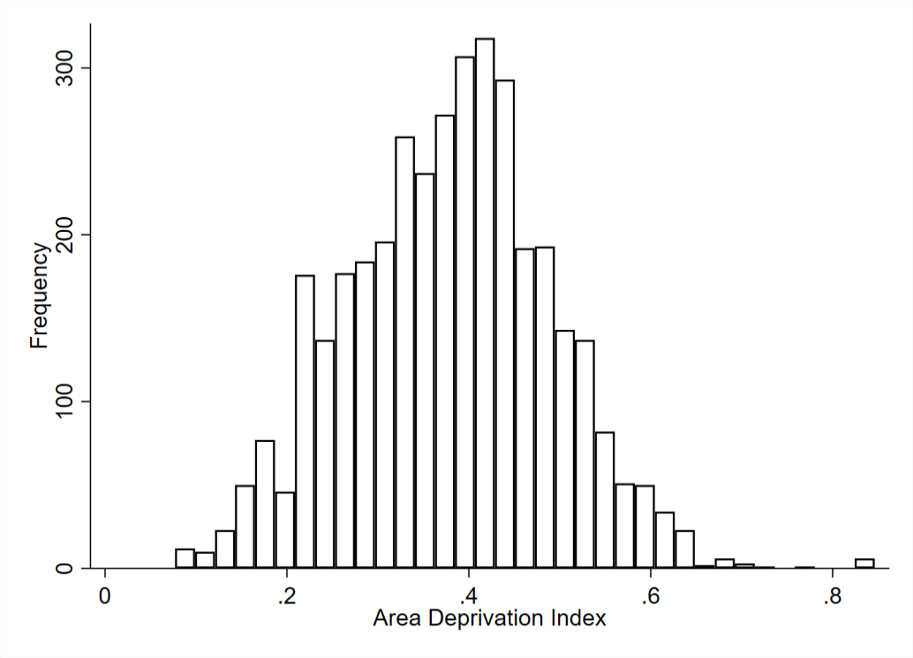
Frequency Distributions of Variables Included
Sample
US Population
?

Slide 14
 | UNADJUSTED |  |  | ADJUSTED*
Census Variable Descriptions | OR | CI | P-value | OR | CI | P-value
Deprivation Index | 1.45 | (0.85, 2.53) | 0.17 | 1.38 | (0.79, 2.41) | 0.25
Fraction Assisted Income | 1.59 | (0.88, 2.85) | 0.12 | 1.45 | (0.79, 2.65) | 0.23
Fraction High School Education | 0.56 | (0.26, 1.20) | 0.14 | 0.60 | (0.28, 1.28) | 0.18
Median Income | 1.00 | (1.00, 1.00) | 0.33 | 1.00 | (1.00,1.00) | 0.39
Fraction No Health Insurance | 1.37 | (0.49, 3.88) | 0.55 | 1.28 | (0.45, 3.70) | 0.64
Fraction Poverty | 1.38 | (0.76, 2.48) | 0.29 | 1.26 | (0.69, 2.32) | 0.46
Fraction Vacant Housing | 1.67 | (0.74, 3.91) | 0.21 | 1.71 | (0.74, 3.96) | 0.21
Table 2: Results of Ordered Logistic Regression for Cancer Stage at Presentation
Notes:
* Results shown are adjusted for age, race and sex

Slide 15
Conclusion
There is not enough evidence to suggest that area deprivation is significantly associated with stage at presentation in a cohort of HPV-related cancers.
Notes:
Counterintuitive due to methodologic limitations (statistical), population limitations (diversity), false assumptions (is ADI the best measure)

Slide 16
Findings from scoping review on area deprivation index

Slide 17
“AREA DEPRIVATION INDEX” Articles [n = 47]
Methods
ADI USED [n =22]
Notes:
115 additional to be reviewed
No health outcome 5 , non us 20
22 included

Slide 18
 | Singh (1990)/ Wisconsin | Brokamp (2015) | NDI (2000) | Disadvantage Index (2010) | SVI (2014) | Palmetto SADI (2011) | SDI (2009)
<9 y of education | X |  |  |  |  |  | (X)
High school diploma | X | X | (X) | X | X | X
White collar employees | X |  | (X)
Median income | X | X |  | X | X
Income disparity | X
Median home value | X |  | X
Median gross rent | X |  | (X)
Median monthly mortgage | X
Owner-occupied housing | X
Unemployment rate | X |  | X |  | X |  | X
Families below poverty level | X | X | X | X | X | X | X
Families below 150% FPL | X |  | (X)
Single Parent Household | X |  | (X) | (X) | X |  | X
Households without vehicle | X |  | X |  | X | X | X
Households without phone | X
Households without plumbing | X
Crowding | X |  | X |  | X |  | X
Other |  | +3 | +1 | +4 | +8 |  | +2
Variety of indices
Notes:
47 pubmed results for “area deprivation index”
100 pubmed results for others
References: https://docs.google.com/spreadsheets/d/13GZ05Ub04CzldqE_7aI7cZATBiYqv8eXO5uo7Kj1Awg/edit#gid=999882093
*NDI- neighborhood deprivation index (factor analysis) (41)
*SDI – social deprivation index (factor analysis) (44)
*SVI – social vulnerability index (65)

Slide 19
ADI Associations* [n = 24]
Cardiology | 3 | Drug eluting stents, peripheral artery disease, heart failure
Gen. Medicine | 6 | Mortality, chronic condition prevalence, CMV seropositivity, diabetes prevalence, HEDIS measures, diabetic foot ulcer healing, functional limitations
Health Services | 7 | Readmissions, surgical expenditures, utilization, hospitalizations
Oncology | 1 | Adjuvant endocrine therapy
Orthopedics | 3 | PROMIS
Pediatrics | 1 | Activity level
Other | 3 | Health literacy, subjective emotional indicators
*Many studies only show correlation for 85 percentile
Notes:
Subject to publication bias
90% relied on regression models
References: https://docs.google.com/spreadsheets/d/13GZ05Ub04CzldqE_7aI7cZATBiYqv8eXO5uo7Kj1Awg/edit#gid=999882093

Slide 20
discussion

Slide 21
DISCUSSION QUESTIONS
What challenges did you encounter when working with this indicator? (statistical, logistical, political, etc.)
How might the proposed “Citizenship Question” impact work in this area?
Are you planning to continue work in this area? Or know anyone else that is?
Are there other techniques for measuring social determinants of health that you have seen utilized?
Are there other resources/websites you would recommend to people interested in this space?
Notes:
Pew Research Foundation: https://www.pewresearch.org/fact-tank/2018/03/30/what-to-know-about-the-citizenship-question-the-census-bureau-is-planning-to-ask-in-2020/

Slide 22
Additional FREE Resources
Neighborhood Index (Univ. of Wisconsin): https://www.neighborhoodatlas.medicine.wisc.edu/
Data Set Director of Social Determinants of Health at the Local Level (CDC): https://www.cdc.gov/dhdsp/docs/data_set_directory.pdf
Community Commons GIS Tool (Univ. of Missouri): https://www.communitycommons.org/map/
Population Health Curriculum (American Board of Family Medicine): https://www.graham-center.org/rgc/maps-data-tools/tools/phate.html
2-1-1 (United Way): http://211tn.org/

Slide 23
ADI Takeaways
Strengths
Weaknesses
More specific compared to zip code
Freely available
Low-resource intensive
National and international data supports its use
Measurement error
Old data
Variety of indices
Resilience

Slide 24
References
Adler, N. E., & Stead, W. W. (2015). Patients in context—EHR capture of social and behavioral determinants of health. New England Journal of Medicine, 372(8), 698-701.
Damiani, G., Basso, D., Acampora, A., Bianchi, C. B. N. A., Silvestrini, G., Frisicale, E. M., … Ricciardi, W. (2015). The impact of level of education on adherence to breast and cervical cancer screening: Evidence from a systematic review and meta-analysis. Preventive Medicine, 81, 281–289. https://doi.org/10.1016/j.ypmed.2015.09.011
Hiatt, R. A., & Breen, N. (2008). The Social Determinants of Cancer: A Challenge for Transdisciplinary Science. American Journal of Preventive Medicine, 35(2, Supplement), S141–S150. https://doi.org/10.1016/j.amepre.2008.05.006
Hu, J., Kind, A. J. H., & Nerenz, D. (2018). Area Deprivation Index Predicts Readmission Risk at an Urban Teaching Hospital. American Journal of Medical Quality, 1062860617753063. https://doi.org/10.1177/1062860617753063
Kind, A. J. H., Jencks, S., Brock, J., Yu, M., Bartels, C., Ehlenbach, W., … Smith, M. (2014). Neighborhood Socioeconomic Disadvantage and 30-Day Rehospitalization: A Retrospective Cohort Study. Annals of Internal Medicine, 161(11), 765. https://doi.org/10.7326/M13-2946
Li, X., Sundquist, K., & Sundquist, J. (2012). Neighborhood deprivation and prostate cancer mortality: a multilevel analysis from Sweden. Prostate Cancer and Prostatic Diseases, 15(2), 128–134. https://doi.org/10.1038/pcan.2011.46
Li, Xinjun, Sundquist, J., Calling, S., Zöller, B., & Sundquist, K. (2012). Neighborhood deprivation and risk of cervical cancer morbidity and mortality: A multilevel analysis from Sweden. Gynecologic Oncology, 127(2), 283–289. https://doi.org/10.1016/j.ygyno.2012.07.103
Li, Xinjun, Sundquist, J., Zöller, B., & Sundquist, K. (2015). Neighborhood Deprivation and Lung Cancer Incidence and Mortality: A Multilevel Analysis from Sweden. Journal of Thoracic Oncology, 10(2), 256–263. https://doi.org/10.1097/JTO.0000000000000417
Moriceau, G., Bourmaud, A., Tinquaut, F., Oriol, M., Jacquin, J.-P., Fournel, P., … Chauvin, F. (2015). Social inequalities and cancer: can the European deprivation index predict patients’ difficulties in health care access? a pilot study. Oncotarget, 7(1), 1055–1065. https://doi.org/10.18632/oncotarget.6274

Slide 25
References (cont.)
Musselwhite, L. W., Oliveira, C. M., Kwaramba, T., de Paula Pantano, N., Smith, J. S., Fregnani, J. H., … Longatto-Filho, A. (2016). Racial/Ethnic Disparities in Cervical Cancer Screening and Outcomes. Acta Cytologica, 60(6), 518–526. https://doi.org/10.1159/000452240
Palència, L., Espelt, A., Rodríguez-Sanz, M., Puigpinós, R., Pons-Vigués, M., Pasarín, M. I., … Borrell, C. (2010). Socio-economic inequalities in breast and cervical cancer screening practices in Europe: influence of the type of screening program. International Journal of Epidemiology, 39(3), 757–765. https://doi.org/10.1093/ije/dyq003
Shack, L., Jordan, C., Thomson, C. S., Mak, V., & Møller, H. (2008). Variation in incidence of breast, lung and cervical cancer and malignant melanoma of skin by socioeconomic group in England. BMC Cancer, 8, 271. https://doi.org/10.1186/1471-2407-8-271
Singh, G. K., Miller, B. A., Hankey, B. F., & Edwards, B. K. (n.d.). Persistent area socioeconomic disparities in U.S. incidence of cervical cancer, mortality, stage, and survival, 1975–2000. Cancer, 101(5), 1051–1057. https://doi.org/10.1002/cncr.20467
Singh, G. K., Williams, S. D., Siahpush, M., & Mulhollen, A. (2011). Socioeconomic, Rural-Urban, and Racial Inequalities in US Cancer Mortality: Part I—All Cancers and Lung Cancer and Part II—Colorectal, Prostate, Breast, and Cervical Cancers. Journal of Cancer Epidemiology, 2011. https://doi.org/10.1155/2011/107497
Spadea, T., dʼErrico, A., Demaria, M., Faggiano, F., Pasian, S., Zanetti, R., … Costa, G. (2009). Educational inequalities in cancer incidence in Turin, Italy: European Journal of Cancer Prevention, 18(3), 169–178. https://doi.org/10.1097/CEJ.0b013e3283265bc9
Williams-Brennan, L., Gastaldo, D., Cole, D. C., & Paszat, L. (2012). Social determinants of health associated with cervical cancer screening among women living in developing countries: a scoping review. Archives of Gynecology and Obstetrics, 286(6), 1487–1505. https://doi.org/10.1007/s00404-012-2575-0

Slide 26
Appendix

Slide 27
Genetics
Medicine
Environment
Genetic Ancestry
Biological Risk Factors
Vaccination
Screening
Early Intervention
Type of Treatment
Neighborhood Poverty
Access to Education
Healthcare Access
Pollution
BioVU
Electronic Health Record
?
Notes:
As my colleagues have summarized, there are a variety of factors that contribute to the health disparities we see. Ky’era just described techniques for determining genetic techniques that utilize BioVU, data can be mined from electronic health records for information related to medical interventions, but we know there are more environmental and behavioral risk factors that are not as well captured by current infrastructure.
Photos: <a href="https://www.freepik.com/free-vector/science-areas-icons-set-with-molecular-physics-philosophy-genetics-art-isolated-vector-illustration_1159285.htm">Designed by Macrovector</a>

Slide 28
Health Outcomes
Notes:
Goal would be to design a model that incorporates all of these elements to better estimate an individual’s risk for presenting at a later stage for cancer. Can we determine the contribution of each factor to the overall health outcome.

Slide 29
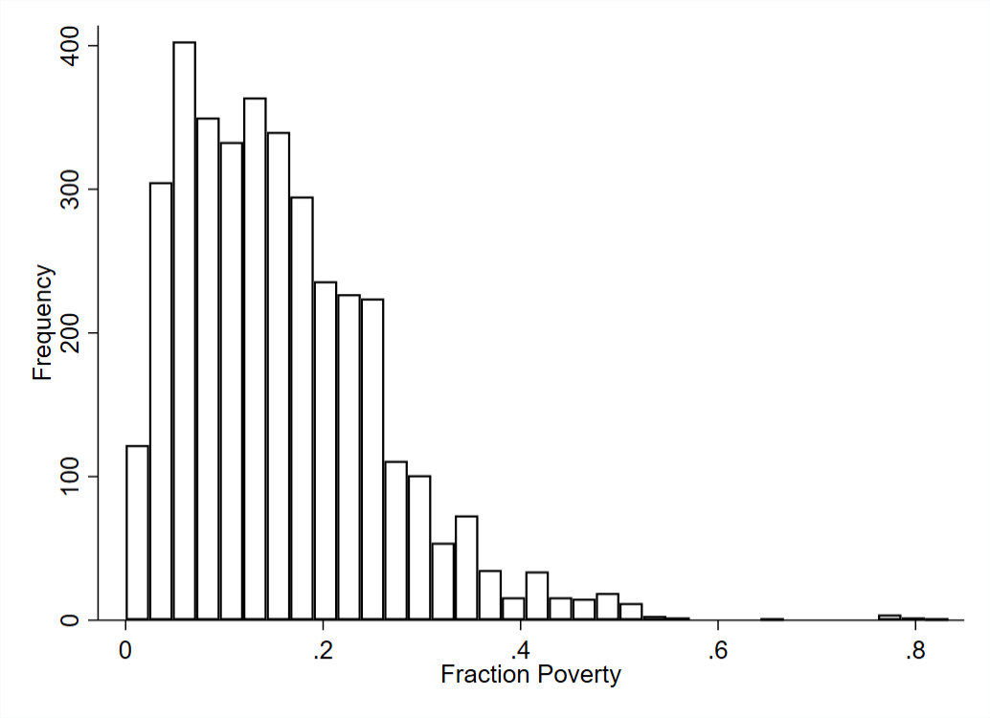
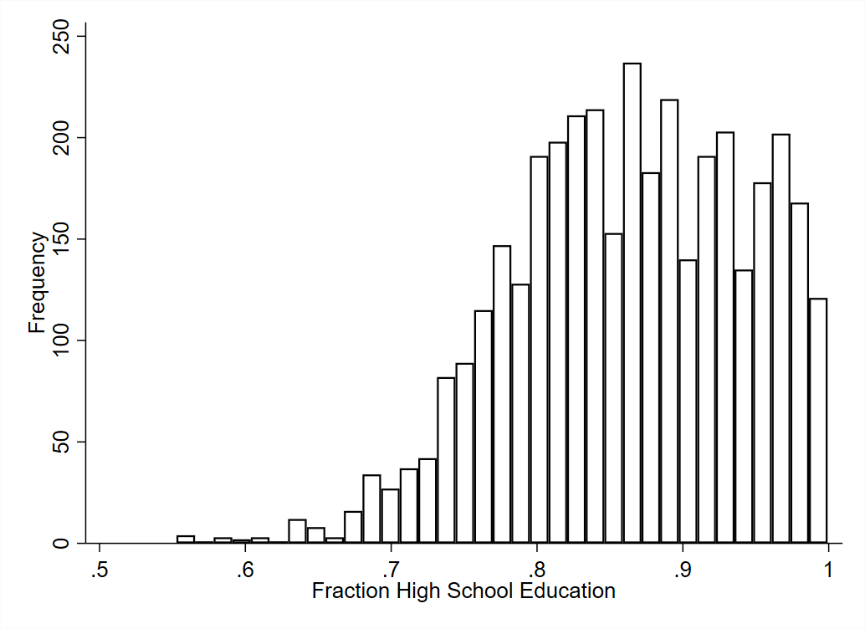
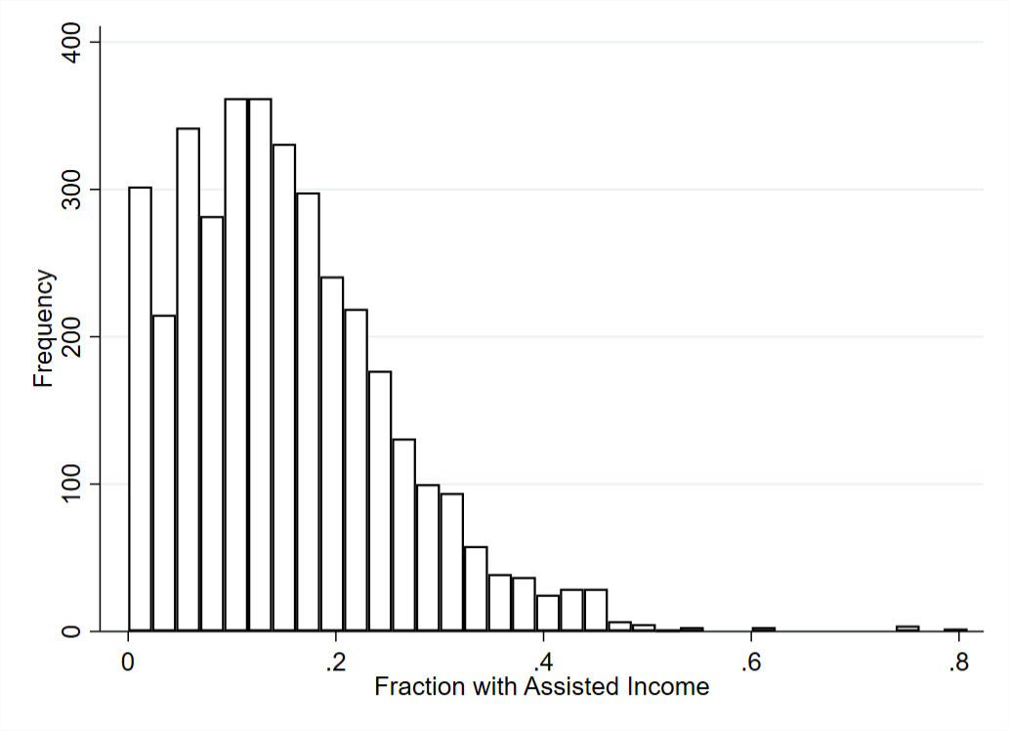
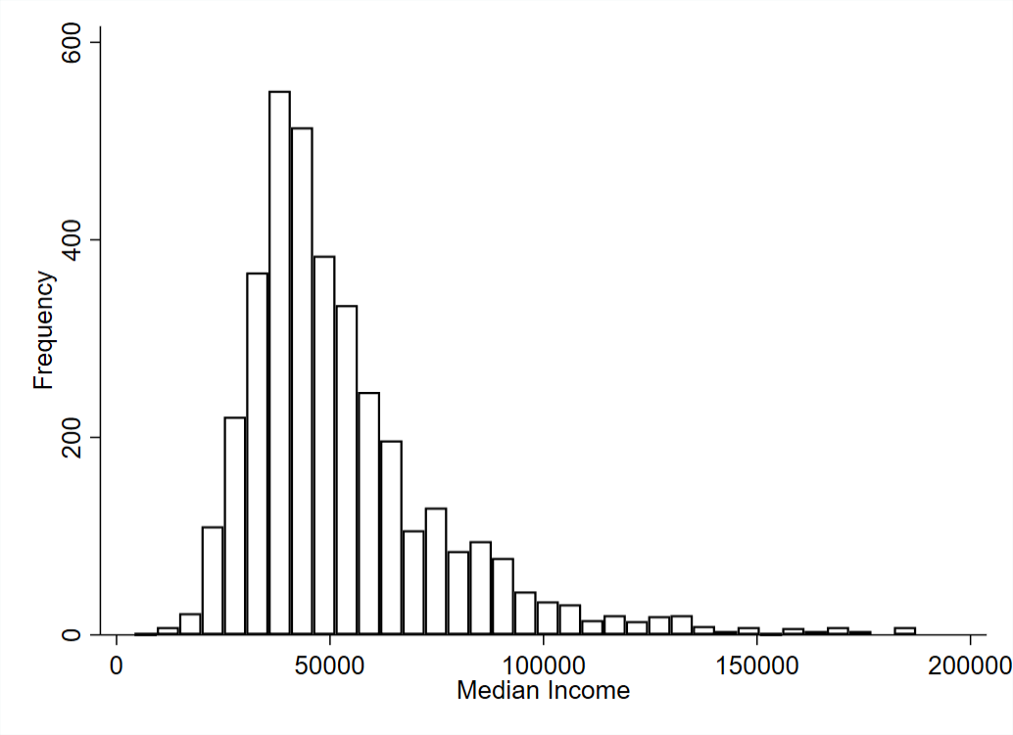
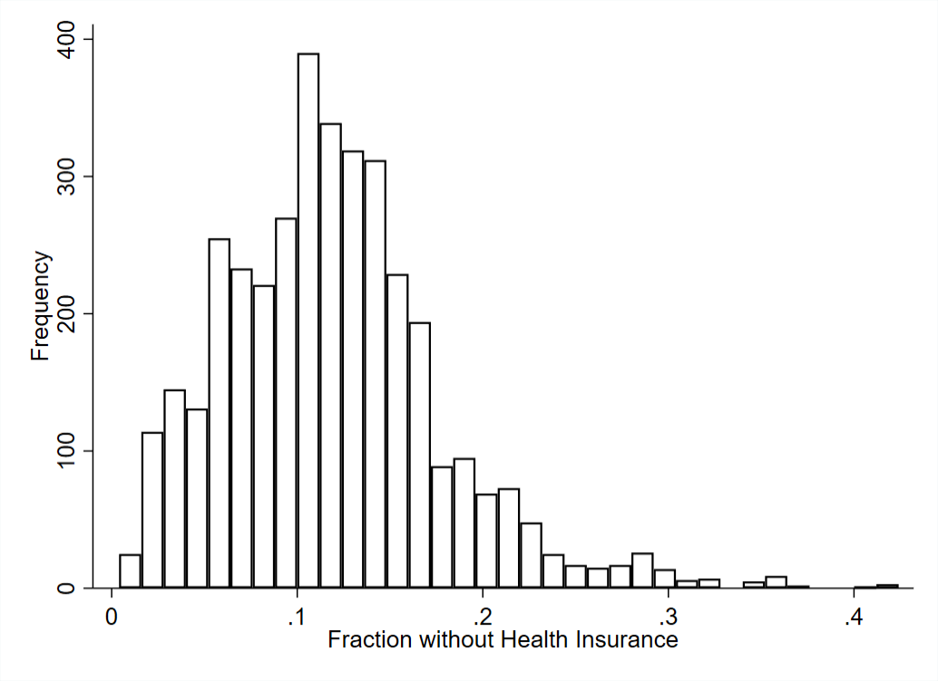
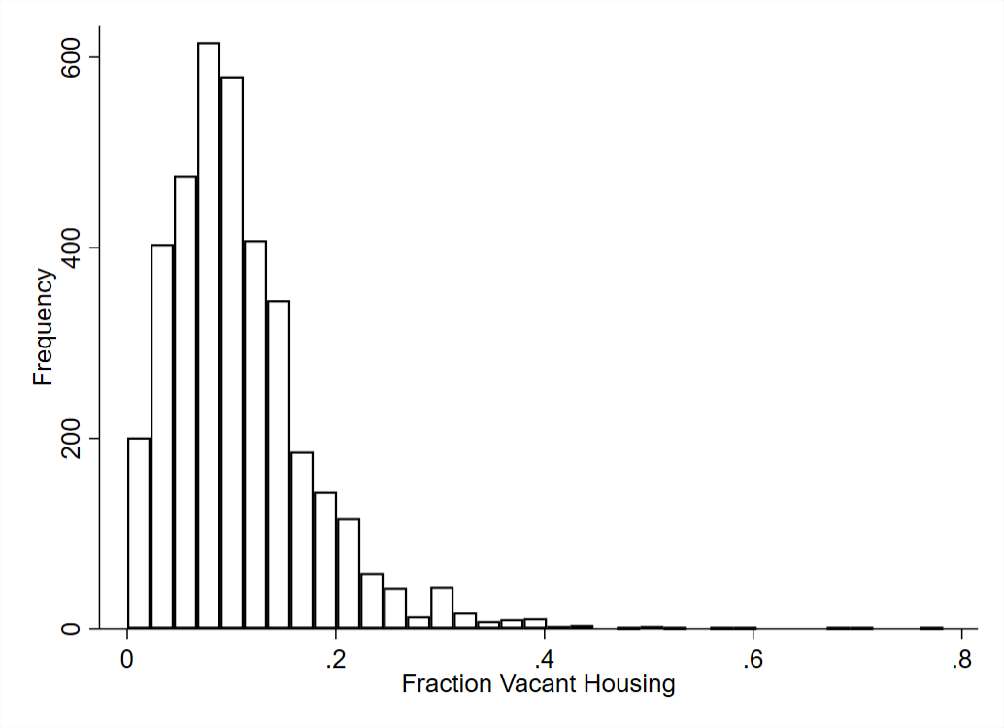
Frequency Distributions of Variables Included

