Slide 1

AIDET® Plus the Vanderbilt University Medical Center Patient and Family Promise
Competency Training Module
Kris Ann Piazza, Studer Group Coach

Slide 2
Welcome!
The single, most important behavior in any healthcare organization is consistent, effective communication. Whether we are interacting with patients, their families or our own coworkers– there is no greater skill to improve quality, decrease errors, improve efficiency and teamwork, build trust or reduce anxiety.
At Vanderbilt, our standard is excellence in everything we do, and that includes the way we communicate. This module reviews AIDET®, an acronym that represents a best-practice framework of five interactive behaviors used to establish effective communication with others: Acknowledge, Introduce, Duration, Explanation and Thank You.
In addition to these fundamental AIDET® elements, we will also review how to use the framework of AIDET® to deliver on the Vanderbilt Patient and Family Promise.

Slide 3
Learning Objective #1
WHY AIDET® Plus the VUMC Patient and Family Promise is Valuable
WHAT the Five Fundamentals of AIDET® Plus the VUMC Patient and Family Promise Involves
HOW to effectively execute AIDET® Plus the VUMC Patient and Family Promise
Test Your Knowledge of AIDET® Plus the VUMC Patient and Family Promise!

Slide 4

First Impressions = Perception
Within the first 7 seconds of meeting you, people will form an opinion of you.
Right or wrong, that perception may greatly influence your ability to do your job!

Slide 5


First impressions = Impact
Positive first impressions inspire others to trust you, cooperate, make your work easier to accomplish and lead to positive outcomes.
Negative first impressions create distrust, anxiety, non-compliance, make your work difficult to accomplish and may lead to negative outcomes.

Slide 6
The Five Fundamentals of AIDET®
The five interactive behaviors of AIDET® are intended to help you establish a positive first impression, as well as keep all future communication open and engaging.
Through these five behaviors, you will be able to demonstrate courtesy and respect to others, keep patients, family members and coworkers informed about what we are doing and why and how long they can expect to wait, as well as show them we enjoy helping them. All of these behaviors build trust and relieve anxiety.

Slide 7
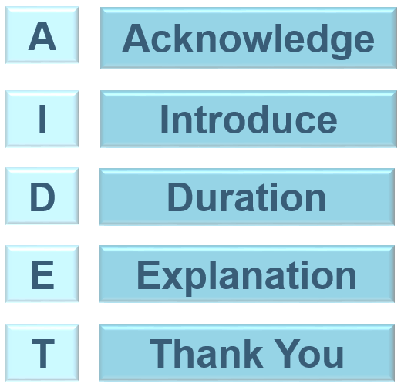
Focus on the “A” and “I” to show courtesy and respect to people.
Focus on the “D” and “E” to keep people informed.
Focus on the “T” to show you enjoy helping people.
Notes:
7

Slide 8
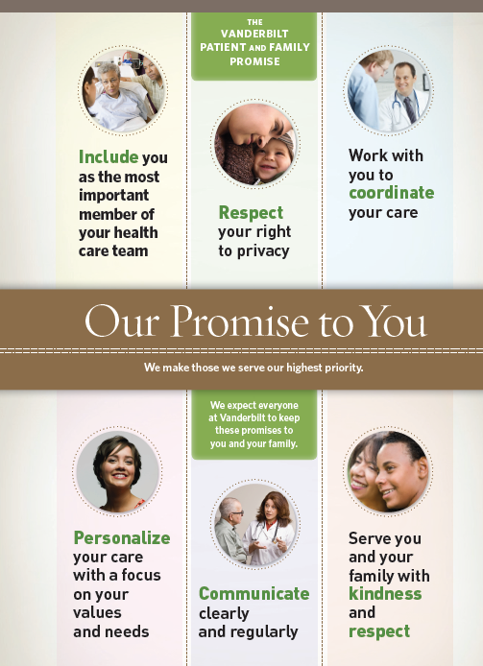
AIDET® Plus the VUMC Patient and Family Promise
The VUMC Patient and Family Promise takes the five fundamental elements of AIDET® to the next level of excellence by laying the foundation for the experience patients and families can expect to have at Vanderbilt: we make those we serve our highest priority.
From the patient and family’s perspective, the VUMC promise is exactly what they want to hear from our employees. From the employee’s perspective, stating the VUMC promise establishes a commitment of personal best, and we want to live true to our word.

Slide 9
WHY Use AIDET® Plus the VUMC Promise?
With PATIENTS
With COWORKERS
Core Elements
Decreases anxiety; builds trust
Improves compliance
Patients feel valued, develop customer loyalty to VUMC
VUMC Promise
A personal commitment (promise) takes customer service to a higher level
Core Elements
Decreases anxiety; builds trust
Improves efficiency & reliability
Employees feel valued, develop loyalty to coworkers and VUMC
VUMC Promise
A personal commitment (promise) takes teamwork to a higher level

Slide 10
Benefits of Effective AIDET® Plus the VUMC Patient and Family Promise
Decreased patient anxiety +
Increased compliance =
Positive patient outcomes
Decreased staff anxiety +
Increased efficiency and reliability =
Healthy, safe work environment

Slide 11
Learning Objective #2
WHY AIDET® Plus the VUMC Patient and Family Promise is Valuable
WHAT the Five Fundamentals of AIDET® Plus the VUMC Patient and Family Promise Involves
HOW to effectively execute AIDET® Plus the VUMC Patient and Family Promise
Test Your Knowledge of AIDET® Plus the VUMC Patient and Family Promise!

Slide 12
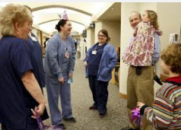


Acknowledge
Purpose: Show courtesy and respect.
Key message: You are important; I see you.
Acknowledge patients you are working with, but also family and friends who are with your patient to be inclusive.
Acknowledge people by name on the phone and in-person to let them know you see them as individuals – not as just another customer.
Take the initiative to make eye contact, smile or say hello in hallways to create a warm, welcoming environment where others feel valued.

Slide 13
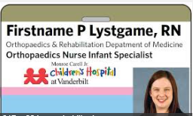

Introduce
Purpose: Build trust.
Key message: You can count on me.
Provide your name and role on the team to reinforce your willingness to be accountable for the service and/or care you provide.
Validate the name of the patient you are interacting with for accuracy of service and/or their safety.
Make your personal commitment (VUMC Promise) to provide the best care or service.
Manage-Up: talk about yourself, co-workers, other departments or VUMC in a positive way that builds confidence.

Slide 14
Introduce: How to Manage-Up Others
Saying positive things about others to build confidence
  Susan is a great housekeeper. She always has a friendly smile for everyone and is determined to create a clean environment for patients.
  I can certainly help you with that. Everyone at Vanderbilt is committed to our patients, so it’s my pleasure to escort you where you need to go!
  You are on a great nursing unit. I’ve worked with the nurses for the past three years, and they are all highly skilled.
Who should you manage up?
    Nurses
    Physicians
    The organization
  Yourself
  Administrators
  Your Boss
  Others?

Slide 15
Introduce: the VUMC Patient and Family Promise
  "Mr. Smith, I promise to respect your right to privacy while I clean your room."
  “Mrs. Franklin, I promise to respect your right to privacy when discussing your billing concerns, so I’m going to close the door during our conversation.”
  "Mr. Jones, I promise to communicate clearly and regularly so you know what to expect during your procedure.“
  “Susan, I promise to personalize your care with the values and needs that are important to you while you are my patient.”
  “Joe and I promise to work with you to coordinate your care until you are safely discharged.”

Slide 16

Duration
Purpose: Keep people informed.
Key Message: I respect your time.
How long will you be working with or caring for the person?
How long will the process, procedure, or test take?
How long will the delay be?
How long will the person be on hold?
How long will it take you to get the job done for your supervisor?

Slide 17
Duration
Set expectations…then exceed them!
Uncertainty about when a task, procedure or interaction will get started, how long it will take, or how long a delay will be can create extreme anxiety in others.
Be specific about times whenever you can, and never underestimate how long something will take to accomplish. Give a time range (ex. 10-15 minutes) if you don’t know exact times, but also be sure to give yourself enough of a window to successfully manage the expectations of others.
If you typically take 10 minutes to complete a task, set the expectation for 15 minutes. This will give you enough time to manage distractions, and patients, families or coworkers will be happy if you are able to complete the task earlier than expected.

Slide 18
Choose Your Words Wisely
SAY | DO | RESULT
A minute | 5 minutes | Upset!
5 minutes | 5 minutes | Satisfied
10 minutes | 5 minutes | Exceeded Expectations!

Slide 19
Explanation
Purpose: Keep people informed.
Key message: You have a right to know what I'm doing and why.
Do not use industry jargon. Words you use at work daily in your area of expertise may not be easily understood by others.
Say what you’re about to do (before you do it) and why, so the other person feels like a valued part of the experience.
Say what will happen, and what they should expect. Make sure the other person does not have questions before you begin.
Always offer an opportunity to ask questions after you explain something. Ex. “What other questions do you have?”

Slide 20
Thank You
Purpose: Show courtesy and respect.
Key Message: I enjoy helping you.
Shows appreciation; provides a positive closing
  Thanks for letting me help you today…
  Thanks for your patience…
Suggested questions to ask:
  "Did I keep my promise to create a positive experience for you today?”
  “What other questions do you have for me?”
  “What more I can do for you?”

Slide 21
Learning Objective #3
WHY AIDET® Plus the VUMC Patient and Family Promise is Valuable
WHAT the Five Fundamentals of AIDET® Plus the VUMC Patient and Family Promise Involves
HOW to effectively execute AIDET® Plus the VUMC Patient and Family Promise
Test Your Knowledge of AIDET® Plus the VUMC Patient and Family Promise!

Slide 22


5 Fundamentals of AIDET®
To successfully implement AIDET® does not rely on scripted conversations, but it does rely on awareness of the messages we are sending to patients, families and coworkers — both verbally and non-verbally (facial expressions, body position, etc.)
If we want our patients and coworkers to trust us and believe that we are committed to providing the best care and service – the verbal, vocal and visual communication cues we give to others must be genuine.

Slide 23
Send the Right Message
 | COMMUNICATION CUE | FACE-TO-FACE | OVER THE PHONE
VERBAL | Choice of WORDS while communicating | % of what people believe is based on the words they hear | % of what people believe is based on the words they hear
VOCAL | TONE of voice while communicating | % of what people believe is based on how the words are spoken | % of what people believe is based on how the words are spoken
VISUAL | BODY LANGUAGE while communicating | % of what people believe is based on what people see in another person | % of what people believe is based on what people see in another person
7
13
38
86
55
1

Slide 24
Helpful Tips to Communicate
Smile: It can be seen and heard. It is also a part of your job!
Pitch: Vary the tone of your voice to avoid sounding bored or rehearsed.
Volume: Speak loud and clearly to indicate confidence.
Emphasis: Stress specific words to convey their importance.
Enthusiasm: Show you enjoy your job with positive energy, as appropriate.

Slide 25






Anxiety-Provoking Words to avoid
We are really busy – not the patient’s problem and rude.
Hopefully– undermines confidence and promises nothing.
As soon as possible, Pretty quick, In a few minutes – context may be different between you and the patient’s perception of “few.” What may be fast to you may not be fast to others.
Probably – fails to make a commitment.

Slide 26
Positive Experience-Provoking Words to Use Daily
Please and Thank you.
How may I help you?
Certainly; I’ll be happy to…
It’s my pleasure…
I promise…

Slide 27
How to Use AIDET®
When walking down the hall– 10/5 Rule
The 10/5 Rule is visual evidence of VUMC's commitment to excellent service by everyone.
    At 10 feet
        – Make eye contact, SMILE and/or nod to those you encounter
    At 5 feet
        – Deliver a verbal “Hello”
        – Is this an opportunity? Does something look wrong? Does the
        person look lost or in need of help?
          NO. Move on
          YES. Approach the person; introduce yourself and ask how you can help.

Slide 28
How to Use AIDET® when answering the phone
In telephone conversations, AIDET® is extremely important. So much of our message is lost when we cannot rely on the visual cues of body language. Standardizing the content of telephone communication with AIDET® can fill some of that gap.
“Thank you for calling Vanderbilt University Medical Center. This is Carla (Department). How may I help you today?”
(Always ask the name of the person calling if they don’t give it first)
  - “May I ask who is calling, so I can personalize the call?”
(After a request is met, ask the customer the following) “(Customer’s Name) is there anything else I can do for you?”
(When completing the call) “Thank you for calling Vanderbilt.”

Slide 29
How to Use AIDET® When You Know the Person
To build a culture of excellence in communication for every interaction, every day – we must always use the best practice technique of AIDET® Plus the VUMC Promise.
  When you are working with a new patient or coworker, always demonstrate personal and professional courtesy and respect, keep people informed and show enthusiasm and pride for the work you do.
  If you are working with someone you have known for years, always demonstrate personal and professional courtesy and respect, keep them informed and show enthusiasm and pride for the work you do.
Creating a standard of how we communicate with every patient and coworker will achieve the culture of excellence at VUMC we strive for.

Slide 30
What can YOU start doing today?
Take ownership for the way you communicate your verbal, vocal and visual cues. Be aware of the words you choose, the tone of your voice, and what message your body language is giving.
Consistently use the elements of AIDET® Plus the VUMC Patient and Family Promise in daily interactions.
Commit to one element of AIDET® Plus the VUMC Patient and Family Promise at a time to practice until you feel you have personally mastered all five foundational elements, plus the VUMC Promise!!

Slide 31
Learning Assessment
WHY AIDET® Plus the VUMC Patient and Family Promise is Valuable
WHAT the Five Fundamentals of AIDET® Plus the VUMC Patient and Family Promise Involves
HOW to effectively execute AIDET® Plus the VUMC Patient and Family Promise
Test Your Knowledge of AIDET® Plus the VUMC Patient and Family Promise!

Slide 32
TRUE or FALSE
AIDET® is a communication tool that should only be used with patients and families.
To manage-up is to say positive things about myself or others.
Saying the VUMC Patient and Family Promise to others allows me to lay the groundwork for the type of experience they can expect to have at Vanderbilt under my care or service.
When working with patients, I should acknowledge them by name and ignore family members to focus my attention on the patient's needs.
Using AIDET® can help me make a positive first impression on patients, their families and coworkers.
The five foundational elements AIDET® are Acknowledge, Introduce, Duration, Excellence and Thank you.
I don’t have to use AIDET® if I have known a patient or coworker for a long time.
Use the A and I of AIDET® to show courtesy and respect.
Use the D and E of AIDET® to keep people informed.
The VUMC Patient and Family Promise is only for clinical staff to use.
Notes:
ANSWER KEY
False
True
True
False
True
False
False
True
True
False

Slide 33
Creating a Culture of Always Excellence
Today's learning on AIDET® Plus the VUMC Patient and Family Promise is intended to give you the skill to effectively communicate with others.
Using AIDET® Plus the VUMC Patient and Family Promise is a mandatory expectation for all employees during interactions with patients, patient families and coworkers.
Completion of this program identifies you as a VUMC employee who is ready to begin practicing these new behaviors. If you would like additional help to be successful with these behaviors, please contact your direct supervisor.

