Slide 1



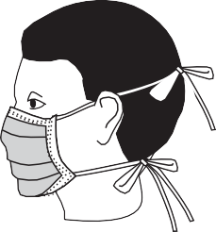
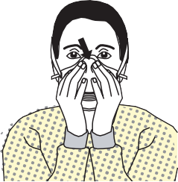












SEQUENCE FOR PUTTING ON or DONNING PERSONAL PROTECTIVE EQUIPMENT (PPE)
1. Perform HAND HYGIENE 2. GOWN Fully cover torso from neck to knees, arms to end of wrists, and wrap around the back Fasten in back of neck and waist 3. N-95 MASK OR RESPIRATOR Secure elastic bands at middle of head and neck Fit flexible band to nose bridge Fit snug to face and below chin Fit-check respirator (see manufacturer directions) 4. GOGGLES OR FACE SHIELD Place over face and eyes and adjust to fit 5. GLOVES Extend to cover wrist of isolation gown
USE SAFE WORK PRACTICES TO PROTECT YOURSELF AND LIMIT THE SPREAD OF CONTAMINATION
Keep hands away from face Limit surfaces touched Change gloves when torn or contaminated Perform hand hygiene

