Slide 1
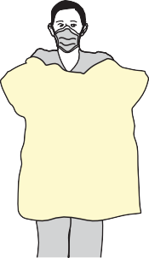
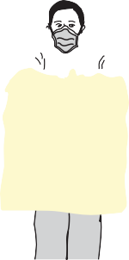
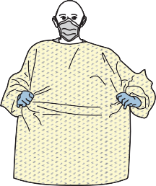
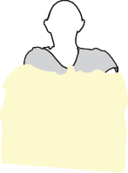

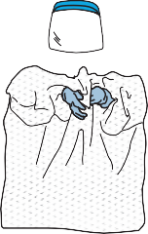
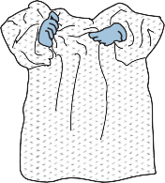
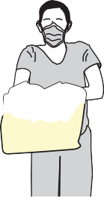
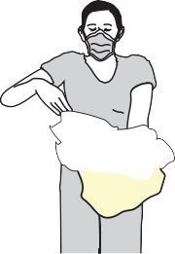




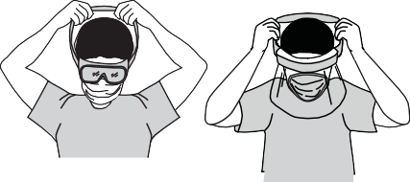
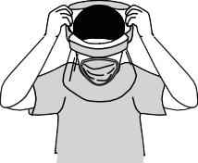

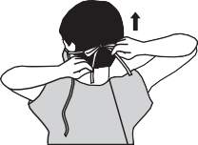
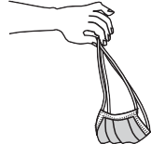
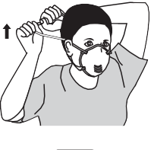
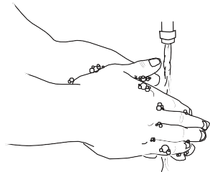
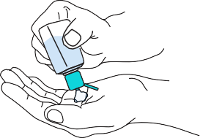


HOW TO SAFELY REMOVE or DOFF PERSONAL PROTECTIVE EQUIPMENT (PPE)
Remove all PPE before exiting the patient room except a respirator, if worn. Remove the respirator after leaving the patient room and closing the door. Remove PPE in the following sequence: 1. GOWN AND GLOVES ^{B C} Gown front and sleeves and the outside of gloves are contaminated! Untie the gown ties, then grasp the front of the gown and pull away from your body, touching only the outside of gown with gloved hands While removing the gown, roll the gown inside-out into a bundle ^{D E} Peel off your gloves at the same time, only touching the inside of the gloves and gown with your bare hands. Discard the gown and gloves into a waste container. 2. Perform HAND HYGIENE 3. GOGGLES OR FACE SHIELD Outside of goggles or face shield are contaminated! Remove goggles or face shield from the back by lifting head band and without touching the front of the goggles or face shield 4. Perform HAND HYGIENE 5. EXIT ROOM & CLOSE DOOR 6. MASK OR RESPIRATOR Front of mask/respirator is contaminated — DO NOT TOUCH! Grasp the bottom strap and pull over head without touching the mask Grasp the top strap, and pull away from face completely. Discard in a waste container 7. WASH HANDS OR USE AN ALCOHOL-BASED HAND SANITIZER IMMEDIATELY AFTER REMOVING ALL PPE
Adapted from CDC protocol March, 2020

