Slide 1

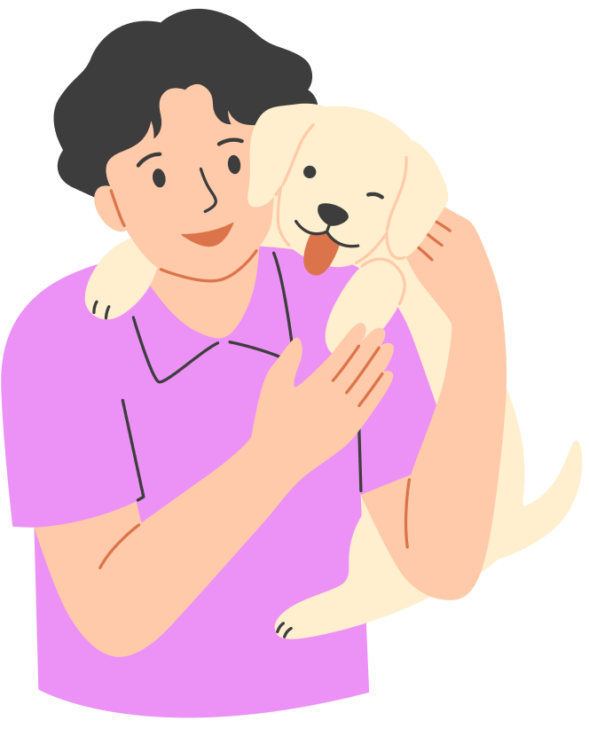



Animals in VUMC Buildings
Policy
Updated December 2024

Slide 2

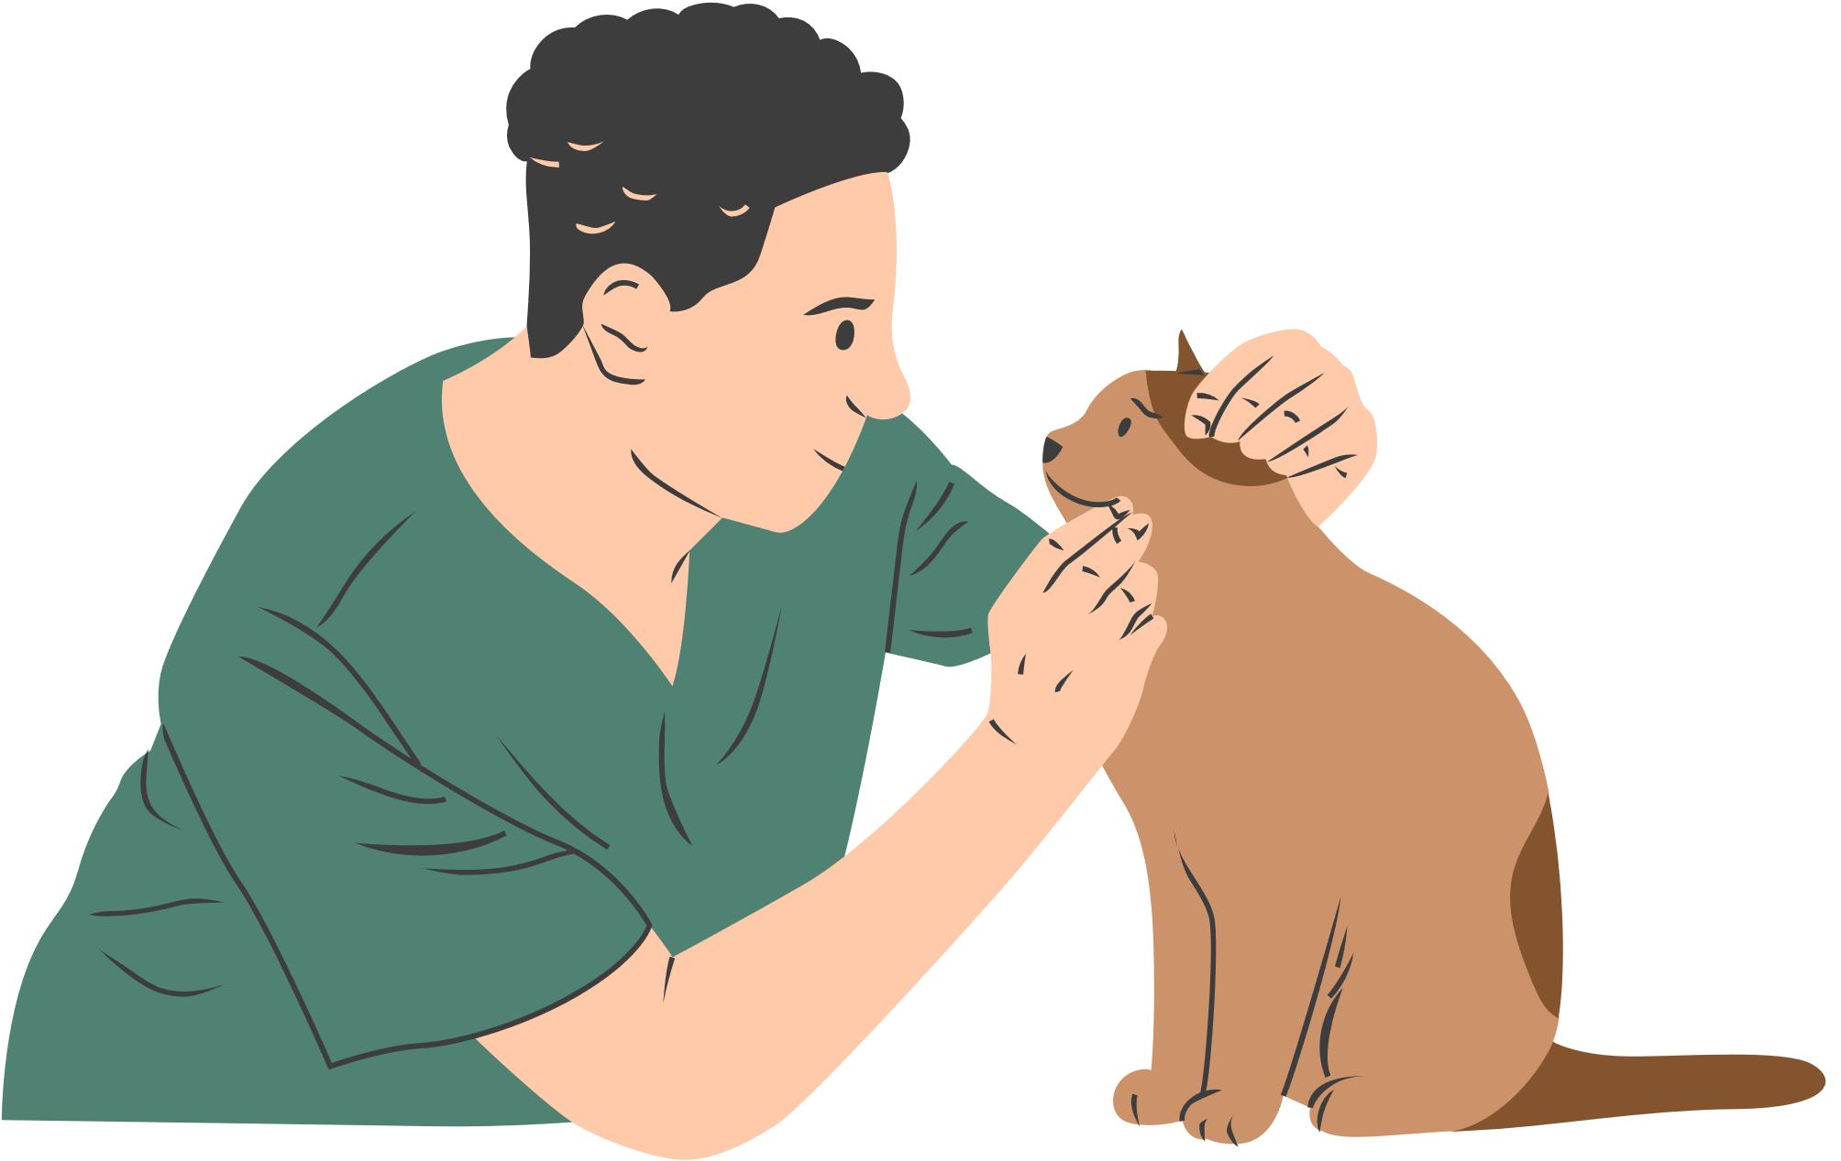


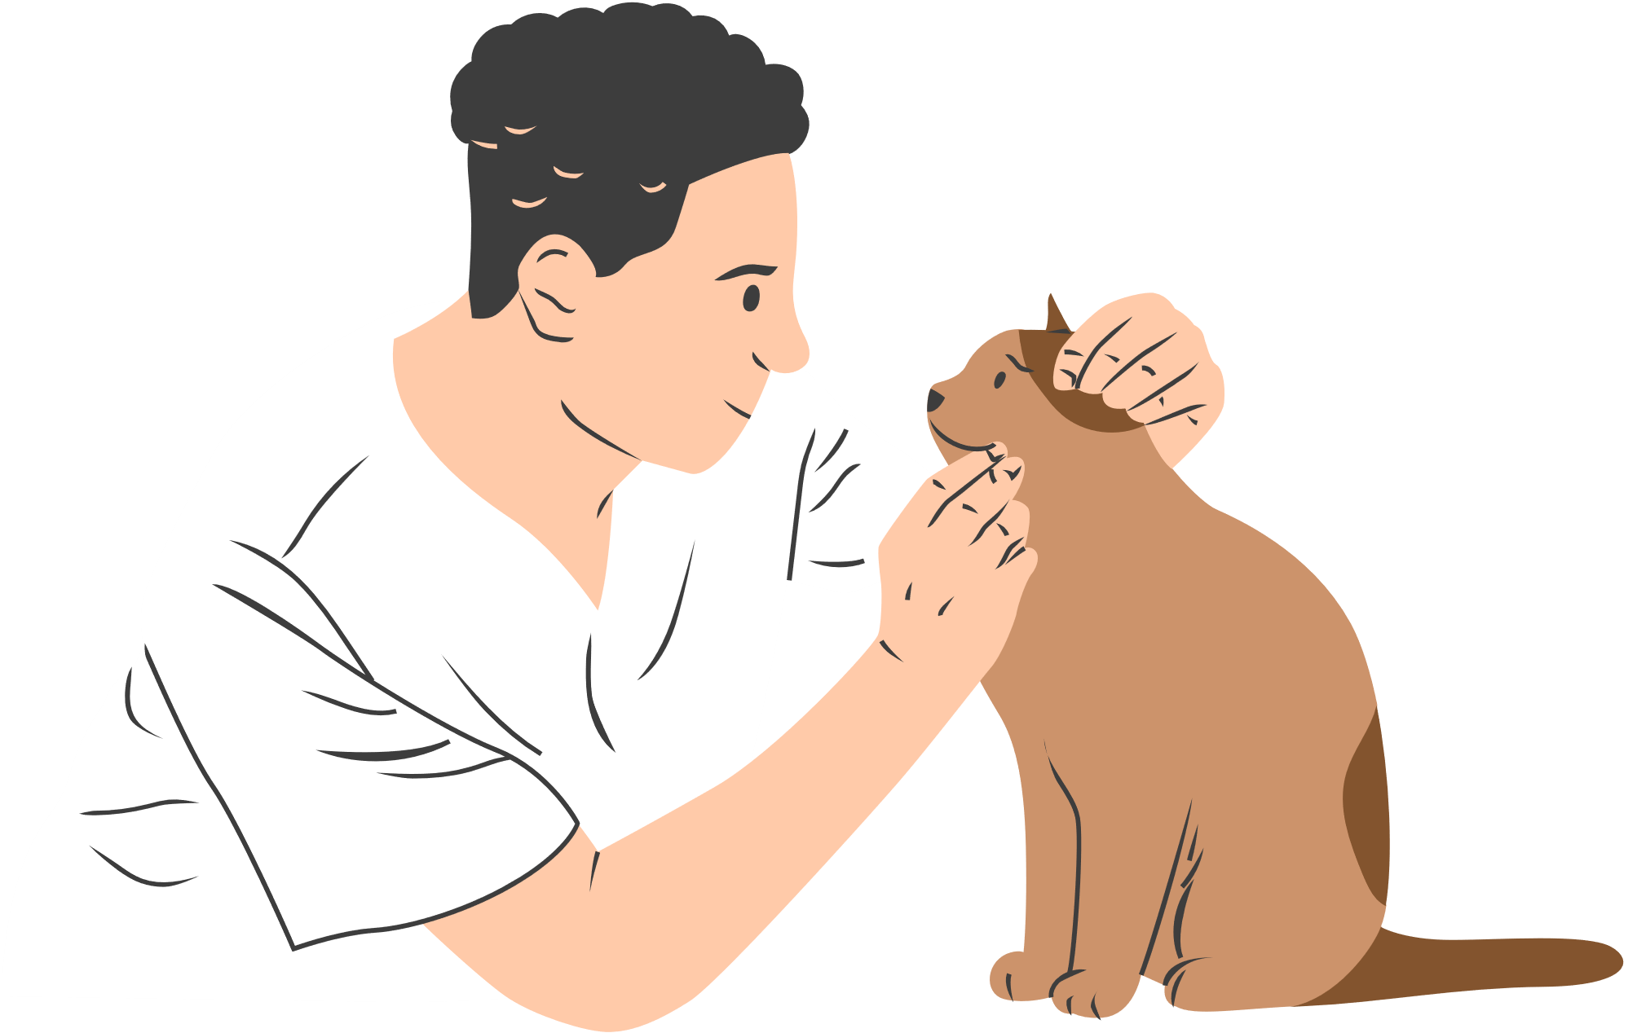
Types of Animals
These animal types are permitted within VUMC buildings, please refer to policy for specific guidance and restrictions.
Service Animals
Facility Animals
Volunteer Therapy Animals
A dog or miniature horse that is specifically trained to do work or perform tasks for the benefit of an individual with a disability.
An animal and handler that is prescreened, trained, and registered by VUMC approved organizations, and managed by designated handler(s); that provides “animal assisted activities” or “animal assisted therapies.”
An animal owned and employed by VUMC to support clinical and therapeutic interventions

Slide 3

Types of Animals
Personal pets and emotional support animals are not permitted inside VUMC buildings. Visitors and patients who arrive with personal pets or ESAs to VUMC buildings may not enter with their animal(s). If Personal Pets or ESAs are discovered inside the building, the handler is asked to remove the animal.
Exceptions may be considered on a case-by-case basis following entity-specific guidance for approval.
Emotional Support Animals
Personal Pets
An animal that does not qualify under the ADA as a Service Animal but may provide emotional support, companionship, and comfort to the owner.
An animal owned by an individual patient or visitor that is not a service animal.

Slide 4

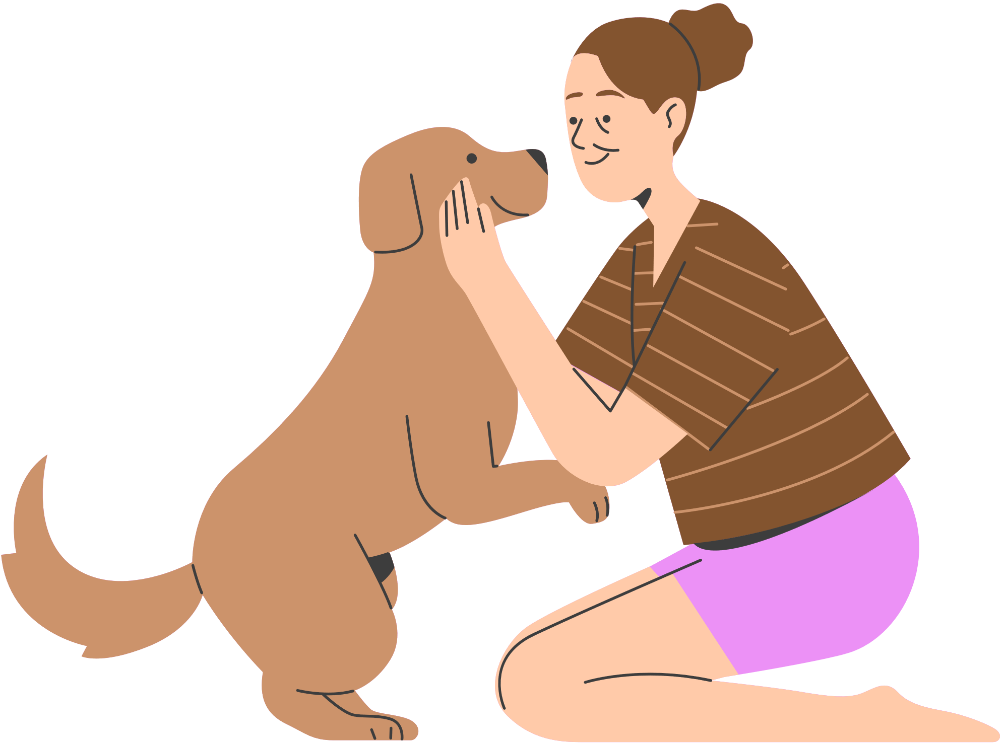

Restricted areas: Animals not Allowed
  Intensive care units (ICU);
  Myelosuppression;
  Procedural areas (e.g., operating rooms, endoscopy suites, Cath labs, holding rooms, and post-anesthesia care units (PACU));
  Isolation precaution rooms;
  Multiple patient occupancy rooms;
  Departments where the animal cannot be shielded from the treatment (e.g., radiology, radiation therapy, magnetic resonance imaging [MRI]);
  Any area where visitors are restricted or required to wear gowns, gloves, or masks prior to entry.
Please visit the VUMC Infection Prevention website for approved exemptions: applicable to facility dogs only.

Slide 5
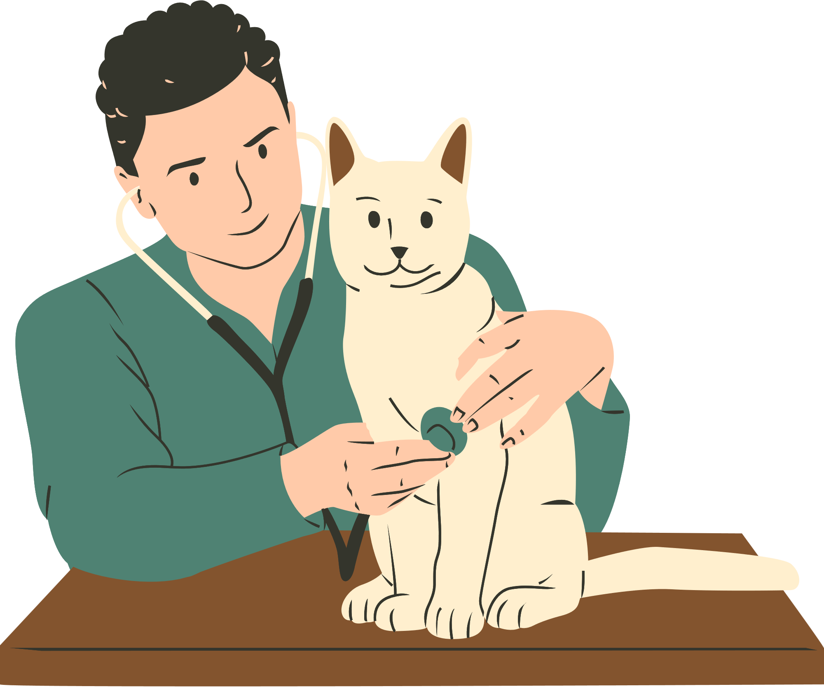
You may ask two questions of the service dog owner/handler:
Service Animals
Is the animal a Service Animal required because of a disability? (or, Is that a Service Animal)
What work or task has the animal been trained to perform?
Patients and visitors with disabilities are permitted to be accompanied by their Service Animals in all areas where the public is allowed, including non-restricted patient care areas as appropriate for patient care. Service Animals are not allowed in restricted area(s).
Workforce Members Cannot:
  Ask about the person’s disability or the nature of the disability
  Require medical documentation of the stated disability
  Require a special identification card or training documentation for the animal; or
  Ask that the animal demonstrate its ability to perform the work or task

Slide 6
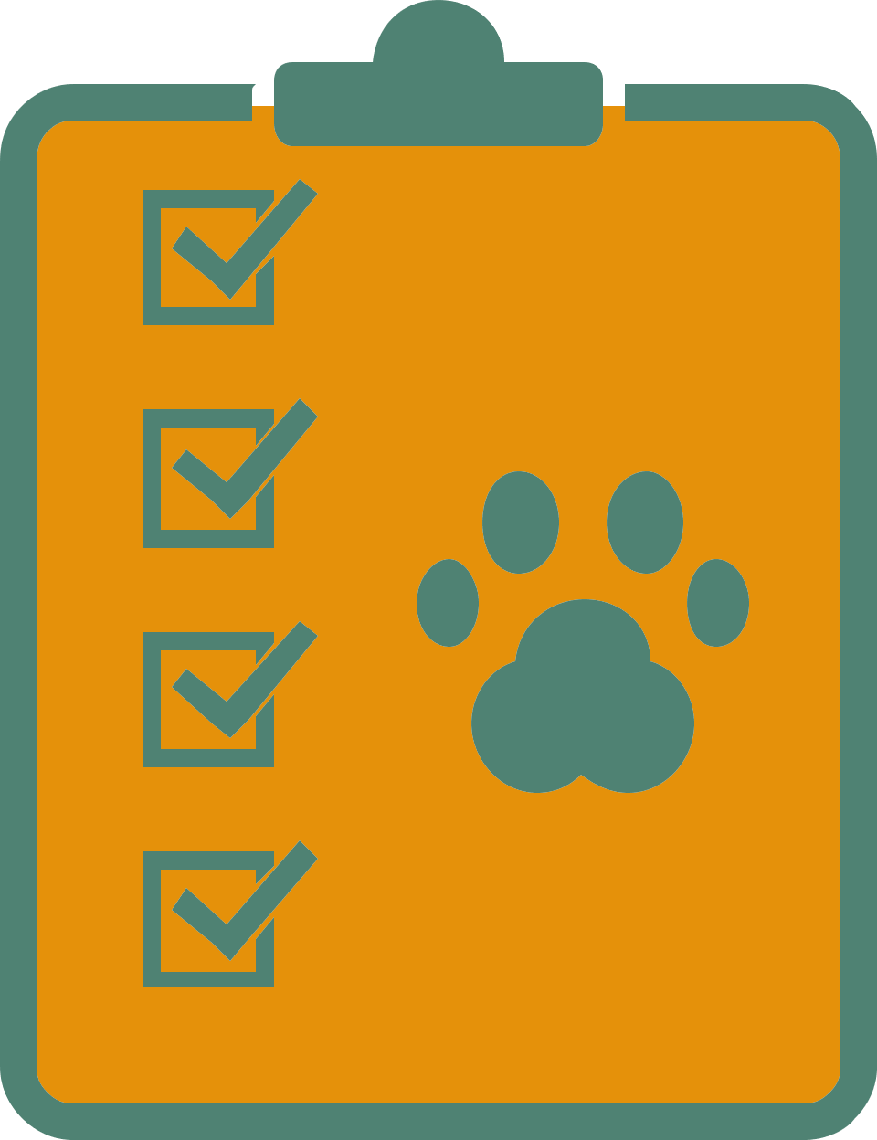
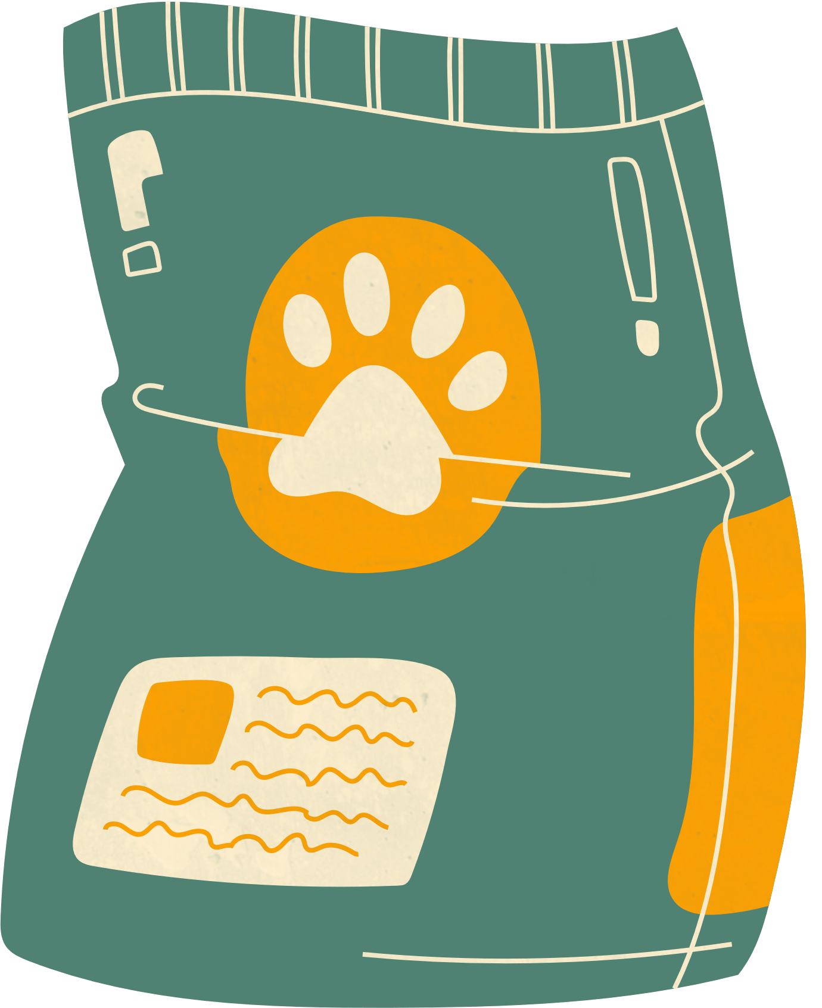
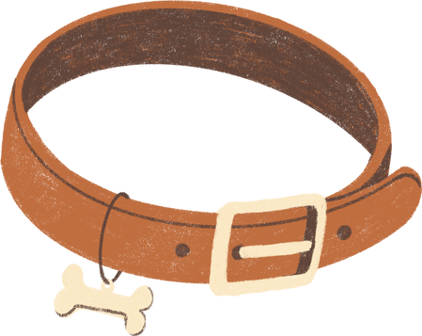
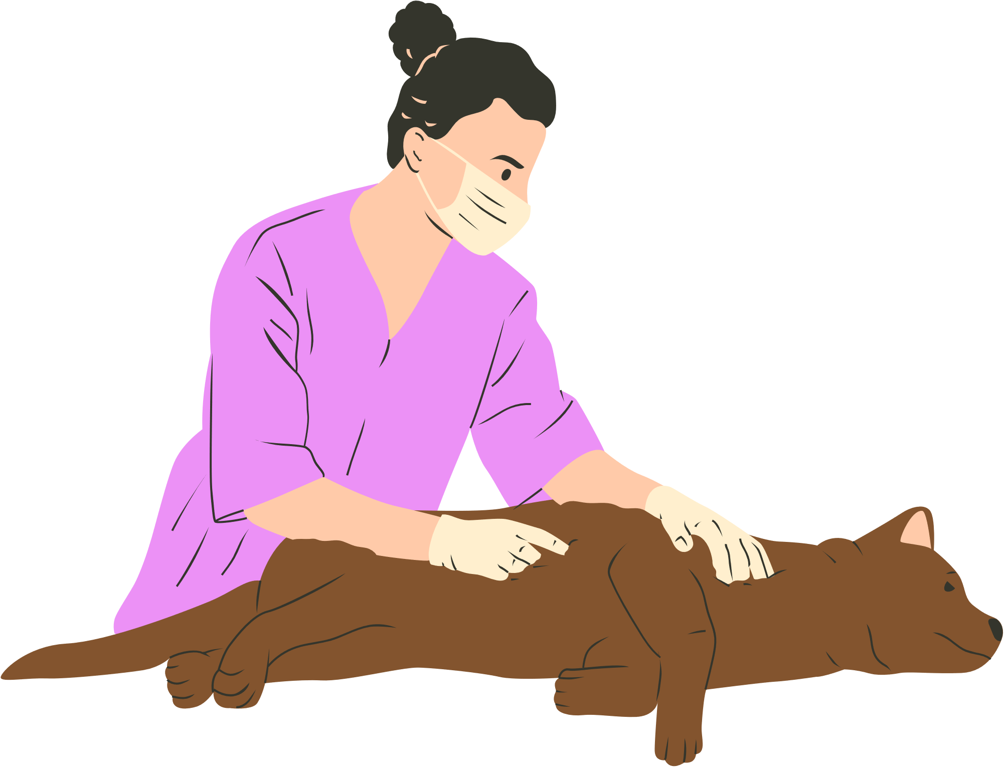
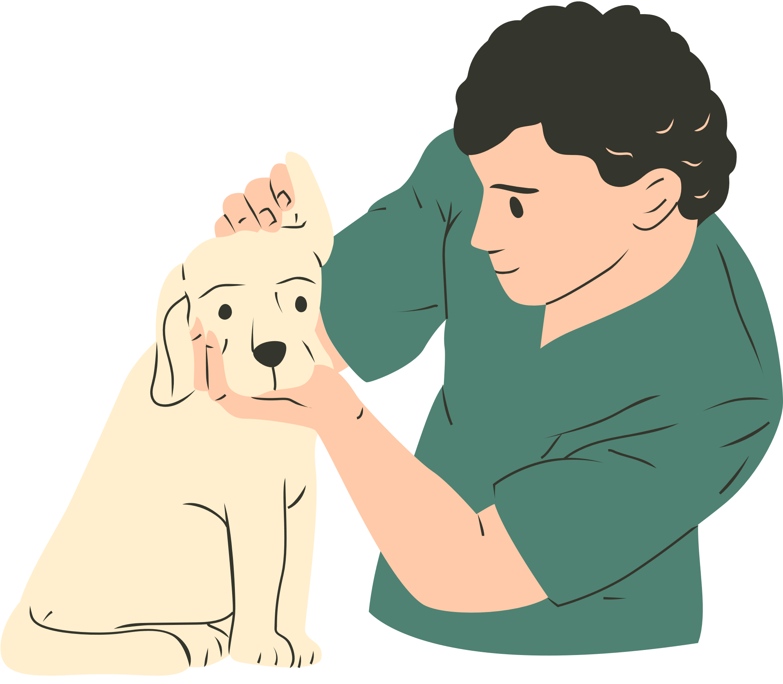
Service Animals:
Handler Responsibilities
On a voluntary basis: Completing the “Service Animal Information” and “Authorization to Transfer the Care of a Service Animal Forms”
All applicable leash and vaccine laws and be responsible for control of the animal
Feeding, watering, walking and toileting

Slide 7
Animal Visitation
Including Facility Animals, Volunteer Therapy Animals, and Program Sponsored Animals.
Excluded Patients
Prohibited Animal Programs
Volunteer Therapy Animals
  Are allergic to animals;
  Have wounds that are open air (without dressing);
  On any type of isolation precautions;
  On critical status;
  Myelosuppressed; or
  Exhibit agitation or aggression.
  Animals over 200lbs, with the exception of minature horses.
  Non-human primates
  Shunks, birds, mink, and raccoons;
  Any poisonous or infectious animal
Approved through Volunteer Services and meets requirements defined in policy. Handler must be an active hospital volunteer.

Slide 8

VUMC Infection Prevention Website
  Animal Care Resources
  Service Animal Information Form
  Authorization to Transfer Care of the Service Animal
  Facility Animals Approved Exemptions
  ADA Service Animal FAQs
Resources

Slide 9
Thank You
For Your Attention

