Slide 1
Visiting Resident Process for Program Administrators
Program Administrator instructions
2025

Slide 2
Visiting Resident Process
Visit the Visiting Resident website page at https://www.vumc.org/gme/visiting-residents.
Obtain any form/documents from this website page to ensure you are utilizing most updated form/document. It is not recommended to save to your desktop as sometimes documents/forms are updated.
Visiting resident applicants must apply 120 days or more from start date and have met all requirements 30 days or more prior to their requested start date. If this requirement is not met, the visiting resident’s request to rotate will be cancelled and they will need to reapply.
Each requirement and step is key so it will be important to stay in touch with the visiting resident and their program coordinator to ensure they meet all requirements.

Slide 3
Visiting Resident Process
The Program Administrator of the VUMC program with which you desire to rotate must initiate a contract /program letter of agreement process at least 100 days before your desired start date. Therefore, you must communicate with her/him, as well as the Program Director, well before the desired rotation. See the PEER instructions on the Visiting Resident website page for instructions. The contract and PLA templates are also included on the Visiting Resident website page.
Your application must be submitted to the VUMC program at least 120 days beforehand and supporting documents (items 1-6, below) must be submitted to the VUMC program at least 90 days beforehand so that the rotation is fully onboarded 30 days from start date. You should submit this information to the appropriate department for approval from the respective VUMC Program Director. See later slide for how to monitor progress. Fully onboarded also includes epic training registration and badge printed.
You must check in with the GME office in person on day one of your rotation. Be sure to include this on the welcome letter you send to the visiting resident.
A completed and signed visiting resident application - Click here for application. This will need to be approved by the VUMC Program Director. The application requires your NPI number. If you don't have one, you can apply for one at the National Plan and Provider Enumeration System (NPPES) website. Your application must be submitted to the VUMC program at least 120 days beforehand. Encourage the PD to review the application as soon as possible so not to delay the processing of the rotation.

Slide 4
Visiting Resident Process
The following documents need to be submitted at least 90 days in advance:
A reference letter from your Program Director stating whether you are in good standing in an accredited training program.
Documentation that your institution will continue to provide your stipend along with benefits, liability and health insurance (can be in the same letter as above).
A copy of your liability insurance policy; the minimum is $1 million per occurrence/ $3 million aggregate.
If you are in a residency/fellowship in Tennessee and do not have your own medical license, a copy of the letter of exemption from licensure (your program or GME Office will have this). Note: If you are not in a Tennessee residency/fellowship and do not have full TN medical license, VUMC/GME will request an exemption from licensure for you.
If applicable, a copy of a valid ECFMG certificate and Visa. You must complete the following at least 60 days in advance:
Immunization Form. This form must be completed by a healthcare provider other than the perspective visiting resident/fellow and sent to the Program Coordinator of the program with which you will rotate.
Immunization Form (.pdf)

Slide 5
Visiting Resident Process
Other required tasks for VUMC program administrator:
Program administrator will need to provide a copy of the PLA if one is already in place and a screenshot of proof of ACGME accreditation of program as listed on ACGME website.

Slide 6
Visiting Resident Process
Check list for Program Administrator

Slide 7
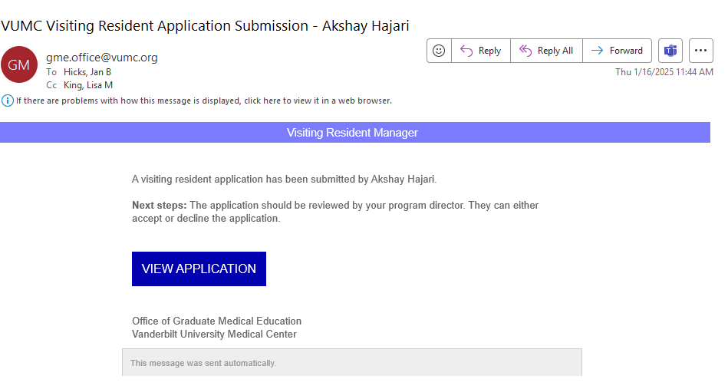
Visiting Resident Process
Onboarding of the visiting resident process is completed by the program administrator with support from the GME office.
The program administrator should begin onboarding the visiting resident as soon as possible after receiving the email notification of the application. See sample to the right. This notification will be sent to both the PC and PD once submitted by visiting resident.

Slide 8
Visiting Resident Process
3 steps running simultaneously:
PEER Contract request (only applicable if no contract exists.)
VUMC GME has master affiliations w/ University of Tennessee, ETSU, Meharry, Baptist Memorial-Memphis and Morehouse. If questions, check with the GME office.
Active contract and Program Letter of Agreement (PLA) are required for all visiting residents.
Collection of all required documents. List found here: https://www.vumc.org/gme/visiting-residents. Forward documents to Lisa.King-Rowan@vumc.org for review.
Workday Contingent worker submission by WD manager which may be different from the program administrator.

Slide 9
Visiting Resident Process
PEER contract submission instructions:
PEER instructions can be found on the visiting resident website page.
Be sure to ping approver once you have submitted the PEER request to not delay processing of contract/PLA. If visiting resident is coming from institution that we have master affiliation contract in place (see previous slide), confirm that there is an active PLA between your program and the other institution. Confirm the PD is still accurate for our institution on the signature page. Remember to access the PLA template from the GME website page: https://www.vumc.org/gme/pcpd-documents-and-tools, scroll to the bottom under Visiting Residents/Resident program letter of agreement or on the visiting resident website page.

Slide 10
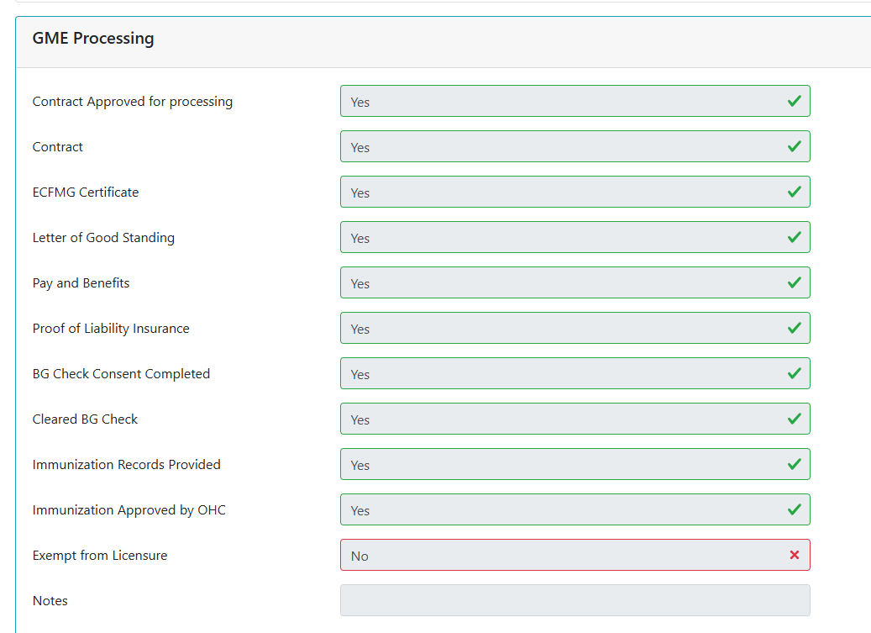
Visiting Resident Process
Collection of all required documents. List found here: https://www.vumc.org/gme/visiting-residents. Forward documents to Lisa.King-Rowan@vumc.org for review.
Program administrator can monitor the status of missing documents by logging into the visiting resident website : App List - Visiting Resident Manager. Click on the visiting resident name, scroll to the bottom of the application and you will see the following section. Any questions about status, please contact Lisa King Rowan.

Slide 11
Visiting Resident Process
Workday Contingent worker submission by WD manager which may not be the program administrator.
Instructions to submit a request for contingent worker via Workday. Part 1
Contingent Worker in Workday (part 1)
Search for create position
Choose a job posting title
Choose number of positions to create
Pick a past date for available date
Use the same date for earliest hire
Choose the job title – we use – 9143 Visiting Resident/Fellow. Use Visiting Resident or GME Visiting Resident as the position title, also.

Slide 12
Visiting Resident Process
Workday Contingent worker submission by WD manager which may not be the program administrator.
Location (choose the building they will be in)
Time Type – full time
Worker Type – Contingent Worker
Worker Sub Type – visiting observer
Click Submit
Click Open
Click Submit
Wait for Approval from HR

Slide 13
Visiting Resident Process
Contingent Worker in Workday part 2
Search for your own name and choose the one that says supervisory org
Click on staffing
Click dots in first column by position and choose hire and then contract contingent worker
Search for person by email or name to make sure they are not already in the system – If you see the same name but just a different email, to please reach out to PEBC or Data Entry to confirm if it is the same person.
If they are in the system, you choose their information
If they aren’t in the system, click on Create New Pre-Hire
Enter first and last name
Click on Contact Info
Add email be sure the email is correct or this will delay their bg check.
Email type: Home
Click OK
Enter start date and contract end date
Click Submit
Click open
Click submit

Slide 14
Visiting Resident Process
Contingent Worker submission:
Once submitted, it is important to notify program approver to approve so not to delay process.
Important required step: Monitor progress by following these instructions:
How to monitor status of a WD contingent worker request: Type into the search bar of WD: Contract Contingent Worker & Direct Hire status. Search the manager name when prompted to select the appropriate sup orgs. A status report will appear and show progress for the visiting resident in WD. It’s very important to not look at the hire process but utilize the Contract Contingent Worker & Direct Hire status.
Email visiting resident to be on the lookout for background check consent from Sterling Talent and to complete in a timely basis. Ask for confirmation that they have completed.

Slide 15
Visiting Resident Process
Crucial step:
VUMC creation – it’s important the visiting resident claim/create their VUMC ID promptly after their background check has cleared. The WD manager will receive an email notification of the bg check clearance. The GME office (Lisa King) needs to receive this VUMC ID to be able to request epic training and ID badge. If the visiting resident does not receive the VUMC ID Claim email, you can send these instructions:
Visiting Resident needs help claiming VUNETID If you have not gotten an email to claim your VUMCID
Go here: https://myidentity.app.vumc.org/vumcemployee/ and make sure the last name is entered. Your second option is, to call the helpdesk at (615) – 343 – 4357 and press option 1 and let them know you have not gotten your email to claim your VUMCID.

Slide 16
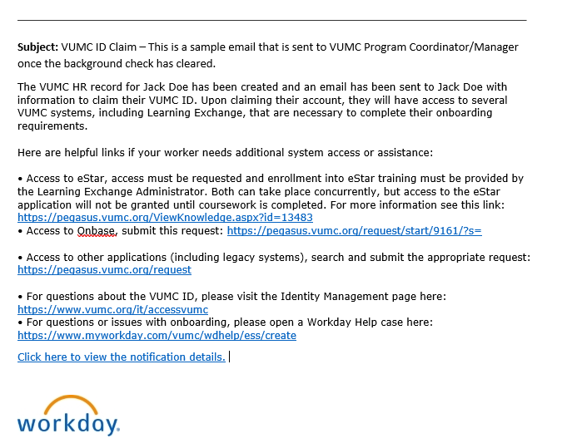
Visiting Resident Process
VUMC creation- sample email below received by visiting resident.

Slide 17
Visiting Resident Process
Badge request – once VUMC ID is sent to the GME office, Lisa King will send an email to visiting resident applicant to upload their photo via provided link. The GME office will pick up badge and have waiting for first day of rotation. Be sure to confirm with visiting resident that they have received a photo accepted email.
Required step: Send the visiting resident a welcome email (see template email on next slide) including important information such as schedule, badge, check in details, epic, maps of campus.

Slide 18
Dear Dr. (visiting resident name),
We are greatly looking forward to you rotating through our (insert program name) Program, (insert dates of rotation). You will need to bring your laptop with your (include this if applicable). See attached schedule along with a map of your clinic location and where to park on your first day. Please review the information and let me know if you have any questions.
INSTRUCTIONS:
On (insert first day of rotation date) I would plan on arriving at 7:40 AM to park. You may park in the East Garage off 21st Avenue South self-park from the Medical Center Drive entrance.
Next, plan to arrive at the Vanderbilt Graduate Medical Education (GME) Office located in Suite 303, 3rd Floor, Light Hall on campus at 8 AM Central Time. The phone number to the office is (615) 322-4916. Here, you will check in with the program and receive your ID badge. You will need your driver’s license to check in with GME.
Attached is a map showing you how to get to Light Hall from the parking garage. Also attached is a similar map showing you the locations of your clinics – you will have clinics (insert address/location of the visiting resident clinic or location on where to meet someone on their first day.) https://maps.google.com/?saddr=Current+Location&daddr=2105%20Edward%20Curd%20Lane,%20Suite%20100,%20Franklin,%20TN%2037067
To obtain a parking permit after your check-in with GME, you will need to go back to the East Garage where you parked. Vanderbilt University Medical Center Central Parking is located on the Green – Ground Level of East Garage/Medical Center East. You will be assigned a parking location thereafter. Please note, the Graduate Medical Education Office nor the Division pays for parking. To register for parking, you will need your driver’s license and vehicle license tag number, model/make/color of vehicle to apply. The phone number to reach Central Parking is 615-322-5000 and ask to be connected to VUMC Central Parking and choose option 3. (if your program pays for parking, please edit the portion above about parking and where they will pick up their permit.

Slide 19
Note after you check in with GME and arrange for your parking, you may join (insert name of person meeting the visiting resident at this point.) To connect, please call (insert cell phone #)
While you are on Vanderbilt University Medical Center Campus:
Map @ http://www.vanderbilt.edu/map
Use pull-down menu in SELECT A LINK box to view maps such as the VANDERBILT COLOR CAMPUS MAP and the CAMPUS VISITOR PARKING MAP.
Guest Wireless Internet in two easy steps:
Select: VUMC Guest network
Input Password: vumcguest
eStar Training - The GME Office should have contacted you regarding your eStar training. This is a (insert either self paced or class) training and offered through the Vanderbilt Learning Exchange. If you have not already completed, please do so as soon as possible, as you won’t be able to have access to patient data until it is completed. Plan to complete at least 24-hr ahead of your shift. If you have not received, please let me know.
Please call me if you have any questions, as I know this is a lot of information. You may call me at (insert your phone # and/or email address
Again, we look forward to having you with us!
Insert your email contact information

