Slide 1
Cancer Staging & Grading Staff Training Meetings
Grace Ordung, Stephanie Shelton, Linda Sircy, Brittney Fain, Alle Crider, Kelsey Shaffer

Slide 2
Explanation
Some staff were required to attend three training meetings to develop their understanding of cancer staging & grading. They were then asked to research and present on the follow topics:
Current Vanderbilt clinical trial
Biomarkers & prognostic indicators
Neoadjuvant vs. Adjuvant
Prostate vs. Ovarian staging
Normal vs. Cancer images
2 different cancers (staging, grading, treatments, symptoms, etc.)

Slide 3
Vanderbilt Clinical Trials
Clinical Trial: VICCGI1405
Drugs used – nabpaclitaxel in combination with gemcitabine
Cancer type – Pancreatic
Objective – to compare disease-free survival (DFS) between subjects given nabpaclitaxel in combination with gemcitabine and subjects given gemicitabine alone
Clinical Trial: VICCGI13101
Drugs used – FOLFOX-bevacizumab
Cancer type – Colorectal
Objective – compare patients given FOLFOX with high doses of vitamin D to patients given FOLFOX and standard doses of vitamin D

Slide 4
Clinical Trial: VICCNEU1404
Drugs used – Nivolumab, Ipilimumab, Bevacizumab
Cancer type – Recurrent Glioblastoma
Objective – to compare the safety of nivolumab in combination with ipilimumab, to compare the survival of nivolumab patients versus bevacizumab and nivolumab in combo with ipilimumab versus bevacizumab
Clinical Trial: I 131 MIBG
Drugs used – 131-MIBG/Iobenguane Sulfate
Cancer type – neuroblastoma, pheochromocytoma or paraganglioma
Objective – to provide palliative therapy with MIBG and gain more info about acute and late toxicity of 131I-MIBG

Slide 5
Clinical Trial: RO5185426, PLX4032
Drugs used – Vemurafenib, Cetuximab
Cancer type – BRAF mutation cancers
Objective – to evaluate the efficacy of vemurafenib in patients with cancers harboring BRAF V600 mutations.
Clinical Trial: VICCMEL0287
Disease site - Melanoma
Objective – to characterize the markers in the steps in melanoma progression
Want a better understanding of the genes involved to improve cancer prevention and therapy

Slide 6
Biomarkers & Prognostic Indicators
Biomarkers:
2 major types:
Biomarkers of exposure
Biomarkers of disease
9 approved protein biomarkers for cancer by FDA
CML
RT-PCR
mRNA
CTCs
miRNAs
KRAS
BRAF
PSA
CA-125
Prognostic Indicators:
Cancer-specific survival
Relative survival
Overall survival
Disease-free survival
Proteomics – the study of protein structure, function and patterns of expression

Slide 7
Cancer Biomarkers
Lung
EGFR. KRAS, EM4-ALK
Prostate
PSA
Gastric
KIT
Pancreatic
CA 19-9
Ovarian
CA-125
Melanoma
LDH, BRAF, S-100
Chronic Myeloid Leukemia (CML)
BCR-ABL
Colorectal Cancer
CEA, KRAS, MMR, mRNA
Liver
AFP
Multiple Myeloma
Β-2-microglobulin
Testicular
AFP, hCG, LDH
Thyroid
Thyroglobulin
Breast
ER/PR, HER2, CA 15-3, CA 27.29, CEA, uPA, PAI-1

Slide 8
Staging Systems
TNM – most common system
T – primary tumor
N – spread to lymph nodes
M – metastasis
FIGO – gynecological cancers
Same factors as TNM
Stage O does not exist
CIN – cervical intraepithelial neoplasia
Usually caused by HPV
Staged in grades (I-III)
WHO – central nervous system
Histological features of tumor
Dukes – Colon cancer
Similar to TNM
A-D to classify tumor spread
B & C divides further
Ann Arbor – lymphomas
Uses roman numerals I-IV and “E” and “S”
Cotswold – lymphoma
Modifications to Ann Arbor
Letter “X” – bulky disease
# of anatomic regions involved
Stage III – 2 separate designations of nodal involvement

Slide 9
Neoadjuvant vs. Adjuvant
Therapy given before the primary therapy, which is usually resection
Common cancers:
Breast
Bladder
Lung
Colon
Brain
Can affect staging of tumor, if tumor shrinks from therapy
Types of therapies:
Chemo
Radiation
Hormone therapy
Therapy given after resection to lower the risk that cancer will come back
Common cancer:
Prostate
Usually used when patient is at higher risk of recurrence
Types of therapies:
Chemo
Hormone therapy
Radiation
Immunotherapy
Targeted therapy

Slide 10
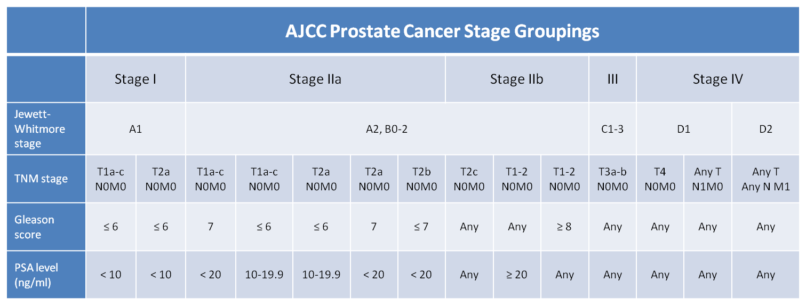
Prostate Cancer staging Gleason Score

Slide 11
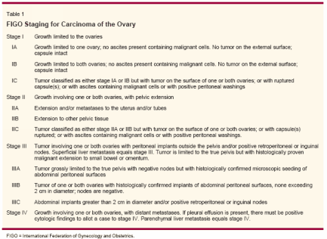
Ovarian Cancer staging FIGO

Slide 12
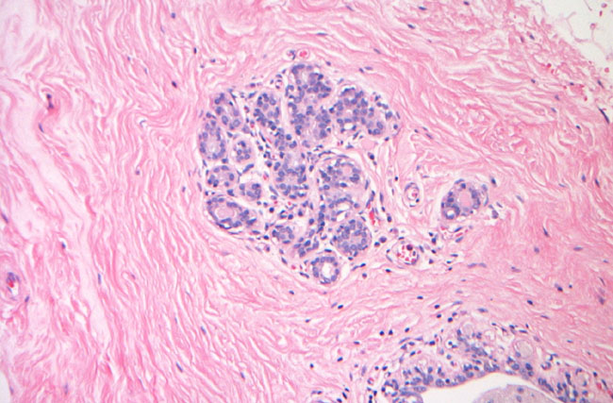
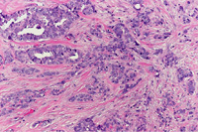
Normal vs. Cancer
Breast normal cells
IDC cells

Slide 13
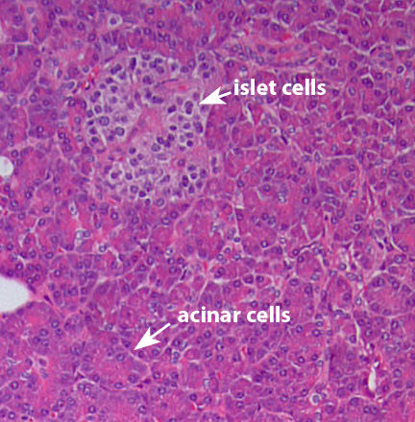
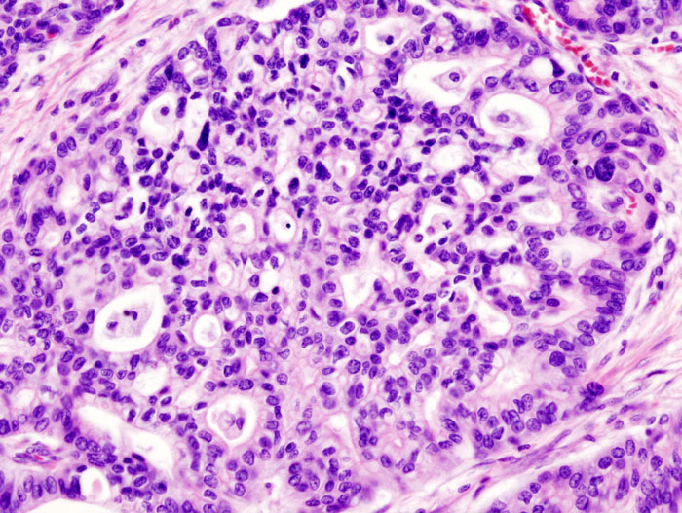
Normal Pancreas
Pancreatic Adenocarcinoma

Slide 14
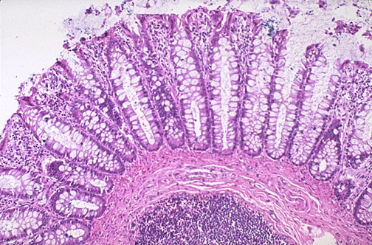
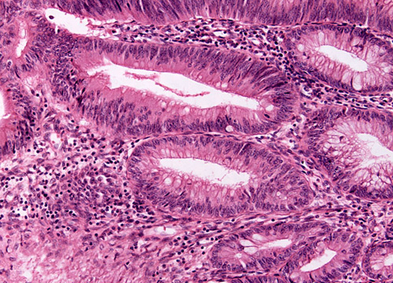
Normal Colon
Colon Adenocarcinoma

Slide 15
Soft Tissue Sarcoma Adult
Most common in head, neck, arms, legs, trunk and abdomen
Muscles, tendons, fat, blood/lymph vessels, nerves, tissue around joints
Survival rates:
83% - localized
54% - regional stage
16% - distant spread
Survival is worse when sarcoma develops other limbs
5-year survival for retroperitoneal sarcomas – 40% to 60%
Treatments:
Surgery
Most common
Removal of sarcoma, whole limb
Radiation
External beam or brachytherapy
Chemo
Most common: ifosfamide (Ifex®) and doxorubicin (Adriamycin®)
Targeted therapy
Pazopanib (Votrient®)
Only therapy drug approved for soft tissue sarcomas

Slide 16
Liver Cancer
Types:
Hepatocellular carcinoma (most common)
Cholangiocarcinoma
5-year survival rates:
Over 50% - Small, resectable tumors
60% to 70% - with liver transplant
All stages is about 15%
Sorafenib has extended survival an average of 3 months
Treatments:
Surgery
Partial hepatectomy
Liver transplant
Ablation therapy
Removes or destroys tissue
Tumor embolization
Substances used to block/decrease blood flow through hepatic artery to tumor
TAE
TACE
Radiation
3-D conformal, stereotactic, proton-beam
Targeted therapy
Sorafenib (Nexavar®)
Chemo
Most effective drugs are doxorubicin, 5-fluorouracil, floxuridine (FUDR), mitomycin C and cisplatin
Liver cancer resists most chemo drugs

Slide 17
Breast Cancer
Clinical staging
Physical exam, imaging, pathologic exam of the breast
Pathological staging
Includes surgery
Types of cancer:
Ductal carcinoma in situ, Lobular carcinoma in situ, IDC, invasive lobular carcinoma, inflammatory breast cancer, triple negative, paget’s disease, phyllodes, angiosarcoma, male breast cancer
5-year survival rates:
Stage 0 – 100%
Stage I – 100%
Stage II – 93%
Stage III – 72%
Stage IV – 22%
Treatments:
Surgery
Lumpectomy, partial or total mastectomy, modified radical mastectomy
Sentinel lymph node biopsy followed by surgery
Radiation
Done is almost every case
Chemo
Over 60 different drugs approved
Hormone Therapy
Tamoxifen, Aromatase
Targeted therapy
Clinical Trials
Stem cell transplant

Slide 18
Melanoma
Diagnosing:
Biopsy, Punch biopsy, Incisional and excisional biopsies, Lymph node biopsy, Imaging
Melanoma can spread very quickly
Makes it hard to diagnose
Staging:
TNM, Clinical, Pathological
Based on thickness of tumor, ulcerated tumor, spread to lymph nodes, spread to other organs
5-year survival rate:
Stage IA – 97%
Stage IB – 92%
Stage IIA – 81%
Stage IIB – 70%
Stage IIC – 53%
Stage IIIA – 78%
Stage IIIB – 59%
Stage IIIC – 40%
Stage IV – 15% to 20%
Treatments (by stage):
Stage 0
surgery
Stage I
surgery, sentinel lymph node biopsy
Adjuvant immunotherapy if positive
Stage II
Surgery
Sentinel lymph node biopsy
Adjuvant immunotherapy if positive
Stage III
Surgery
Adjuvant immunotherapy
Radiation at times
If multiple, follow different steps
Stage IV
Surgery
Radiation
Immunotherapy
Chemo
Targeted therapy

Slide 19
Prostate Cancer
Around 233,000 new cases in 2014 with 29,000 deaths
Survival rates:
Local – 100%
Regional – 100%
Distant – 28%
Treatment:
Stage I & II is usually radical prostatectomy
External-beam radiation therapy
Internal radiation therapy
TURP
Hormone therapy
Cryosurgery

Slide 20
Bladder Cancer
Over 70,000 new case in 2014 and 15,000 deaths
Survival rates:
Stage 0 – 98%
Stage I – 88%
Stage II – 63%
Stage III – 46%
Stage IV – 15%
Treatment:
TUR
BCG
Radical & partial cystectomy
Reconstructive surgery
Incontinent diversion
Continent diversion
Neobladder

Slide 21
Rectal Cancer
Types:
Adenocarcinoma, carcinoid tumors, GISTs, Lymphomas, Sarcomas
Survival rates:
Stage I – 74%
Stage IIA – 65%
Stage IIB – 52%
Stage IIC – 32%
Stage IIIA – 74%
Stage IIIB – 45%
Stage IIIC – 33%
Stage IV – 6%
Treatments:
Surgery
Radiation
External and internal
Chemo
Capecitabine- (Xeloda FDA approved)
Targeted therapy
Adjuvant

Slide 22
Neuroblastoma
Most common in and around adrenal glands
Most commonly affects children age 5 and younger
Develops from immature nerve cells
Sporadic and Familial
5-year survival rate by age:
Younger than 1 – 90%
1to 4 years – 68%
5 to 9 years – 52%
10 to 14 years – 66%
Staging:
INSS
INRGSS
Treatments:
Observation
Surgery
Radiation
External and internal
Chemo
Systemic and regional
High-dose chemo and radiation therapy with stem cell rescue

Slide 23
Pancreatic Cancer
Staging:
TNM
5-year survival rates:
localized – 25.8%
Regional – 9.9%
Distant – 2.3%
Unstagged – 4.4%
Treatments:
Surgery
Whipple
Total pancreatectomy
Distal pancreatectomy
Radiation
Chemo/radiation
Chemo
Targeted therapy

Slide 24
Bone Cancer
An uncommon cancer that begins in a bone
Most commonly affects the long bones of the arms and legs
Types:
Osteoscarcoma
Chondrosarcoma
Ewing Sarcoma
Staging:
TNM
TX, T0-T3
N0, N1
M0, M1. M1a, M1b
Grade:
G1-G2 – low grade
G3-G4 – high grade
Treatment:
Surgery
Radiation
Chemo
Targeted therapy
5-year survival rate:
66.6%
Bone cancer represents 0.2% of all new cancer cases in the U.S.

Slide 25
Anal Cancer
An uncommon malignancy that starts in the anus.
Begins when normal cells in or on the anus change and grow uncontrollably, forming a tumor mass.
Staging:
Stage 0
Stage I
Stage II
Stage IIIA
Stage IIIB
Stage IV
Treatment:
Surgery
Radiation
Chemo
Chemoradiation
Best approach
5-year survival rate:
Localized – 79.7%
Regional – 58.1%
Distant – 32%
Unstagged – 60.4%
Anal cancer represents 0.4% of all new cancer cases in the U.S.

Slide 26
Thank you for reading!
If you have any questions or comments, please visit our contact page to obtain email addresses and phone numbers of staff.

