Slide 1
Staging and Grading of cancers
By
Haleigh Nelson

Slide 2
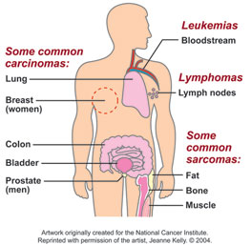
What is Cancer
Cancer is the uncontrolled growth of abnormal cells in the body.
5 main categories:
Carcinomas
Sarcomas
Leukemia
Lymphomas/Myelomas
CNS cancers

Slide 3
Types of Staging
“Elements to be considered are the primary tumor site, tumor size, multiplicity (number of tumors), depth of invasion and extension to regional or distant tissues, involvement of regional lymph nodes, and distant metastases.”
4 different types of staging
Clinical Staging
Pathological Staging
Post-Therapy Staging
Restaging

Slide 4
Staging Systems
FIGO
Dukes
Jewett-Marshall
Ann Arbor
TNM
Rai/Binet
Clarks/Breslow (level of invasiveness)

Slide 5
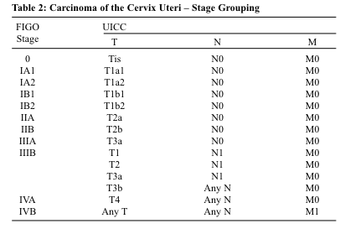
International Federation of Gynecology and Obstetrics(FIGO)
Used for Ovarian, Vulvar, Cervical, Endometrial, and Uterine Cancer
Similar to TNM
Originally based on clinical examinations, now based on surgical pathology (with exception of cervical cancer)

Slide 6
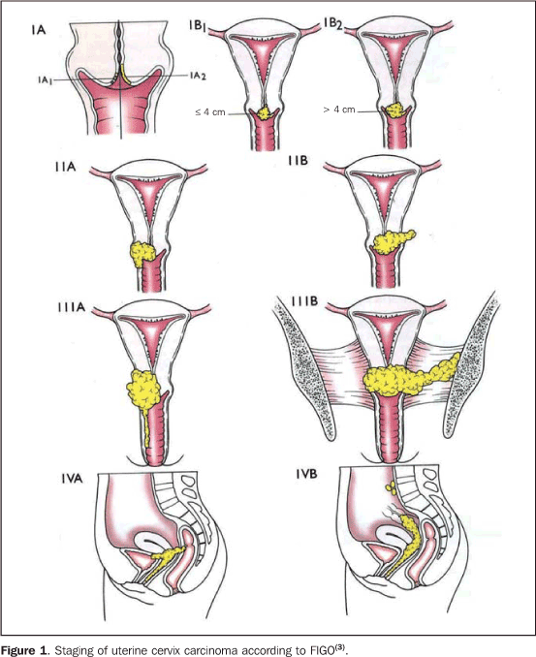
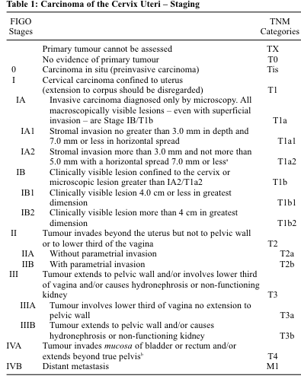
FIGO Staging

Slide 7
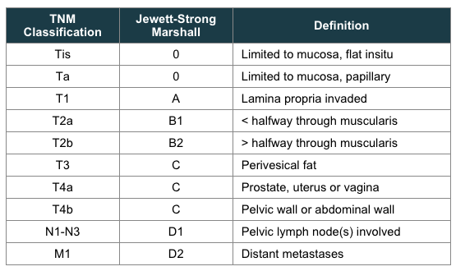
Jewett-Marshall
Histologic staging based on depth of invasion through the bladder wall. It does not consider grade of tumor, local recurrence rate or multicentricity of tumors
Used in conjunction with TNM system

Slide 8
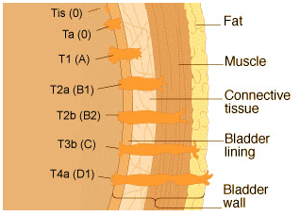
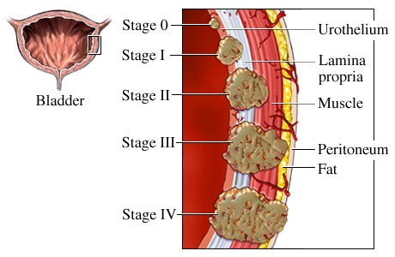
Jewett-Marshall Staging

Slide 9
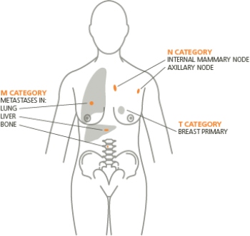
TNM Staging
based on the size and/or extent (reach) of the primary tumor (T), whether cancer cells have spread to nearby (regional) lymph nodes (N), and whether metastasis (M), or the spread of the cancer to other parts of the body, has occurred.

Slide 10
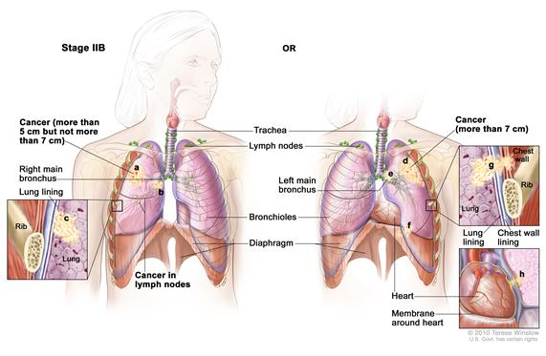
Small cell lung cancer vs Non small cell lung cancer
Non-small cell follows typical TNM staging
Stage 0 - the cancer has not spread beyond the inner lining of the lung
Stage I - the cancer is small and has not spread to the lymph nodes
Stage II - the cancer has spread to some lymph nodes near the original tumor
Stage III - the cancer has spread to nearby tissue or to far away lymph nodes
Stage IV - the cancer has spread to other organs of the body, such as the other lung, brain, or liver

Slide 11
Small cell lung cancer
Veterans Administration Lung Study Group (VALG) Staging
Limited stage: the strict involvement of the ipsilateral lung.
Extensive:extends beyond the ipsilateral lung and may involve the contralateral lung, or can be associated with pleural effusion, pericardial effusion, or hematogenous spread.
TNM Staging-same as NSCLC
National Comprehensive Cancer Network (NCCN) Staging
Limited: includes lung cancer cases of stage I, II, or III which can be treated with radiation therapy.This stage does not include tumor T3 or T4 with multiple lung nodules, as well as tumor or lymph nodes that are too large to fit in the radiation plan.
Extensive:all SCLC categorized as stage IV, or tumor T3 or T4 with multiple lung nodules, or tumor or lymph nodes that are too large to fit in the radiation plan

Slide 12
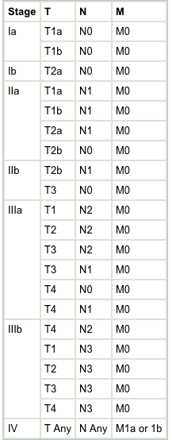

Slide 13
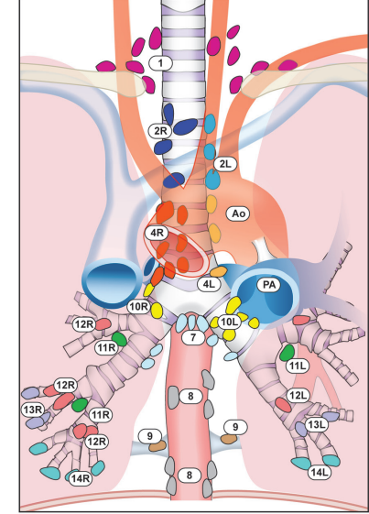
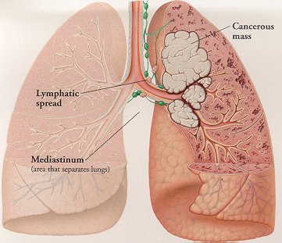

Slide 14
Grading
“Tumor grade is the description of a tumor based on how abnormal the tumor cells and the tumor tissue look under a microscope.”
General grading:
GX: Grade cannot be assessed (undetermined grade)
G1: Well differentiated (low grade)
G2: Moderately differentiated (intermediate grade)
G3: Poorly differentiated (high grade)
G4: Undifferentiated (high grade)

Slide 15
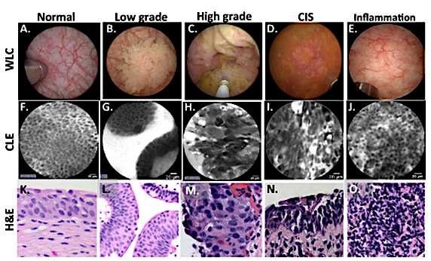
Bladder Cancer

Slide 16
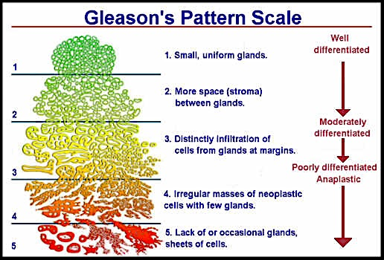
Gleason Grading
Prostate cancer
Range from 1-5
Grade 3 is most often observed
Gleason score ranges from 2-10

Slide 17
Bibliography
http://www.cancer.gov/cancertopics/factsheet/detection/staging
http://www.cancer.gov/cancertopics/pdq/treatment/cervical/HealthProfessional/page3
http://www.igcs.org/files/TreatmentResources/FIGO_IGCS_staging.pdf
http://www.uicc.org/resources/tnm
http://www.cancer.gov/cancertopics/pdq/treatment/small-cell-lung/healthprofessional/page3
http://training.seer.cancer.gov/staging/systems/schemes/jewett.html
http://seer.cancer.gov/statfacts/html/all.html
https://cancerstaging.org/references-tools/quickreferences/Documents/LungMedium.pdf
http://accessmedicine.mhmedical.com/content.aspx?bookid=352&sectionid=40039783&jumpsectionID=40053113#5025574
http://web.stanford.edu/group/liaolab/Projects/Projects.html
http://www.cancer.org/treatment/understandingyourdiagnosis/understandingyourpathologyreport/prostatepathology/prostate-cancer-pathology

