Slide 1
SKIN CANCER

Slide 2
SKIN
The skin is the largest organ of the body.
Covers the internal organs and protects them from injury
Serves as a barrier from pathogens (bacteria)
Helps prevent fluid loss
Stores water and fat
Helps control body temperature
Helps get rid of certain body wastes (salt, sweat)
Cells in the skin communicate with the brain and allow temperature, touch, vibration and pain sensations

Slide 3
Layers of Skin
The skin has 3 layers
Epidermis (the top layer) very thin averaging about 0.2 millimeters thick. It protects the deeper layers of skin.
Dermis (middle layer) contains hair follicles, sweat glands, blood vessels and nerves.
Subcutis (deepest layer) forms a network of collagen and fat cells. Helps body conserve heat and serves as a shock absorber that helps protects the body’s organs from injury.

Slide 4
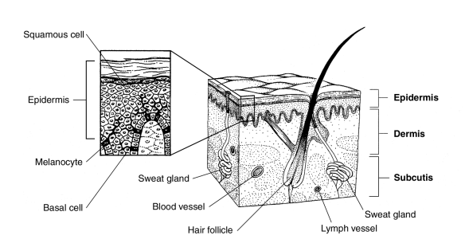
Layers of Skin

Slide 5
Types of Skin Cancers
Melanoma
Basal Cell and Squamous Cell

Slide 6
What is Melanoma
Melanoma is a cancer that begins in the melanocytes – the cells that produce the skin coloring or pigment known as melanin.
Melanin helps protect the deeper layers of the skin from the harmful effects of the sun.
Melanoma effects your skin but can also spread to your organs and bones.

Slide 7
What is Basal Cell/Squamous Cell
Basal Cell/Squamous Cell are classified as non-melanomas to set them apart from the serious type of skin cancer which is the Melanoma. These cells are found at the base of the outer layer skin.
Most of these cancers develop on sun-exposed areas of the skin (face, ear, neck, lips and hands) and rarely spread to other parts of the body.
These type cancers progress slowly, usually detected easily and curable if treated early.

Slide 8
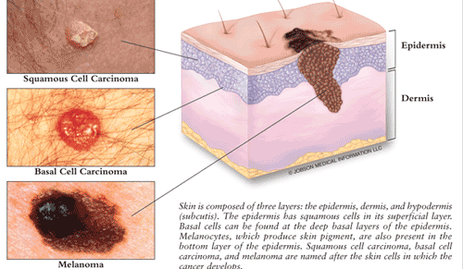
Skin Cancer

Slide 9
Statistics
Skin cancer is the most common form of cancer in the US and more than 3.5 million people are diagnosed annually.
Each year there are more new cases of skin cancer than the combined breast, prostate ,lung, and colon.
Melanoma is the most common form of cancer for young adults 25-29 of age.
1 in 50 men and women will be diagnosed with Melanoma of the skin during their lifetime.
One person dies of Melanoma every hour.
An estimated 9,480 people will die of Melanoma in 2013.

Slide 10
What Causes Melanoma
Melanoma occurs when something goes wrong in the melanin producing cells that give color to your skin.
Normally, healthy cells push the older cells towards the skins surface where they die and fall off.
When the cells develop DNA damage, the new cells grow out of control and eventually form a mass of cancerous cells.

Slide 11
What Damages DNA
Its believed that a combination of these factors are the reason.
Enviroment
Sun Exposure
Genetic Factors
UV radiation (Sun and Tanning Beds)

Slide 12

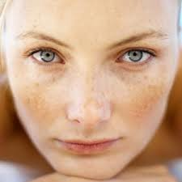
Risk Factors
Fair Skin
Having less pigment means you have less protection from UV radiation.
If you have blonde or red hair, light colored eyes and freckles or sunburn easily.

Slide 13
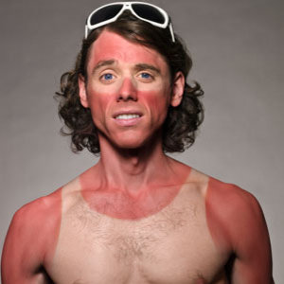
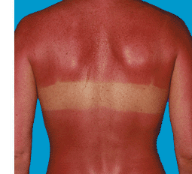
Risk Factors
History of Sunburn

Slide 14
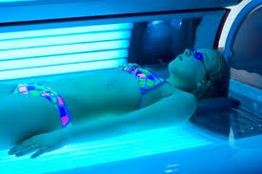

Risk Factors
Excessive UV Light

Slide 15
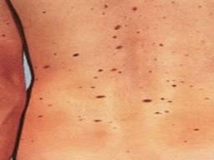
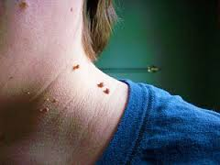
Risk Factors
Having a lot of moles / Unusual moles

Slide 16
Risk Factors
Family history of Melanoma
Weakened immune system due to HIV/Aids or someone who has had a organ transplant

Slide 17
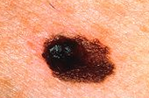
Signs of Melanoma (ABCDE)
A = Asymmetry
One half of the mole does not match other half

Slide 18

Signs of Melanoma (ABCDE)
B = Borders
Uneven , ragged, or notched

Slide 19
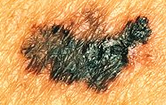
Signs of Melanoma (ABCDE)
C = Color
Different shades of brown, black or tan

Slide 20

Signs of Melanoma (ABCDE)
D = Diameter
Changed in size over time

Slide 21
Signs of Melanoma (ABCDE)
E = Evolving
Changes over time
Growing in size
Color
Shape
New symptoms
Bleeding
Itchiness

Slide 22
Procedures
Skin exam: Doctor checks the skin for bumps or spots that look abnormal in color, size, shape or texture.
Skin Biopsy: All or part the abnormal growth is cut from the skin and reviewed under a microscope
Shave Biopsy: A sterile razor blade is used to shave off the growth
Punch Biopsy: A special instrument called a punch or a trephine is used to remove a circle of tissue from the abnormal-looking growth

Slide 23
Treatment by Stages
Stage 0
Stage 0 melanomas have not grown deeper than the epidermis.
They are usually treated by surgery to remove the melanoma and a margin of about 1/2 cm (about 1/5 inch) of normal skin around it.

Slide 24
Stage I
Stage I melanoma is treated by wide excision (surgery to remove the melanoma as well as a margin of normal skin around it).
The amount of normal skin removed depends on the thickness of the melanoma. When the thickness is 1 mm or less, wide excision with 1 cm (2/5 inch) margins is recommended. For stage I melanomas between 1 mm and 2 mm thick, the tumor and 1 cm to 2 cm (4/5 inch) of surrounding skin are removed.

Slide 25
Stage II
Wide excision is the standard treatment for stage II melanoma. If the melanoma is between 1 mm and 2 mm thick, a margin of 1 to 2 cm of normal skin will be removed as well.
If the melanoma is thicker than 2 mm, about 2 cm of normal skin will be removed from around the tumor site.

Slide 26
Stage III
These cancers have already reached the lymph nodes when the melanoma is first diagnosed.
Surgical treatment for stage III melanoma usually requires lymph node dissection, along with wide excision of the primary tumor as in stage II.

Slide 27
Stage IV
Stage IV melanomas are very hard to cure, as they have already spread to distant lymph nodes or other areas of the body.
Metastases in internal organs are sometimes removed, depending on how many there are, where they are located, and how likely they are to cause symptoms.
Metastases that cause symptoms but cannot be removed surgically may be treated with radiation, immunotherapy, targeted therapy, or chemotherapy.

Slide 28
Reduce Your Risk

Slide 29
“Slip, Slop, Slap” Method
Slip on a shirt
Slop on sunscreen
Slap on a hat
Wear sunglasses to protect your eyes and skin around them

Slide 30
Seek shade when possible
Avoid tanning beds and sunlamps
Watch for abnormal moles
Get yearly checks with your doctor

Slide 31
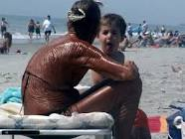
Consequences
If you love your sun bathing on the beach…

Slide 32
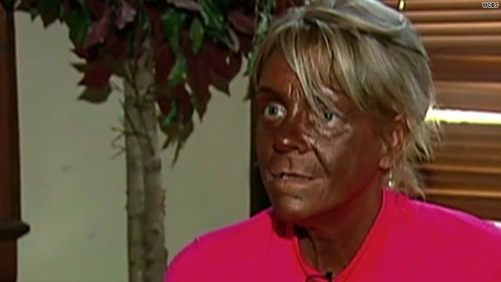
If you love tanning beds….

Slide 33
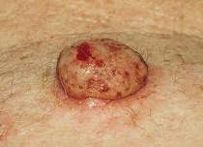
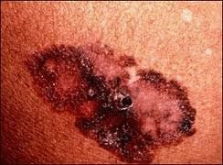
Or you decide to let your moles to get to this stage……

Slide 34


