Slide 1
Carcinoma of the Prostate
By:
Ishan Parikh

Slide 2
Background on Cancer
Oldest information dates back to 3000 BC, Egyptian textbook on trauma surgery – “There is no treatment.”
Hippocrates – “Father of Medicine” first used the term carcinos or carcinoma to describe non-ulcer forming tumor
The Greeks started referring to it as a crab because of it’s finger-like projections.
Latin term for crab – “Cancer”
Source: American Cancer Society
Notes:
Oldest description of cancer was found close to 3000 BC. It was in an ancient egyptian book and in the text they wrote “there is no treatment”
To us, cancer is known as any cell starting to grow abnormally or one that has gone out-of-control
When

Slide 3
What is Cancer?
Cells growing uncontrollably and having the potential to spread
When those abnormal cells become a mass, it becomes a “tumor”
Benign (noncancerous) tumors may interfere with body functions, such as urinating, but are not considered life threatening
Malignant tumors will invade surrounding tissues and destroy them
Prostate cancer is a malignant tumor that begins growing in the prostate gland
Metastasis is when the cells break away and spread to others parts of the body
Source: Marieb E. The reproductive system. Human Anatomy & Physiology. 4th ed. ; Pharmacotherapy: A Pathophysiologic Approach. 3rd ed.
Notes:
Oldest description of cancer was found close to 3000 BC. It was in an ancient egyptian book and in the text they wrote “there is no treatment”
To us, cancer is known as any cell starting to grow abnormally or one that has gone out-of-control
When

Slide 4
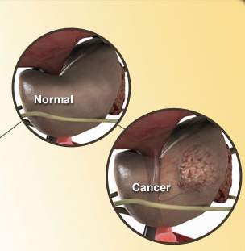
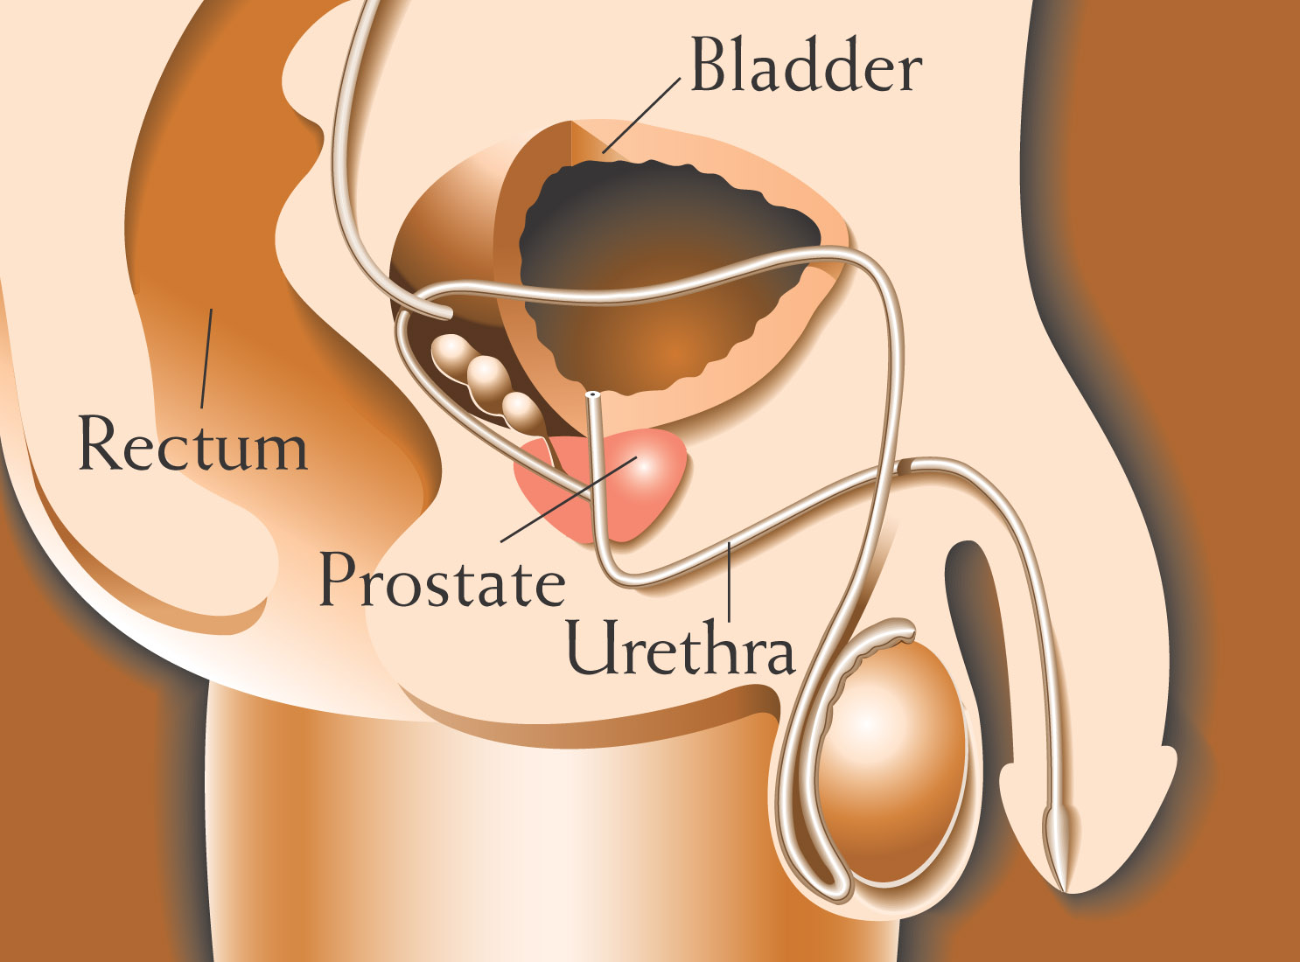
Prostate Carcinoma
Prostate gland produces fluid for semen
Most common cancer and 6th leading cause of death in males
Source: Marieb E. The reproductive system. Human Anatomy & Physiology. 4th ed. ; Pharmacotherapy: A Pathophysiologic Approach. 3rd ed.

Slide 5
Prostate Carcinoma Detection
Common methods to asses state of prostate include
A digital rectal exam (DRE)
A PSA blood test
prostate-specific antigen
A biopsy of tissue
Higher risk in men aged 50 or older, with 70% of cases coming from those aged 65 or older
All stages have an overall survival rate of 97%
Source: American Cancer Society

Slide 6
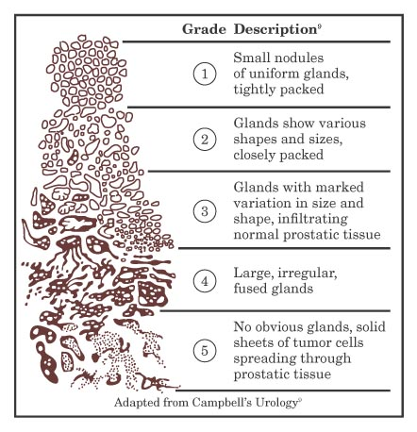
Grades of Prostate Cancer
Grades are how differentiated a single cell is from the normal
Gleason grade of 1 indicates the cancer cells resemble regular evenly spaced prostate tissue
Gleason grade 5 indicates tissue completely composed of tumor cells
If tumor has areas of different grades, the grades will add together to obtain a score from 2-10
Source: Campbell’s Urology

Slide 7
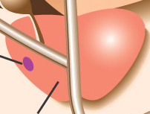
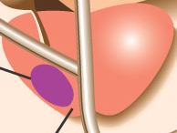
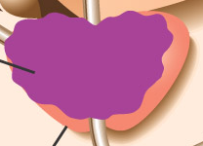
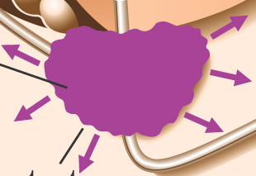
Stages of Prostate Cancer
Staging is an assessment of the size and location of tumor.
Important factor in determining treatment
Stage A (T1) – early cancer, tumor in prostate gland but can’t be detected by rectal exam
Stage B (T2) – Tumor confined to prostate but detected by rectal exam
Stage C (T3-T4) – Tumor has spread to surrounding areas
Stage D (N, M) – Cancer has spread to nearby and distant organs
Source: American Cancer Society
Notes:
M is given value from 0 for non metastasis to 1 for metastasized
N is grade of lymph node involvement from 0-3, 0 means no involvement

Slide 8
Treatments
Radical prostatectomy - Surgical removal before the cancer spreads
Cryosurgery - Liquid nitrogen put at the source of cancer cells to freeze and kill
Radiation – radioactive seeds implanted near cancer
Hormonal therapy – suppress testosterone to slow growth
Chemotherapy – targets cancer but also kills normal cells
Watchful waiting – usually for old age or slow growth
Source: American Cancer Society

