Slide 1
Polycystic Kidney Disease
Anne Campbell
1.23.2014

Slide 2
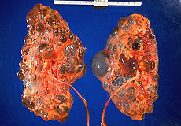
Polycystic Kidney Disease
Genetic Disease
Normal kidney tissue is replaced with fluid filled cysts
600K People suffer from PKD

Slide 3
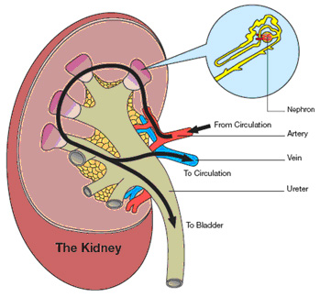
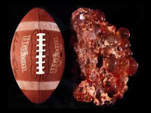
Characteristics of PKD
Enlargement of the Kidneys
Formation of fluid filled cysts
Pain

Slide 4
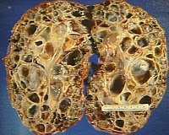
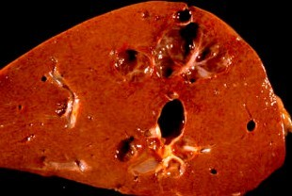
Characteristics of PKD
Renal Failure
Complications with other organs
2 types of PKD

Slide 5
Recessive vs. Dominant
Autosomal Recessive PKD
Autosomal Dominant PKD
Rare
Infantile
Must inherit 2 copies to express symptoms
25% chance
Common type of PKD
Adult PKD
Can inherit from a single parent
50% chance

Slide 6
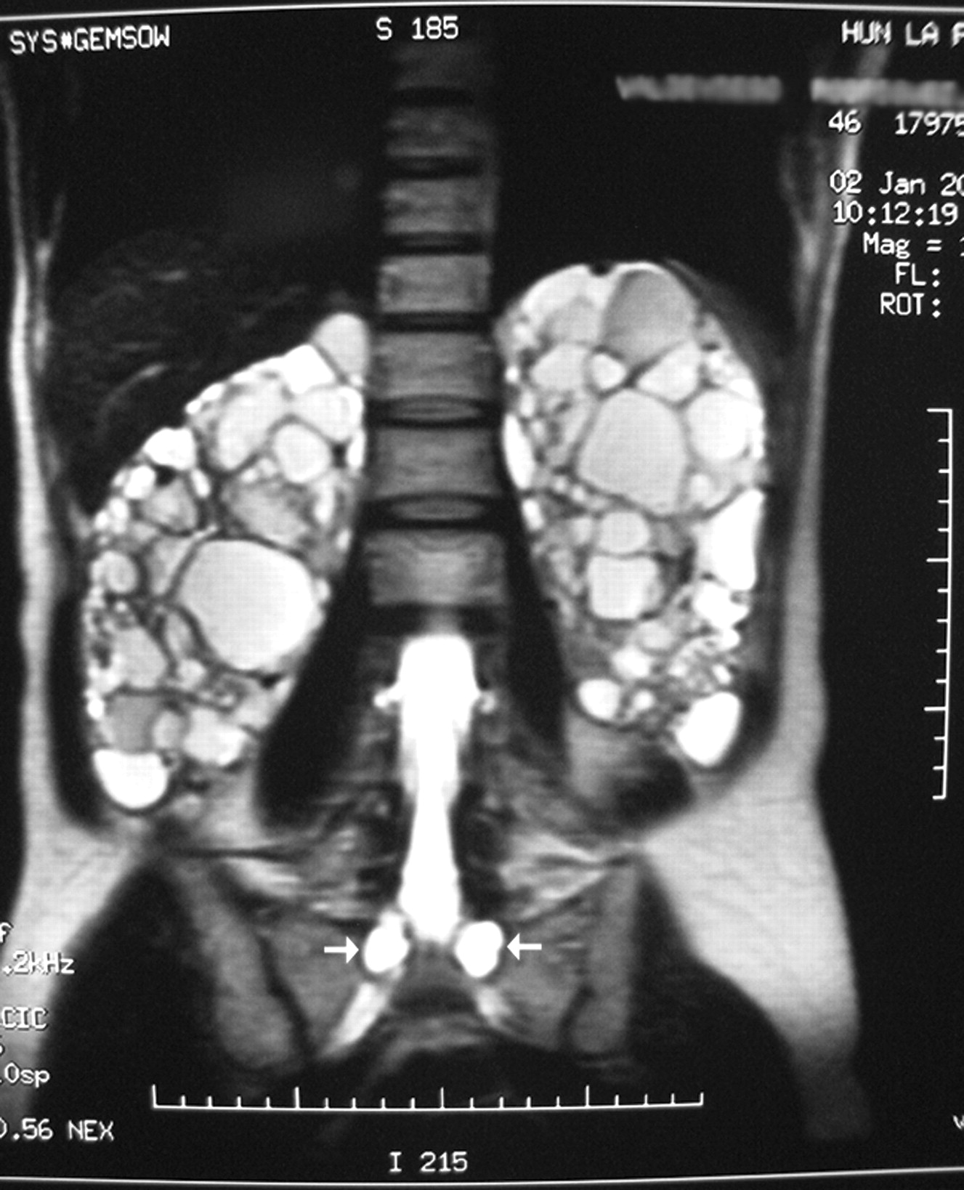
Autosomal Dominant PKD
10% of cases arise spontaneously
Symptoms appear around 20-30 years of age
20-30 lb kidneys
No cure, treat symptoms (high blood pressure, pain)

Slide 7
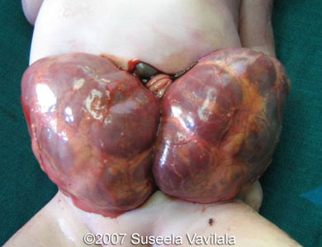
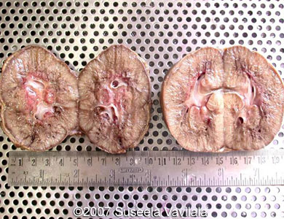
Autosomal Recessive PKD
Signs can begin before birth
Enlarged, abnormal kidneys
Developmental issues
Kidney failure early on
Liver scarring- worsens with age
No cure, treat symptoms
Worse cases- live only hours or days

Slide 8
Genetics of PKD
Autosomal Dominant: PKD1 and PKD2 (chr.16 and chr.4)
Polycystin-1 and polycystin-2
Autosomal Recessive: PKDH1 (chr.6)

Slide 9
References
http://sonoworld.com/fetus/page.aspx?id=2100
http://kidney.niddk.nih.gov/kudiseases/pubs/polycystic/#genetic
http://www.mayoclinic.org/diseases-conditions/polycystic-kidney-disease/basics/causes/con-20028831

