Slide 1
CHTN Staff Meeting Neuroblastoma
Alle Crider

Slide 2
Neuroblastoma
Neuroblastoma
Develops from immature nerve cells
Most commonly in and around the adrenal glands
Can also develop
In other areas of the abdomen
Chest, neck, & near the spine (where groups of nerve cells exist)
Horner Syndrome
Most commonly affects children age 5 or younger
Sporadic vs. Familial
Somatic mutations = Sporadic neuroblastoma
Familial - Gene mutations that increase the risk of developing cancer can be inherited from a parent
Mutations in the ALK and PHOX2B genes
Anaplastic Lymphoma Kinase
Nerve cells
http://ghr.nlm.nih.gov/condition/neuroblastoma
http://www.mayoclinic.org/diseases-conditions/neuroblastoma/basics/definition/con-20027487.

Slide 3
Neuroblastoma

Slide 4
Neuroblastoma
Neuroblastoma
Most common extracranial solid tumor in childhood
More than 650 cases are diagnosed each year in North America
Prevalence is about 1 case per 7,000 live births
Incidence is about 10.54 cases per 1 million per year in children younger than 15 years
About 37% are diagnosed as infants, and 90% are younger than 5 years at diagnosis, with a median age at diagnosis of 19 months
http://emedicine.medscape.com/article/988284-overview

Slide 5
Survival by: Risk Group and Age
The 5-year survival by risk group:
Low-risk group: Higher than 95%
Intermediate-risk group: 90%-95%
High-risk group: 40%-50%
The 5-year survival stratified by age:
Younger than 1 year – 90%
1 to 4 years – 68%
5 to 9 years – 52%
10 to 14 years – 66%
http://www.cancer.gov/cancertopics/pdq/treatment/neuroblastoma/HealthProfessional/page1
http://www.cancer.org/cancer/neuroblastoma/detailedguide/neuroblastoma-survival-rates

Slide 6
Survival by: Race
http://www.healio.com/hematology-oncology/news/print/hemonc-today/%7Be59a2ba2-4050-41bc-9656-d3e8b24d889c%7D/blacks-native-americans-more-likely-to-have-high-risk-neuroblastoma-poorer-survival

Slide 7
Staging
INSS
a postoperative staging system that was developed in 1988 (in an effort to combine two previously used staging systems) and used the extent of surgical resection to stage patients
INRGSS
a preoperative staging system that was developed specifically for the INRG classification system.
http://www.cancer.gov/cancertopics/pdq/treatment/neuroblastoma/HealthProfessional/page3.

Slide 8
Staging INSS

Slide 9
Staging INRGSS
Each patient has a risk stage defined that predicts outcome and dictates the appropriate treatment approach to be followed
Predictive value for lower stage patients, with stage L1 having a 5-year EFS (event free survival) of 90%, compared with 78% for L2

Slide 10
Treatments
Standard Treatments
Observation
Surgery
Radiation
Chemotherapy/drugs
High-dose chemo and radiation therapy with stem cell rescue
http://www.vicc.org/cancers/disease-info.php?xml=xml-files/summary/CDR258023.xml&target=treatment#

Slide 11
Treatments: Radiation
External Beam Radiation
Usually directed at the tumor, but total body radiation is used as well
MIBG radiotherapy
Used to treat some patients with advanced Neuroblastoma
http://www.cncfhope.org/Neuroblastoma_Radiation_Therapy

Slide 12
Treatments: Chemotherapy
Combinations are common
Examples of main drugs used
Cyclophosphamide/ifosfamide
Alkylating agent
Cisplatin/carboplatin
Platinum-compound that acts as an alkylating agent
Vincristine
Vinca alkaloid
Doxorubicin (Adriamycin)
Anthracycline antibiotic
Etoposide
Derived from a type of plant alkaloid called podophyllotoxin
Topotecan
Type of plant alkaloid known as a topoisomerase I inhibitor
http://www.cancer.org/treatment/treatmentsandsideeffects/guidetocancerdrugs/busulfan

Slide 13
Treatments: Retinoid Therapy
Retinoids – Chemicals that are related to Vitamin A
Differentiating agents – thought to help some cancer cells differentiate into normal cells
Isotretinoin – reduces risk of recurance after high-dose chemo and stem cell transplant

Slide 14
Treatments: High-Dose Chemo/Radiation Therapy with Stem Cell Transplant
Used in children with high-risk Neuroblastoma
Harvesting child’s own stem-cells
High-dose chemo and/or radiation
Peripheral blood stem cell transplant
http://www.cncfhope.org/Neuroblastoma_High-Dose_Chemotherapy-Radiation_Therapy_and_Stem_Cell_Transplant

Slide 15
Treatments
Low Risk
Surgery followed by observation
Chemo with or without surgery
Intermediate Risk
Chemo with or without surgery
Surgery alone for infants
Observation alone for infants
Radiation therapy for tumors that are causing major problems or that are not responding to other therapies
High Risk
Regimen of combination therapy, surgery, stem cell rescue, radiation, and chemotherapy
Clinical trials

Slide 16
Literature
2008 – MIBG for the Treatment of Neuroblastoma
Two things increase the uptake of MIBG into Neuroblastoma cells:
Pretreatment with Cisplatin or doxorubicin
Pretreatment with ϒ-interferon and retinoic acid
http://www.ncbi.nlm.nih.gov/pmc/articles/PMC2633223/

Slide 17
Clinical Trial
Objective: to provide palliative therapy with MIBG for patients with advanced neuroblastoma, pheochromocytoma, or paraganglioma, and gain more information about acute and late toxicity of 131I-MIBG therapy for patients with refractory neuroblastoma, pheochromocytoma, or paraganglioma
Patients: 12 months or older
Enrollment not listed
Principal Investigator: Haydar Frangoul
Drugs:131-MIBG/Iobenguane Sulfate
http://www.vicc.org/ct/protocol-results.php?protocol-no=VICCPED1249.

Slide 18
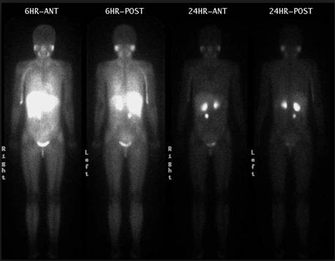
MIBG
MIBG: combined with radioactive iodine (I 123, I 131) to form a radioactive compound
I 123 MIBG
Has a shorter half-life than I 131 MIBG
Preferred for scans because of lower radiation dose, better quality images, less thyroid toxicity, and lower cost
http://www.drugs.com/pro/iobenguane-sulfate-i-131.html
http://www.cancer.gov/clinicaltrials/search/view?cdrid=682134&version=HealthProfessional.

Slide 19
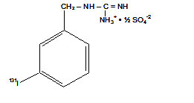
MIBG
I 131 MIBG
Iobenguane sulfate I 131, I 131-meta-iodobenzylguanidine sulfate
Similar in structure to the anti-hypertensive drug guanethidine and neurotransmitter norepinephrine
http://www.mayoclinic.org/drugs-supplements/iobenguane-i-131-intravenous-route/description/drg-20064357.

Slide 20
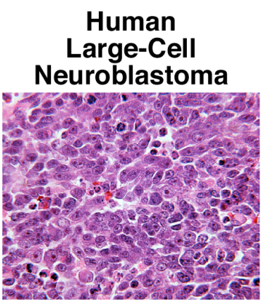
MIBG
I 131 MIBG
Taken up by neuroblastoma or pheochromocytoma tumor cells and delivers radiation specifically to the cancer cells and causes them to die
http://www.mayoclinic.org/drugs-supplements/iobenguane-i-131-intravenous-route/description/drg-20064357.

Slide 21
MIBG
Side effects
Most of the radiation stays in the area of the neuroblastoma, so most children do not have serious side effects from this treatment
Nausea, vomiting and sleepiness have been reported after injection of higher than the recommended doses of Iobenguane sulfate I 131
Some children might have swollen cheeks because it can affect the salivary glands and in rare cases it may cause high blood pressure for a short period of time
http://www.cancer.gov/clinicaltrials/search/view?cdrid=682134&version=HealthProfessional.

Slide 22
Sources
http://ghr.nlm.nih.gov/condition/neuroblastoma
http://www.mayoclinic.org/diseases-conditions/neuroblastoma/basics/definition/con-20027487.
http://emedicine.medscape.com/article/988284-overview
http://www.cancer.gov/cancertopics/pdq/treatment/neuroblastoma/HealthProfessional/page1
http://www.cancer.gov/cancertopics/pdq/treatment/neuroblastoma/HealthProfessional/page3
http://www.vicc.org/cancers/disease-info.php?xml=xml-files/summary/CDR258023.xml&target=treatment#
http://www.cancer.gov/drugdictionary?CdrID=38860
http://www.cancer.gov/drugdictionary?CdrID=39748
http://www.cancer.gov/drugdictionary?CdrID=42251
http://www.vicc.org/ct/protocol-results.php?protocol-no=VICCPED1249
http://www.drugs.com/pro/iobenguane-sulfate-i-131.html
http://www.cancer.gov/clinicaltrials/search/view?cdrid=682134&version=HealthProfessional
http://www.mayoclinic.org/drugs-supplements/iobenguane-i-131-intravenous-route/description/drg-20064357
http://www.cancer.gov/clinicaltrials/search/view?cdrid=682134&version=HealthProfessional

