Slide 1
Lymphoma
Focusing on Hodgkin Disease

Slide 2
Basics
Lymphoma – a cancer started in the cells of the immune system
5 types:
Hodgkin Disease
Non-Hodgkin Lymphoma
Non-Hodgkin Lymphoma in Children
Lymphoma of the Skin
Waldenstrom Macroglobulinemia
It is important to know the type you have because it can affect your treatment options and prognosis.

Slide 3
Hodgkin Disease
Type of lymphoma that starts in the white blood cells called lymphocytes
Named after Dr. Thomas Hodgkin (first discovered the disease)
2 kinds of lymphomas:
Hodgkin Disease (focusing on)
Non-Hodgkin lymphoma
Can be developed in children or adults

Slide 4
Understanding the body’s lymph (lymphatic) system
Part of the body’s immune system
Helps fight infections and other diseases
Helps move fluids around the body
Made up of tissue and organs
Composed of:
Lymphoid tissue – lymph nodes and related organs that are part of the body’s immune and blood forming system
Lymph – a clear fluid that travels through the lymph system carrying waste and excess fluid from tissues
Lymph vessels – small tubes through which lymph travels to different parts of the lymph system
Similar to blood vessels

Slide 5
Lymphocytes
Makes up lymphoid tissue
A type of white blood cell that fights infection
2 major types:
B lymphocytes – B cells protect the body from germs
Almost all Hodgkin cases start here
T lymphocytes – several types, each with a special job
Example: some can destroy certain kinds of bacteria

Slide 6
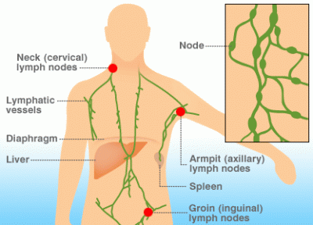
Organs with lymphoid tissue
Lymph nodes
Found in chest, abdomen, pelvis, groin, neck and under arms
Spleen
Bone Marrow
Thymus
Digestive tract

Slide 7
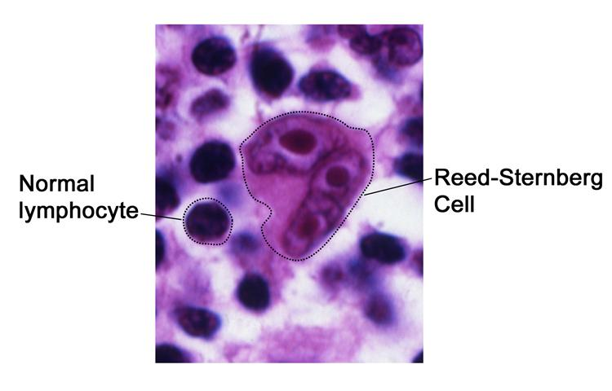
Hodgkin Disease: specifics
It can start almost anywhere, but most often in lymph nodes in the upper body.
Most common: chest, neck or under arms
Spreads through the lymph vessels from lymph node to lymph node.
Rarely and late in disease, it can invade the bloodstream and spread to other sites in the body
Cancer cells called Reed-Sternberg cells
Named after the two 2 doctors who first found them
Usually an abnormal type of B lymphocyte
Interesting point*

Slide 8
Types of Hodgkin Disease
Different types are classified based on how they look under a microscope because they grow and spread differently.
2 main types:
Classic Hodgkin Disease
Reed-Sternberg cells
(Rare) Nodular lymphocyte predominant Hodgkin disease
ALL types are malignant.

Slide 9
Classic Hodgkin Disease
Accounts for about 95% of all cases of Hodgkin Disease
Subtypes:
Nodular sclerosis Hodgkin disease
Most common type
Occurs mainly in younger people
Tends to start in lymph nodes in neck or chest
Mixed cellularity Hodgkin disease
Seen mostly in older adults
Mainly occurs in upper half of body
Lymphocyte-rich Hodgkin disease
Usually occurs in the upper half of the body
Rarely found in more than a few lymph nodes
Lymphocyte-depleted Hodgkin disease
Least common form
Occurs mainly in older adults
Usually advanced when first found

Slide 10
Nodular lymphocyte predominant Hodgkin disease
Accounts for about 5% of Hodgkin disease
Can occur at any age
More common in men than women
Usually involves lymph nodes in neck and under the arm
Contains large cells called popcorn cells because they resemble popcorn

Slide 11
Risks
Mono
Age*
Gender: Male is more common
Location: most common in US, Canada and northern Europe
Brothers and sisters with disease, identical twin with disease
HIV infection
Interesting risk*

Slide 12
Causes & Preventions
There are no exact causes or preventions for Hodgkin Disease
However it has been linked to Mono and HIV
Limit your risk by avoiding known risk factors for HIV
There is no way to prevent Mono

Slide 13
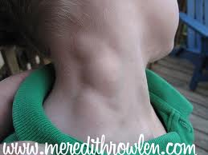
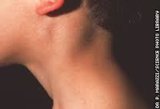
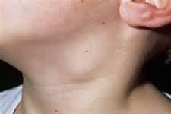
Signs/Symptoms
Lump under skin
Located in neck, under arm or in the groin
Fever
Drenching night sweats
Weight loss
Itching skin
Tiredness
Loss of appetite
Cough, trouble breathing, chest pain

Slide 14
Staging
Based on:
Medical history, physical exam, biopsies, imaging tests, blood tests and bone marrow aspirations/biopsies
Cotswold staging system:
Stage I:
Hodgkin found in only 1 lymph node or lymphoid organ
Cancer is found in only 1 area of a single organ outside the lymph system
Stage II:
Found in 2 or more lymph nodes on the same side of the diaphragm
Extends locally from 1 lymph node area into a nearby organ
Stage III:
Disease found in lymph nodes on both sides of the diaphragm
Disease is in lymph nodes above and below the diaphragm, and has spread to a nearby organ
Stage IV:
Disease has spread through 1 or more organs outside the lymph system
Disease found in organs in 2 distant parts of the body
Disease is in liver, bone marrow, lungs or cerebrospinal fluid

Slide 16
A, B, E and S
A and B
A = no symptoms
B = any of the symptoms listed:
Loss of more than 10% body weight over last 6 months
Unexplained fever of 100.4°F or more
Drenching night sweats
E and S
E = outside the lymph system
S = in the spleen

Slide 17
Treatment
Several types can be used:
Chemotherapy
Radiation therapy
Monoclonal antibodies
High-dose chemotherapy and stem cell transplant*
The method of treatment depends on the stage of the disease and how the individual’s body reacts to therapy.
When treating children, doctor’s often combine chemotherapy with low doses of radiation because radiation can be more harmful to a child that isn’t fully developed.

Slide 18
Statistics
American Cancer Society estimates that 1,180 people will die of Hodgkin Disease in 2014
NCI’s SEER database: 8000 participants diagnosed with Hodgkin disease between 1988-2001 (5-year survival rate)
Stage I: ~ 90%
Stage II: ~ 90%
Stage III: ~80%
Stage IV: ~65%
NCI’s SEER:
85.3% 5 year survival rate from 2004-2010

Slide 19
References
American Cancer Society: http://www.cancer.org/cancer/lymphoma/index
National Cancer Institute: http://www.cancer.gov/cancertopics/types/hodgkin

