Slide 1
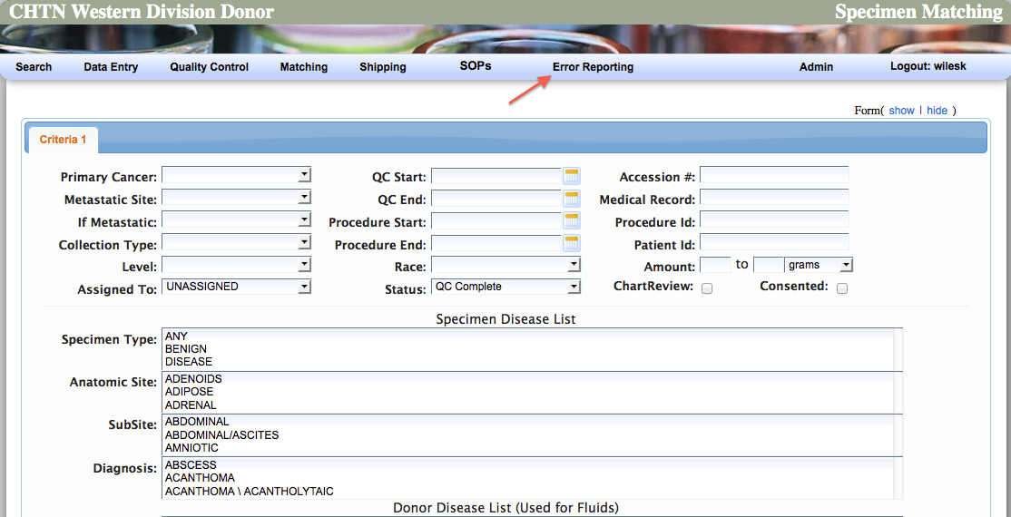
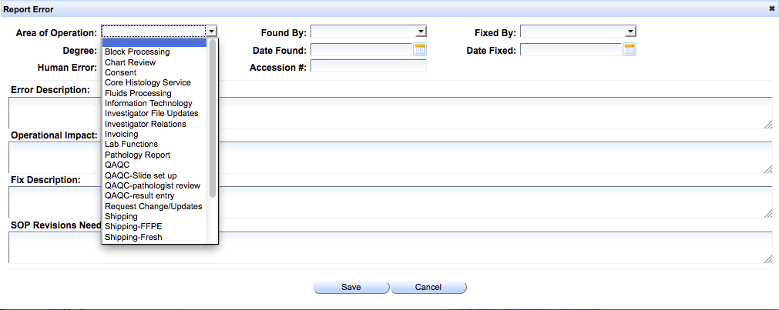
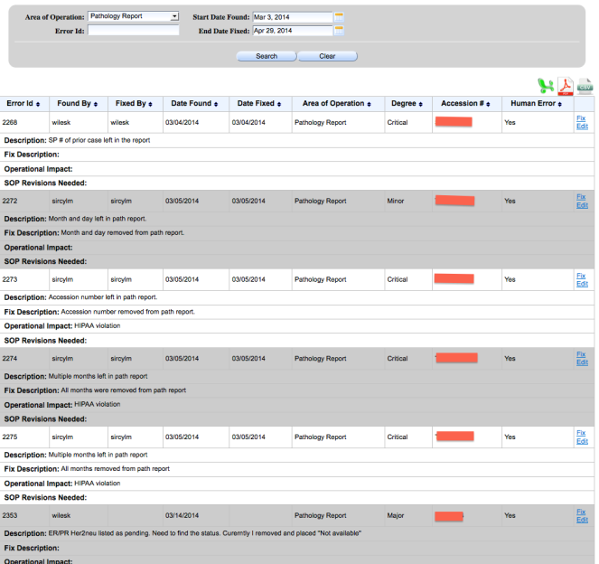
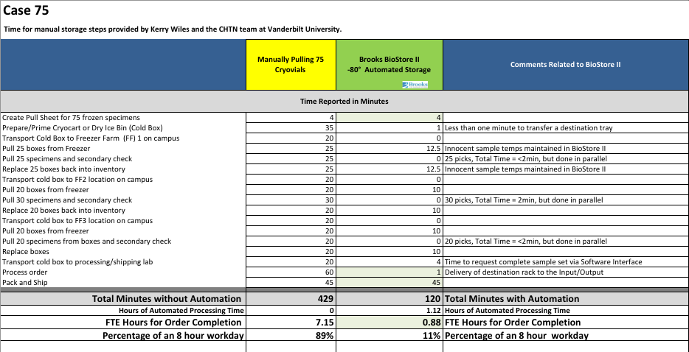
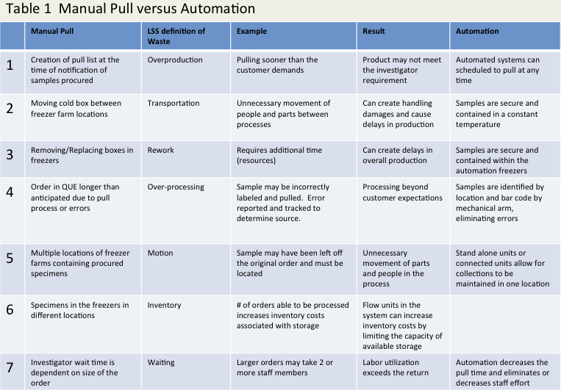
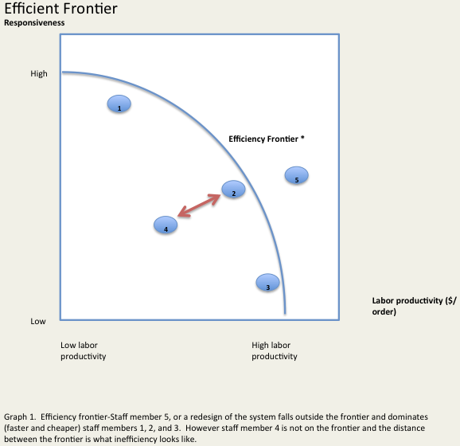
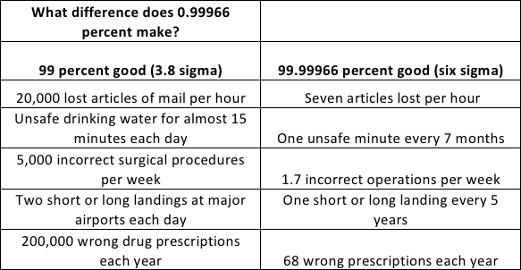
#RM_08
Applying End-to-End
Real World Process Infrastructure to Biobanking
in the Academic Setting
By: Kerry Wiles (Vanderbilt University Medical Center,CHTN), Ian Pope (Cryo Associates), David Lewandowski (Brooks Automation)
Introduction
Error Reporting Cont.
Maintaining, growing and sustaining an academic biorepository is not an easy feat, especially if the financial support is not consistent. Many academic repositories look for opportunity outside the institution or choose to grow from the inside through engineered innovation. Both are challenging and are not always feasible alone or when used in combination. Choosing to grow from within requires that the operations management, institutional resources and growth targets be aligned. To accomplish this, you must:
streamline operations
come up with new ideas and vet them successfully
implement the strategy of financial sustainability in operations which include growth.
Mapping out a clear plan of action, reviewing strategies, defining the “business need” and finding workable solutions can be difficult and confusing. Unfortunately, there is not a one-size-fits-all approach. The solution will most likely include best practices and principles focusing on lean manufacturing and operations management.
Lean six sigma (LSS), six sigma (SS), process and operations management (POM), innovation techniques and the McKinsey method are a few examples of methodologies that can be applied to biorepository operations to identify gaps between current, required and optimal performance. The approach chosen by a biorepository and ultimately the success will be dictated by the institutional systems that can be leveraged to enhance data transfer and minimize manual entry, ergonomic work space, equipment provided and trained and qualified staff.
The Cooperative Human Tissue Network at Vanderbilt University Medical Center is an academic, federally funded repository that completed LSS series in combination with a McKinsey approach in 2009 in order to find inefficiencies and waste. In the LSS model there are eight kinds of waste; defects, overproduction, waiting, non-utilized talent, transportation, inventory, motion and extra processing.
The exercise involved training and workbooks with expectations and deadlines that were completed by each team leader and their support staff from each repository area. LSS-DMAIC was used to define, measure, analyze, improve and control functions in their work area. The process in each area was broken down into “task-transactions” in which there were potential for error and waste. A task-transaction was defined as any field that required manual work or data entry or required the user to save data to the donor tissue repository application. The transaction was defined as a process and included examples of possible waste and errors (human and IT). Working under the premise that problems, errors and waste can be extracted from a process and modeled; user-friendly tools were developed to report and analyze error and inefficiencies in the operations.
The over arching goal of the exercise was to improve performance and quality by preserving value with less work and develop lean enterprise strategies that can institute last change at the process level.
The error-reporting module allows users to report directly to the tissue repository donor system under any menu item (Screenshot 1). A pop up box appears that contains pre-populated data and allows the user to select from drop downs defining which operational area the error most likely occurred, the severity, date found and fixed, which staff member reported the error and a brief description of the error, the operational impact, how the error was fixed and if SOPs need revisions.
Error reports can be viewed and analyzed by repository function and date range (Screenshot 2). The errors are binned by repository operation and then sorted by impact and severity and reviewed and discussed to determine if changes are required to SOP manuals or if re-training should exist (Screenshot 3 & 4).
There is no firm consensus on what constitutes an “acceptable error rate” for biorepositories, like there are in many businesses, so benchmarking our operations against another institutions was not possible. However, the error-reporting module has allowed us to revise SOPs to include very detailed instructions and alter training methods, which decreased the number of errors in operational areas.
Screenshot 1
Screenshot 2
Screenshot 3
Screenshot 4
Challenges of the Academic Biorepository
The goal of every biorepository should be to minimize waste, operate as efficiently as possible, match supply with demand and be poised for growth to ensure sustainability. The problem is figuring out how to best achieve this goal, using the resources available. Biorepositories preparing for expansion and growth are typically plagued with some important questions; can I afford to expand and maintain or improve the level of service and what does expansion look like?
This poster will discuss two areas of the greatest sources of waste in the CHTN VUMC model; pulling frozen tissues for orders and error reporting. We will compare our findings against storage automation with real time performance dashboards.
Currently, CHTN VUMC has biospecimens stored in -8ͦ0°c mechanical freezers in 4 locations across campus and 2 liquid nitrogen freezers, each with its own risk, disaster and continuity of operations plan. CHTN VUMC like many academic centers have limited space available for research and therefore utilizes freezer farms for long-term storage. Personnel are required to move dry ice bins or Cryocarts to each location to remove specimens for pending orders, thus increasing the “pull time” and potentially introducing errors in cold chain of custody, all of which directly impacts processing cost. In the most basic sense, the process can be described as beginning with an input (biospecimen order), utilizing resources (labor and capital) to produce an output (shipment).
The process flow chart 1 shows the steps and time involved in pulling an order from 3 mechanical freezers, located in different freezer farms at VUMC. The red highlighted steps could be perceived as bottlenecks in the system and therefore waste, but it does not provide a clear picture of all the possible waste that can occur in a manual process. Using the paradigm that there are seven sources of waste in a system enhances the process so that waste is explained and visualized completely compared to an automated system (Table 1).
To provide stronger evidence that inefficiencies exist in a manual effort lies with the staff members themselves. Assuming all staff members are equally trained to process an order, differences (inefficiencies) between how quickly an order is processed (responsiveness) and the overall cost to the repository (labor costs) will be seen across the staff members (Graph 1). There will always be tension between responsiveness and productivity, but the objective is to find the right balance between competing objectives, high service and low cost. One way to meet that challenge would be to question the design of the current system and consider investments in developing new technologies to reduce pull time and labor costs, such as implementing automation that would push to a new frontier.
Results – Automation vs. Manual Pull
Comparing the financial cost (staff labor) of manually pulling an order of 75 specimens at multiple freezer farm locations against an automated system (Brooks Biostore II) clearly demonstrates the waste and inefficiencies (Table 3). Other factors that were examined and compared were; density/storage capacity, the equipment footprint and the kilowatt of energy utilized by the systems (Table 4).
Table 3
Table 4
Results – Error Reporting
Error-reporting is crucial in developing and sustaining an efficient biorepository, especially if staff turn-over is high. The reports can be viewed to drill down to specific operational areas or specific staff members who are continually repeating errors to areas that are more prone to errors than other areas. The data generated by the reporting feature can be used to revise or generate new work breakdown structures and evaluate resource load so that leveling techniques can be identified to reduce cost and errors. The ultimate goal of any biorespository if to operate efficiently and repeating work to fix errors can cause delays in getting the tissues into the hands of the investigators or causing the sample and data integrity concerns.
CHTN VUMC has criteria that exists in the SOPs for certain cancers to be reported as an additional data element in the final pathology report that is currently not a CAP requirement, such as smoking history for lung cancers or PSA levels for prostate cancers. Failure of the staff assigned to “scrub” final pathology reports and input the data is considered an “error” for this operational step. CHTN VUMC noted a high error rate in this area and determined that re-training and assigning the task to more highly trained staff members reduced the errors significantly.
Error Reporting
Conclusion
Error reporting and the disclosure of errors are two important concepts affecting how well a biorepository operates. The way errors are identified, reported and communicated is critical to its success. Even small changes including revisions to SOPs and processes can impact your operations success or failure. Many biorepositories struggle with how to effectively evaluate their operations, especially if operations take place across many locations and departments. Determining operational efficiency and error rates can be a difficult task.
“If you operate at a Six Sigma quality level, then you commit no more than 3.4 defects per million opportunities for defects. This means that you operate your processes correctly the first time 99.9997 percent of the time”(1). Table 2 depicts the 99 percent “good” (3.8 sigma) and the 99.99966 percent good (1).
Table 2.
Most repositories do not have a sophisticated strategy for error reporting and analysis, which can help identify opportunities to improve SOPS and operations. Today, many systems rely on the staff to inform the Director or Manager when an error occurs which shifts the burden on the Manager to determine the severity, log the error and solution and then determine if changes to SOPs are required.
VUMC-CHTN developed an error-reporting module within our Donor repository IT system. This module allows staff to report an error, determine the severity and the effect on operations. Personnel are required to make decisions regarding the impact of the error and suggest whether the SOPs should to be updated. We took a structured and systematic approach and developed very detailed process flow charts outlining each transaction in each operational area in which potential errors could take place. We then combined this data with known errors reported over the course of three years. There were several phases that teams/leaders went through including:
Engagement. The staff committed to change and determine how the error log would contribute to their area and the project
Execution. The staff helped establish an action plan, communicated how it will contribute to the repository
Evaluation. Collected data and measure the effect.
The result of the assessment helped to develop a risk analysis and mitigation plan for each operational area and identified opportunities to improve the system, prevent errors and add value to the repository (QR code). The same Risk Analysis and mitigation plan for our internal consent process can be viewed by scanning the QR code. A beta test version of the error-reporting module was developed in excel and used as an exercise in the development of the final product which is hosted on our Donor IT system
Most often, especially in federal funding the quest is for new, innovative and novel wet bench research tools that will enhance the use of or increase the usefulness of the biospecimen. Although this type of funding is vitally important, it is equally important for the funding agencies understand and support the process of biorepository itself and understand how systemic innovation can reduce the overall operational cost and institutional cost, while increasing the integrity of the sample and associated data. The single major factor that prevents the academic biorepository from moving into the automation era is the initial capital investment and the subsequent maintenance or service contract costs. There must be an understanding at the highest level, that innovating a process and streamlining a system has the potential to save research dollars as demonstrated by the cost saving of electricity, labor costs and ensuring the integrity of the sample. The ability of the academic, federally funded repository service to innovate and streamline is seriously hampered by the lack of biorepository operational sustainability grants and the indirect costs of the institution, not to mention the depreciation of equipment. The other limiting factor may be the rules surrounding the federal grants and the program income rules that limit the repository from moving into the automation era.
There may be several viable options such as; a tax incentive for companies that provide automation equipment at reduced cost to academic entities, re-organization of rules associated with grants that allow any academic center receiving federal funding to operate a biorepository a reduction of 15% to 20% in indirect costs; revising program income rules to allow funds to be placed into an interest bearing saving account or unrestricted fund account which can generate interest. A strategic alliance between both the academic center and the automation manufacturer in which mutual needs bring them together to create new value may be the most viable option.
Currently, there is no federal funding available for biorepositories that wish to innovate using the tools that exist for Private Corporations, such as freezer automation equipment. Clearly we have shown that the processes surrounding research can be innovated to produce better quality, less waste, a constant cold chain of custody and sample management with the use of automated freezers.
The error reporting dashboard feature in our Donor IT system has helped to identify waste and provide a mechanism to allow the repository manager to get a birds eye view of the operations as well as drill down to potential problems areas and monitor efficiency and evaluate quality and implement changes to increase overall efficiency.
Table 2
Acknowledgements & References
This project is supported by NCI/NIH 2U01CA091664-10. Thank you to Kiley Wease, VUMC-CHTN administrative assistant, for design and compilation of poster.
(1) A Breakthrough Management Group with Neil DeCarlo. Lean Six Sigma, Get the tools you need to build a lean, mean business machine. New York; Penguin Group, 2007. Page 24.
QR code

