Slide 1
HPV tumors & Head and Neck Cancers

Slide 2
What is HPV?
Human papillomavirus: A family of over 100 viruses including those which causes warts and are transmitted by contact.
Each virus is given a number and this is called an HPV type.
75% of them causes warts on the skin, while the other 25% are mucosal (STI’s). These are the types that cause genital warts .
Some types of HPV is known to cause cervical, anogenital, and head and neck cancers.
Notes:
While there isn't a cure for HPV normally the infection would clear up on its on. If not steps would be taken: Cerivical HPV infection the abnormal cells would be froze with LN2 or removed with electrical current.

Slide 3
Mucosal/genital
(~40 types)
Nonmucosal
(~60 types)
High-risk types
16,18,31,45
(and others)
Low-risk types
6,11
(and others)
Low-grade cervical abnormalities
Genital warts
Laryngeal papillomas
Skin warts
Low-grade cervical abnormalities
Cancer precursors
Anogenital cancers
Head and neck cancers
Notes:
While not all HPV infections will develop into cancer, persistent infection with HPV types 16 and 18 can lead to cancer.

Slide 4
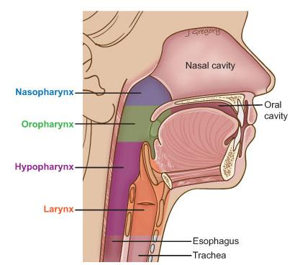
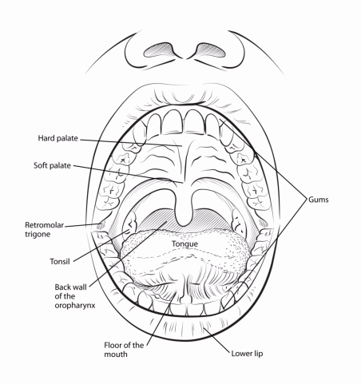
Signs and symptoms
Sore throat that does not go away
Dull pain behind the breast bone
Constant cough
Trouble swallowing
A lump in the back of mouth, throat, or neck.
Notes:
More than 90% of HPV postive cancers are Squamous Cell carcinomas

Slide 5
63% of Head and neck cancers are associated with HPV infection.
HPV tumors are found in 2 out of 3 head and neck cancers.
In 2010 NCI estimated more than 12,000 cases of throat cancer and ¾ caused by HPV.
There is a vaccine for mucosal HPV’s
Notes:
Some think that if HPV positive throat cancer continues to rise the incident rate will be higher than cervical cancer. Can anything think of a reason why

Slide 6
HPV Prevention
There are vaccines that are “safe” and “effective” for both male and female which are given in three doses over six months.
Cervarix ( )and Gardasil ( )are known to protect females from HPV types that cause most cervical cancers. Both vaccines are also shown to protect ano-genital cancers in both men and women.
Gardasil protects against most HPV types that causes genital warts.
Notes:
Biomarkers- there were previous studies of patients with HPV-related oropharynx cancer found antibodies to HPV16 E6 in their blood.
While you don’t think about talking about your sex life with your dentist, dentists are screening for oral cancers along with your routine cleaning.

Slide 7
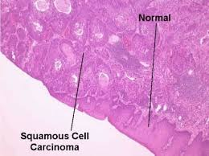
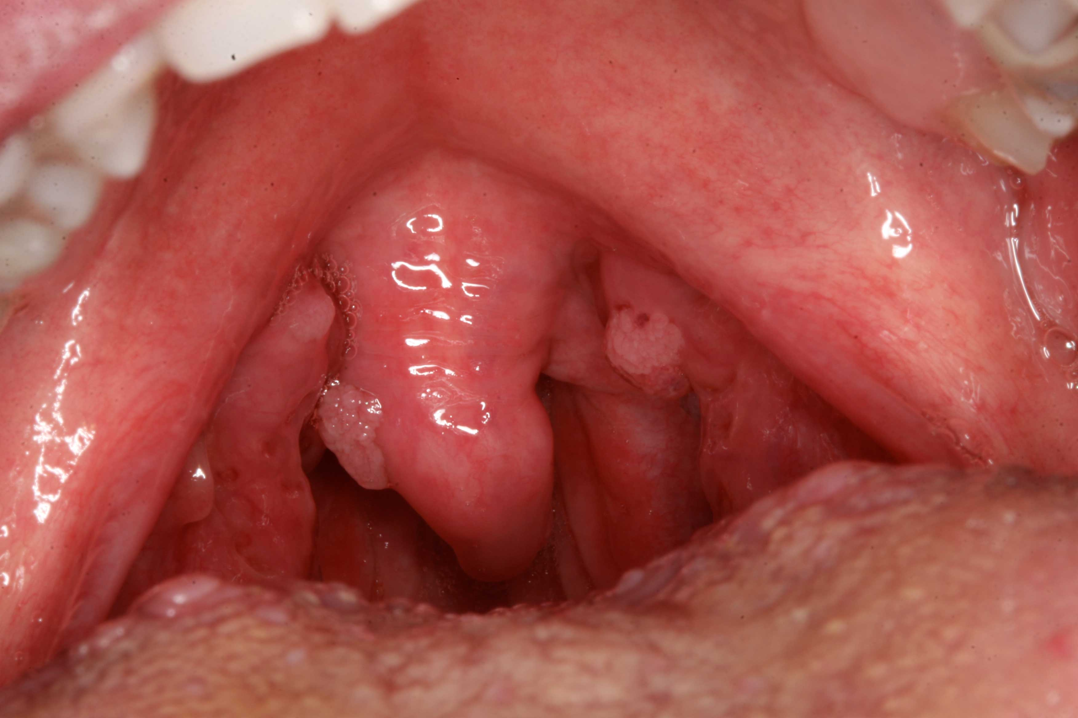
Notes:
90% of OPC’s are SCC.
Squamous Cells are in the inner lining of the cheeks, gums, and tongue.

Slide 8
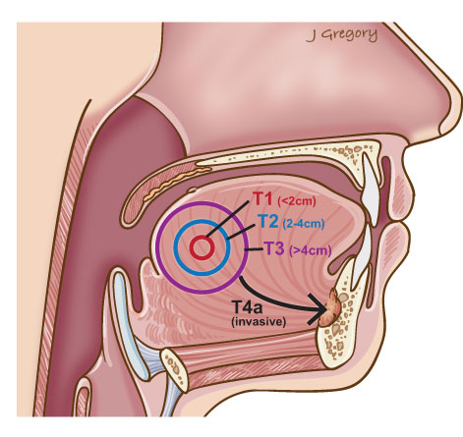
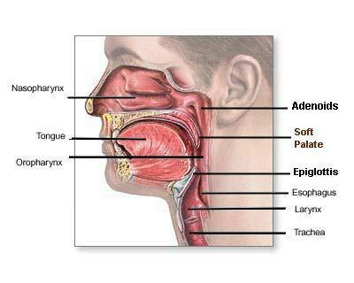
Notes:
For cancers in the oropharynx stage III this includes if the tumor has grown to the epiglottis ( the little flap that covers the trachea during swallowing.
Stage IV is broken down into three categories A B and C: A the tumor has spread to the larynx, the front part of the roof of the mouth, lower jaw or muscles that move the tongue or are used for chewing.
B: The tumor surrounds the carotid artery or has spread to the muscle that opens the jaw the bone that’s attatched to those muscles, the Nasopharynx or the base of the skull.
C: the tumor is of any size but has spread to the lung bone or liver.

Slide 9
Treatments
 | Stages I & II | Stage III & IVA | Stage IVB
LIP | Main- Surgery/radiation alone |  | Usually treated with chemo and/or cetuximab**
Front of tongue Floor of mouth Inside cheek | Main- Surgery/Radiation* Adjuvant- chemo | Surgery and Radiation combo after lymph nodes removed
Oropharynx | Main- radiation therapy aimed at the lymph nodes | Chemo-radiation Lymph node dissection
Notes:
*Radation would be used on patients who have medical issues
**Epidermal growth factor receptor inhibitor- also used in metastatic colorectal cancers( KRAS wild-type)
There hasn’t really been enough cases and studies to say for sure that HPV+ cancers have a higher survival rate but since the patients are getting younger and younger I can imagine them battling the side effects from surgery and chemo a little better.

Slide 10
Notes:
A lot of this is still fairly new…Vaccines were created not even 15 years ago, the incidence rates are still rising. Its very frightening that an STI can lead to something like cancer. There are so many factors that are out there: Kids are having unprotected sex younger now, what if a mother has an HPV 16 infection and unknowingly pass it to her child? There are still women out there that doesn’t seek prenatal care.

