Slide 1
Progeria
The disease of accelerated aging
By: A.Campbell
11.14.13

Slide 2
Definition:
A genetic disorder that results in premature aging
Hutchinson-Gilford progeria syndrome (HGPS)
Werner Syndrome

Slide 3
Background Information
Prevalence: Rare
  130+ cases since 1886
Physical Development vs. Intellectual Development
Autosomal Dominant

Slide 4
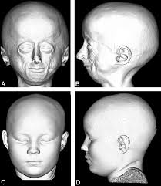
Symptoms: What and When

Slide 5
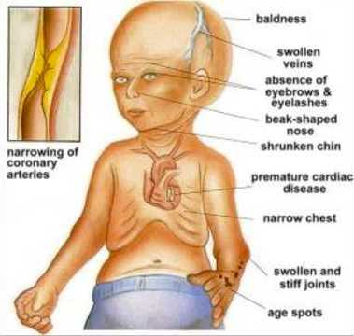
What are the symptoms?
Slow growth/ weight gain
Alopecia
Joint abnormalities
Cardiovascular disease
Loss of subcutaneous fat

Slide 6
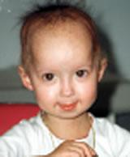
When do they start?
After Infancy
Children look normal at birth/early infancy

Slide 7

Physical features
Prominent eyes
Thin, beaked nose
Thin Lips
Small chin

Slide 8
Treatments
No known cure
Treat the symptoms
Promising results with Farnesyltransferase Inhibitors
  Treats the cause of progeria

Slide 9
Life Expectancy
100% Fatality rate
Die of symptoms
  Most often heart attack or stroke
Live for about ~13 years

Slide 10
GENETICS: LMNA Gene

Slide 11
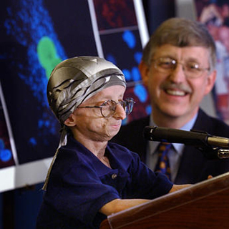
LMNA Gene
Linked to progeria in 2003
Discovered by NHGRI team led by Francis Collins

Slide 12
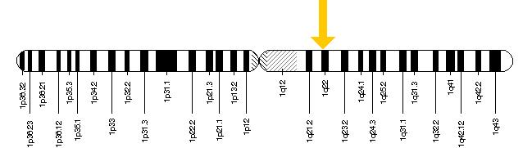
LMNA Gene
Produces Lamin A/C
Lamin A is a nuclear membrane protein
Maintains structural integrity of nucleus
Located 1q22

Slide 13
Mutated LMNA Gene
Single point mutation
C1824T
Truncates Lamin A = progerin

Slide 14
Progerin
Lamin A requires posttranslation modification → Farnesyl group is removed
Progerin lacks the cleavage site needed to removed the Farnesyl group

Slide 15
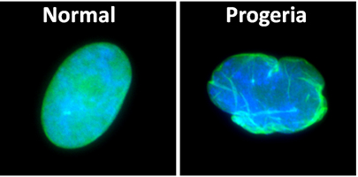
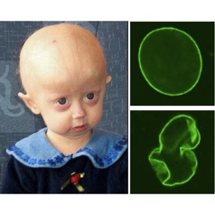
Progerin
Farnesylation: facilitates membrane association
What does this mean for progerin??
What does this mean for the nucleus??
Collins’ Lab study: supports theory

Slide 16
Current Research
"Connecting this rare disease and normal aging is bearing fruit in an important way...valuable biological insights are gained by studying rare disorders such as Progeria. Our sense from the start was that Progeria had a lot to teach us about the normal aging process."
- Dr. Francis Collins, Director of the National Institutes of Health

Slide 17
Role of progerin in normal aging
NHGRI linked telomere length to progerin production
Cells w/ high telomerase levels had little progerin production
Studied normal cells- ages 10-92YO

Slide 18
Breakthrough Treatment
FTIs
Show reversal of HGPS symptoms

Slide 19
Have we found a cure?
Lonafarnib- FTI
Weight gain- increased bone density + lean body mass
Aortic stiffness decreased

Slide 20
References
http://www.nih.gov/news/health/jun2011/nhgri-13.htm
http://www.genome.gov/27534095
http://ghr.nlm.nih.gov/gene/LMNA
http://www.progeriaresearch.org/first-ever-progeria-treatment.html
Gordon et. al., Clinical Trial of a Farnesyltransferase Inhibitor in Children with Hutchinson-Gilford Progeria Syndrome, PNAS, October 9, 2012 vol. 109 no. 41 16666-16671
http://report.nih.gov/nihfactsheets/viewfactsheet.aspx?csid=59
http://www.ncbi.nlm.nih.gov/pubmed/11842430
http://www.pnas.org/content/109/41/16666.full
http://ghr.nlm.nih.gov/condition/hutchinson-gilford-progeria-syndrome
http://www.genome.gov/11007255

