Slide 1
Targeted Cancer Therapies
How they work and the future of medicine

Slide 2
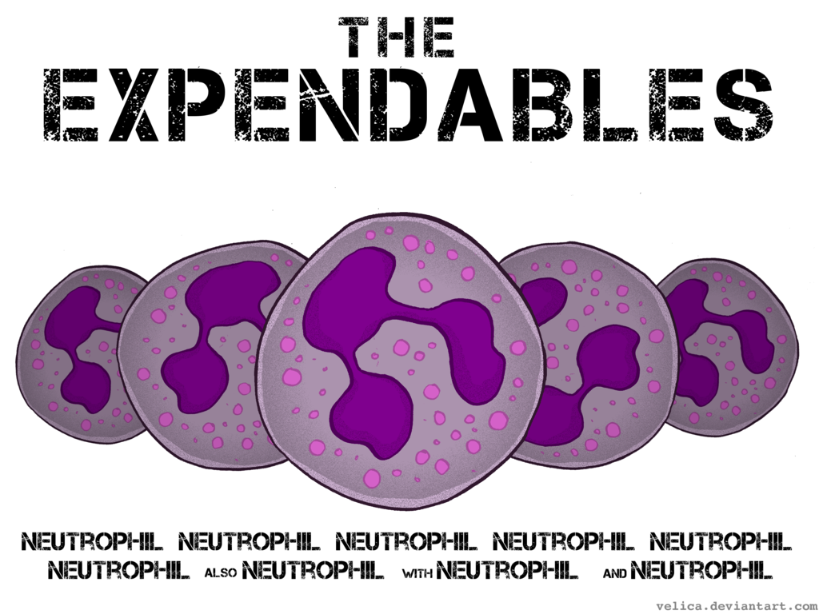
The life(span) of a cell
Every cell has a set lifespan
After that lifespan has been reached, a cell undergoes apoptosis (programmed cell death)

Slide 3
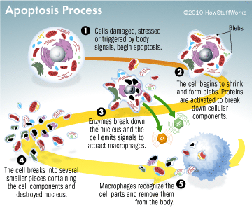
How does apoptosis work?

Slide 4
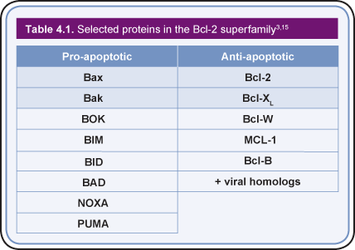
The Apoptotic Molecules

Slide 5
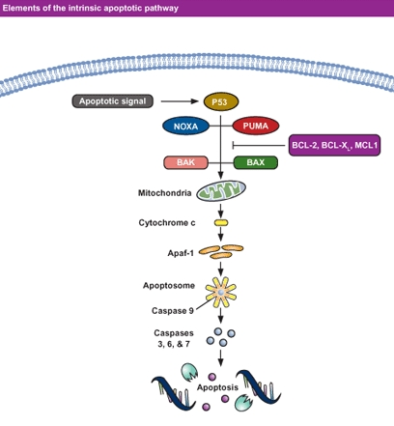
The Intrinsic Pathway
Mitochondrial pathway initiated from within cell
Activated in response to signals resulting from DNA damage, loss of cell-survival factors, or other types of severe cell stress
Pro-apoptotic proteins are released from the mitochondria
The intrinsic pathway hinges on the balance of activity between pro- and anti-apoptotic signals of the Bcl-2 family

Slide 6
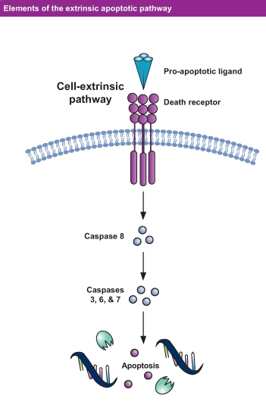
The Extrinsic Pathway
The extrinsic pathway involves transmembrane death receptors that are members of the tumor necrosis factor (TNF) receptor gene superfamily
They bind to extrinsic ligands and transduce intracellular signals that ultimately result in cell destruction
Molecules that stimulate the activity of the pro-apoptotic proteins or activate these receptors are currently under evaluation for potential in the treatment of cancer

Slide 7
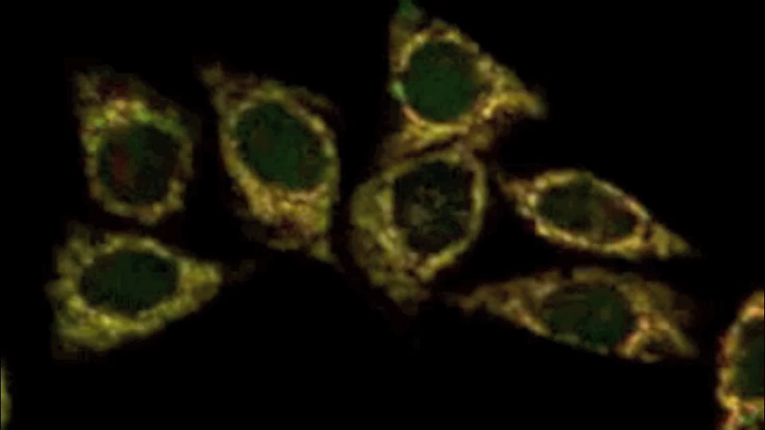
Cells undergoing apoptosis

Slide 8
Normally…
Cells are remarkable at taking care of problems that arise.
Apoptosis is triggered not only when a cell reaches the end of its lifespan,
But also when the cell DNA is damaged and cannot repair it,
    Example: DNA is copied incorrectly in a dividing cell
Or when the cell no longer has a useful function or lost its function,
    Example: Cells of the webbing between fingers and toes during development are lost when the digits become fully developed
Or when a cell loses during cell competition.
    Example: As the brain develops, more neurons are made than actually needed, and those that don’t reach their target die

Slide 9
“Traditional” Targeted Therapies
Drugs that block the growth and spread of cancer by interfering with specific molecules involved in tumor growth
Most targeted therapies are either small-molecule drugs or monoclonal antibodies:
  Small-molecule drugs diffuse into cells & act on intracellular targets
  Most monoclonal antibodies cannot penetrate the plasma membrane and are directed against targets on the cell surface
The first molecular target was the receptor for estrogen, which many breast cancers require for growth
  When estrogen binds to the estrogen receptor, the hormone-receptor complex activates the expression of specific genes, including those involved in cell growth and proliferation.

Slide 10
Targeted Cancer Therapies
Signal transduction inhibitors block specific enzymes and growth factor receptors involved in cancer cell proliferation
Modify the function of proteins that regulate gene expression and other cellular functions
Induce cancer cells to undergo apoptosis
Block the growth of blood vessels to tumors (angiogenesis) and subsequently may block tumor growth
Help the immune system to destroy cancer cells
Monoclonal antibodies deliver toxic molecules to cancer cells
Cancer vaccines and gene therapy interfere with the growth of specific cancer cells

Slide 11
“Traditional” Targeted Therapies
Targeted therapies have a major limitation:
  The potential for cells to develop resistance
  Targeted therapies may work best in combination, either with other targeted therapies or with more traditional therapies.
Targeted cancer therapies allow to tailor cancer treatment, especially when a target is present in some but not all tumors of a particular type.
Eventually, treatments may be individualized based on the unique set of molecular targets produced by a patient’s tumor.
Targeted cancer therapies also hold the promise of being more selective for cancer cells than normal cells, thus harming fewer normal cells, reducing side effects, and improving quality of life.

Slide 12
What’s next in the future of cancer treatment?
Cancer vaccines, which are designed to activate B cells and killer T cells
Cancer cells can carry both self antigens and cancer-associated antigens, which mark cells as foreign and cause an immune response
There are two broad types of cancer vaccines:
  Preventive (or prophylactic) vaccines are intended to prevent cancer from developing
  Treatment (or therapeutic) vaccines are intended to treat an existing cancer by strengthening the body’s natural defenses

Slide 13
Cancer vaccines
The FDA has approved:
  Preventive vaccine against the Hepatitis B virus, which can cause liver cancer
  Preventive vaccine against HPV types 16 and 18, responsible for about 70% of cervical cancer cases
  One treatment vaccine for certain men with metastatic prostate cancer

Slide 14
What’s next in the future of cancer treatment?
Gene Therapy
Traditional cancer treatments, such as resection, radiation , or chemotherapy, is comparable to treating the symptoms of a disease.
Targeted therapies are one step closer to treating the actual source of cancer by focusing on the cancer cells and prohibiting further proliferation of the damaged cells through different methods.
With gene therapy, treatments are directed to the source of the genetic problem which further tailors cancer treatments to patients.

Slide 15
How gene therapy works:
A normal copy of the affected gene is introduced into cells to compensate for abnormal genes which restores protein function
A gene inserted directly into a cell usually does not function. So, a vector is genetically engineered to deliver the gene.
Viruses are often used as vectors because they deliver the new gene by infecting the cell.
  Retroviruses integrate their genetic material into a chromosome
    Lentiviruses are complex retroviruses that include human immunodeficiency viruses

Slide 16
How gene therapy works:
  Adenoviruses introduce their DNA into the nucleus of the cell, but the DNA is not integrated into a chromosome
The vector can be injected directly into a specific tissue in the body, where it is taken up by individual cells.
Or, a sample of the patient’s cells are removed and exposed to the vector in a laboratory setting. The cells containing the vector are returned to the patient.

Slide 17
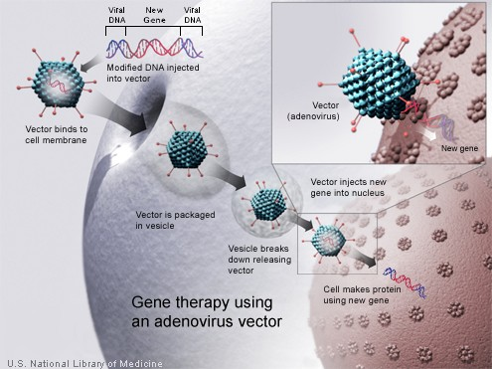

Slide 18
Nonviral options
There are also nonviral vectors that are used for gene delivery:
  Direct injection of naked DNA
  Gene gun using DNA-coated gold particles expelled into tissue using an accelerated particle carrier
  Electroporation and laser and cationic lipids to envelope DNA, which enhance the entry of DNA into a cell
  Ultrasound contrast agents or microbubbles
    Genetic material is introduced into the microbubble and inserted into the body intravenously.
  Nanoparticles
    Most commonly used are cationic lipid and cationic polymer based which enter the cell by adsorptive endocytosis

Slide 19
Limitations and concerns of gene therapy
Delivery of the therapeutic gene to the target cell or tissue is a major challenge as uncontrolled transduction often leads to severe side-effects
Vector uptake by non-specific cells
Vectors can also lead to cytotoxicity, immunogenicity
Viral vector random insertions into the genome
Nonviral vectors, while safer, are not as efficient in gene delivery as viral vectors

Slide 20
Even though gene therapy has a long way to go…
Studies show the use of genetic profiles of tumors to tailor targeted therapies to a patient
  Example: the therapeutic antibody Cetuximab (Erbitux) is active against colon cancer that is only Kirsten rat sarcoma viral oncogene (KRAS) wild type
Different tumor types can have a similar histological appearance but different clinical behavior. Also, the same tumor type can have different morphologies.
Multi-gene assays (MGAs) are used in choosing effective treatments.
  Example: Her2-negative and ER-positive breast cancer is difficult to determine whether anti-hormone therapy is sufficient or if additional chemotherapy is necessary.
These advances could have relevance for the development and clinical application of cancer gene therapies. With more understanding of molecular pathways involved in cancer pathogenesis and treatment resistance, cancer gene therapy targets for gene replacement or suppression treatments can be identified.

Slide 21
Even though gene therapy has a long way to go…
Gene-directed enzyme prodrug therapy (GDEPT)
  Clinical trials have been completed for brain and prostate cancers
  The first product, Cerepro®, is for use after surgical removal of hard-to-treat brain tumors
GDEPT uses an inactive drug (or prodrug) and a gene to produce an enzyme
  The prodrug is delivered to the whole body and is converted by the enzyme into a toxin that kills targeted cells
  Toxins can kill dividing cells and/or non-dividing cells
  The toxin may spread via cell-cell communication channels to kill nearby cells
GDEPT uses two broad strategies:
  “Search and destroy”, where a vector selectively identifies and kills tumor cells at a systemic level
  “Induction”, where a vector is delivered locally into an accessible tumor to induce cell killing and an effective immune response, which finds distant tumor cells to kill

Slide 22
Even though gene therapy has a long way to go…
There are also other methods of Directed Enzyme Prodrug Therapy (DEPT):
  Antibody-directed enzyme prodrug therapy (ADEPT)
  Virus-directed enzyme prodrug therapy (VDEPT)
  Polymer-directed enzyme prodrug therapy (PDEPT)
  Clostridia-directed enzyme prodrug therapy (CDEPT)
http://en.wikipedia.org/wiki/DEPT_(medicine)

Slide 23
Questions?

Slide 24
References
http://www.cancer.gov/cancertopics/factsheet/Therapy/targeted
http://www.nature.com/cgt/journal/v20/n4/full/cgt201313a.html
http://www.biooncology.com/research-education/
http://www.scientificamerican.com/article.cfm?id=why-does-programmed-cell
http://learn.genetics.utah.edu/content/tech/genetherapy/whatisgt/
http://ghr.nlm.nih.gov/handbook/therapy/procedures
http://www.fda.gov/biologicsbloodvaccines/scienceresearch/biologicsresearchareas/ucm127160.htm
http://www.discoverymedicine.com/Shilpa-Bhatia/2013/05/27/innovative-approaches-for-enhancing-cancer-gene-therapy/
http://www.cancer.gov/cancertopics/factsheet/Therapy/cancer-vaccines
http://www.discoverymedicine.com/Gerald-W-Both/2009/10/04/gene-directed-enzyme-prodrug-therapy-for-cancer-a-glimpse-into-the-future/

