Slide 1
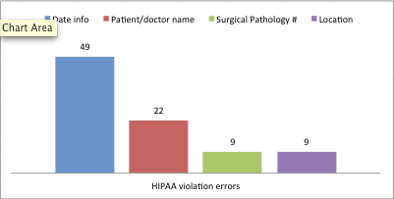
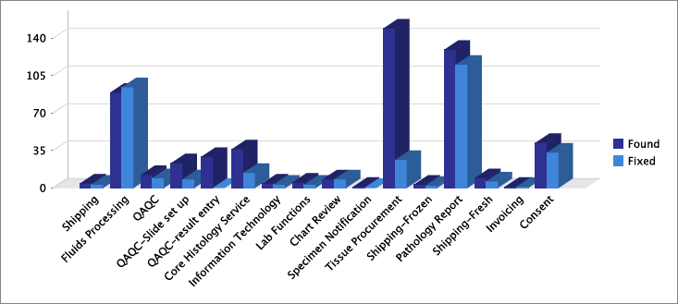
#145
Retrospective Analysis of Reported Errors
for Development of Key Performance Indicators
By: Erik Brooks, Kiley Wease, Ying Jin, Kerry Wiles and Mary Kay Washington M.D., Ph.D.
Department of Pathology, Microbiology and Immunology – Vanderbilt University Medical Center
Introduction
Results Con’t.
The Cooperative Human Tissue Network’s Western Division (CHTN-WD) at Vanderbilt University Medical Center (VUMC) is a federally funded service oriented grant that provides high-quality biospecimens to the research community. Within the last two years, CHTN-WD has developed and utilized an error-reporting dashboard in its Biorepository Information Management System, VUMC DonorQuest, to record and track errors by operational area. By ‘binning’ these errors within each operational area, Key Performance Indicators (KPIs) can be developed and implemented to further reduce error rates and indicate if staff retraining is necessary. Analysis of these reported errors will lead to reduction in repetitive mistakes and improve overall customer satisfaction. By utilizing these tools to identify problem areas and generate action plans to fix them, it substantiates our Total Quality Management (TQM) and enhances our operation to better serve customers.
Identifying this as a process problem, the protocol can be revised to include a secondary checking staff member that will always be responsible for inspecting the dry ice chest at the end of each day to handle to ensure that specimens are properly handled. No matter which technician is responsible for aliquoting the biofluids, the designated staff member will always confirm that the specimens have been properly stored in the freezer. This secondary check system will eliminate these types of errors from happening in future transactions.
Pathology report entry shows a total of 129 reported errors, with 69% of those indicating HIPAA violations including date/year, patient or doctor names, Surgical Pathology numbers, and hospital location elements remaining in the reports. These elements should be ‘scrubbed’ from the final pathology report to protect patient confidentiality and to comply with HIPAA regulations. The operational impact reported by the users is that these are potential HIPAA violations that could compromise the patient and the biorepository, potentially leading to an audit. When the pathology report has been signed out by the pathologist, staff members then search and remove any identifying information in the report that could compromise or link back to the patient before entering the newly scrubbed report into DonorQuest.
Background
Lean manufacturing practices is one tool that an enterprise can use to align itself to the goal of being responsive to customers, be as accurate as possible and eliminate many forms of waste, which includes resources and time. Working under the premise that problems can be extracted and modeled, CHTN-WD at VUMC developed and implemented an error reporting dashboard feature in 2011 to attempt to better understand error rates within our biorepository at the process and in some instances the transaction level. Staff members were trained and are responsible for reporting and attempting to correct errors after recording them into the Error Reporting Dashboard (ERD). When an error is identified, the user utilizes the ERD and selects the appropriate operational area, the suspected department they feel is responsible, and assigns a severity status as well as assessing if they feel the error is human or IT. CHTN-WD is unique in that each department subsequently checks the previous department’s work and reporting these errors real-time using this integrated module allows for accurate recording and promotes downstream analysis by utilizing a business intelligence software package (Jasper reports). Information culled from the error reporting module has allowed us to revisit the way in which errors are reported, how they are resolved and the degree of severity based upon the path of the biospecimen and data, revealing the direction the inventive process should follow to discover a solution. The anticipated outcome is to form an empirical algorithm for solving classes or ‘bins’ of problems and allows the biorepository staff to help develop meaningful KPI’s for their department or area.
Figure 3
Figure 3 shows that 49 errors were reported that included leaving the month and year in the report. If the patient is consented, the month and year can be included in the final pathology report, however, recent changes and integration with BioVU called for removal of all date elements except for the year. BioVU utilizes a date-shifting methodology, which could eventually link back to the patient. There were 22 errors that left the doctor or patient name inside the report, nine errors where the Surgical Pathology number was not removed, and nine where the hospital location was overlooked. To prevent oversight of these critical data elements, IT staff are asked to develop a script that would ‘scan’ the report after the staff member has saved the scrubbed pathology report for any accidentally overlooked items. For example, the script could scan for certain prefixes that are common in each pathology report (i.e., Dr. or S14). By running this script in the background after the document is saved, an alert will notify the staff member to recheck the report if questionable items have been located. By utilizing IT innovation to ‘scan’ the report after entry but before being released to any researcher, HIPAA violations can be prevented and critical elements caught, lowering the operational impact. Enhancing the DonorQuest application helps protect the user, the researcher, and the patient’s sensitive information.
Ancillary testing omission errors accounted for 29% of reported errors in Pathology reports. When these elements have been ordered by the clinician but not included in the final pathology report, it must be recorded as an error due to the report being incomplete. Though these mistakes are not violating HIPAA regulations, the operational impact is that the investigator/researcher does not receive the vital information necessary. By enhancing the DonorQuest application to search for key words in saved reports such as “MSI, KRAS, etc,” the system will remind the user that the ‘MSI’ value has been located in the report, prompting the user to recheck the patient’s medical record for additional information.
Results
Data points accumulated over a one year period from January 2013 to February 2014 are binned by the appropriate departmental area and reviewed. There are 526 total reported errors by staff members over this period (see figure 1). Errors are shown by departmental area below with total number of recorded errors and indicates the ones that have been corrected by staff members. Figure 2 represents the various types of errors found in the areas with the highest numbers of reported issues.
Figure 1
Figure 2
Conclusion
Fluids Processing |  | Tissue Procurement |  | Pathology report |  | Consent
Plasma/serum lysing (77) |  | Data entry (15) |  | Ancillary testing omission (37) |  | Consent not entered (9)
Aliquot storage (5) |  | QC result (103) |  | HIPAA violations (89) |  | Clerical errors (20)
Mislabeling (5) |  | Offsite collection issues (29) |  | Incorrect report entered (3) |  | HIPAA violations (5)
OR unable to draw (1) |  | Procedural error (1) |  |  |  | Patient histories (5)
 |  |  |  |  |  | Holding room issues (2)
88 |  | 149 |  | 129 |  | 41
Most often, especially in federal funding the quest is for “new and innovative wet bench research tools” to solve a problem. However, it may be the processes surrounding the research that can be innovated to produce better quality and less waste. Utilizing this error reporting function and the generated data is critical to developing appropriate KPIs to truly lower the error rate of the biorepository and will lead to innovative ideas that can enhance all aspects of the enterprise. By creating specific solutions for identified problem areas, systems can be transformed and SOPs can be altered to accommodate these initiatives. Better detection measurements can be implemented into DonorQuest and other systems to aid in error detection, enhancing the end product. These added measures will benefit the user and help prevent critical errors from occurring, resulting in fewer HIPAA violations and potentially compromised patients. This type of innovation will lead to higher customer satisfaction and decreased waste. Managers will be able to monitor efficiency of the biorepository and evaluate quality in each departmental area, leading to better effectiveness and solidifying the ability to serve customers in every way.
For purposes of this poster, two specific examples of process improvement will be discussed. Fluids Processing shows a total of 88 reported errors. Plasma and serum lysing issues represent 86% of those errors, however, many variables could be to blame for these so focusing on elements that can be identified and controlled are targeted. A human error that happens 6% of the time is departmental staff leaving the biofluid aliquots in dry ice overnight instead of properly storing them in the -80 freezer. Upon review of the process, the Lead Fluids Technician indicated that when back-up personnel handle the biofluids later in the day, the aliquots are forgotten in the dry ice chest. The user identifying these errors indicates that the operational impact is that the integrity of the sample is diminished, resulting in less scientific value for the researcher and wasted time and effort.
Acknowledgements
We thank the CHTN-VUMC staff for their continued efforts and support: Kiley Wease, Robert Burnell, Anne Campbell, Aunshka Collins, Brittney Fain, Regina Jenkins, Grace Ordung, Stephanie Shelton and Linda Sircy. This project is supported by NCI/NIH 2U01CA091664-10.

