Slide 1
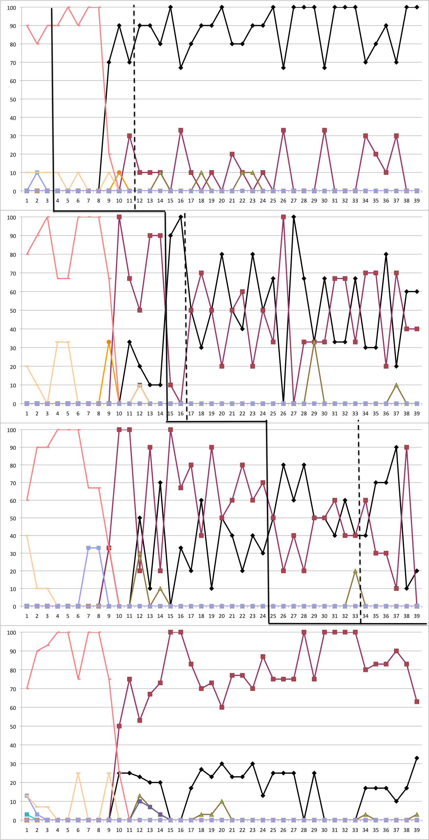
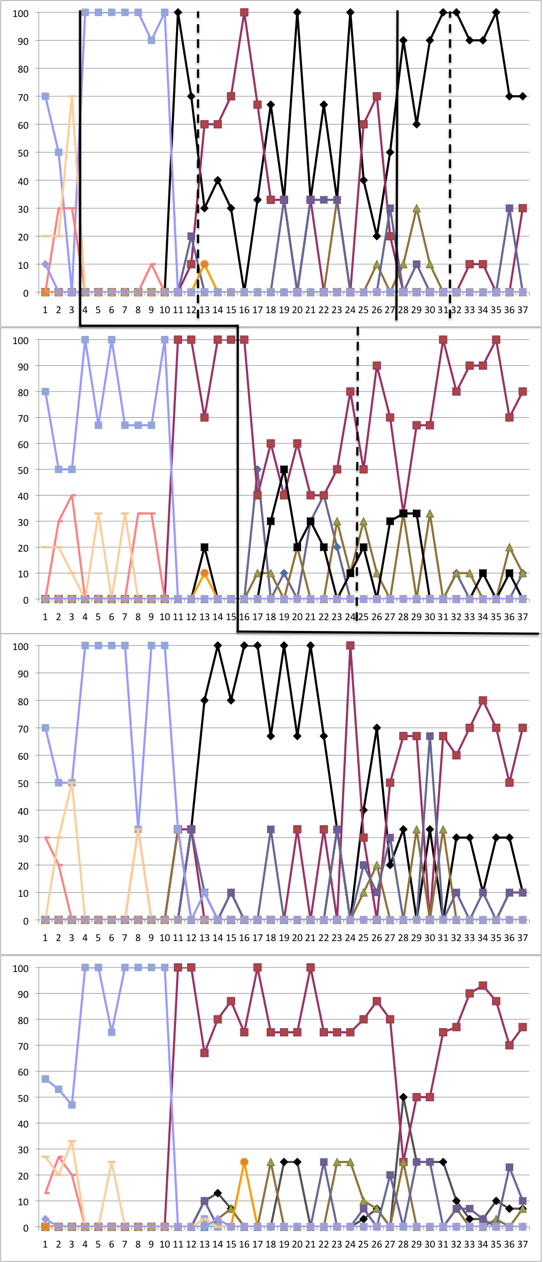
Error Analysis of Initial Sound Segmentation in Children with Hearing Loss
Krystal L. Werfel  C. Melanie Schuele
Vanderbilt University School of Medicine, Department of Hearing and Speech Sciences
Abstract
CHILD1
CHILD2
Results and Discussion
Purpose: Despite technological advances in amplification, average reading levels for children with hearing loss have not increased in the past several decades. Phonological processing deficits may contribute to poor reading outcomes. The purpose of this poster is to present the types of errors children with hearing loss made in initial sound segmentation.
Method: Two preschool children participated in individual initial sound segmentation intervention in this multiple probe design single subject study. Assessment occurred at the beginning of each session.
Results: Children’s errors shifted from whole word to single sound responses during intervention. Participants exhibit different types of errors.
Conclusions: Error analysis of responses of children with hearing loss can provide insight into their ability to segment initial sounds and inform intervention targets.
Children with hearing loss show delays in developing spoken language and in acquiring preliteracy skills that profoundly impede reading development. The average 18-year-old with severe hearing loss reads on a fourth grade level (Paul, 2009). Despite technological advances in amplification (e.g., cochlear implants), the average reading level for this population has not increased in the past several decades (Trybus & Karchmer, 1977; Paul, 2009).
The National Reading Panel (2000) identified phonemic awareness instruction as a key component of early literacy instruction. The development of phonological awareness in children with hearing loss seems to follow the same sequence of development as in children with typical hearing (James et al., 2005). However, children with hearing loss tend to perform more poorly than children with typical hearing on phonological awareness tasks (Most, Aram, & Andorn, 2006).
The purpose of this poster is to present the types of errors children with hearing loss made in initial sound segmentation.
Participants were two four-year-old children with hearing loss (CHILD1 and CHILD2). Participants used amplification, spoke English as their native language, had normal cognition, passed an articulation screening, and did not use manual communication.
Children individually participated in initial sound segmentation intervention and assessment in this single subject design study. Growth in initial sound segmentation skill was reported in Werfel and Schuele (2010). In addition to measuring growth in initial sound segmentation skill in response to intervention, the types of errors that children with hearing loss made were of interest. An error analysis coding scheme was developed to allow for analysis of error responses. Errors were graphed by assessment session and total number of errors in each category were calculated for each child for analysis.
Error Coding Scheme
Participant Information for CHILD1
Participant Information for CHILD2
CHILD1
Note: NT=sounds not taught in intervention.
CHILD1 had 1031 total errors. The majority of CHILD1’s errors were responses that were not the target sound of the word but one of the sounds taught in intervention (n = 704). The next most common error was providing a whole word that was not the target word (n = 254). Less common errors included responding with a phrase (n = 28) or a sound not taught in intervention but assessed in the study (n = 27). CHILD1 almost never repeated the target word (n = 8), responded with a sound not assessed or taught in the study (n = 7), responded with a letter name (n = 2) or responded with a group of sounds that was not a whole word (n = 3).
CHILD2
Note: NT=sounds not taught in intervention.
CHILD2 had 1067 total errors. The majority of CHILD2’s errors were responses that were not the target sound of the word but were one of the sounds taught in intervention (n = 599). The next most common error was repeating the target word (n = 228). Less common errors included responding with a sound not taught in intervention but assessed in the study (n = 53), a sound not taught or assessed (n = 86), a whole word that was not the target word (n = 41), or a phrase (n = 53). CHILD2 almost never responded with a letter name (n = 4) or provided no response (n = 3).
Both participants’ errors changed over the course of the study. At the beginning of the study, their errors consisted mostly of whole word responses and changed to providing a sound response when initial sound segmentation skill increased.
Both participants made a shift from holistic to incremental analysis of the sounds in words early in intervention. However the specific pattern of errors differed for the two participants. Thus, error analysis of responses of children with hearing loss can provide insight into their individual paths of development and inform intervention targets for individual children.
This study was supported by a Student Research Grant in Early Childhood Language Development awarded to the first author by the American Speech-Language-Hearing Foundation and by a Preparation of Leadership Personnel grant (H325D080075; PI: Schuele), US Department of Education.
James, D., Rajput, K., Brown, T., Sirimanna, T., Brinton, J., & Goswami, U. (2005). Phonological awareness in deaf children who use cochlear
implants. Journal of Speech, Language, and Hearing Research, 48, 1511-1528.
Most, T., Aram, D., & Andorn, T. (2006). Early literacy in children with hearing loss: A comparison between two educational systems. The
Volta Review, 106, 5-28.
National Reading Panel. (2000). Teaching children to read: An evidence-based assessment of the scientific research literature on reading
and its implications for reading instruction. Washington, DC: U.S. National Institute for Literacy.
Paul, P. (2009). Language and deafness (4th ed.). San Diego, CA: Singular Publishing Group.
Trybus, R., & Karchmer, M. (1977). School achievement scores of hearing-impaired children: National data on achievement status and
growth patterns. American Annals of the Deaf, 122, 62-69.
Werfel, K.L., & Schuele, C.M. (2010, November). Phonological awareness training in preschool children with hearing loss. Poster presented
at the Annual Convention of the American Speech-Language and Hearing Association, Philadelphia, PA.
Age | 4;6
Sex | Female
Race | African American/Caucasian
Ethnicity | Not Hispanic
Type of HL | Bilateral Moderately Severe to Severe SNHL
Age at ID | 1;9
Amplification | Hearing Aids
Education | Auditory Oral
Speech-Language Treatment per week | 1 hour
Leiter-R Standard Score | 113
CELF-P Standard Score | 67
PPVT-III Standard Score | 70
EOWPVT Standard Score | 82
GFTA-2 Standard Score | 78
PALS-K Rhyme | 3/10
PALS-K Initial Sounds | 2/10
PALS-K Letter Sounds | 8/26
MLU | 2.83
Age | 4;9
Sex | Male
Race | Caucasian
Ethnicity | Not Hispanic
Type of HL | Bilateral Profound SNHL
Age at ID | 2;3
Amplification | Cochlear Implants
Education | Auditory Oral
Speech-Language Treatment per week | 2 hours
Leiter-R Standard Score | 107
CELF-P Standard Score | 67
PPVT-III Standard Score | 79
EOWPVT Standard Score | 84
Arizona-3 Standard Score | 90
PALS-K Rhyme | 5/10
PALS-K Initial Sounds | 5/10
PALS-K Letter Sounds | 10/26
MLU | 3.12
Background Information
Error Analysis by Session
Error Analysis by Session
m
m
Method
d
d
Percent
Percent
Acknowledgements
b
b
Selected References
NT
NT
Session
Session

