Slide 1
MERINO Trial Journal Club
Ben Ereshefsky
Thursday, November 30, 2023

Slide 2
Background
ESBL enzymes are inhibited by ß-lactamase inhibitors like clavulanate and tazobactam
In vitro testing frequently shows that ESBL-producing organisms are susceptible to TZP
Carbapenems should be reserved to select infections, and carbapenem-sparing options should be used first
Using less carbapenems will select for less resistance
Harris. Lancet Infect Dis. 2015;15(4):475-485.

Slide 3
Previous Observational Studies of ESBL Bacteremia
Study | Sample Size | Organisms | Sources | ICU Admission | Clinical Outcomes (BLIC vs. Carb) | Comments
Kang 2012 | TZP = 36 Carbapenem = 78 | E. coli (68%), K. pneumoniae (32%) | Not reported | Not reported | 30-d mortality: 22% vs. 27%
Rodriguez-Bano 2012 | BLIC empiric = 72 BLIC definitive = 54 Carb empiric = 31 Carb definitive = 120 | Only E. coli | 70% urine or biliary | 13% | 30-d mortality empiric: 10% vs. 19% 30-d mortality definitive: 9% vs. 17% | Lower severity cohort and infection sources.
Harris 2015 | BLIC = 24 Carbapenem = 23 | E. coli (86%), K. pneumoniae (14%) | 47% urine, 9% biliary | 15% | 30-d mortality: 8% vs. 17% | Lower severity cohort and infection sources. Carb group had more IS patients.
Ofer-Friedman 2015 | TZP = 10 Carbapenems = 69 | E. coli (53%), K. pneumoniae (28%), P. mirabilis (19%) | 34% PNA, 28% SSTI, 17% biliary, 9% IAI | >50% | 30-d mortality: 60% vs. 34% 90-d mortality: 80% vs. 48% (p=0.03) | Very small TZP sample size. High number of critically ill and higher severity sources.
Tamma 2015 | TZP = 103 Carbapenems = 110 | K. pneumoniae (68%), E. coli (31%), P. mirabilis (1%) | 46% catheter, 21% urine, 17% IAI, 9% biliary, 9% PNA | 34% | 14-d mortality: 17% vs. 8% (p<0.05) 30-d mortality: 26% vs. 11% (p<0.01) | Lower TZP doses used in ~40% of patients.
Ng 2016 | TZP = 97 Carbapenems = 57 | E. coli (67%), K. pneumoniae (33%) | 4% catheter, 59% urine, 9% biliary, 9% PNA, 5% IAI | 9% | 30-d mortality: 31% vs. 30% | Lower severity cohort and infection sources.
Gutierrez-Gutierrez 2016 | BLIC empiric = 170 BLIC definitive = 92 Carb empiric = 195 Carb definitive = 509 | E. coli (73%), K. pneumoniae (19%) | 45% urine, 12% biliary | 11% | 30-d mortality empiric: 18% vs. 20% 30-d mortality definitive: 10% vs. 14% | Lower severity cohort and infection sources. Overlapping patients from Rodriguez-Bano.
Notes:
Higher severity sources important to include as concerns exist about potential inoculum effect with TZP.

Slide 4
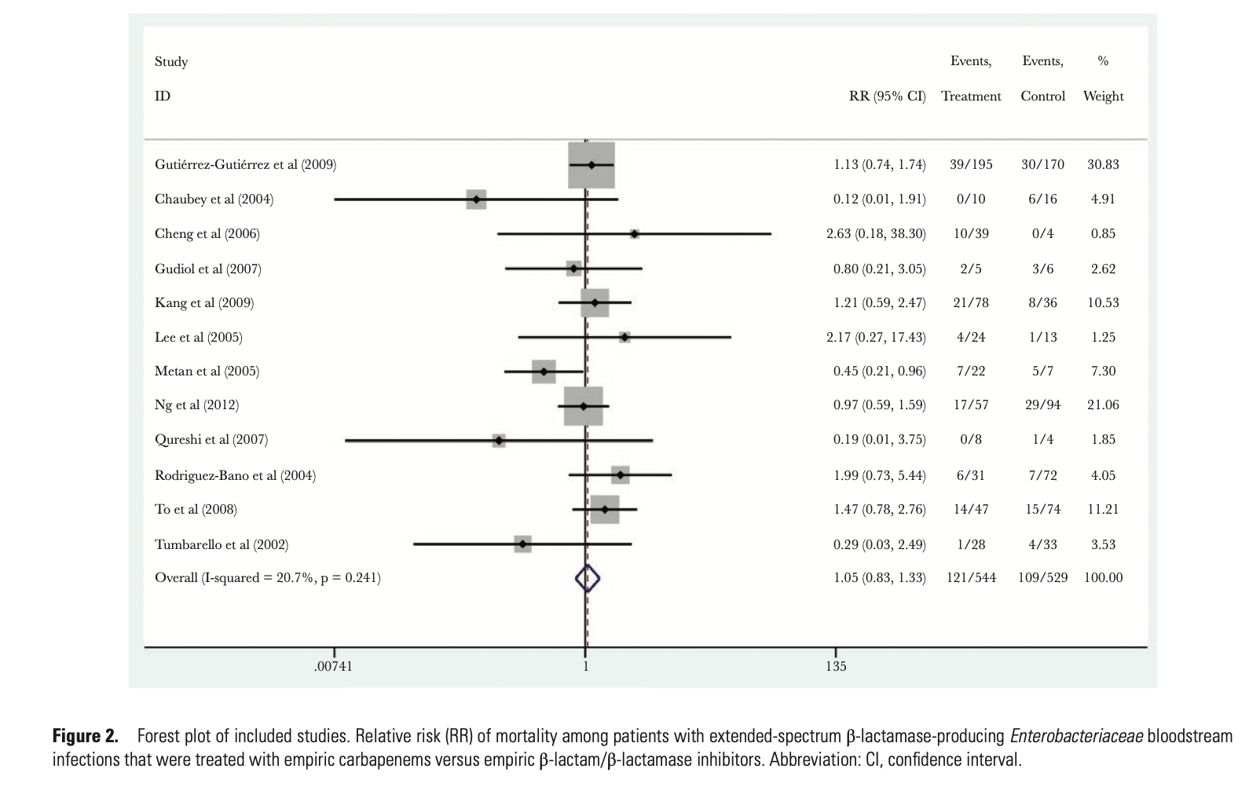
Meta-Analysis of BLIC vs. Carbapenem for ESBL Bacteremia
Carbapenems
BLIC
22.2%
20.6%
Muhammed. Open Forum Infect Dis. 2017;4(2). doi: 10.1093/ofid/ofx099.

Slide 5
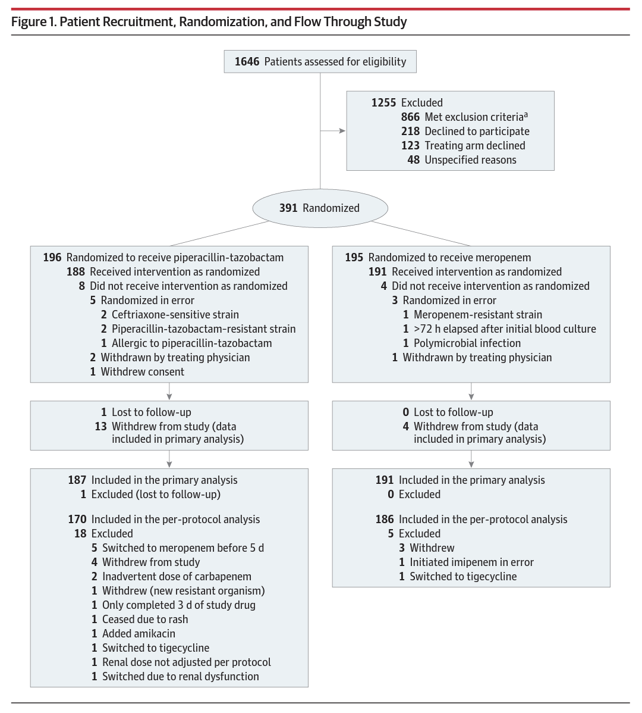

Slide 6
Table 1: Baseline Characteristics of Patients in the Primary Analysis Population
 | Piperacillin-tazobactam (n=188) | Meropenem (n=191)
Organism E. coli K. pneumoniae | 162 (86.2) 26 (13.8) | 166 (86.9) 25 (13.1)
Stratification E1 (E. coli, less severe) E2 (E. coli, more severe) K1 (K. pneumo, less …..severe) K2 (K. pneumo, more …..severe) | 159 (84.6) 3 (1.6) 23 (12.2) 3 (1.6) | 162 (84.8) 3 (1.6) 25 (13.1) 1 (0.5)
Age, y | 70 (55-78) | 69 (59-78)
Male | 101 (53.7) | 97 (50.8)
Weight, kg | 67.2 (18.1) | 69.3 (19.3)
Acquisition Hospital-acquired Health care-associated Community-associated | 52 (27.7) 55 (29.3) 81 (43.1) | 46 (24.1) 61 (31.9) 84 (44.0)
Source of bacteremia Urinary tract Intra-abdominal Surgical Site Pneumonia Mucositis/neutropenia | 103 (54.8) 34 (18.1) 8 (4.3) 9 (4.8) 12 (6.4) | 128 (67.0) 28 (14.7) 4 (2.1) 3 (1.6) 7 (3.7)
Table 1: Baseline Characteristics of Patients in the Primary Analysis Population
 | Piperacillin-tazobactam (n=188) | Meropenem (n=191)
ICU admission | 13 (7.0) | 14 (7.5)
APACHE II | 17.9 ± 6.1 | 21.0 ± 6.9
CCI* | 2.0 (1.0-4.0) | 2.0 (1.0-4.0)
Pitt score | 1.0 (0-2.0) | 1.0 (0-2.0)
Immune compromised | 51 (27.1) | 40 (20.9)
Neutropenia | 16 (8.5) | 9 (4.7)
Urinary catheter/nephrostomy | 51 (27.1) | 37 (19.4)
Moderate-severe renal dysfunction | 31 (16.5) | 30 (15.7)
Diabetes | 59 (31.4) | 79 (41.4)
Liver disease | 12 (6.4) | 18 (9.4)
Empiric antibiotic Piperacillin/tazobactam Carbapenem Other | 38 (20.2) 26 (13.8) 124 (66.0) | 49 (25.7) 28 (14.7) 114 (59.7)
Appropriate empiric ABX | 126 (67.0) | 127 (66.5)
Time to appropriate ABX, h | 5.5 (0.4-31.5) | 9.6 (0.5-32.1)
*CCI = Charlson Comorbidity Index
Notes:
Notes: very low numbers of the “more severe infection” groups, fairly even male/female, weights may not be comparable to those seen in the US. High-proportion of patients receive empiric therapy with a drug to which they were not randomized, including to the opposite study drug.

Slide 7
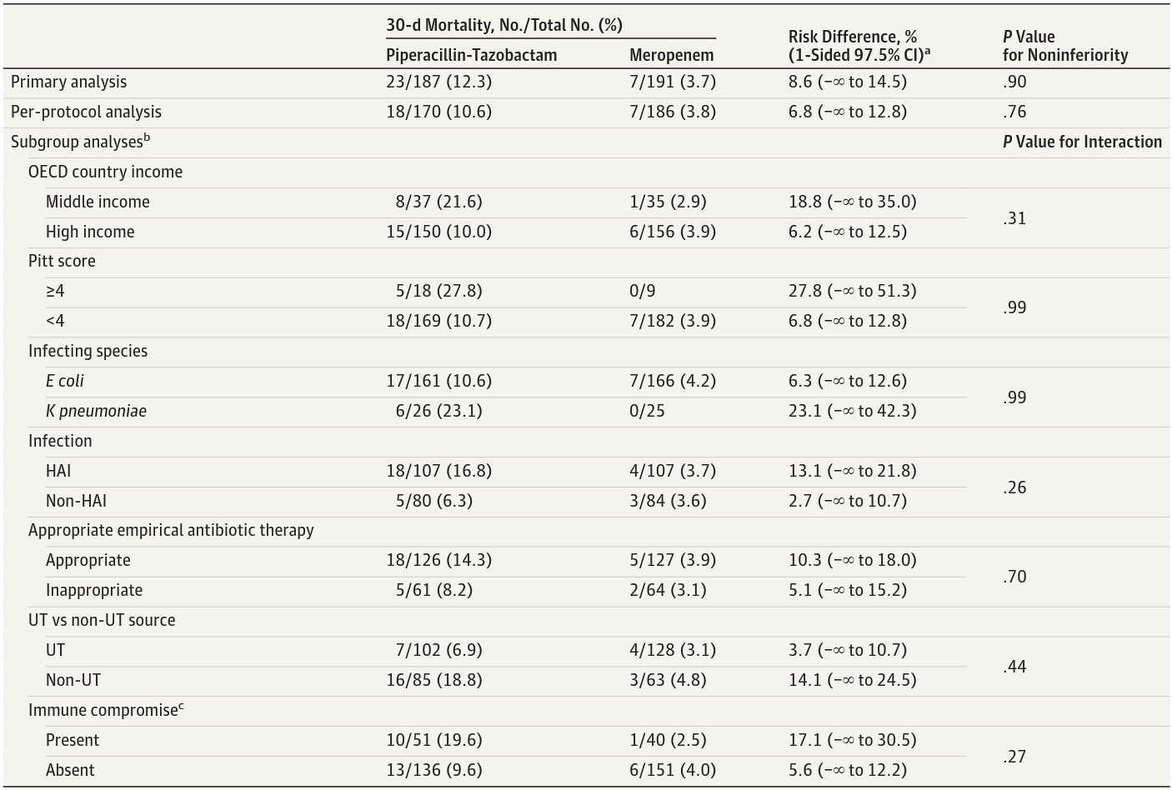
Subgroup Analyses of Primary Outcome

Slide 8
Study Site Susceptibility Testing
All isolates tested susceptible to study treatments at local hospital laboratories.
Susceptibility Results from “Coordinating Laboratory”
 | N = 306 (E. coli = 266 and K. pneumoniae = 40)
Piperacillin-tazobactam MIC | 2 mg/L (1.5 mg/L to 4 mg/L) 12 non-susceptible per EUCAST ( ≤8 mg/L) & 4 non-susceptible per CLSI (≤16 mg/L)
 | E. Coli median = 2 mg/L | K. Pneumoniae median = 4 mg/L
Meropenem MIC | 0.023 mg/L (0.016 mg/L to 0.032 mg/L)
Mortality in TZP Arm Based on MIC
 | Minimum Inhibitory Concentration (MIC) mg/L
 | 0.5 | 0.75 | 1 | 1.5 | 2 | 3 | 4 | 6 | 8 | 12 | 16 | 24
Mortality | 0/2 | 1/6 | 5/15 | 1/26 | 3/20 | 2/24 | 0/12 | 3/10 | 1/11 | 1/3 | 0/1 | 1/2

Slide 9
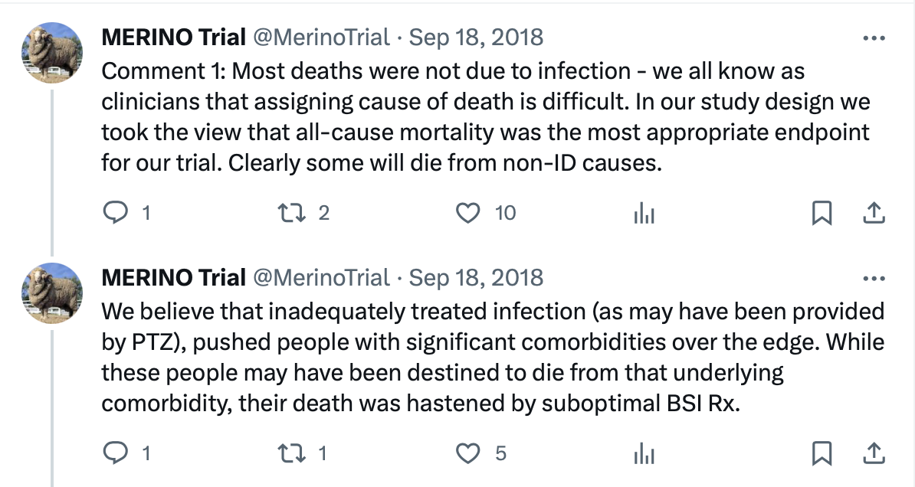
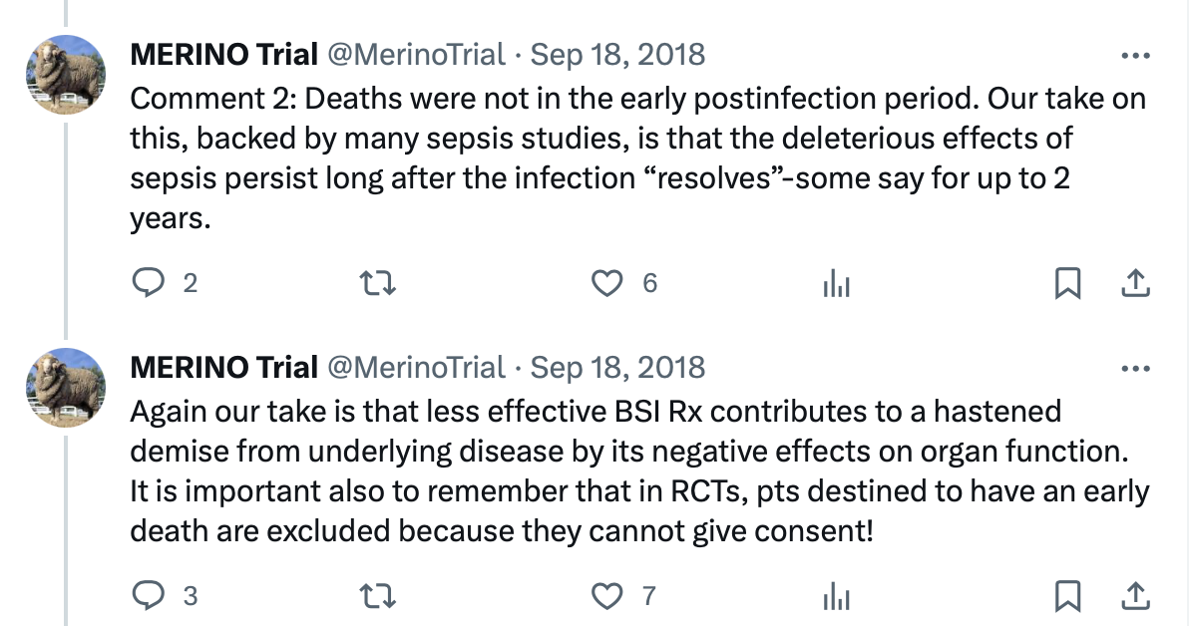
What Did the Authors Think About Mortality?
All but 1 of the 30 deaths in the study were reported as due to malignancy ± other comorbidities
5 deaths were new infection ± malignancy/other comorbidities and 1 was new infection only

Slide 10
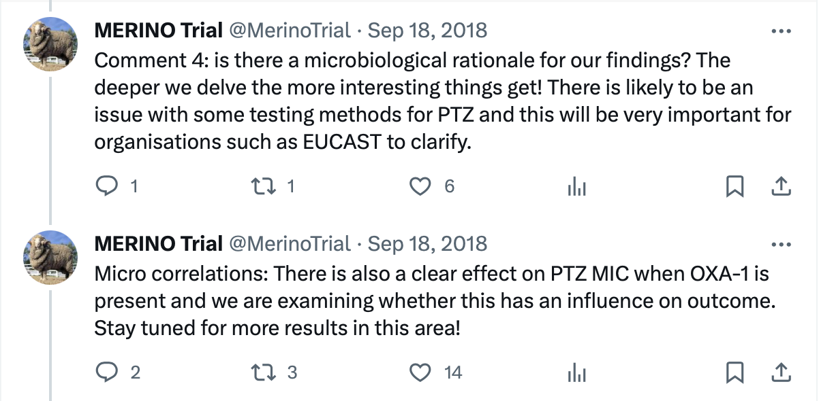
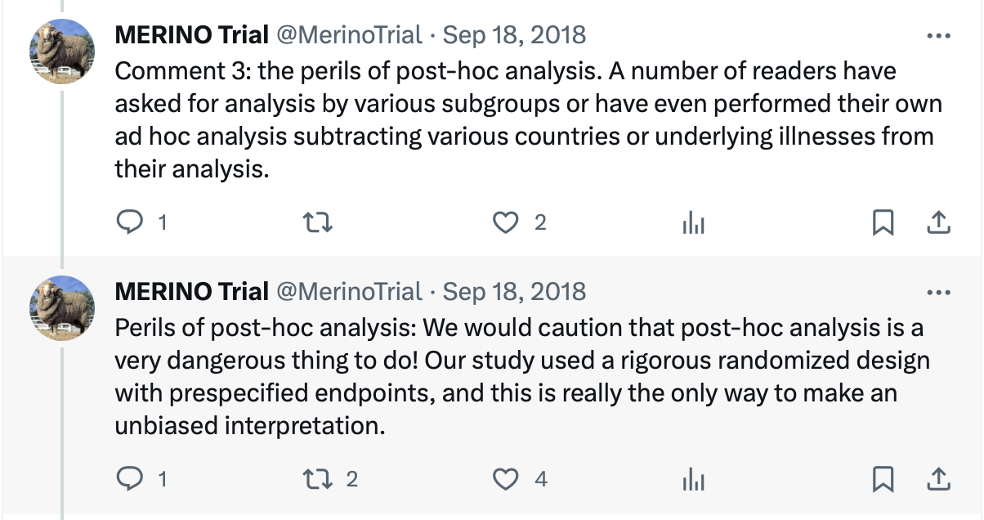
Author Comments, Continued…

Slide 11
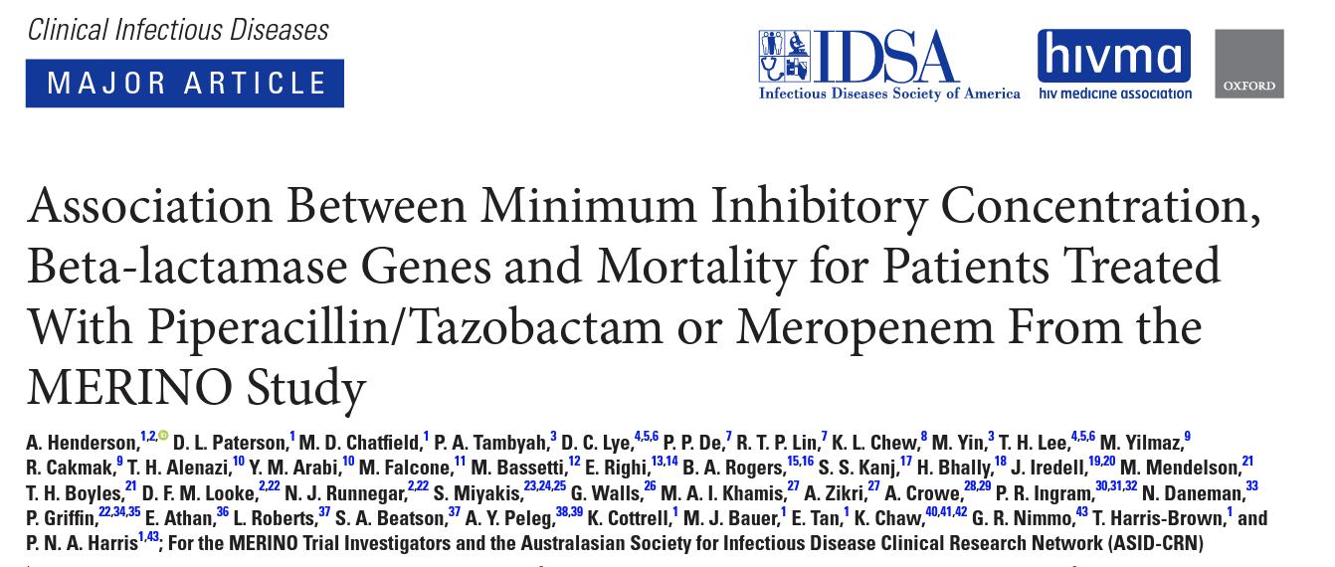
BONUS CONTENT!!!!

Slide 12
Methods
Testing of first positive blood culture at university reference lab
Use of broth microdilution testing
Primary testing during the study predominantly used Vitek 2 or disk diffusion
WGS performed to assess for ß-lactamase genes with focus on:
ESBL
ampC
Narrow-spectrum OXA

Slide 13
ß-Lactamase Sequencing Results
Included 320 isolates (278 E. coli and 42 K. pneumoniae)
CTX-M group was the most prevalent in 273 isolates
SHV ESBL in 12 isolates
Plasmid-encoded ampC in 36 isolates
Chromosomal ampC in 3 isolates (all E. coli)
Narrow-spectrum OXA genes in 102 isolates (96% also had CTX-M-15)
No OXA carbapenemase genes identified

Slide 14
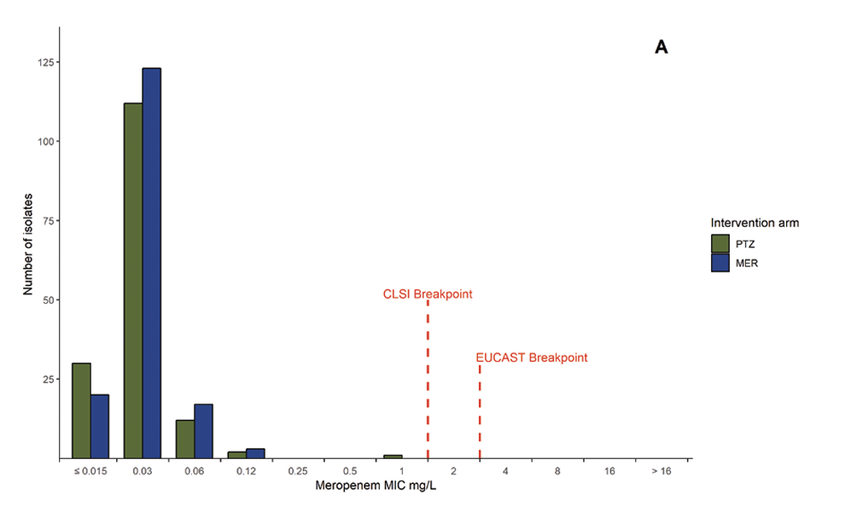
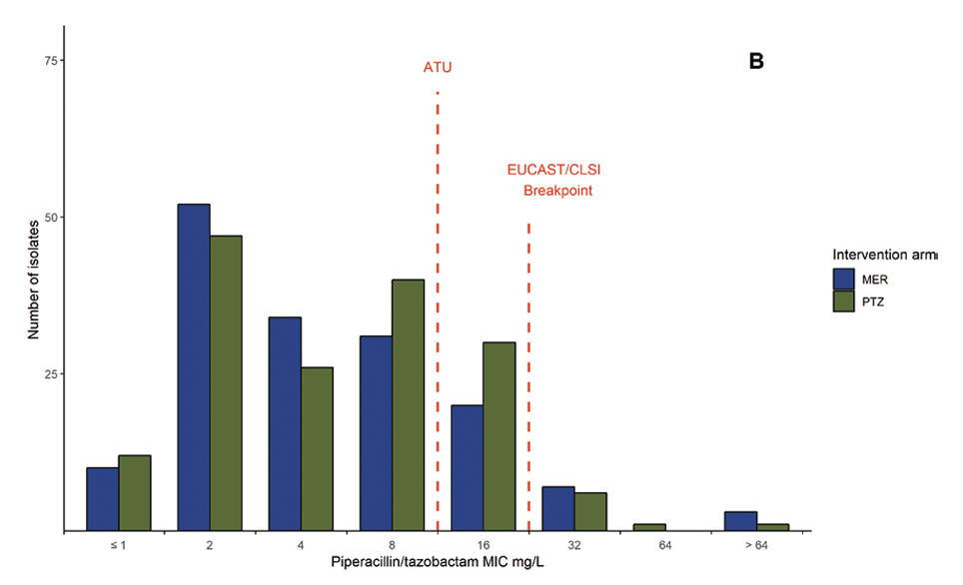
Results
Mortality in patients with isolates sent for analysis: 11% (18/157) for TZP and 4% (6/163) MEM
94% susceptible
100% susceptible
Modal TZP MIC for isolates with OXA + ESBL vs. without was 8mg/L vs. 2mg/L (p < 0.001)

Slide 15
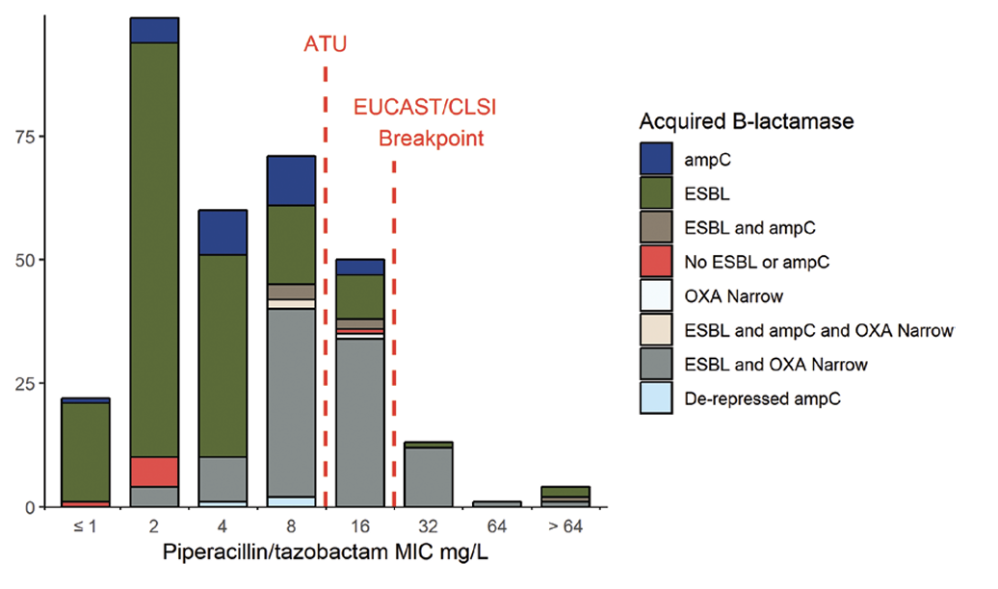
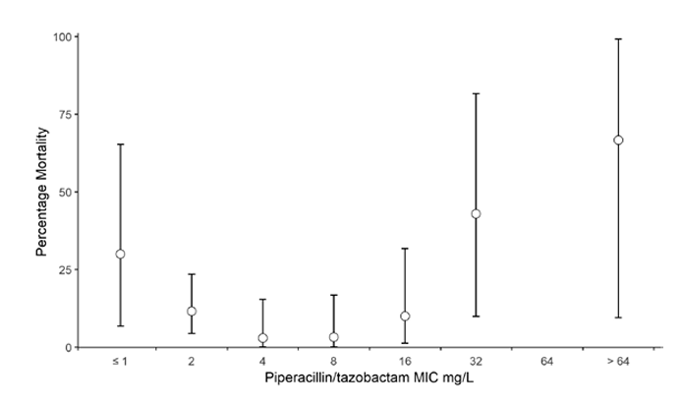
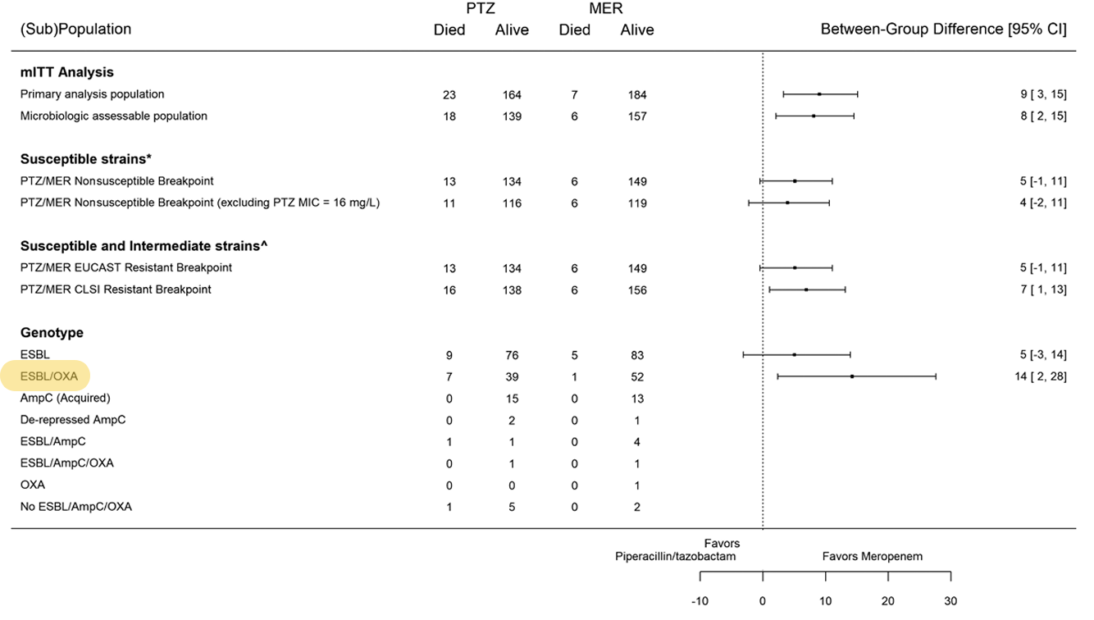
ß-Lactamases, MIC, and Mortality
Significant mortality difference with MIC ≤ 16 mg/L vs. > 16 mg/L

Slide 16
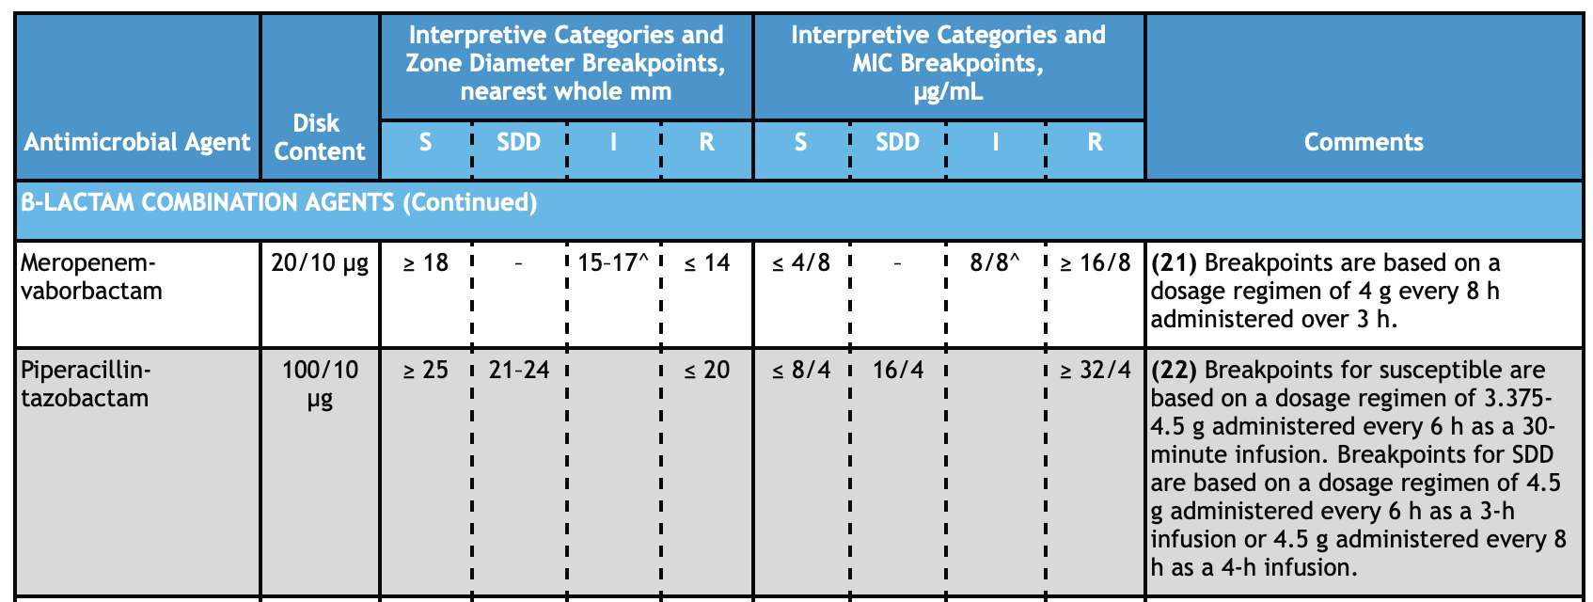
What are the Recommended Doses for TZP?
CLSI M100 (©2023) – these are from AFTER MERINO
Table 2A (Enterobacterales)
https://clsi.org/all-free-resources/

Slide 17
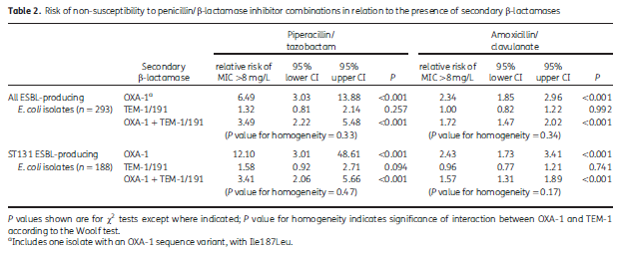
Impact of OXA-1 on BL/BLI Activity
Study Design
Human bloodstream infection isolates
Period from 2013-2014
E. coli isolates only
Gene sequencing for ESBL enzymes (CTX-M, TEM, SHV)
Double-disc synergy and susceptibility testing
Whole genome sequencing for additional resistance genes
Piperacillin-Tazobactam Susceptibility (MIC ≤8mg/L)
ESBL Only | 98.4%
ESBL + TEM-1 | 94.9%
ESBL + OXA-1 | 75.8%
ESBL + TEM-1 + OXA-1 | 56.9%
ESBL + AmpC | 0%
Livermore. J Antimicrob Chemother. 2019;74:326-333.

Slide 18
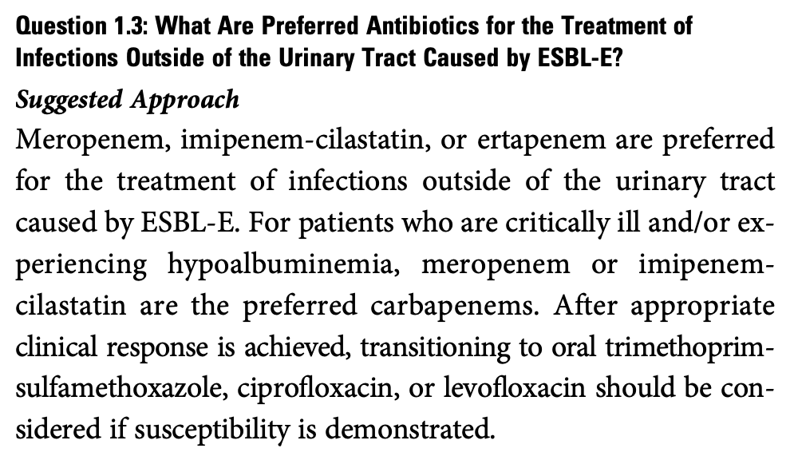
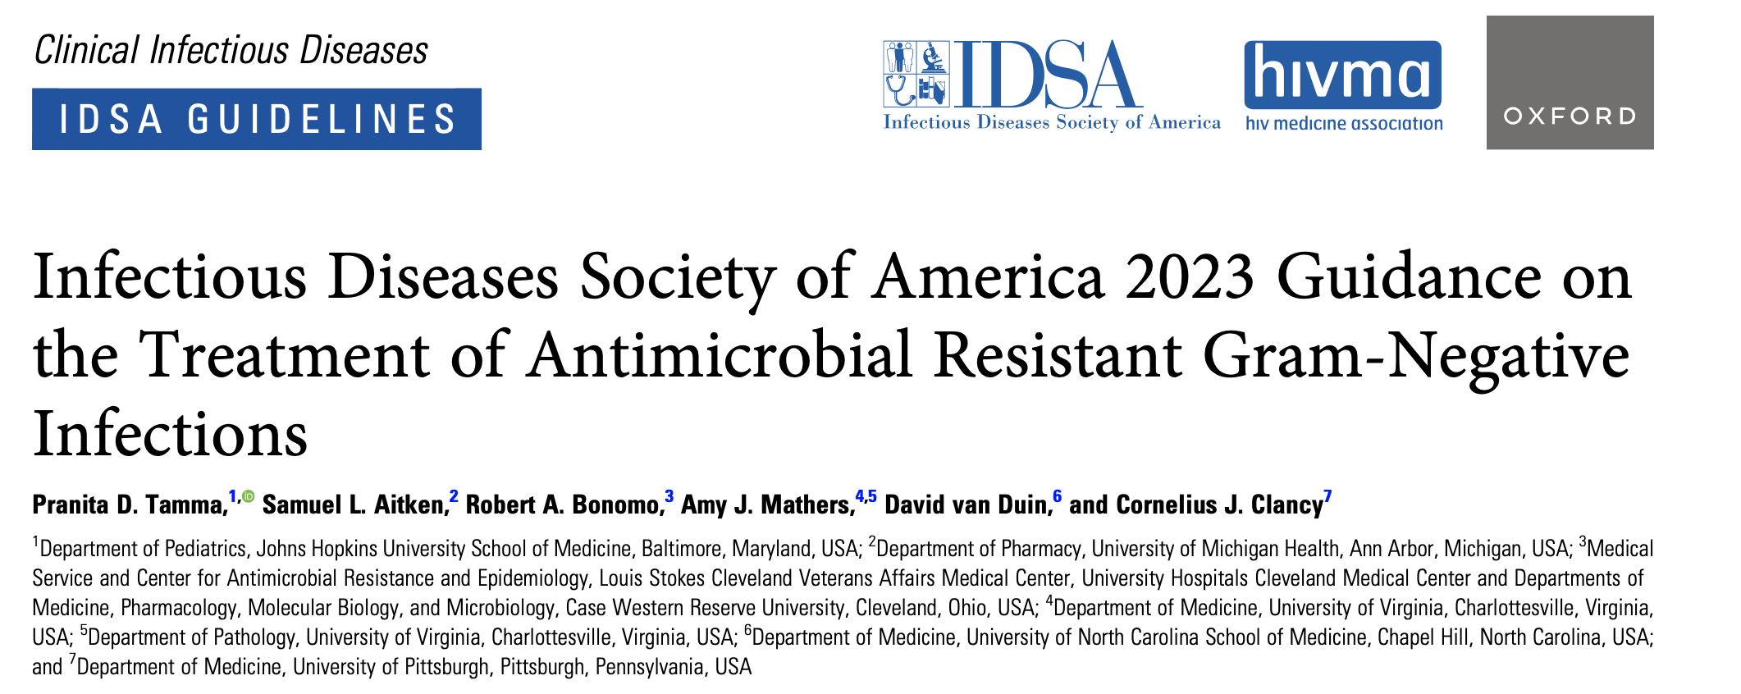
Note that there are also major concerns from a PK/PD standpoint about the AMOUNT of tazobactam in TZP and inability to provide adequate protection to piperacillin in the setting of hydrolyzing enzymes.*
Tamma. Clin Infect Dis. 2023. doi: 10.1093/cid/ciad428.
*Pogue. Expert Opin Pharmacother. 2019;20(17):2053-2057.

