Slide 1
DO LET METRICS IMPORVE AND REINFORCE YOUR PRACTICE: the Multicenter Perioperative Outcomes Group (MPOG) & The Anesthesiology Performance Improvement and Reporting Exchange (ASPIRE) Measures
Brent Dunworth, Leslie Fowler, Robert Freundlich, Miklos D. Kertai,
Carrie Menser, Paul St. Jacques
January 29, 2021

Slide 2
What is MPOG?
Formed in 2008
Academic and community hospital consortium. Includes over 50 hospitals across the country (and 2 in the Netherlands)
MPOG aggregates data
Dual mission of research and quality improvement
Notes:
Academic and community hospital consortium seeking to improve patient care using data
MPOG aggregates inpatient EHR data, and data from other complementary data sources
Formed in 2008, initial mission to develop the processes and technical infrastructure required for multicenter perioperative outcomes research
Has evolved into dual mission of research and quality improvement over last couple of years

Slide 3
What we have achieved so far
~12 million cases extracted, mapped, de-identified, and available for QI and research
~170 million medication doses
24 BILLION vital signs
50 institutions, 5 EHR vendors
Demographic Information
Preoperative H&P
Medications / Infusions / Fluids / Outputs
Physiologic values/ Laboratory values
Intraop events
IV Access
Staff in / out
Professional fee CPT codes
Discharge ICD 9/10 codes
Outcome record / Outcome registry

Slide 4
ASPIRE is the quality improvement arm of the Multicenter Perioperative Outcomes Group
MPOG
Research
BCBSM funded program
Quality
(ASPIRE)
Not drawn to scale

Slide 5
What Does ASPIRE do?
Collaboration through monthly Quality Committee meetings (tele-conference)
Quarterly in person meetings
Annual retreat before ASA
Quality Measure Dashboard
Individual Provider Feedback

Slide 6
Our mission and challenge is to adopt measures and implement programs that improve care

Slide 7
VUMC ASPIRE MEASURES TASK FORCE
Clinical Divisions
Ambulatory (Chris Canlas)
Cardiac (Mias Pretorius and Miklos Kertai)
Critical Care (Jeremy Walco)
MSA (David Netterville and Paul St. Jacques)
Neuro (Marc Mclawhorn)
OB/GYN (Holly Ende)
Pediatric (Carrie Menser and Dave Moore)
Pain (David Edwards)
Departmental Leadership:
Brian Gelfand
Matt McEvoy
Amy Robertson
Warren Sandberg
Education, ERAS, CEBA:
Leslie Fowler
Jen Jayaram
Alex Moore
Certified Registered Nurse Anesthetists:
Brent Dunworth
Brad Koss
Jordan Miller
Laura Payne
Vanderbilt Anesthesiology & Perioperative Informatics Research (VAPIR):
Robert Freundlich
Karen McCarthy
Zameer Lodhi
Notes:
Academic and community hospital consortium seeking to improve patient care using data
MPOG aggregates inpatient EHR data, and data from other complementary data sources
Formed in 2008, initial mission to develop the processes and technical infrastructure required for multicenter perioperative outcomes research
Has evolved into dual mission of research and quality improvement over last couple of years

Slide 8
MPOG ASPIRE MEASURES
https://spec.mpog.org/Measures/Public
Notes:
Academic and community hospital consortium seeking to improve patient care using data
MPOG aggregates inpatient EHR data, and data from other complementary data sources
Formed in 2008, initial mission to develop the processes and technical infrastructure required for multicenter perioperative outcomes research
Has evolved into dual mission of research and quality improvement over last couple of years

Slide 9
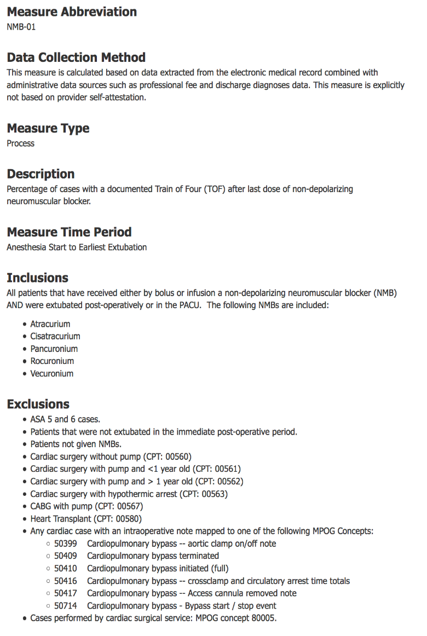
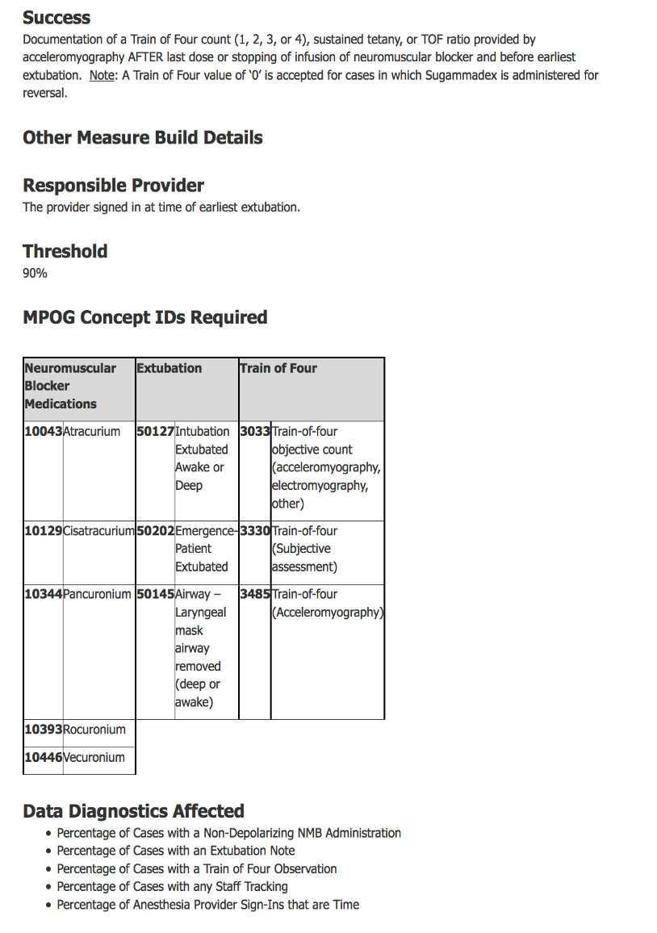
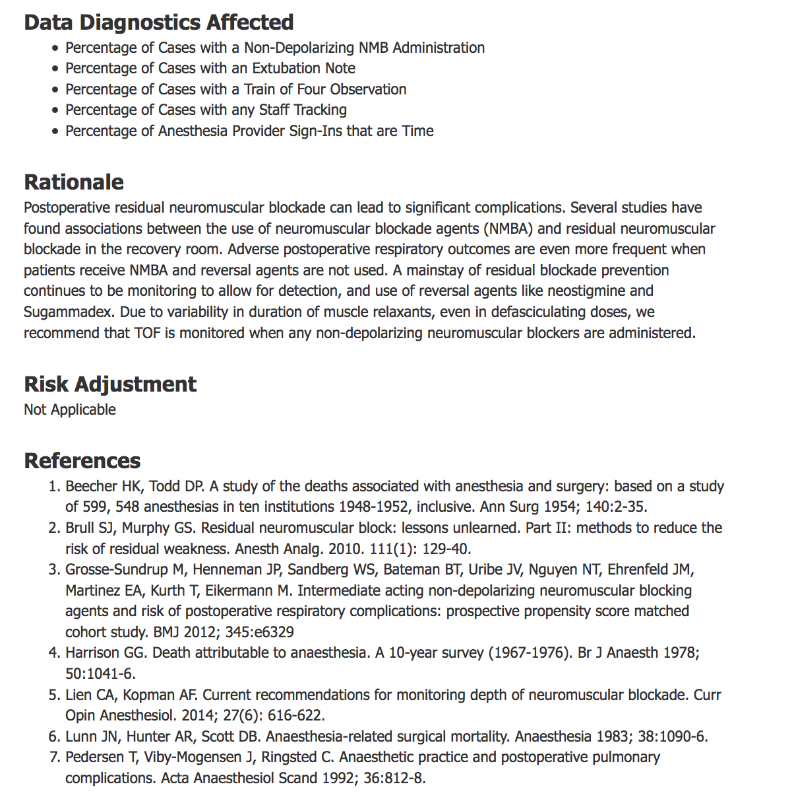
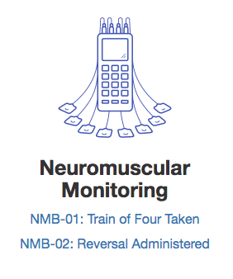
MPOG ASPIRE MEASURES: NMB-01, Train of Four Taken
https://spec.mpog.org/Spec/Public/1
Notes:
Academic and community hospital consortium seeking to improve patient care using data
MPOG aggregates inpatient EHR data, and data from other complementary data sources
Formed in 2008, initial mission to develop the processes and technical infrastructure required for multicenter perioperative outcomes research
Has evolved into dual mission of research and quality improvement over last couple of years

Slide 10
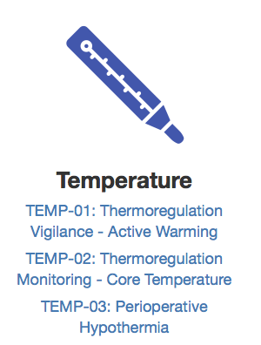
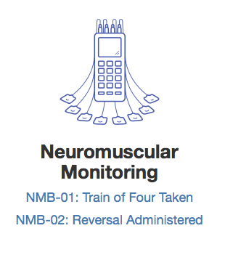
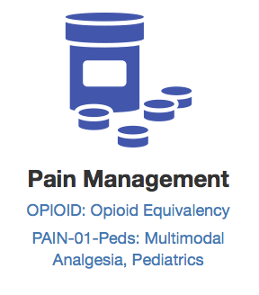
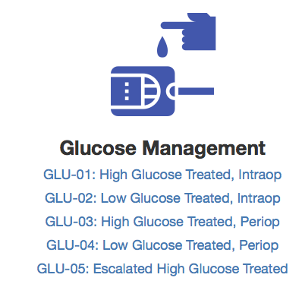
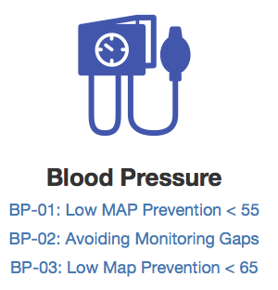
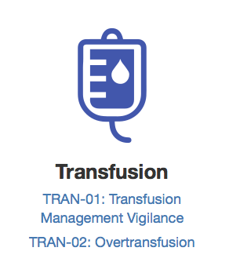
MPOG ASPIRE MEASURES: VUMC Anesthesiology Department
ADULT
PEDIATRIC
https://spec.mpog.org/Measures/Public
Notes:
Academic and community hospital consortium seeking to improve patient care using data
MPOG aggregates inpatient EHR data, and data from other complementary data sources
Formed in 2008, initial mission to develop the processes and technical infrastructure required for multicenter perioperative outcomes research
Has evolved into dual mission of research and quality improvement over last couple of years

Slide 11
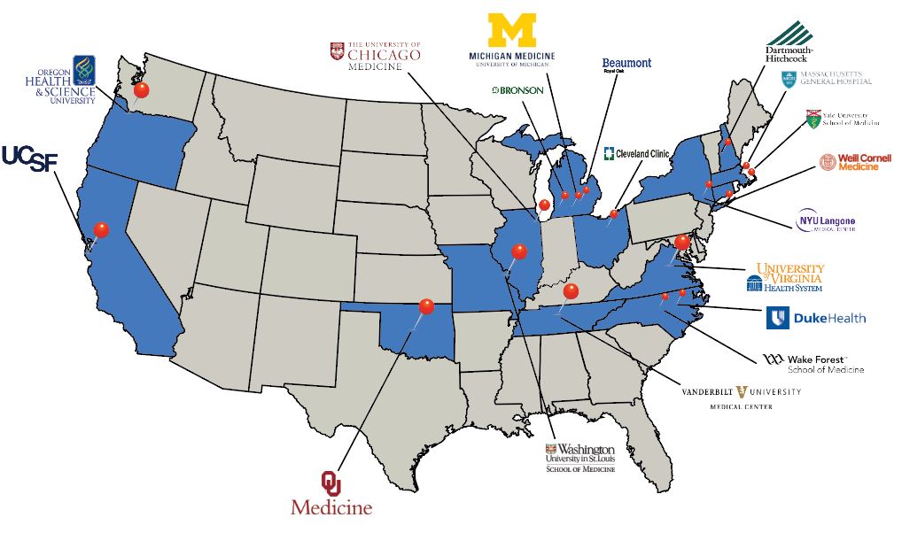
Utilizing Quality Metrics in Pediatric Anesthesia
Carrie Menser, MD
Dave Moore, MD

Slide 12
MPOG/ASPIRE Pediatric Subcommittee Members
Bishr Haydar, MD
Lisa Vitale, MD
Lori Reigger, MD
Shobha Malviya, MD
Vikas O’Reilly-Shah, MD
Amber Franz, MD
Joseph Cravero, MD
Morgan Brown, MD
Bob Brustowicz, MD
Steve Zgleszewski, MD
Jacques Scharoun, MD
Anastasia Grivoyannis, MD
Jina Sinskey, MD
Claudia Benkwitz, MD
Brad Taicher, MD
Lucy Everett, MD
Louis Tollinche, MD
Olga Eydlin, MD
Liem Pham, MD
Priti Dalal, MD
Shannon Grap, MD
Uma Parekh, MD
Jonathan Halem, MD
Hamid Vahabzadeh-Monshie, MD
Cheryl Gooden, MD
Alina Bodas, MD
Anshuman Sharma, MD
Charles Schrock, MD
Dan Roke, MD
Phillip Yun, MD
Ronak Patel, MD
Jim Fehr, MD
RJ Ramamurthi, MD
James Xie, MD
Julianne Mendoza, MD
Christy Crockett, MD
Carrie Menser, MD
Dave Moore, MD
Jeana Havidich, MD
Anna Clebone, MD
Notes:
64 Pediatric Anesthesiologists in total
Pediatric Representatives have joined us from around the US and Netherlands!

Slide 13
Top MPOG Sites Contributing Pediatric Data
Institution | Age < 18
Monroe Carell Jr. Children’s (Vanderbilt) | 250,430
Mott Children’s (Michigan Medicine) | 234,243
University of Oklahoma Health Sciences Center | 116,232
St. Louis Children’s (Washington University) | 87,700
University Medical Center - Utrecht | 68,266
Doernberger Children’s (OHSU) | 67,276
Cleveland Clinic Children’s | 58,733
Hassenfeld Children’s (NYU Langone) | 57,610
Yale New Haven Children’s | 46,151
Wake Forest Baptist Medical Center | 40,149
Memorial Sloan Kettering Cancer Center | 38,673
Weill Cornell Medicine | 37,476
University of Virginia | 32,590
Duke University | 27,074
Benioff Children’s (UCSF) | 23,398
Massachusetts General | 23,180
Children’s Hospital at Dartmouth-Hitchcock | 18,261
Comer Children’s (UChicago) | 6,162
Total Pediatric cases in MPOG Database: 1,634,829
Notes:
Opportunity to lead the way with pediatric metric utilization
Leverage the QI capability and knowledge of division and department to impact future pediatric metric development and improve the quality of the care we provide at VCH
2021 Anticipated Sites
Helen - Devos Children’s (Grand Rapids, MI)
Children’s Colorado
Penn State Children’s
Interested
Boston Children’s

Slide 14
Metrics with functionality for pediatrics
Current Selected Metrics for VUMC
PAIN 01 (Pediatric specific, brand new Dec 2020)
TEMP 03
NMB 02
GLUC 02
Tracking “never” events, BG <60
Validation in peds ongoing
Future Metrics on the horizon for pediatrics (Pediatric specific)
PONV 02 – Metric under revision, release ~ Spring 2021
TEMP 04 - MPOG trying to clean up artifact currently
Notes:
Some metrics are not validated for use in peds cases
TRAN 02- can be useful is a particular subset of pediatric cases

Slide 15
Multimodal Analgesia: PAIN-01-Peds
Description: Percentage of patients < 18 years old who undergo a surgical or therapeutic procedure and receive a non-opioid adjunct preoperatively and/or intraoperatively.
Success Criteria: At least one non-opioid adjunct medication OR regional block was administered to the patient during the preoperative or intraoperative period.
Measure Time Period: Preop Start → Anesthesia End
Exclusions
ASA 5 and 6; Patients transferred directly to ICU
Organ Harvest , Cardiac Surgery , Non-operative procedures and Radiology procedures
Patients that were not extubated in the immediate postoperative period.
Patients not given opioids or non-opioid adjuncts
Notes:
New since last meeting:
Patients extubated rather than ICU transfer
No responsible provider - cases flagged at departmental level

Slide 16
Perioperative Hypothermia: TEMP-03
Description: Percentage of patients with hypothermia (<36ºC) at the end of the case.
Success Criteria: At least one body temperature measurement equal to or greater then 36 degrees Celsius achieved within 30 minutes immediately before or the 15 minutes immediately after anesthesia end time.
TEMP 04 – Intraoperative temperature monitoring
MPOG database management team trying to clean up artifact currently
Description: Percentage of patients < 18 years old who undergo any procedure greater than 30 minutes whom have a median core/near core body temperature > 36ºC

Slide 17
Neuromuscular Blockade Reversal: NMB-02
Description: Percentage of cases with appropriate neuromuscular blockade reversal administration.
Success Criteria:
Documentation of neostigmine, Sugammadex, and/or edrophonium before earliest extubation. OR
A period of greater than 3 hours exists between last dose of non-depolarizing medication and extubation for patients ≥ 12 years old. OR
A period of greater than 2 hours exists between last dose of non-depolarizing medication and extubation for patients <12 years old. OR
An acceleromyography ratio of ≥ 0.9 documented after last dose of NMB and before earliest extubation.
Measure Time Period: Anesthesia start→ Extubation
Key Exclusions:
Patients not extubated at the conclusion of the case.
Notes:
Process measure

Slide 18
ASPIRE Dashboards: Practice Level Feedback

Slide 19
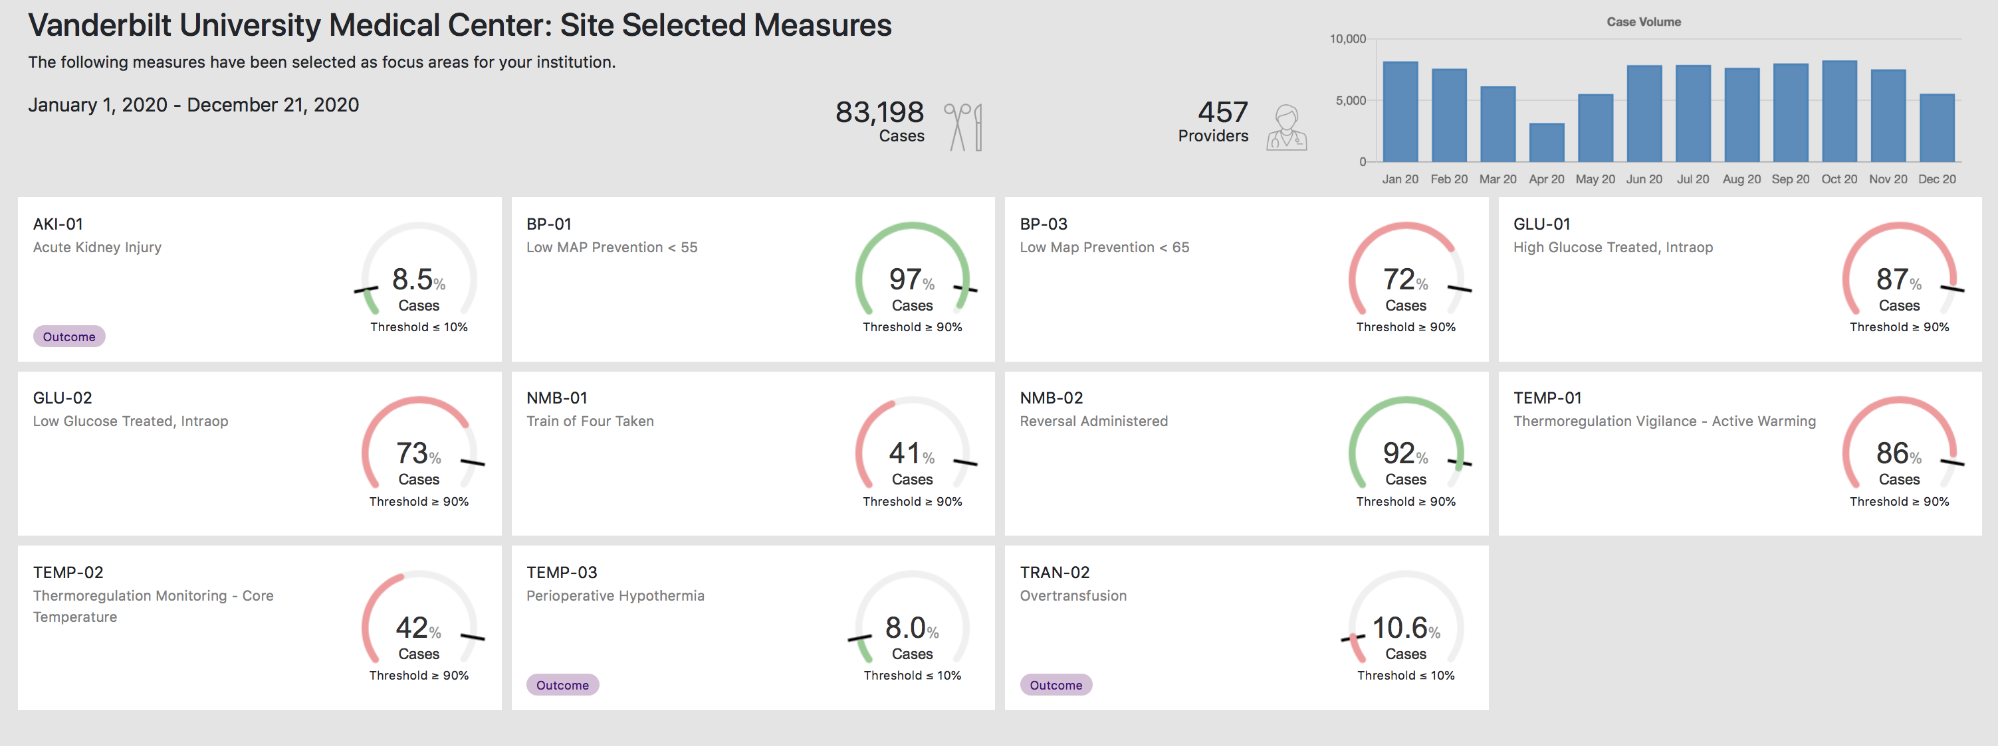
Reporting Dashboard

Slide 20
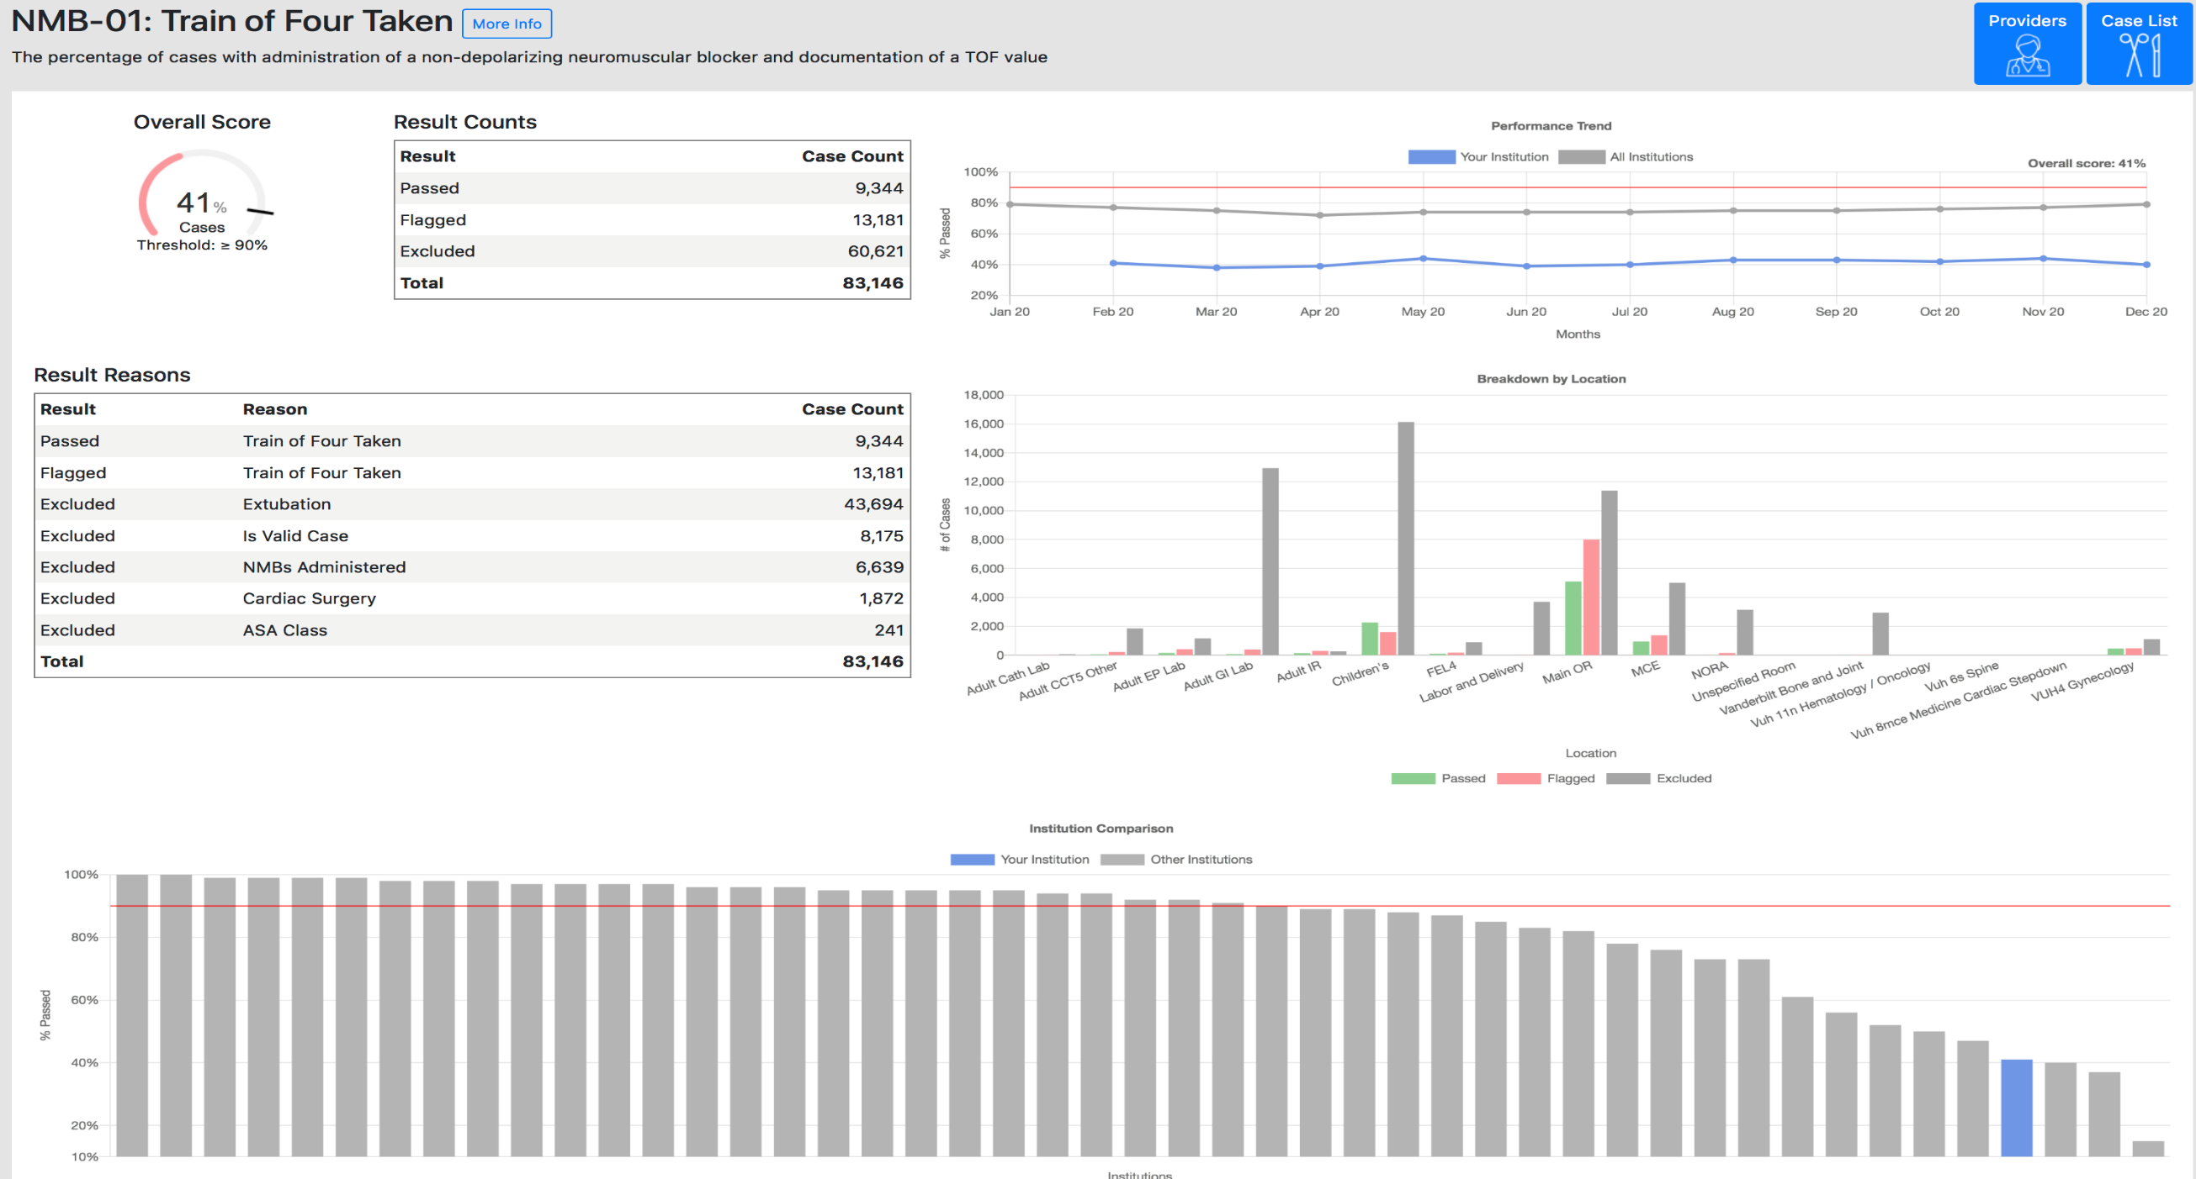

Slide 21
Excluded Case Lists

Slide 22
Failed/Passed Case Lists

Slide 23
CME Code 1.29.21 TEXT 40089 to 855-776-6263

Slide 24
Scientific Evolution
Experience-Based Practice
Evidence-Based Practice
BD

Slide 25
Goal
Evidence-based practice is a conscientious, problem-solving approach to clinical practice that incorporates the best evidence from well-designed studies, patient values and preferences, and a clinician's expertise in making decisions about a patient's care.
Improved Care
BD

Slide 26
17 years
BD

Slide 27
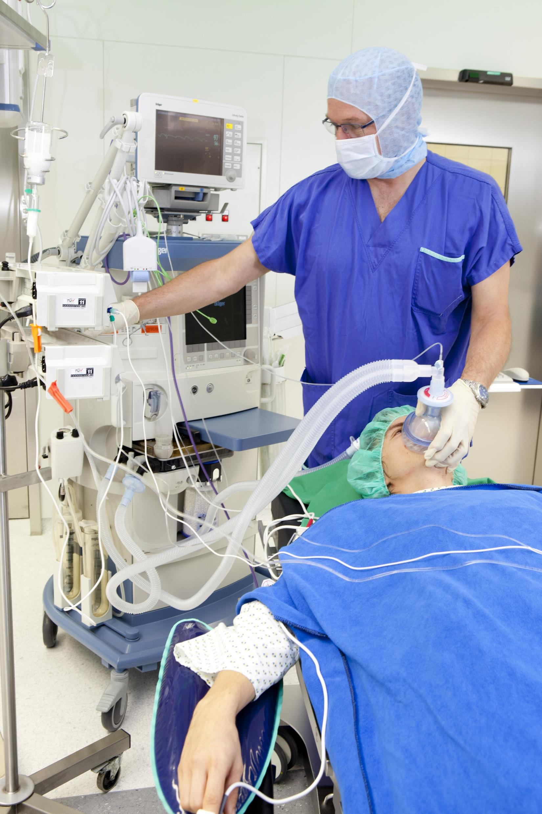
In-Room Providers
Finger on the pulse
Understand proven elements that contribute to better patient outcomes
Execute on them
Feedback loop
Enhance VUMC brand strength
BD

Slide 28
Outcomes
Short-Term
Identify workflow enhancements
Long-Term
Improved patient outcomes
Benefits
Identify barriers
World leader
Serve as exemplar to other institutions
QI opportunities
Outcome-based research opportunities
Make the day smoother
Hard-wired excellence
BD

Slide 29
ASPIRE Emails: Provider Level Feedback

Slide 30
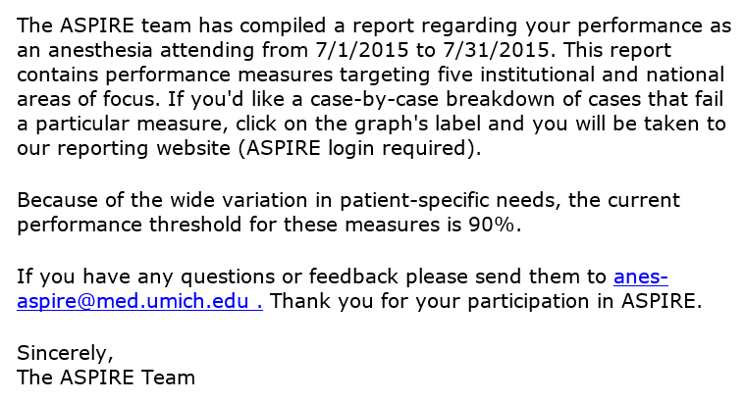
Individual Provider Feedback
Non-punitive
Spirit of quality improvement
Each hospital/ department chooses measures to focus on

Slide 31
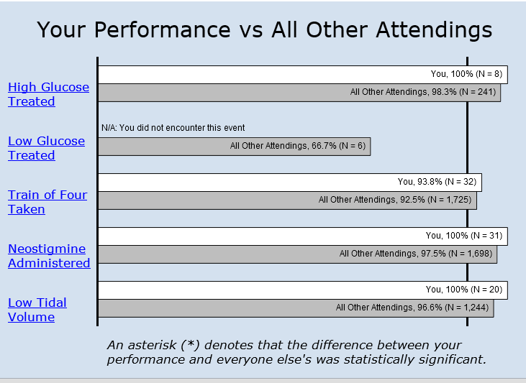
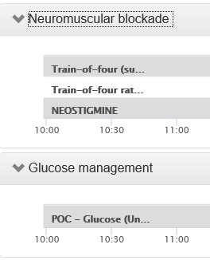
The goal is to easily enable anesthesia providers to understand why certain cases did not pass a measure.
1
2
3

Slide 32
Individual Performance E-mail

Slide 33
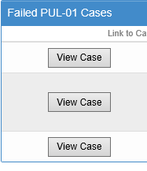
Single click from email to list of failures

Slide 34
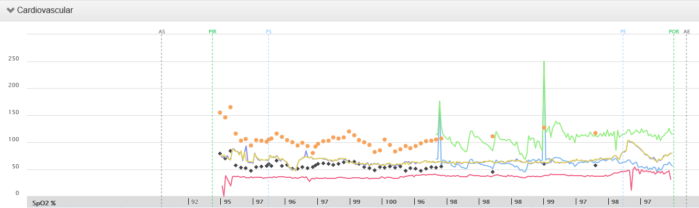
Easy access to actual intraoperative record

Slide 35
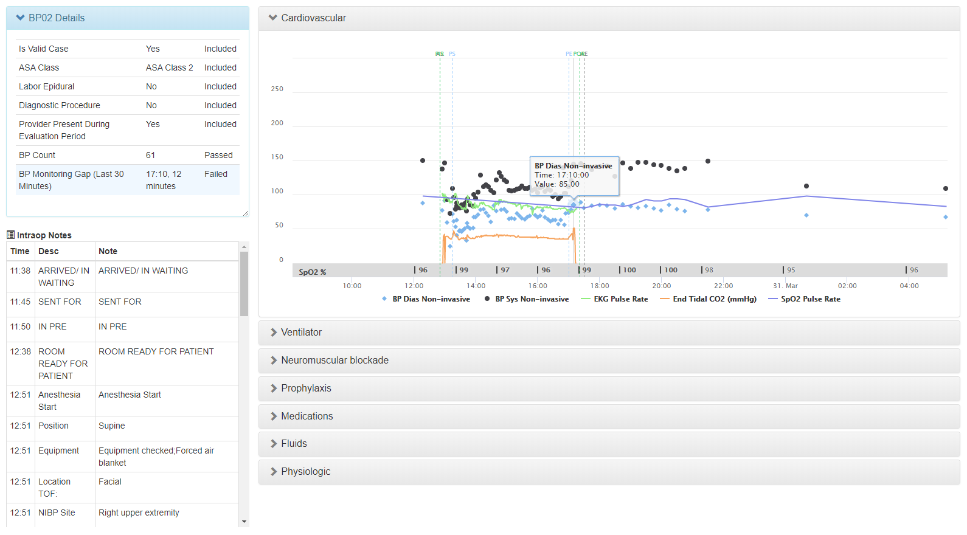

Slide 36
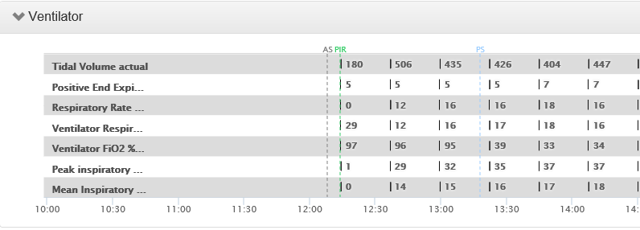
Case Viewer Template per Measure

Slide 37
Utilizing Metrics to Improve
CM
Notes:
Individual performance reflection

Slide 38
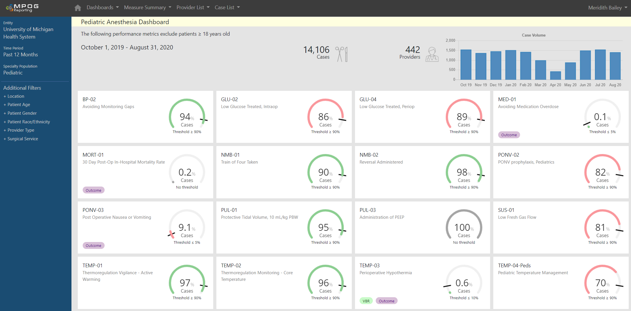
Utilizing Metrics to Improve
CM
Notes:
A combination of process measures and outcome measures in the MPOG database

Slide 39
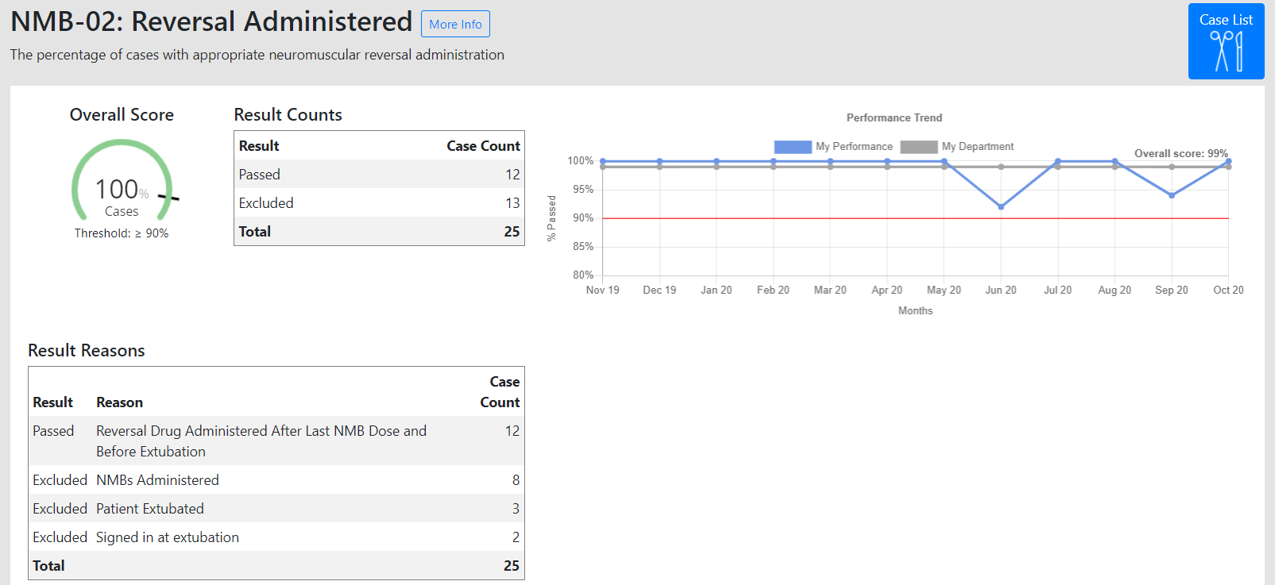
Utilizing Metrics to Improve
CM
Notes:
Clicking on the measure will result in the specific measure overview, which will include overall performance, case counts, trend graph, and a detailed breakdown of primary cause.

Slide 40
Utilizing Metrics to Improve: Benchmarking against other MPOG sites
CM

Slide 41
Opportunities for Quality Improvement
Monitoring of institutional performance on individual metrics to identify opportunities for improvement
Utilization of QI methodology to produce evidence based change
Process mapping and failure analysis
Data monitoring with control charts
PDSA cycles to test theories for improvement
Development of best practices and formalization in new clinical practice guidelines
CEBA protocols
Opportunity to help with future metric development to help positively impact our specialty across children’s hospitals nationwide
CM

Slide 42
Rollout and timeline for implementation
January 18, 2021: Validation of used cases completed
January 22, 2021: VUMC data uploaded into the MPOG central database
January 27, 2021: a 3-month of pilot rollout started, QuizTime learning modules
January 29, 2021: Introduction to ASPIRE Metrics, survey sent out to pilot group
March 31, 2021: Pilot rollout will be ending, feedback will analyzed
April 28, 2021: Departmental wide rollout to all providers
Onwards: performance will be monitored, feedback will be sought and analyzed for facilitators and barriers, QI and research opportunities advertised

Slide 43
Thank you

Slide 44
CME Code 1.29.21 TEXT 40089 to 855-776-6263

