Slide 1
VUMC Core Manager Customer Support Guide
VUMC Office of Research
https://www.vumc.org/oor/
Revised Dec. 5, 2018

Slide 2
User Registration & Accounts
All users will need to register.
Registration instructions available on the Office of Research website.
Once registered, all VUMC and VU users will access the application using their VUNet ID and ePassword.
VUMC Users
Requested accounts approved within 24-48 business hours by VUMC Office of Research
Help: Contact VUMCcores@vumc.org
VU Users
Requested accounts approved by VU Office of Contracts & Grant Accounting
Help: Contact CoresVU@vanderbilt.edu
The VUMC or VU PI also can approve the request directly in iLab.
Notes:
NOTE: Webform located on the OOR site. Existing users can request additional roles by submitting a request on a webform.

Slide 3
VUMC Payment Number Management
VUMC users pay with a cost center.
(1) Cost centers are added by the department administrator.
(2) PI or Lab Manager grants access to the activated cost center to other lab members.
VUMC users can also pay with scholarship or VICTR voucher.
(1) Scholarship or VICTR voucher activated systematically by OOR.
(2) PI or Lab Manager grants access to the activated number to other lab members.
User SOPs available on the Office of Research website.
Notes:
NOTE: Webform located on the OOR site. Existing users can request additional roles by submitting a request on a webform.

Slide 4
VU Payment Number Management
VU users pay with a Standing PO CoA or POET numbers.
VU users are considered external users. iLab uses the term ‘standing po’ when referring to external billing numbers.
(1) VU department, PI, or staff will submit a webform to add a new VU standing PO to iLab for use in VUMC core groups.
The VU users are instructed to request their “CoA or POET” number completing the webform.
(2) VU Finance will review and approve any web forms submitted to ensure the number is valid.
(3) OOR will activate and assign access to the Standing PO under the existing “VU Lab Group”
Example: Smith, John (VU) Lab
VU users can also pay with scholarship or VICTR voucher.
(1) Scholarship or VICTR voucher activated systematically by OOR.
These numbers are considered internal funding sources.
All VU users with scholarship or VICTR voucher funds will be assigned a special lab group.
Example: Smith, John (VUMC Scholarship & Voucher Lab)
(2) PI or Lab Manager grants access to the activated number to other lab members.
User SOPs available on the Office of Research website.
Notes:
NOTE: Webform located on the OOR site. Existing users can request additional roles by submitting a request on a webform.

Slide 5
VA Payment Number Management
Some VUMC or VU faculty members may have VA funding.
VA funding is considered external funding source.
Faculty members with this funding is assigned a special lab group.
Example: Smith, John (VA-TVHS) Lab
OOR will activate and manage the VA standing POs in coordination with Mike Walsh.
User SOPs available on the Office of Research website.
Notes:
NOTE: Webform located on the OOR site. Existing users can request additional roles by submitting a request on a webform.

Slide 6
External User Notes
Step 1: Complete “Request a new External User for your iLab site” webform
https://www.vumc.org/oor/vumc-cores-ilab-solutions-transition
VUMC Office of Research will:
(1) Register on behalf of the external PI (or verify he/she has an active iLab account)
(2) Once the external account is active, OOR will add the institution to the core’s pricing panel and assign the applicable pricing group.
(3) Add a PO or billing reference number to the core’s site.
Step 2: Provide user with instructions on using iLab.
Step 3: Invoice Distribution
All external invoices are distributed to the invoice owner and financial managers monthly during the closing process. (Typically completed by the 10th business day the following month)
Step 4: Work with your Core Administrative Officer to monitor the aging report and mark invoices as paid.
Payment remittance instructions are stated on the invoice.
An SOP for external customer management is available on the OOR website.
Notes:
NOTE: Webform located on the OOR site. Existing users can request additional roles by submitting a request on a webform.

Slide 7
External User Notes
Updates to External Lab Groups:
If your external customer requests new financial contacts, email address, or address a HELP ticket will need to be submitted.
The user can do this directly. Or, the core can submit on their behalf.
PO Numbers
External Users may add a new billing number as a “Purchase Order” when submitting a request.
The core will need to approve this request before the charges can be billed to the customer preferred PO number.
NOTE: The PO number displays on the customer’s invoice
IMPORTANT
Do not approve PO numbers for VU Lab Groups
Do not approve PO numbers for VA Lab Groups
The Office of Research will manage the activation of all VU and VA billing numbers.
Notes:
NOTE: Webform located on the OOR site. Existing users can request additional roles by submitting a request on a webform.

Slide 8
Lab groups available for VUMC Faculty
Smith, John (VUMC) Lab
Smith, John (VA) Lab
Fund Type:
Select this lab when you want to make core purchases/ reservations using your VUMC cost centers.
Select this lab when you want to make core purchases/ reservations using your scholarship or voucher funds.
VUMC Cost Centers
VUMC Cost Centers are activated by the department administrator.
Access to VUMC Cost Centers
The PI has automatic access to the VUMC cost center once activated by the department.
The PI or Lab Manager will need to grant access for specific users to specific cost centers via the PI’s fund grid.
Vouchers & Scholarships
Vouchers & Scholarships funds are activated in iLab via an outside process.
Access to Voucher & Scholarship Funds
The PI will have automatic access to these funds once activated
The PI or Lab Manager will need to grant access for specific users to specific cost centers via the PI’s fund grid.
Fund Type:
Select this lab when you want to make core purchases/ reservations using your VA Funds (99999XXXX)
VA Funds (999999xxxx)
VA funds are considered external funds.
VA funds are added as a ‘Standing PO’ number to each VUMC core facility that will be used.
The VA fund must be added for each individual lab member at each core facility.
Activating VA Funds
Contact the Office of Research to activate VA funds for each of the lab members.
NOTE: This is a manual process, and we will activate upon request. Please provide the VUMC core name and the name of the lab member.
Access to VA Funds
Once the VA fund has been added to the requested core site as a “Standing PO’, the user will have access to the fund.

Slide 9
Lab groups available for VU Faculty
Smith, John (VU) Lab
Smith, John (VA) Lab
Smith, John (VUMC Scholarship & Voucher) Lab
Fund Type:
Select this lab when you want to make core purchases/ reservations using your VU billing number.
Activating VU Cost Centers
VU Billing Numbers are added as Standing POs
To request activation or updates of a VU billing number submit the OOR Webform
OOR will add and approve POs as requested via the webform.
https://www.vumc.org/oor/vu-billing-number-change-use-vumc-core-groups-ilab-vumc-cores
Access to VU Funds
Once the VU billing number has been added to the requested core site as a “Standing PO’, the user will have access to the fund.
Fund Type:
Select this lab when you want to make core purchases/ reservations using your VA Funds (99999XXXX)
VA Funds (999999xxxx)
VA funds are considered an external fund source; therefore, are added as a ‘Standing PO’
Activating VA Funds
Contact the Office of Research to activate VA funds.
Email VUMCcores@vumc.org
VUMC OOR coordinates management of VA funding with Mike Walsh at the VA.
Access to VA Funds
Once the VA fund has been added to the requested core site as a “Standing PO’, the user will have access to the fund.
Contact the VUMC Office of Research to grant access to the VA billing number for new lab members.
Fund Type:
Select this lab when you want to make core purchases/ reservations using your scholarship or voucher funds.
Scholarship and Voucher Funds
These funds are considered internal funds.
Activating Scholarship & Voucher Funds
These funds are activated via an outside process.
Scholarships: Office of Research Allocation Process
Voucher: StarBRITE Feed
Access to Voucher & Scholarship Funds
The PI will have automatic access to these funds once activated
The PI or Lab Manager will need to grant access for specific users to specific cost centers via the PI’s fund grid.

Slide 10
Invoices
Customers or the core can view all invoices
Click “invoices” in the left-hand menu.
Refund request should be directed to core directly.
The email address for the core is listed on the invoice.
External customers will need to submit payment via wire transfer or check to our Finance lockbox address.
Payment of VUMC and VU invoices are managed my our office.
VUMC invoice payments posts to the core’s ledger the same month the invoice is created.
VU invoice payments posts to the core’s ledger 1 month after the invoice is created.
Notes:
NOTE: Webform located on the OOR site. Existing users can request additional roles by submitting a request on a webform.

Slide 11
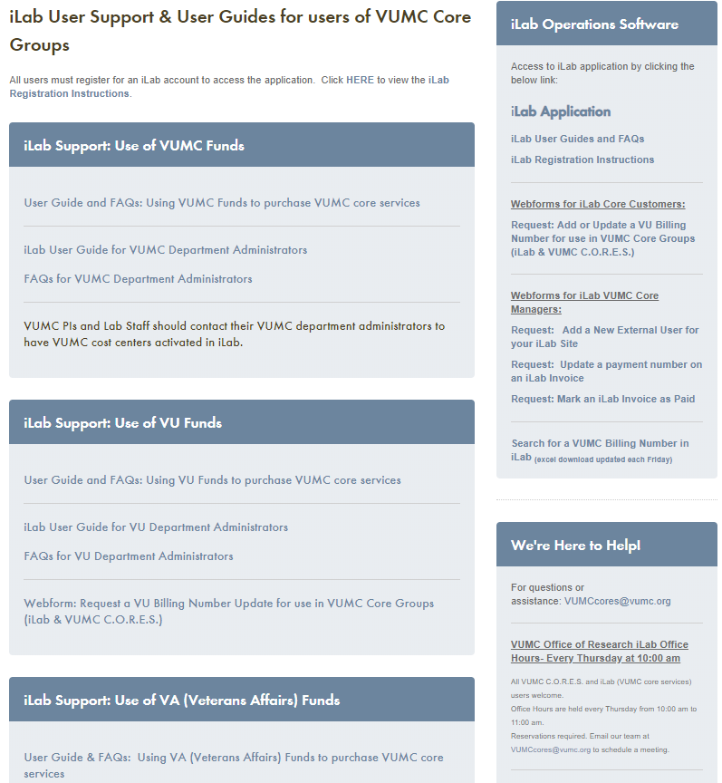
Office of Research Website
Link to iLab Application
Registration Instructions
User Guides
FAQs
VU Billing Number Update Webform Request
Monthly iLab User Trainings:
General customer support topics covered.
Schedule available on our website.
iLab/VUMC C.O.R.E.S Office Hours:
10:00am to 11:00am on Thursdays
Reservations required.
VUMC Office of Research Support Email Address:
VUMCcores@vumc.org
VUMC Core List:
https://www.vumc.org/oor/full-listing-vanderbilt-research-cores-and-shared-resources
https://www.vumc.org/oor/ilab-user-support-user-guides-users-vumc-core-groups

Slide 12
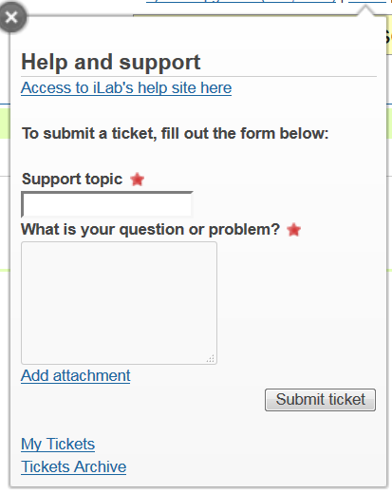
iLab Support
Select HELP
Complete the questionnaire and select Submit Ticket
Notes:
You can “Add Attachments” and view Archived Tickets.

