Slide 1
VUMC Core Managers Meeting
May 30, 2019

Slide 2
Agenda
Institutional Review Entity for Dual Use Research of Concern (DURC)
Rigor, Reproducibility and Transparency
StrategyShare 2019
Upcoming Events
Q&A

Slide 3
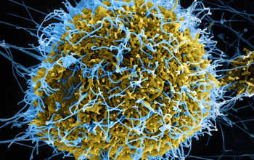
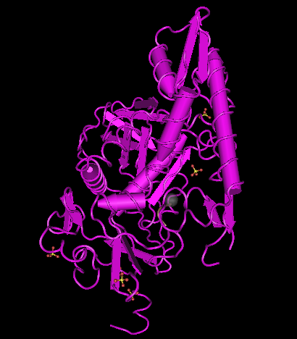
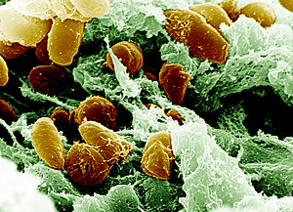
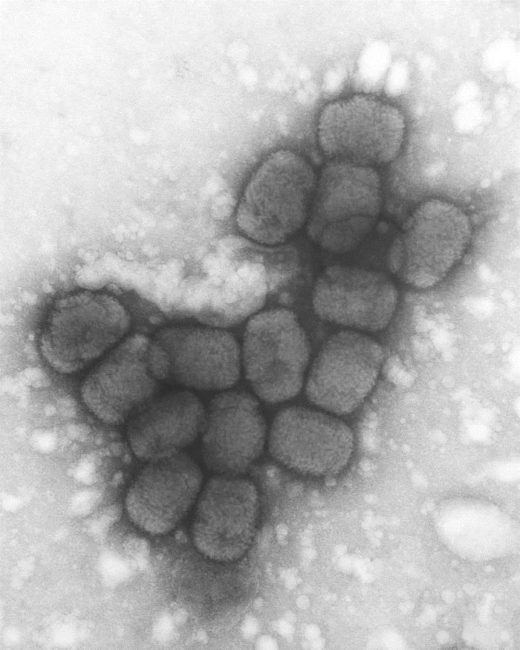

Dual Use Research of Concern (DURC)
VUMC Policy and Procedures
NIH
Madej et al. Nucleic Acids Res. 2014 Jan; 42(Database issue):D297-303
Rocky Mountain Laboratories, NIAID, NIH
CDC Public Health Image LIbrary

Slide 4
What is Dual Use Research of Concern (DURC)?
“Life sciences research that, based on current understanding, can be reasonably anticipated to provide knowledge, information, products, or technologies that could be directly misapplied to pose a significant threat with broad potential consequences to public health and safety, agricultural crops and other plants, animals, the environment, materiel, or national security.”
More simply:
DURC is beneficial life sciences research that could also be potentially used for nefarious purposes.

Slide 5
VUMC DURC Policy
Overview:
Federal Government defines “dual use research” and regulatory requirements
Complements existing federal regulations such as Select Agent Regulations and Export Control Laws
Scope defined by the 15 agents and toxins, and 7 experimental effects that indicate potential DURC
Policy applies to all VUMC research* that could meet the definition of DURC.
  Federal and/or non-Federal funding
  VUMC is prime recipient, or sub-recipient, of award
*applies to VUMC-employed PIs only
PI Responsibility:
Each PI is responsible for awareness of, and compliance with, federal and VUMC DURC policies.
VUMC Institutional Responsibility:
Designate an Institutional Contact for Dual Use Research (ICDUR)
Establish the Institutional Review Entity (IRE) and required oversight procedures

Slide 6
Institutional Review Entity (IRE) &
Institutional Contact for Dual Use Research (ICDUR)
The IRE is empowered to execute requirements of federal DURC policy on behalf of the institution. The IRE:
Assesses research for potential DURC
Communicates assessments to appropriate funding agencies
If research is assessed to meet the definition of DURC, the IRE:
Works with the PI to draft risk mitigation plan for approval by funding agency
Monitors compliance for the life of the project
The ICDUR is point of contact for questions re: DURC compliance, implementation.
The ICDUR is liaison between VUMC and relevant federal funding agencies.

Slide 7








Institutional Review Entity (IRE)
Chair: Eric Skaar
PMI
Vanderbilt Institute for Infection, Immunology
& Inflammation
Mark Denison
Pediatrics
Infectious Disease
Buddy Creech
Pediatrics
Infectious Disease
Vanderbilt Vaccine
Research Program
David Aronoff
Medicine
Infectious Disease
Jennifer Pietenpol
VICC
Executive Vice President for
Research
Adam Riddick
Export Compliance
Robin Trundy
Biosafety
Susan Meyn
Office of Research
ICDUR

Slide 8
DURC Review Process – Overview
Review is initiated when the PI notifies the Institutional Review Entity (IRE) as soon as any of the following apply:
  The PI’s research involves any of the 15 listed agents and toxins
  One or more of the 7 listed categories of experiments can be reasonably considered applicable to the PI’s research involving one or more of the 15 listed agents and toxins
  The PI’s research meets criteria that may meet the definition of DURC.
Possible IRE review outcomes:
LIKELY OUTCOME:
Research is not DURC.
No further action is required.
NOT LIKELY OUTCOME:
Research meets the definition of DURC, and requires submission of a Draft Risk Mitigation Plan to the appropriate funding agency

Slide 9
How does a PI know if research should be reviewed for potential DURC?
Is the PI working with one or more of these 15 agents or toxins?
Avian influenza virus (highly pathogenic)
Bacillus anthracis​
Botulinum neurotoxin (including Botox)
Burkholderia mallei
Burkholderia pseudomallei​
Ebola virus
Foot-and-mouth disease virus
Francisella tularensis​
Marburg virus
Reconstructed 1918 Influenza virus
Rinderpest virus
Toxin-producing strains of Clostridium botulinum
Variola major virus
Variola minor virus
Yersinia pestis​
If answer = “yes”, the PI should submit the Initial DURC Assessment form to initiate review by the IRE, or contact Susan Meyn (ICDUR) by phone
for guidance.

Slide 10
Typical DURC Review
PI’s research uses one or more of the listed 15 agents and toxins.
STEP 1: PI submits Initial DURC Assessment
PI indicates that the 7 categories of experiments/experimental
effects are not applicable to the PI’s research
The IRE concurs that the 7 categories of experiments/experimental effects are not applicable to the PI’s research
OUTCOME: PI will be informed that
no further DURC review is required.

Slide 11
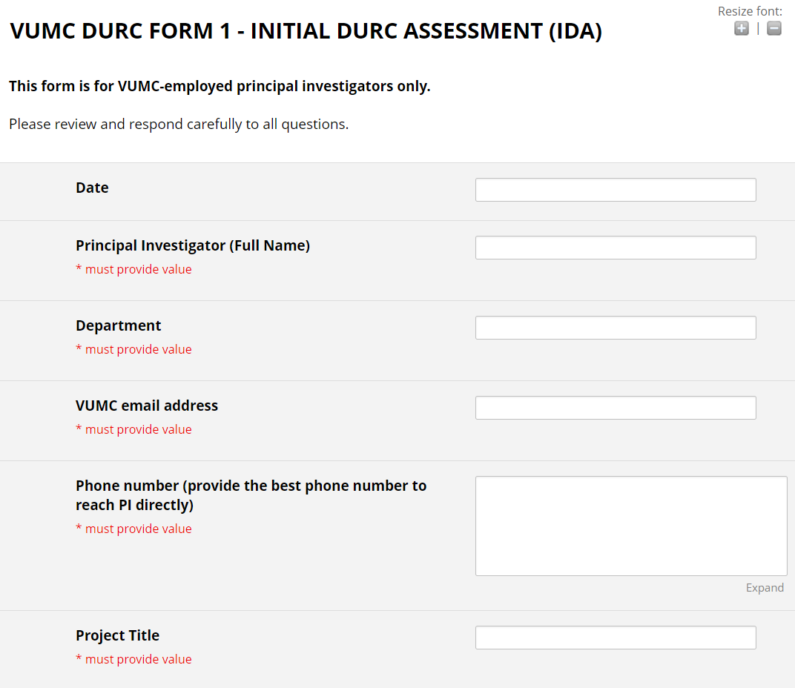
Initial DURC Assessment - REDCap form
www.vumc.org/oor/vumc-initial-durc-assessment-form
Vunet ID required

Slide 12
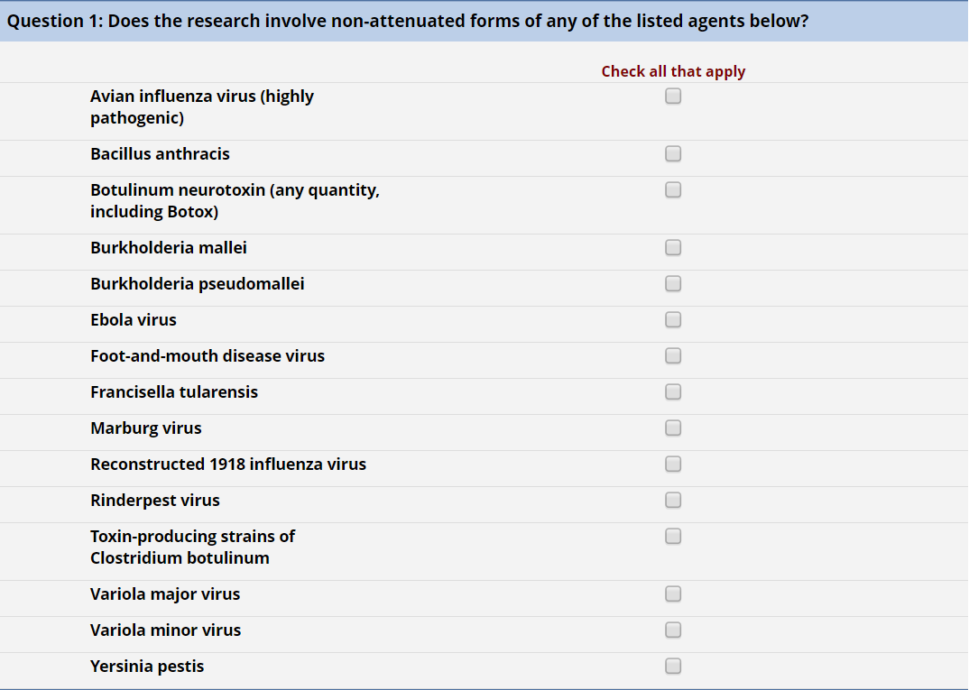
Initial DURC Assessment - REDCap form
Note: Botox

Slide 13
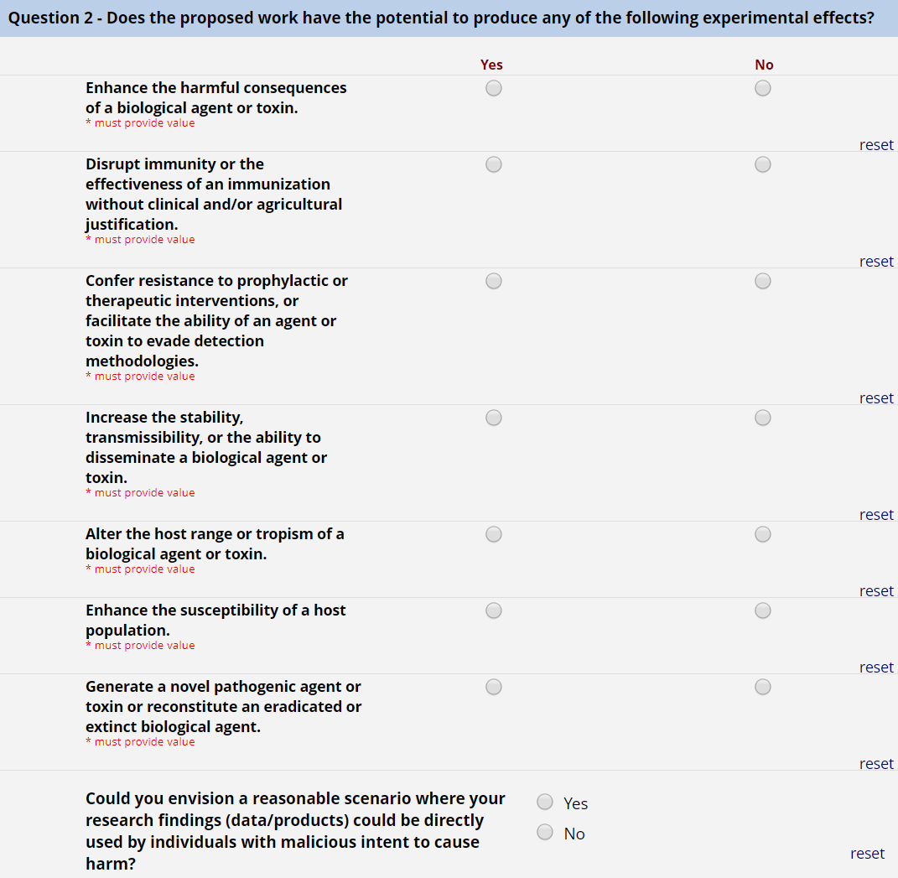
Initial DURC Assessment - REDCap form
comment field opens if “yes”

Slide 14
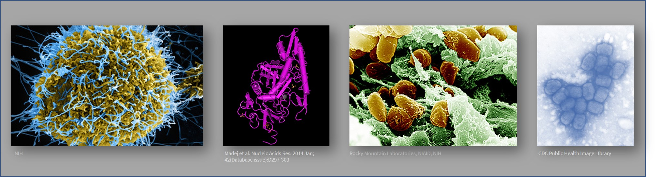
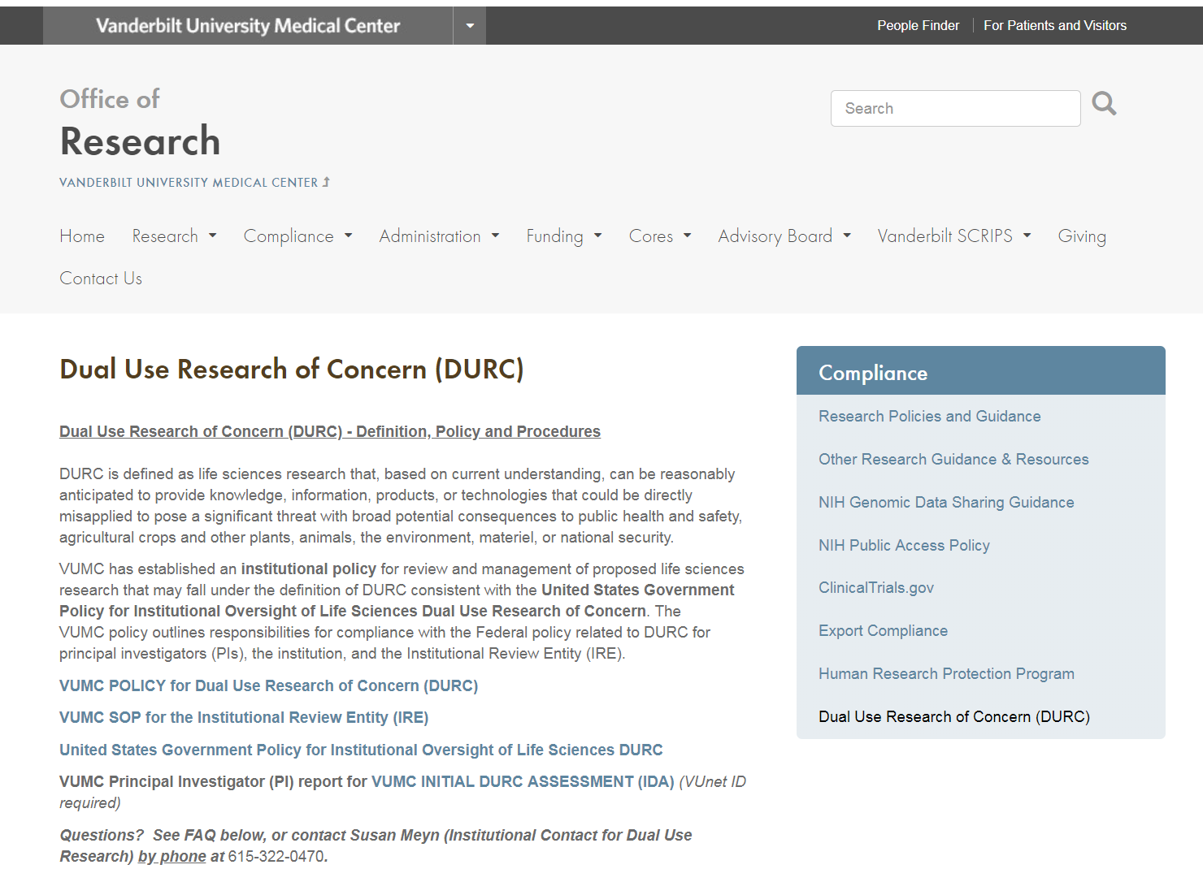
Office of Research DURC Information Page
www.vumc.org/oor/dual-use-research-concern-durc
VUMC and Federal Policies for DURC
VUMC SOP for the Institutional Review Entity
VUMC Initial DURC Assessment form
FAQ
Contact information

Slide 15
Dual Use Research of Concern (DURC) Review Process Summary for PI
The PI notifies* the Institutional Review Entity (IRE) as soon as any of the following apply:
  The PI’s research involves any of the 15 listed agents and toxins
  One or more of the 7 listed categories of experiments can be reasonably considered applicable to the PI’s research involving one or more of the 15 listed agents and toxins
  The PI’s research meets criteria that may meet the definition of DURC.
STEP 1: PI submits *Initial DURC Assessment
Option 1
Option 2
Option 3
PI answers that the 7 categories of experiments/experimental effects (see VUMC Policy) are not applicable to the PI’s research
PI answers that the 7 categories of experiments/experimental effects (see VUMC Policy) are not applicable to the PI’s research
PI answers that one or more 7 categories of experiments/experimental effects (see VUMC Policy)
are applicable to the PI’s research
STEP 2: The IRE concurs that the 7 categories of experiments/experimental effects (see VUMC Policy)
are not applicable to the PI’s research
STEP 2: The IRE disagrees with PI’s assessment that the 7 categories of experiments/experimental effects
(see VUMC Policy)
are not applicable to the PI’s research
Skip to Step 3
OUTCOME 1: PI will be informed that no further DURC review is required.
STEP 3: PI will be asked to submit a DURC Determination Analysis form
STEP 3: PI will be asked to submit a DURC Determination Analysis form
STEP 4: IRE reviews all submitted documentation
STEP 4: IRE reviews all submitted documentation
IRE determines that research does not meet definition of DURC
IRE determines that research does meet definition of DURC
IRE determines that research does not meet definition of DURC
IRE determines that research does meet definition of DURC
This chart is a summary of the VUMC institutional review workflow.
For questions, contact Susan Meyn, Institutional Contact for Dual Use Research (ICDUR) at 615.322.0470
For more details on DURC policy and process, refer to the VUMC Policy for Dual Use Research of Concern (DURC), the VUMC SOP for the Institutional Review Entity (IRE), and the FAQ posted on
www.vumc.org/oor/dual-use-research-concern-durc
OUTCOME 1: PI will be informed that no further DURC review is required.
OUTCOME 2: PI works with IRE and ICDUR to prepare a Draft Risk Mitigation Planning Assessment
OUTCOME 1: PI will be informed that no further DURC review is required.
OUTCOME 2: PI works with IRE and ICDUR to prepare a Draft Risk Mitigation Planning Assessment
STEP 5: Submit to funding agency for approval
STEP 5: Submit to funding agency for approval

Slide 16

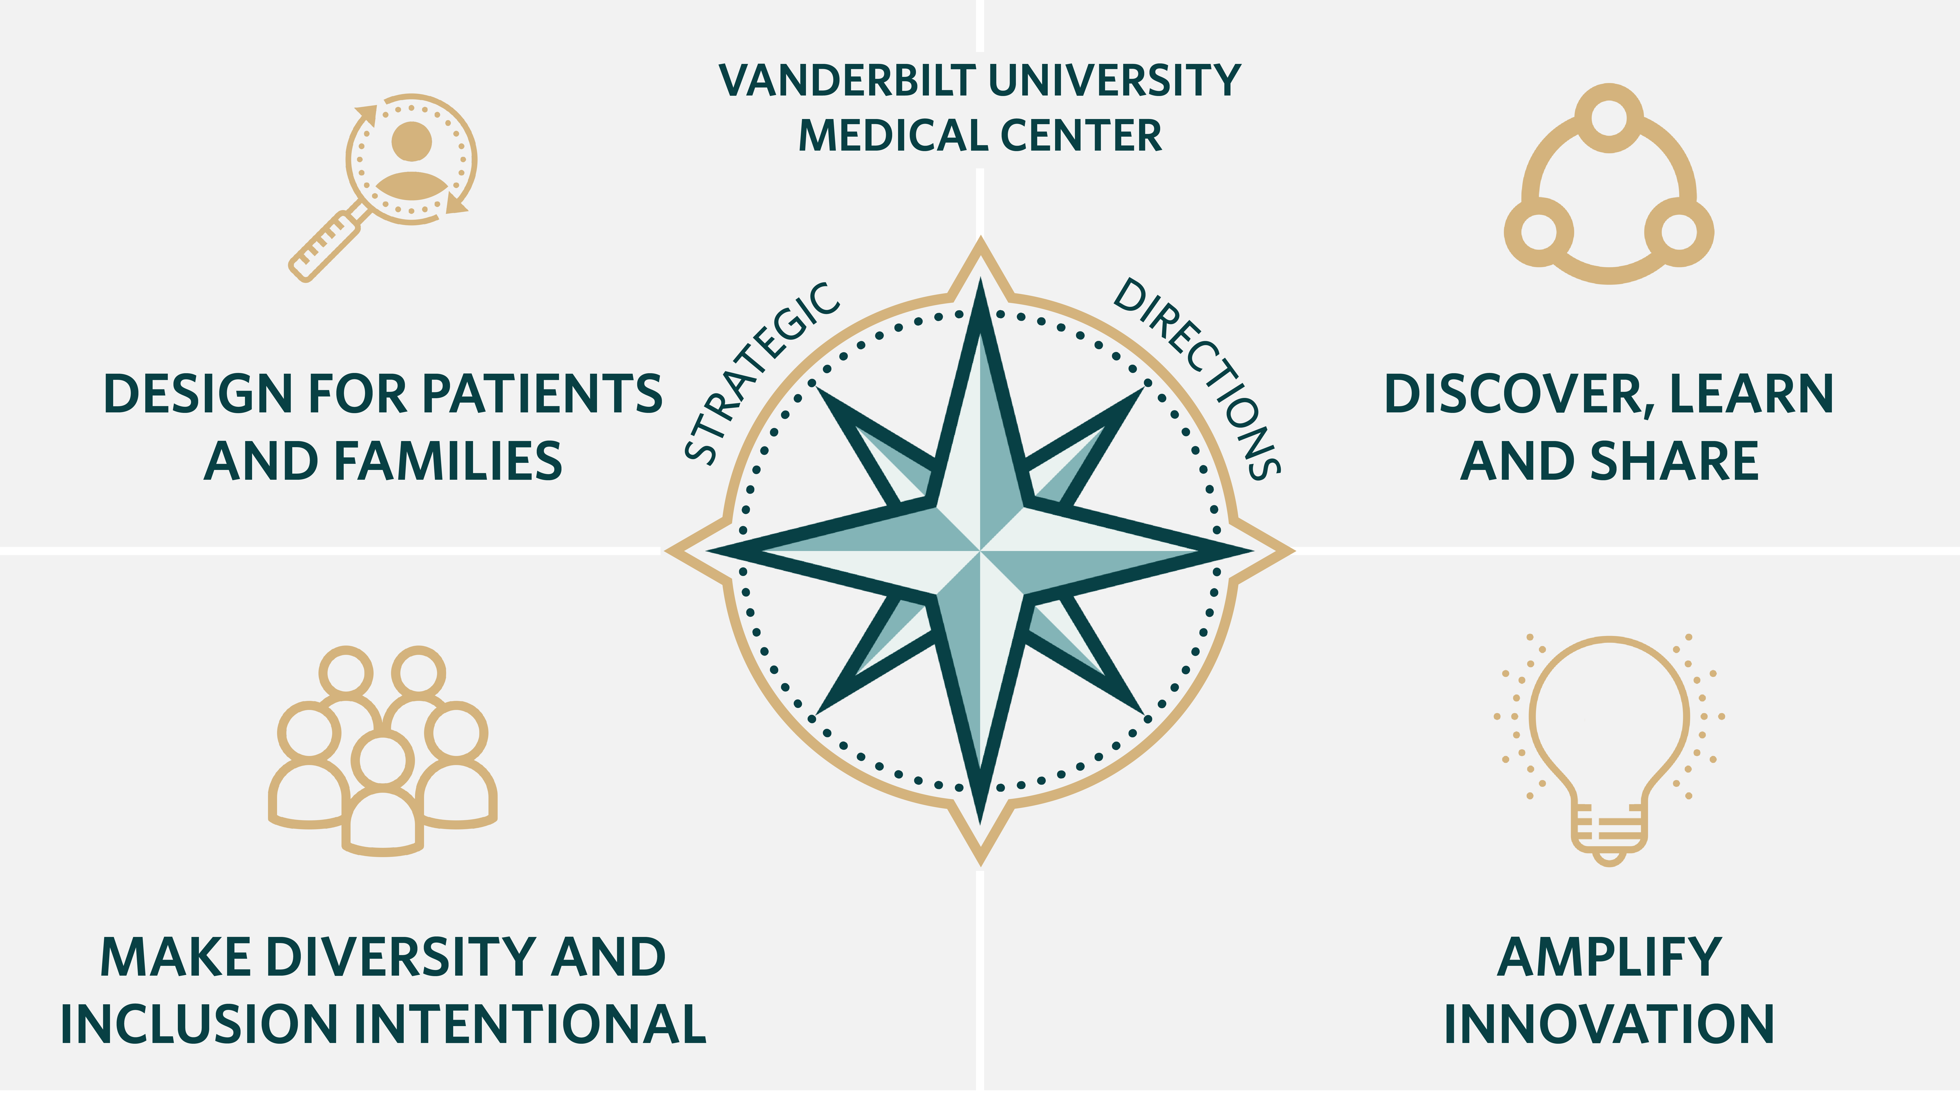


Rigor and Reproducibility:
Updates from ABRF and VUMC working groups
Notes:
Collaborative process
Connections between VUMC's work-in-progress and the best practices identified by respondents to the CCoRRe survey will be emphasized.
CCoRRe survey data inspires research cores and institutions to develop similar resources and spark new initiatives.

Slide 17
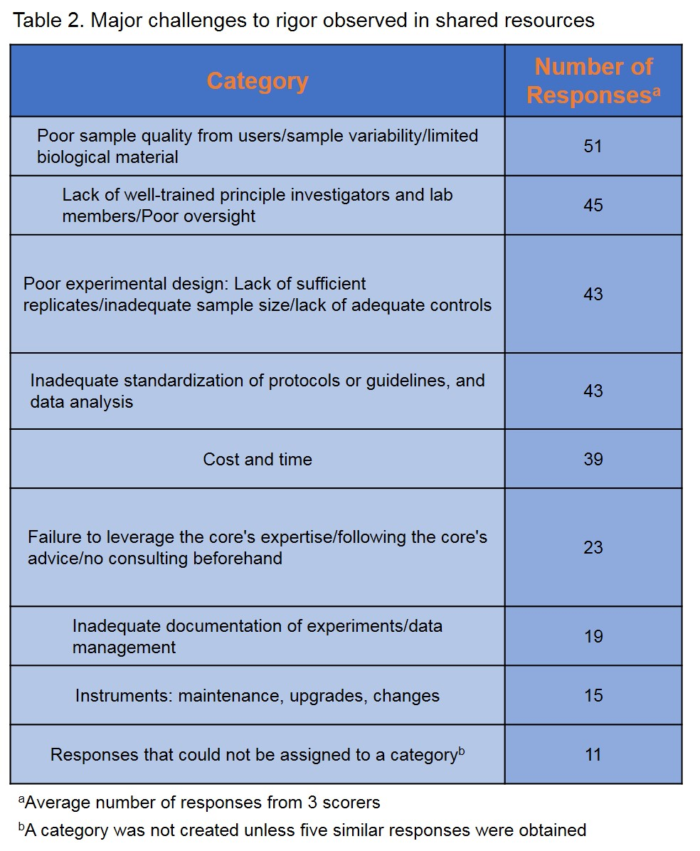
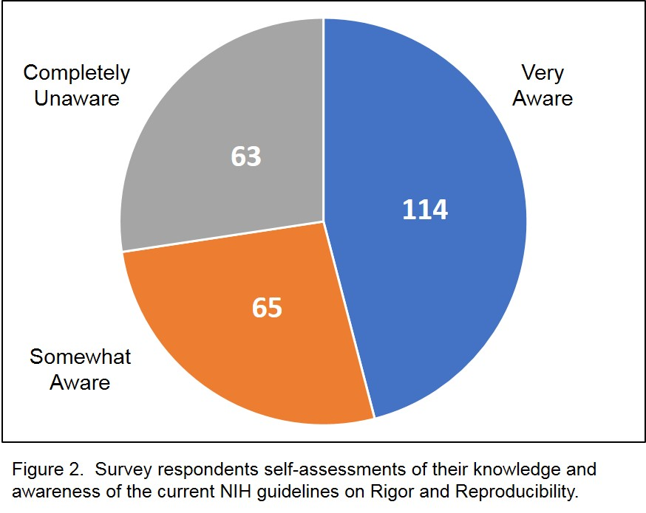
ABRF Committee on Core Rigor and Reproducibility (CCoRRe) survey
Have NIH initiatives to advance scientific rigor and reproducibility influenced core leaders in providing services and developing new technology?
243 respondents from 21 countries (79% from U.S.)
53% ABRF Members
69% were core facility directors that work in an academic setting (72%)
Broad range of technologies represented
Common factors contributing to lack of rigorous and reproducible research:
- Lack of training -
- Mentorship -
- Expertise -
- Oversight -
Publication pending in Journal of Biomolecular Techniques
Notes:
The survey returned valuable feedback regarding challenges, opportunities, and new practices/resources that can help ensure the conduct of rigorous research.
The survey results showed that awareness of the NIH guidelines is variable.
However, a consistent picture also emerged from the survey results, highlighting the factors that support or impede the conduct of rigorous research, and the types of supportive services that research cores can offer to their users.

Slide 18




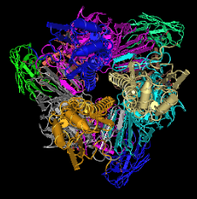
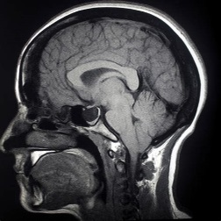












The Data Challenge
Data Levels
Data Types
Expertise
Notes:
Graphic notes
Data levels (sub molecular, molecular, cell, organ, individual, population, society)
Data types (structured, imaging, EHR, internet of things)
Expertise (computation, informatics, math, statistics, biomedical, policy, ethics)
Executive faculty updates:
Health Data Science Center update at Exec Fac – 5/30
Biostatistics update at Exec Fac – 9/20
Biomedical Informatics update at Exec Fac – 10/17
BSAB in Dec
Leadership group - SMEs (Harrell, Harris, Lindsell, Malin, Rothman); Chairs (KJ, YS), Research EVPs (GHB, BD, JP), facilitator (BS)
Clarify VUMC areas of emphasis and desired capabilities
Notes:
AI Challenge winners - dual track liver fat hypotheses, target suicide risk at intersection with lack of HCare engagement; recast cardiac surgery as predicting readiness for discharge
BSAB
Leveraging BioVU to inform practice (overview, Phenotype Risk Prediction Score, genetic evolution as basic science example, NashBio)
Data Science (overview, Landscape, Imaging, Breast CA)

Slide 19
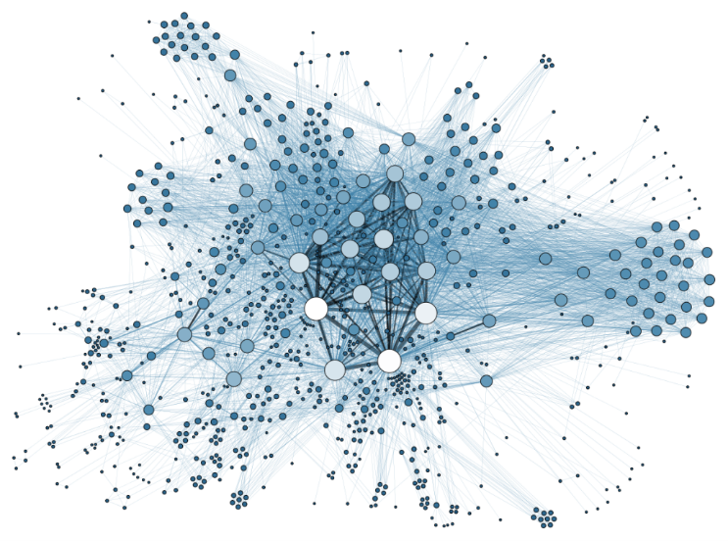

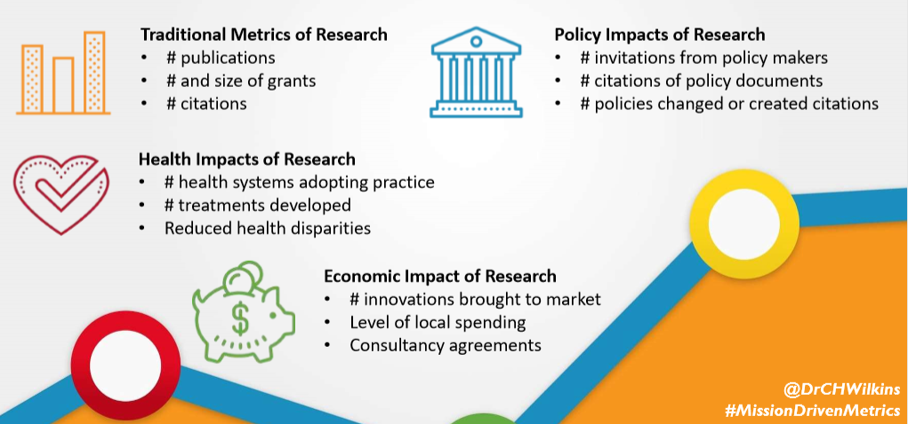
The Opportunity
Advance Knowledge
Change Practice, Policy and Paradigms
Analyze and Understand
Grow Research
Reproducible Results
en.wikipedia.org

Slide 20

VUMC Strategic Directions: Discover, Learn & Share
Cores ENHANCE DISCOVERY through
Rigorous experimentation & data analysis
Reproducible research
Transparency of data sets & methods
Cores DEVELOP SYSTEMS for
Experimental data generation
Co-registration, mining data & biological specimens at scale
Data science, IT, management
Cores are integral

Slide 21

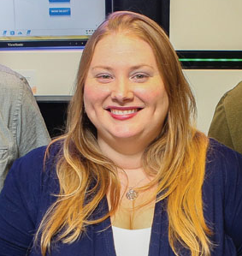
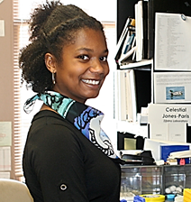
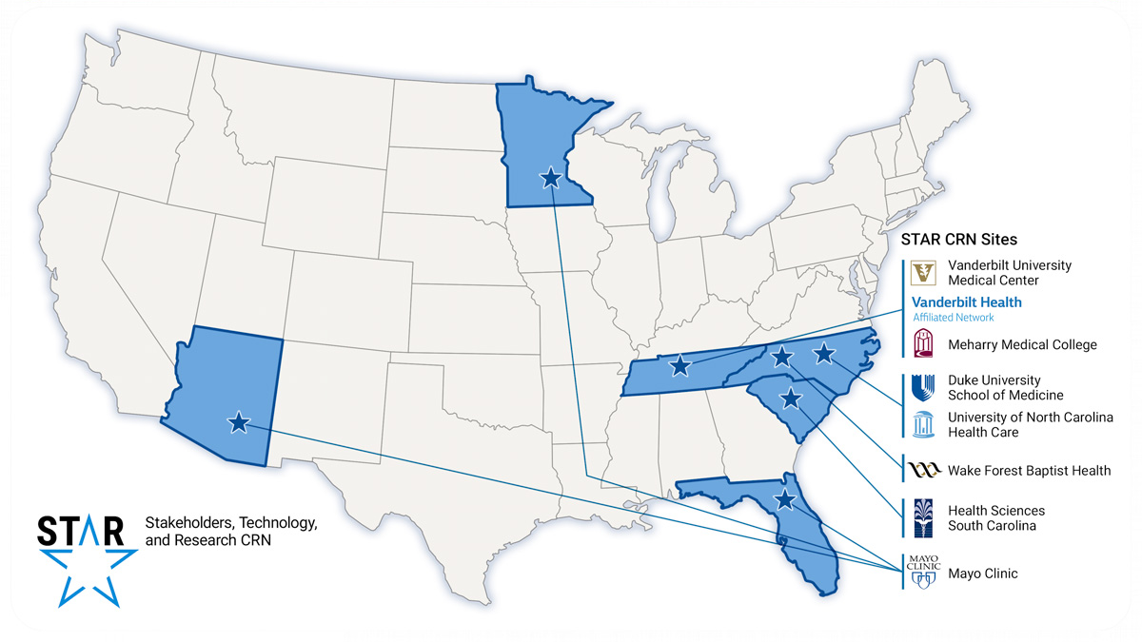




Action Plan: VUMC Core RR&T Working Group
Rob Carnahan, PhD
Associate Professor of Pediatrics
Director of Research, Crowe Lab
Former Director, Vanderbilt Antibody & Protein Resource (VAPR)
Megan Cook, MHA
Sr. Project Manager for the STAR Clinical Research Network
Manager, Health Services Research Center Cores
Liv Koues, PhD
Managing Director, University of Michigan Medical School DNA Sequencing Core
Former Manager, Vanderbilt Technologies for Advanced Genomics
Celestial Jones-Paris, PhD
Project Manager, BioVU: DNA biorepository w/linked phenotypic + genotypic data
Amy Martinez, PhD
Program Officer
Office of Research
Mike Nickels, PhD
Technical Director, Radiochemistry Core Lab
VUMC Center for Molecular Probes
Scott Sobecki
Director, Research Informatics Core
& VICC Bioinformatics/IT Resources

Slide 22
VUMC Working Group Timeline
2018
2019
May
Presented RR&T to VUMC Core Managers quarterly meeting, including preliminary results from the CCoRRe survey
Call for interested volunteers to join Working Group
August
First WG meeting
First draft of Guidelines document
September - December
Second WG meeting
Iterate to refine draft Guidelines document
January – March
Unexpected hiatus
April – June
Third WG meeting to finalize draft, and plan
Submit for executive review
Initiate communication and rollout to cores

Slide 23
Leverage the Unique Capabilities and Role of Cores
to advance rigor, reproducibility & transparency (RR&T) at VUMC
Cores
enable, facilitate, promote & define
RCR
Experimental Design
SOPs
QC/QA
Authenticate key biologics,
chemicals
BIG DATA
Mentorship
Rigorous Methods
Notes:
Enabling the responsible conduct of research through training, informal mentorship and experimental services.
Facilitating good experimental design via well-developed, implemented and defined standard operating procedures (SOPs) and application of quality control/quality (QC/QA) assurance best practices.
Offer and promote authentication services for key biological and/or chemical resources to help achieve compliance with NIH policies and guidance related to rigor and reproducibility.
Defining and establishing rigorous methods for acquiring and analyzing data; effectively transmitting these methods and concepts to users of a core; and producing large, complex experimental data sets.

Slide 24
Establish Guidelines for Core RR&T
Promote intellectual and scholarly rigor, reproducibility and appropriate transparency in science and practice
Highest level of RR&T
Demonstrate effectiveness of RR&T
Balance needs for
autonomy
Full range of hypothesis-driven work
Translate best practices
from core to PI
Validated experimental methods
Research Services
Notes:
Balance the needs for autonomy across the range of hypothesis-driven discovery and learning-based practice.
Provide research services and products using validated experimental methods that employ the highest level of RR&T.
Demonstrate effectiveness of more rigorous approach to the conduct of science, enabling individual investigators to better incorporate these practices into their own research programs.

Slide 25

Draft Guidelines for VUMC Cores:
Methods documented, systematically defined, consistently applied
Core staff trained on instrumentation & methods
Instrumentation maintained & calibrated
Reagents validated, properly maintained w/inventory controls, proper storage
Software tools validated
Positive/negative controls used and justified
Batch effects defined and reported
Statistical tests appropriate to the data type and experiment
QC, sample data clearly annotated; raw results provided when possible for future analysis
Limitations on interpretation of data/results are explained.
Education, mentorship for experimental design, data analysis, accurate reporting of results
Notes:
Methods are documented and systematically defined by use of peer-reviewed, consistently applied SOPs.
Core staff are appropriately trained on new instrumentation/methods
Instrumentation is maintained and calibrated
Reagents are validated and properly maintained (i.e. inventory controls and proper storage)
Software tools are validated
Positive/negative controls are used and justified
Batch effects are defined and reported
Statistical tests are appropriate to the data type and experiment
QC and sample data clearly annotated, and where possible, results provided in full unadulterated form for future analysis
Any limitations on interpretation of data/results are explained.
Education and mentorship provided to researchers for experimental design, data analysis and accurate reporting of results

Slide 26

Proposed Toolbox:
Grant- and manuscript-ready text
Core and Institutional SOP templates
Future Directions
Focus on RR&T by
Faculty Oversight Committees
Educational and training materials
Translate to VUMC-wide guidelines and resource, working with:
Academic departments
Research centers
Data science & knowledge management SMEs
Individual PIs
and cores, of course!
ABRF Committee for Core Rigor and Reproducibility (CCoRRe)
VUMC Office of Research webpage, reciprocal links to core pages

Slide 27
Selected Resources:
NIH Rigor and Reproducibility: https://www.nih.gov/research-training/rigor-reproducibility
ABRF Committee for Core Rigor and Reproducibility (CCoRRe):
https://abrf.org/committee/committee-core-rigor-and-reproducibility-ccorre
Rigorous Science: a How-To Guide. Arturo Casadevall, Ferric C. Fang. mBio Nov 2016, 7 (6) e01902-16; DOI: 10.1128/mBio.01902-16 https://mbio.asm.org/content/7/6/e01902-16
How Can Scientists Enhance Rigor in Conducting Basic Research and Reporting Research Results? (ASCB White Paper) https://www.ascb.org/wp-content/uploads/2015/11/How-can-scientist-enhance-rigor.pdf
Rigor and Reproducibility in Federally-Funded Scientific Research: What are the Right Questions to Ask? (Clarivate White Paper) https://clarivate.com/wp-content/uploads/2017/11/nov-update_Rigor_and_Reproducibility_Whitepaper_SAR_17.pdf
Challenges in irreproducible research (Nature collection of articles): https://www.nature.com/collections/prbfkwmwvz/
Example core webpage: UNC Flow Cytometry Core Facility Guide to Rigor and Reproducibility for Flow Cytometry Experiments: http://www.med.unc.edu/flowcytometry/resources-2/guide-to-rigor-and-reproducibility-for-flow-cytometry-experiments

Slide 28
Acknowledgements
ABRF Committee on Core Rigor and Reproducibility (CCoRRe):
  Kevin L. Knudtson (chair), Rebecca Hegstad-Davies, Nancy Fisher, Belynda Hicks, Sheenah M. Mische, Katia Sol-Church, Frances Weis-Garcia, Susan Meyn
AMAZING VUMC Core Directors, Managers and Staff:
  www.vumc.org/oor/institutional-research-shared-resources-and-core-facilities

Slide 29
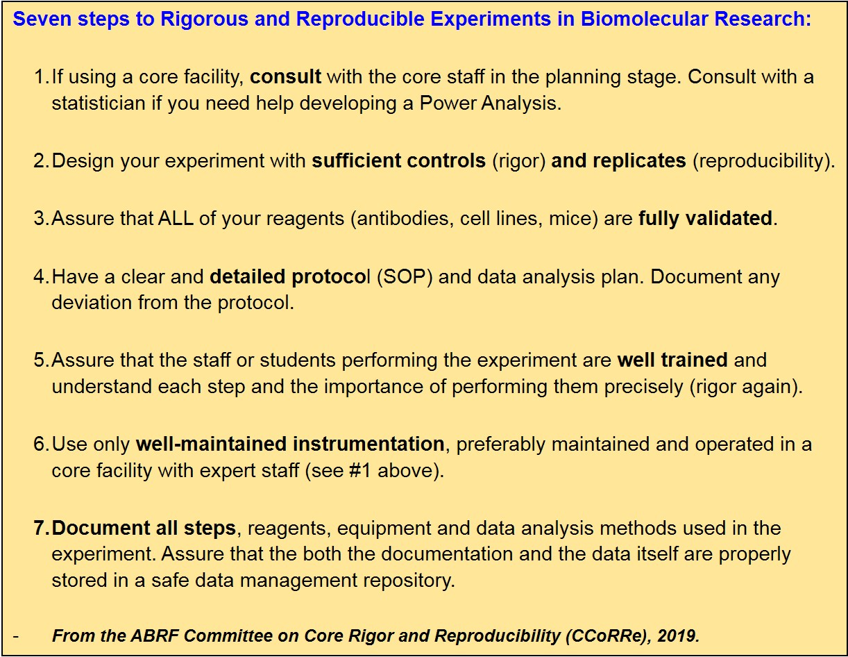

Slide 30
Notes:
Thank xxx for chance to take a few minutes to “pitch” engaging in SS19
A bit of context –
In 2016, We coalesced around 4 strategic directions to guide decisions by individuals and teams – be they working bottom up or top down.
Each direction calls for a fundamental shift in approach, walk around the compass …
Example of impact -Launch of VUMC Office of D& I with Andre Churchwell as the CDO
Guided by the compass, we are free to change our plans as we work together to try new approaches.
We committed to an annual “refresh” of the strategic directions - SSyy is a big part of the annual update process.

Slide 31

Notes:
In 2019 we are focusing on Design for Patients and Family
We have moved the event into Lanford to be more accessible to the clinical enterprise
Everyone in our community is welcome to attend – the registration link is open at this link.
We will have posters accessible starting at noon so that people can drop by over the lunch break, and during the wine and cheese reception after the “live” program if they want to stop by one the way home
We will also have an interactive web cast
The Design for Pats & Families strategic direction shifts our thinking to starting with the patient at the center instead of designing around what we do
Asking what the patient and their family want and how we can design systems and partnerships to bring their wishes to life.

Slide 32

Notes:
We have created a REDCap survey to gather the exciting work being done across Vanderbilt University Medical Center to advance our “Design for Patients and Families” Strategic Direction.
Please take a few moments to share what your team is doing via the REDCap survey below.

Slide 33

Upcoming Events

Slide 34
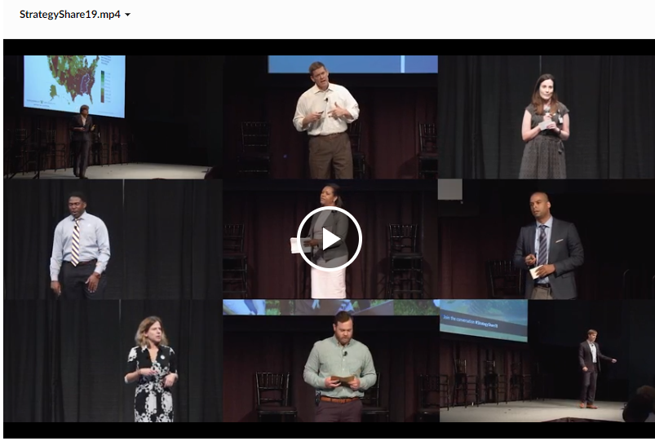
Video Link: https://www.vumc.org/strategy/strategyshare19

Slide 35
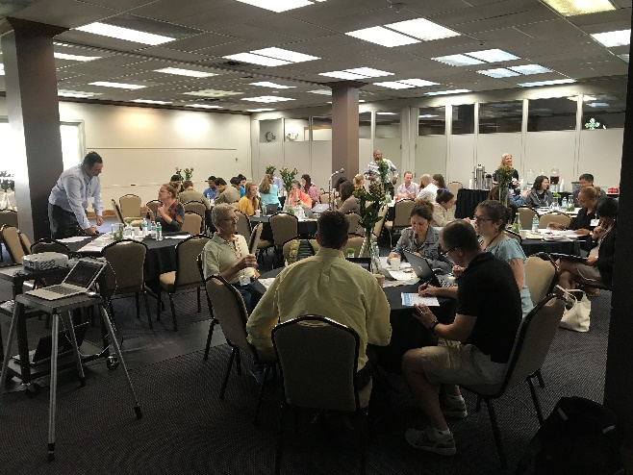
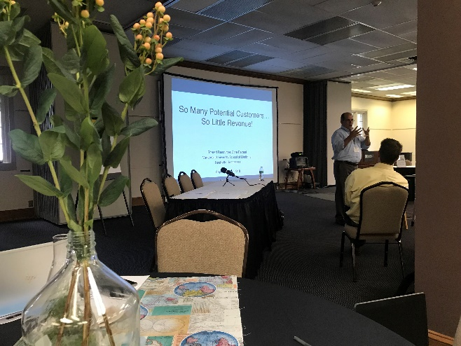
Make plans to attend the
Core Retreat on Sep. 11!
Confirmed sessions on INNOVATION
& LEADERSHIP… more to come!
Registration announced soon via the
OOR Weekly Update & Cores listserv

Slide 36





2019 SEASR Conference
June 12-14
Emory Conference Center Hotel
Atlanta, GA
Free academic registration with code:
FreeAcademic
“Making the Right Decisions:
Adapting to Emerging Needs”
MEETING AND HOTEL REGISTRATION IS NOW OPEN
Bioethics in gene editing
Project management skills
Strategic planning
Electronic laboratory notebooks
“Omics” research best practices
Networking and more!
For full agenda, registration, and
hotel reservations visit:
seasr.abrf.org
Rob Carnahan, PhD
Vanderbilt University
Medical Center
Marcy Darnovsky, PhD
Center for
Genetics and Society
Mike Zwick, PhD
Emory University

Slide 37



Website: www.vumc.org/oor/
Email: s.meyn@vumc.org
Cores: VUMCcores@vumc.org
Twitter: @VUMCResearch

