Slide 1
Advancing the Science of Community Engaged Research
DISMANTLING STRUCTURAL INEQUALITY

Slide 2
About Us
The mission of Community-Campus Partnerships for Health is to promote health equity and social justice through partnerships between communities and academic institutions.
▪ Established in 1997
▪ 501c3 nonprofit membership organization
▪ International leader in community-campus partnerships

Slide 3
5 Pillars define our core work…
Leading
Convening
Partnering
Training
Disseminating

Slide 4
CCPH upholds the following beliefs and values:
1
2
3
4
5
6
We view health broadly as physical, mental, emotional, social and spiritual well-being.
We emphasize partnership approaches to health that focus on changing the conditions and environments in which people live, work, study, pray and play.
We believe in the fundamental need for healthier communities and the central role that communities play in their own well-being.
We believe creating healthier communities and overcoming complex societal concerns requires collaborative solutions that bring communities and institutions together as equal partners and build upon their assets, strengths and capacities.
We believe in the power of partnerships to transform communities and institutions.
We are committed to social justice and strive to model equity and justice in how we approach and carry out our work.

Slide 7
Defining Structural Racism
…a system in which public policies, institutional practices, cultural representations and other norms work in various, often reinforcing ways to perpetuate racial group inequity.
https://assets.aspeninstitute.org/content/uploads/files/content/docs/rcc/RCC-Structural-Racism-Glossary.pdf

Slide 8
A National CampaignAgainst Racism
Dr. Camara Jones
2016 APHA President
Racism as a system of structuring opportunity and assigning value based on the social interpretation of how one looks — which is what we call “race” — that unfairly disadvantages some individuals and communities, unfairly advantages other individuals and communities and saps the strength of the whole society through the waste of human resources.

Slide 9
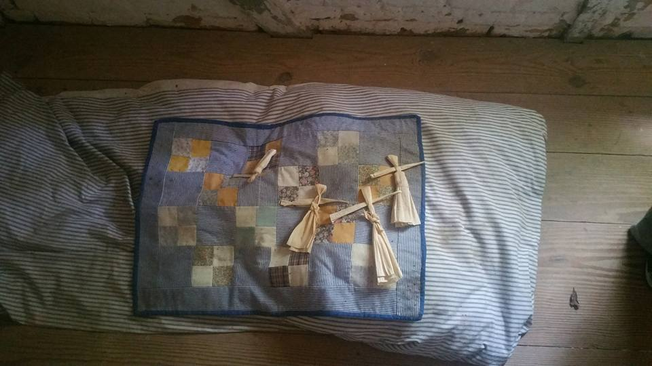
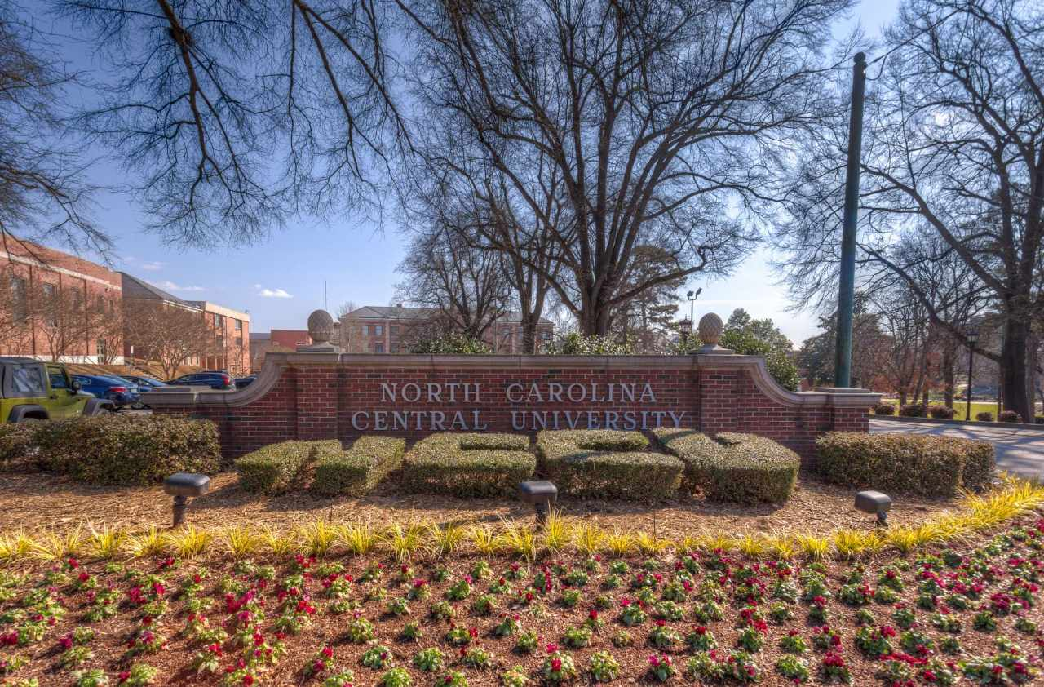
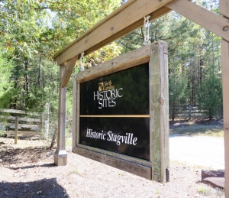
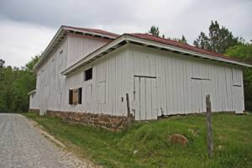
STRUCTURAL INEQAULITY:
AN ON THE GROUND VIEW
Durham, North Carolina
2017 Summer Intensive

Slide 10
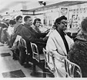
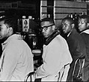

Slide 13
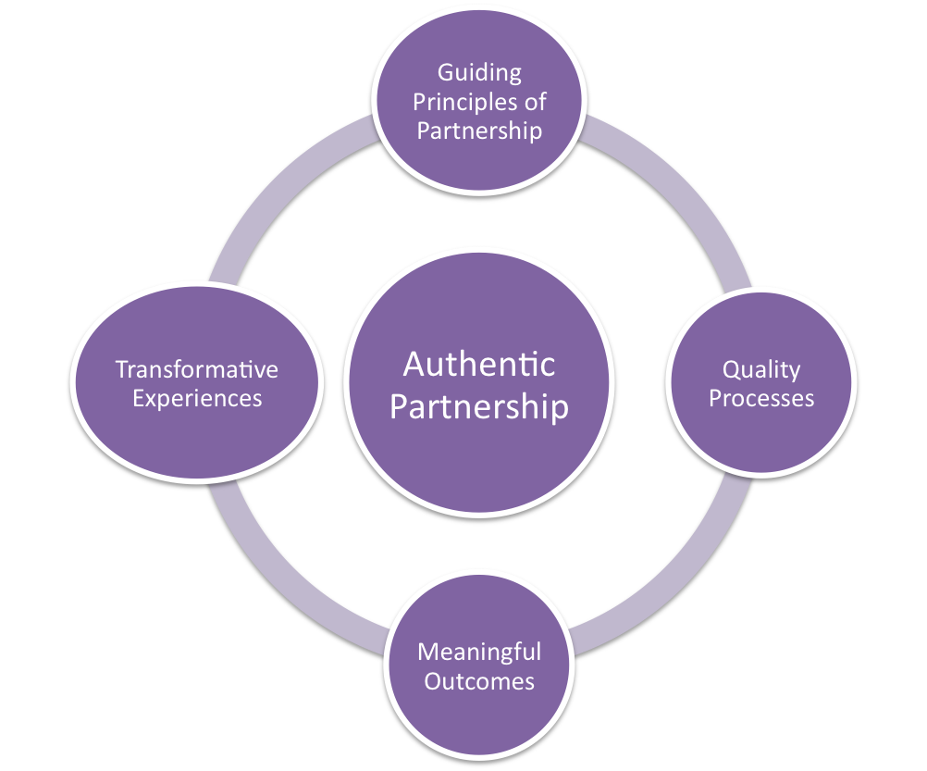
CCPH Principles of Partnership

Slide 14
Creating Transformative Experiences
Personal
Inter-personal
Institutional
Community

Slide 15
Call for Nominations
2017 RWJF Award for Health Equity
Presented by
Nomination Receipt Deadline
Monday, September 18, 2017

